Slide 1
Open Banking Payment Analysis
What drives conversion, value, failures, and retention?
500,000
10.34M
173
payment records analyzed
executed TPV
unique users

Slide 2
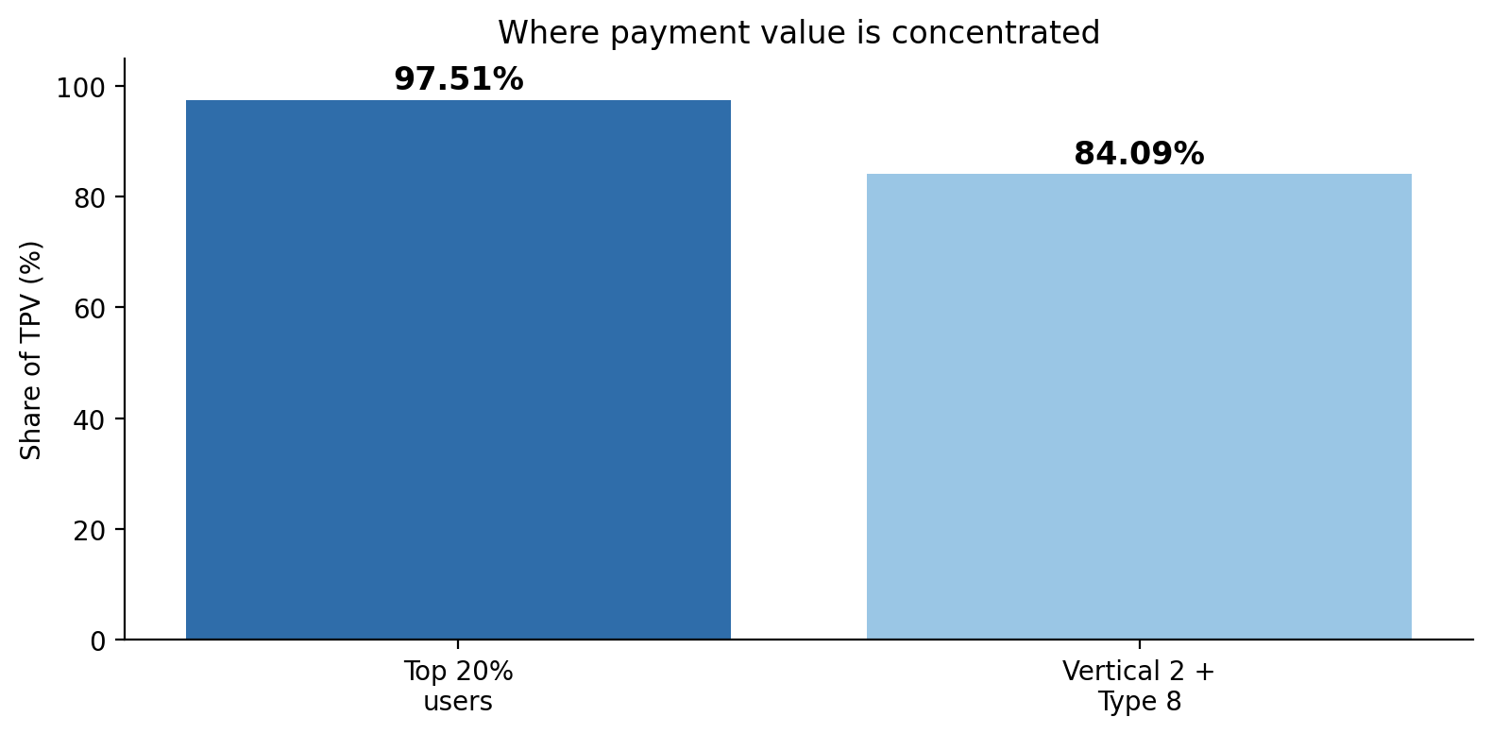
Main finding: value is extremely concentrated
The averages hide where the business actually sits
Top 20% of users drive 97.51% of TPV
Vertical 2 + Type 8 drives 84.09% of TPV
So the most important risk and opportunity are concentrated in a small group of users and one major segment.

Slide 3
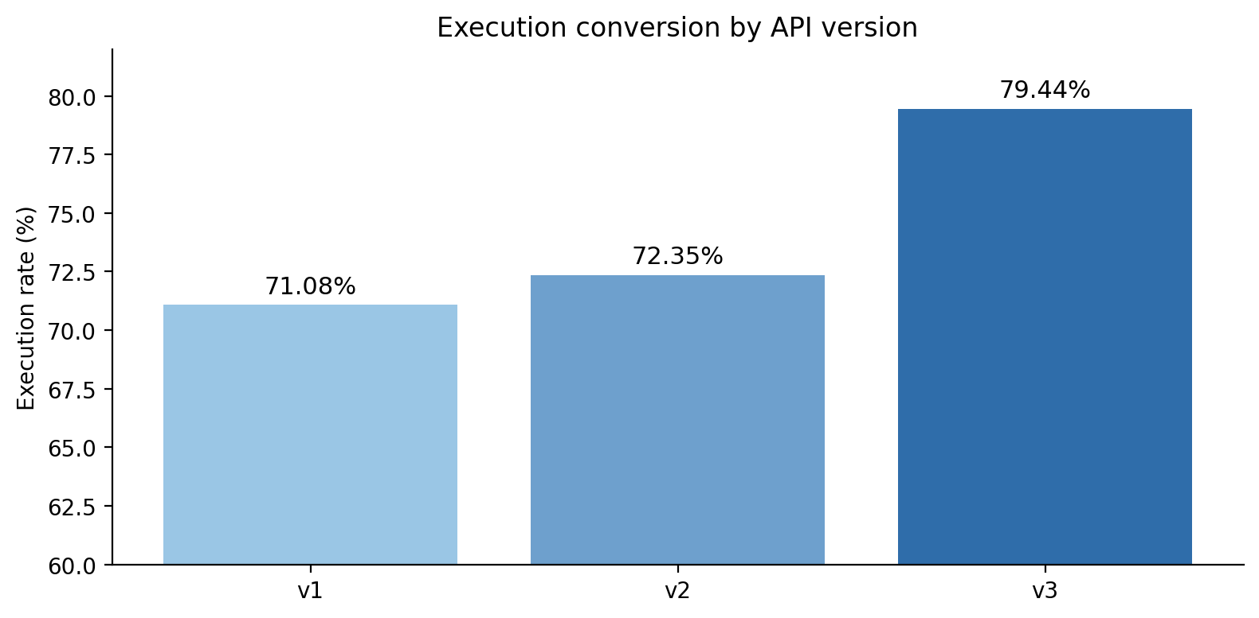
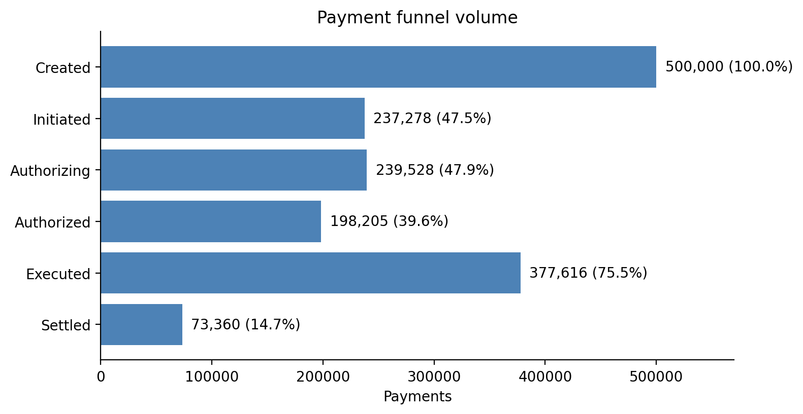
Payment performance is strong, but not uniform
Execution improves, and API v3 performs best
Executed payments: 377,616 / 500,000 ≈ 75.5%
v3 execution rate: 79.44%, higher than v1 and v2
The settlement gap should be checked separately, because settlement may be tracked differently from execution.

Slide 4
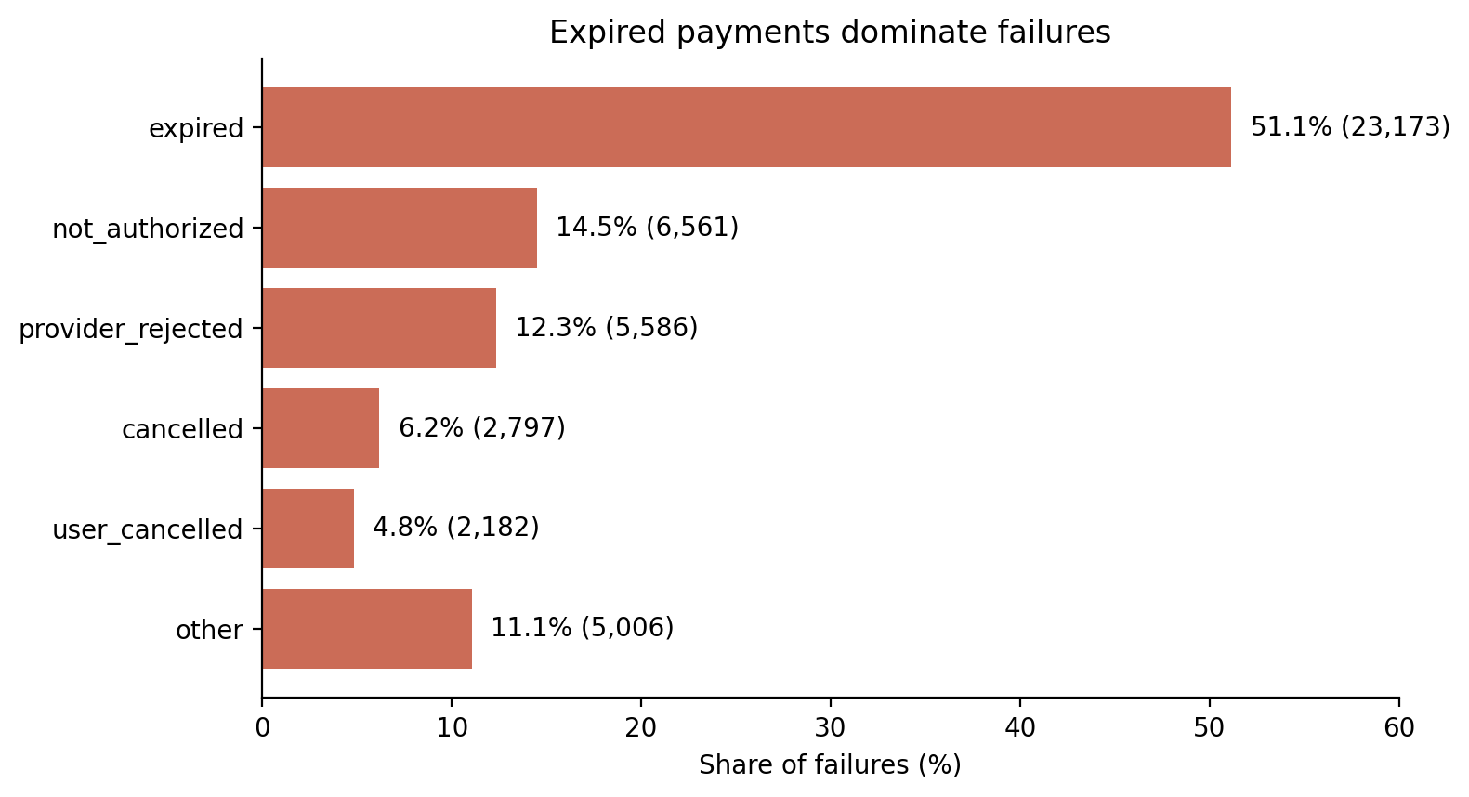
The clearest operational issue is expired payments
Failures are not random; one reason dominates
45,305
failed payments
9.06%
overall failure rate
51.15%
of failures are expired

Slide 5
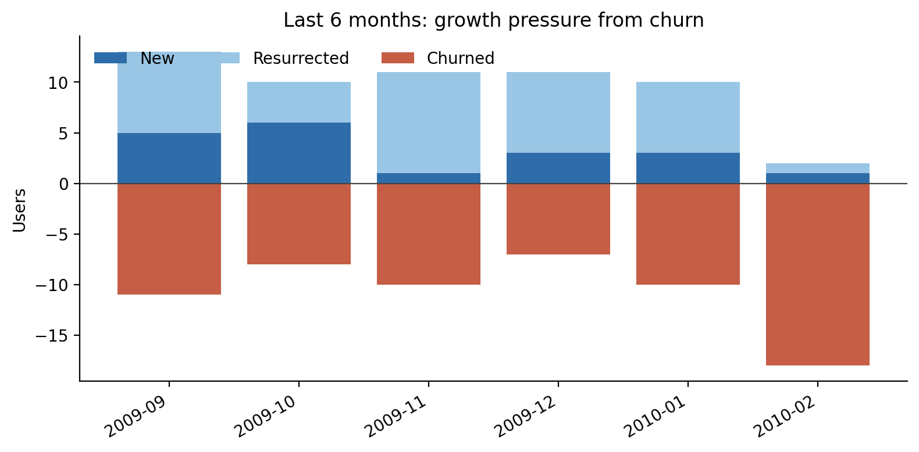
Loyal user base, but growth depends on retained users
Returning users and Champions carry most of the activity
90-day retention: 99.96%
Returning users: 75.57% conversion
Champions: 40 users, 9.68M TPV
The `At Risk` segment has 21 users and 437.6k TPV,
(meaning these users used to be valuable but havent paid recently)
The last 6 months show net change of -7 users, but the final month may be partial.

Slide 6
Recommended next steps
Focus on the areas where the data shows the biggest leverage
1
Protect high-value users
Top users and Champions drive almost all TPV, so retention of this group matters most.
2
Investigate expired failures
Expired payments are the largest failure category and the clearest operational issue.
3
Clarify the settlement gap
Executed volume is strong, but settled payments are much lower and need business-rule validation.
4
Track growth quality
Retention is strong, but new-user growth is small and the latest months show possible flattening.

