Slide 1
Retail Loan Portfolio Analysis
Borrower segmentation and credit-risk prediction Loan Data 2007–2014
464,776
226,540
4
Loans in unsupervised sample
Loans in supervised sample
Final borrower segments
1

Slide 2
Two questions guided the project
1. How is the portfolio structured?
Use mixed borrower and loan variables to find natural groupings.
2. Can bad outcomes be predicted?
Use origination-time variables to classify Fully Paid vs Charged Off.
Why combine both approaches?
The unsupervised part helps explain who is in the portfolio. The supervised part tests whether those financial patterns actually translate into future loss outcomes.
2

Slide 3
Dataset and modelling setup
What went into the data
Loan amount, term, interest rate, installment, income, DTI, revolving balance and utilization, inquiries, delinquencies, account counts, employment length, home ownership, verification status, purpose, and initial listing status.
Cleaning and feature work
Converted text fields to numeric, standardized categories, parsed dates, created credit-history length, and log-transformed highly skewed monetary variables.
Supervised target
Kept only two final outcomes: • Fully Paid = successful repayment • Charged Off = realized loss for the lender This avoids mixing final outcomes with unresolved statuses like Current or Late.
Unsupervised sample
464,776
Supervised sample
226,540
Bad-loan share
18.7%
Important design choice: for prediction, only information known at origination was used, so the supervised model stayed forward-looking and leakage-free.
3

Slide 4
Unsupervised part: how the segmentation was built
Clean data
FAMD
K-means
Interpret
Why FAMD?
Because the dataset mixes numeric and categorical variables. FAMD is the natural dimension-reduction tool for that setup.
Why k-means on FAMD dimensions?
It groups loans using the main latent structure of the portfolio rather than raw variables with very different scales.
How k was chosen
A broad 2-group structure existed, but 4 clusters were retained because they gave the clearest and most economically interpretable portfolio view.
4

Slide 5
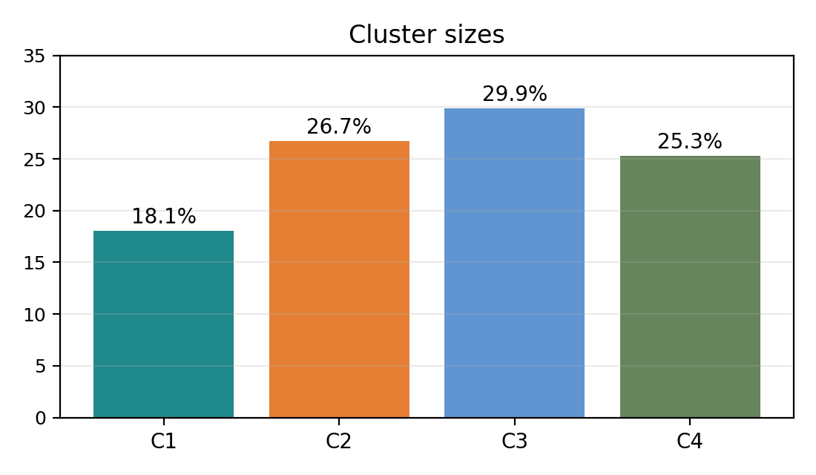
Unsupervised results: four borrower types
Conservative small-balance
Small loans, lighter burden, more cautious credit use
Mainstream revolving-debt
Mid-size loans, ordinary profile, but active revolving debt use
Stressed high-rate
Largest loans, highest rates, heaviest debt pressure
Affluent seasoned
Higher income, longer credit history, deeper account structure
Takeaway: the portfolio is not split into one simple 'safe vs risky' divide. It contains four distinct borrowing styles with different mixes of leverage, pricing, revolving-debt use, and credit depth.
5

Slide 6
What the segmentation is useful for
Stressed high-rate
Closer monitoring, tighter exposure control, and more conservative underwriting.
Mainstream revolving-debt
Standard retail strategy, but monitor dependence on revolving debt.
Conservative small-balance
Retention, simpler products, lower-intensity relationship building.
Affluent seasoned
Relationship deepening, tailored pricing, and cross-sell potential.
Main unsupervised conclusion
The segmentation is useful because it turns a large portfolio into a set of manageable borrower types. That makes monitoring, pricing, targeting, and strategy design much easier to discuss in business terms.
6

Slide 7
Supervised part: predicting realized loss
Target definition
Fully Paid versus Charged Off. This keeps the problem clean and avoids unresolved statuses like Current or Late.
Models compared
LDA as a simple benchmark. Random Forest as the main nonlinear model.
Evaluation approach
Train / validation / test split. Threshold chosen on validation, then final performance checked on the untouched test set.
Why accuracy was not enough
Only 18.7% of the supervised sample was in the bad-loan class. In that setting, a model can look 'accurate' while still missing most charged-off loans. That is why recall, precision, and F1 for the bad class mattered more than raw accuracy.
7

Slide 8
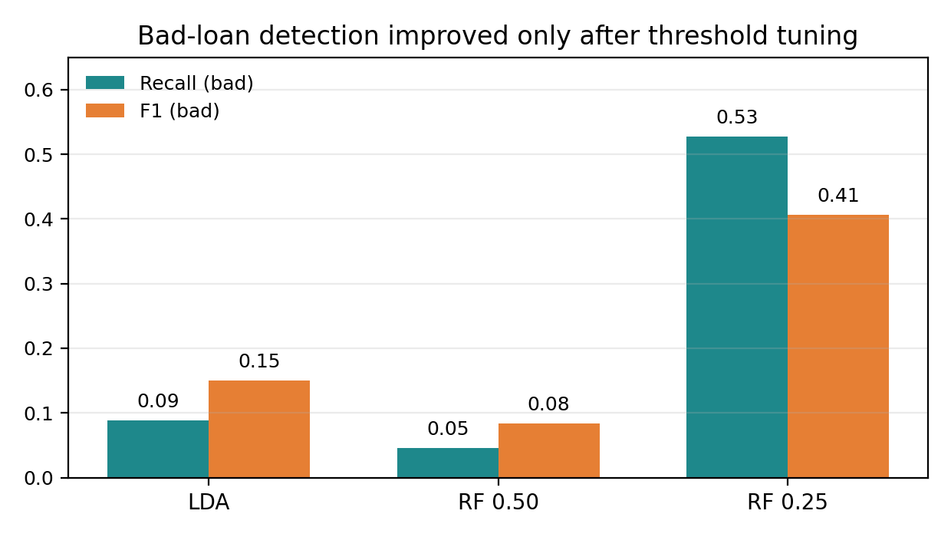
Supervised results: the default models were too conservative
LDA
Accuracy 0.812 | Recall (bad) 0.089 | F1 (bad) 0.150
Random Forest at 0.50
Accuracy 0.815 | Recall (bad) 0.046 | F1 (bad) 0.084
Random Forest at 0.25 — final choice
Accuracy 0.712 | Recall (bad) 0.528 | F1 (bad) 0.406 This was the best balance for actually catching charged-off loans.
So the supervised story is not 'we built a perfect predictor.' There was useful signal in the data, but it took a more flexible model and a lower threshold to make that signal operational.
8

Slide 9
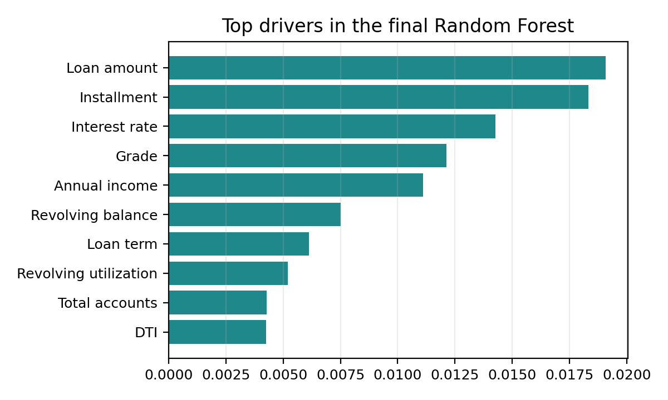
What the final model learned — and what it did not
The model picked up financially sensible drivers
Loan size, installment burden, interest rate, grade, income, revolving debt, term, utilization, account depth, and DTI all mattered. That is exactly the kind of mix a lender would expect.
Why the results are meaningful but not spectacular
The model catches many more bad loans than the baseline, but precision is still moderate. It is useful for screening, but not strong enough for automatic approval decisions.
Best honest interpretation
A good risk-flagging tool, not a full replacement for underwriting judgment.
9

Slide 10
How a bank could use the results
Portfolio understanding
Use the 4 segments to see who is in the book and where risk is concentrated.
Why the supervised results are only moderate
The model used origination-time information only. It did not use later payment behavior, macro shocks, or post-origination borrower changes.
Main trade-off
Catching more bad loans meant accepting more false positives. That is normal in credit screening, but it limits the model's use as a stand-alone decision rule.
Risk screening
Use the tuned Random Forest as an early filter for loans that deserve closer review.
Overall business reading
Unsupervised learning helped explain the shape of the portfolio. Supervised learning added a forward-looking risk signal. Together, they give a much fuller picture than either part on its own.
Decision support
Helpful for manual review, pricing, monitoring, and portfolio strategy — not for automatic yes/no decisions.
10

Slide 11
Final takeaway
What the unsupervised part proved
The retail loan portfolio contains four borrower types that differ in leverage, pricing, revolving-debt use, and credit depth.
What the supervised part proved
Future loss can be predicted to a meaningful extent from origination-time information, but the model is strongest as a screening tool rather than a final approval engine.
Summary
This project first mapped who is in the portfolio, then tested whether those borrower and loan characteristics can predict realized loss. That combination is what makes the analysis useful.
the portfolio is heterogeneous, and risk is predictable but imperfect. so the best use is structured screening and decision support.
11

