Slide 1
Top 5 Safest Zipcodes to Invest
Property Value Predictions for Austin, TX
By Ulku Guneysu

Slide 2
Appendix
Price Analysis
Property Value Trends
Average Price Change
Investment Parameters
Analyzing Investment Predictions
18-Month Investment Period
36-Month Investment Period
Comparison

Slide 3
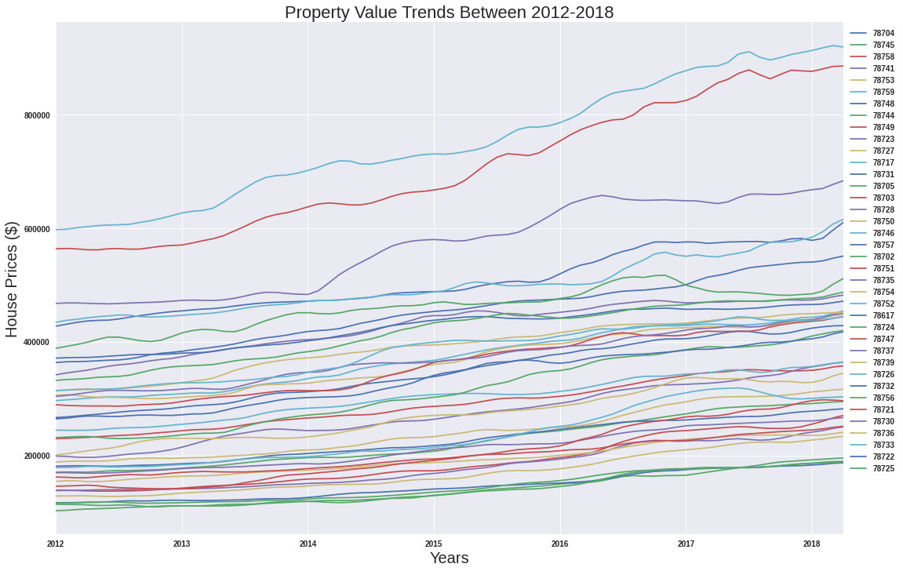
Property
Value
Trends
Property Value Trends Between 2012 and 2018 for 38 Different Zip-codes

Slide 4
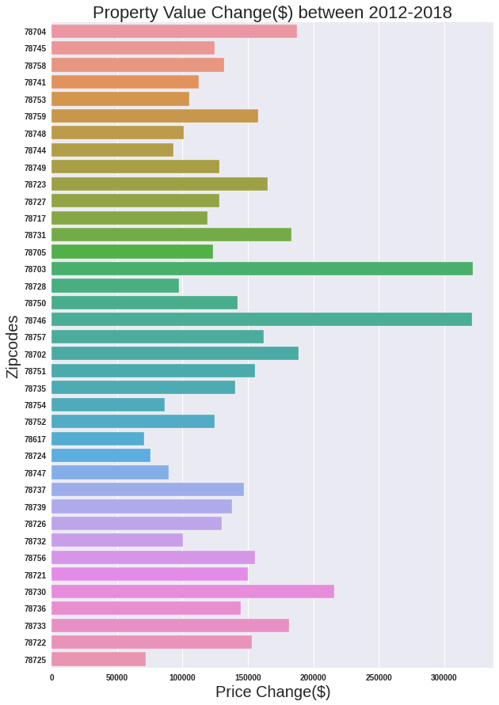
Average
Price
Change
Property Value Changes From 2012 To 2018:
Highest Price Change:
78703 ( $ 321,900.000 )
78746 ( $ 321,500.000 )
78730 ( $ 216,200.000 )
Lowest Price Change:
78617 ( $ 70,700.000 )
78725 ( $ 71,700.000 )
78724 ( $ 75,300.000 )

Slide 5


Investment
Parameters
Return On Investment
Return On Investment Percentage
Risk Factor Percentage
Minimum Return On Investment Percentage

Slide 6
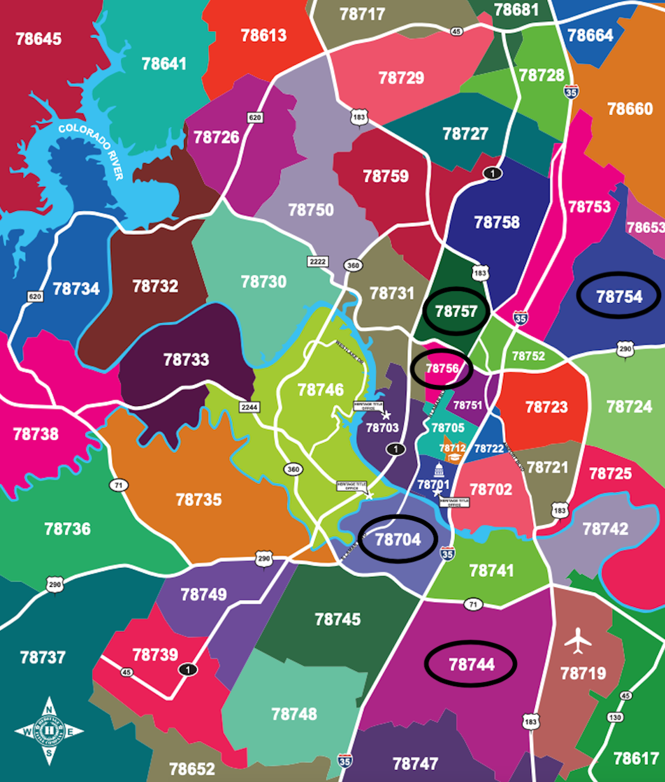
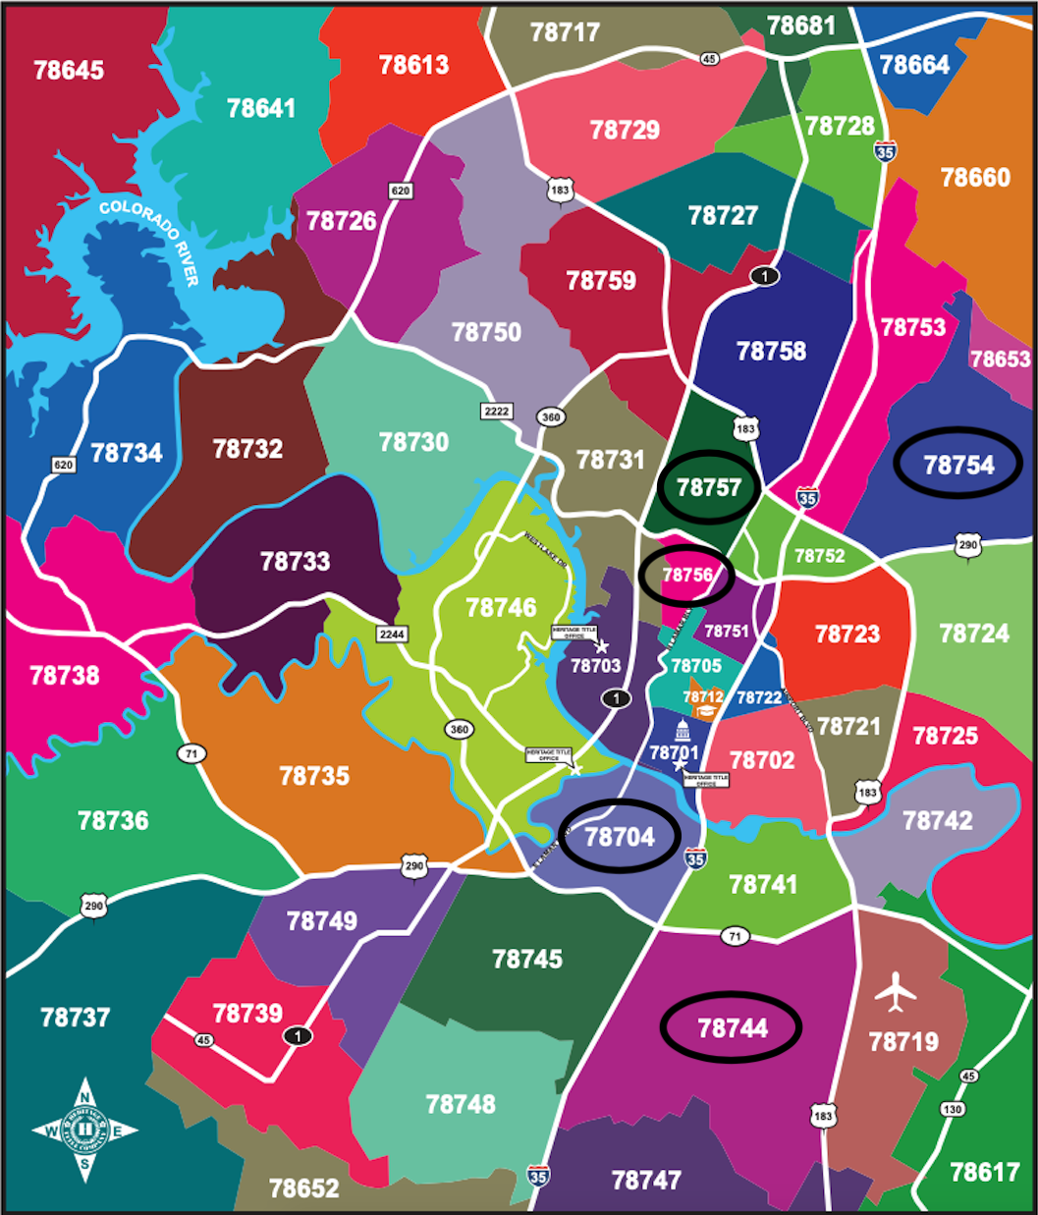
18-Month
Investment
Period
Recommendations are made for:
Maximum 10% risk factor
At least 1% annual return on investment 18 month period
Return on investment - risk factor ratio above 0.5
Buy value for top 5 zip-code:
78744 - $ 195,500.000
78754 - $ 240,600.000
78757 - $ 428,500.000
78704 - $ 550,900.000
78756 - $ 487,400.000

Slide 7
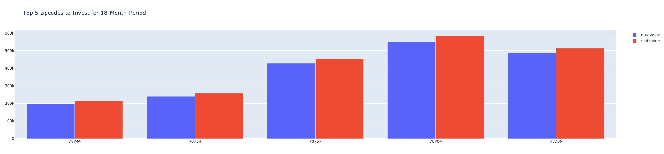
Buy Value
vs
Sell Value
For 18-Month
Investment
Period

Slide 8
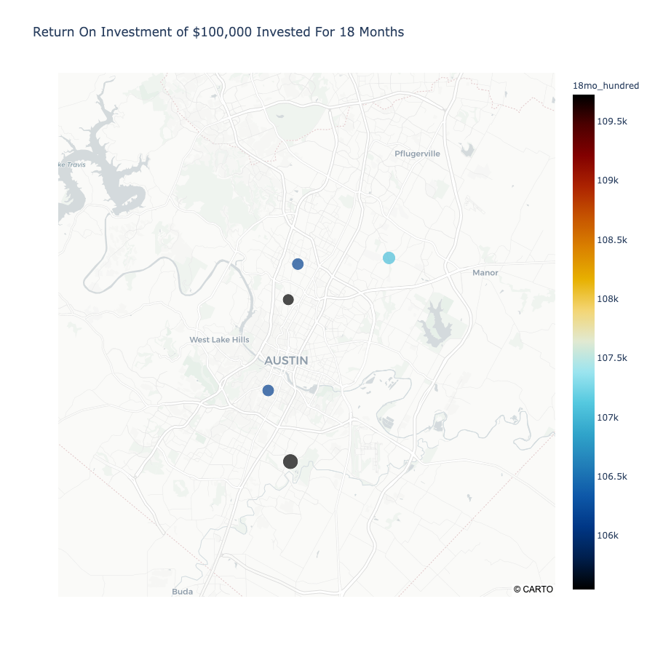
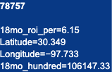
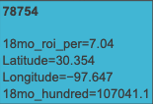
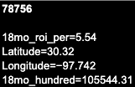
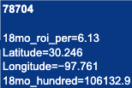
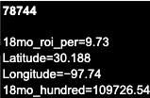
Return On
$100,000
Investment
For 18-Months
78744 - $ 109,726.54
78754 - $ 107,041.10
78757 - $ 106,147.33
78704 - $ 106,132.90
78586 - $ 105,544.31

Slide 9

36-Month
Investment
Period
Recommendations are made for:
Maximum 20% risk factor
At least 1% annual return on investment 36 month period
Return on investment - risk factor ratio above 0.25
Buy value for top 5 zip-code:
78744 - $ 195,500.000
78757 - $ 428,500.000
78704 - $ 550,900.000
78756 - $ 487,400.000
78732 - $ 471,500.000

Slide 10
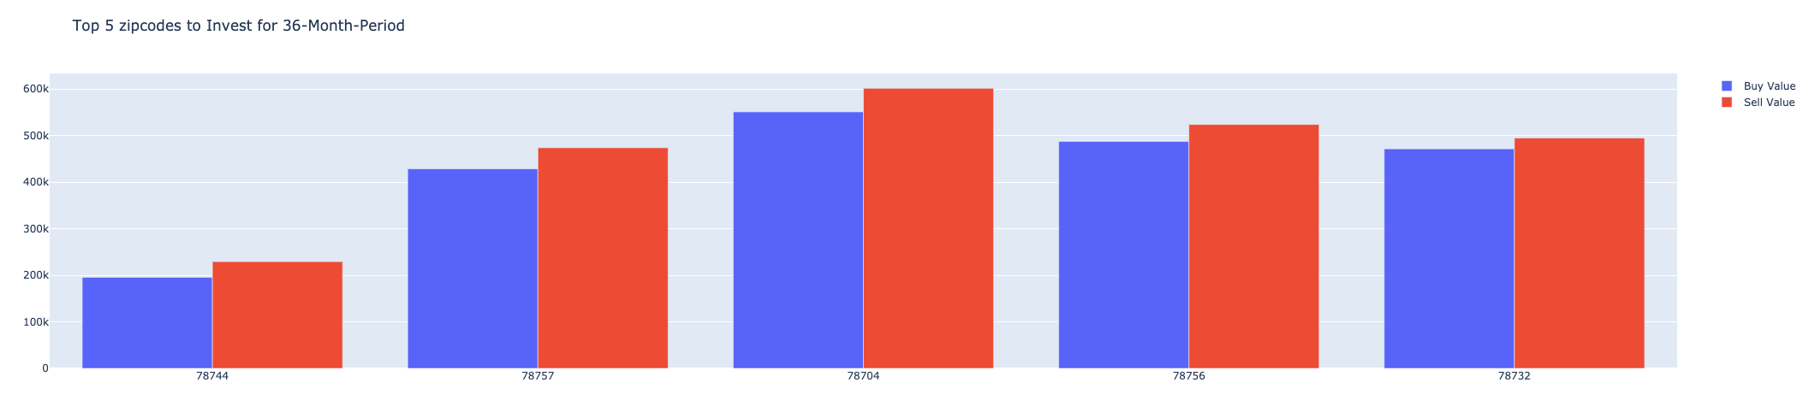
Buy Value
vs
Sell Value
For 36-Month
Investment
Period

Slide 11
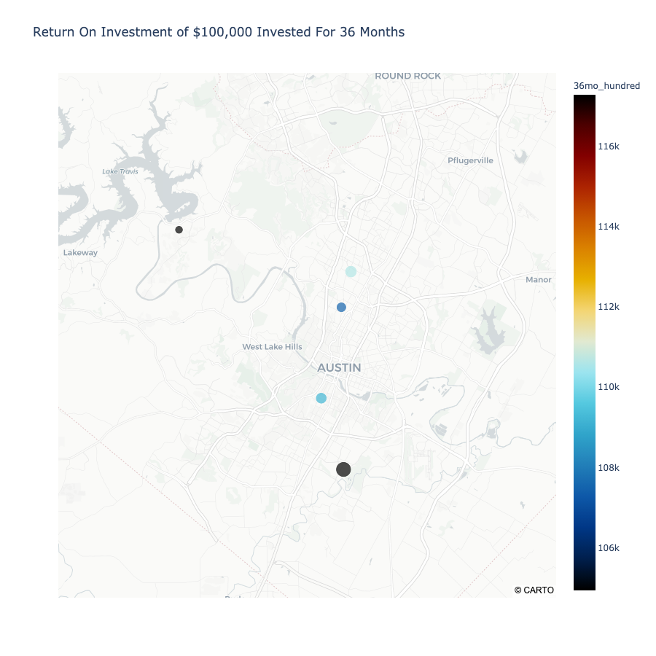
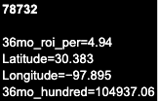
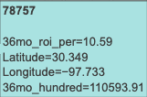
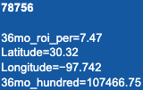
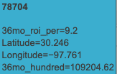
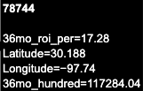
Return On
$100,000
Investment
For 36-Months
78744 - $ 117,284.04
78757 - $ 110,593.91
78704 - $ 109,204.62
78756 - $ 107,466.75
78732 - $ 104,937.06

Slide 12
18-Month
Vs
36-Month
ZIPCODES | 18-MONTH ROI (%) | 36-MONTH ROI (%)
78744 | 9.73 | 17.28
78704 | 6.13 | 9.2
78756 | 5.54 | 7.47
78757 | 6.15 | 10.59

Slide 13
Questions?

Slide 14
Thank you.

