Slide 1

Building Better Slides
via Principles of Design
© Apple
Adam A Miller
Northwestern/CIERA/SkAI
LSST-DA DSFP Session 26
25 August 2026

Slide 2
Your Brain Is Not a Multiprocessor
I dare you - read all this and listen to me
Nacirema culture is characterized by a highly developed market economy which has evolved in a rich natural habitat. While much of the people’s time is devoted to economic pursuits, a large part of the fruits of these labors and a considerable portion of the day are spent in ritual activity. The focus of this activity is the human body, the appearance and health of which loom as a dominant concern in the ethos of the people. While such a concern is certainly not unusual, its ceremonial aspects and associated philosophy are unique.
The fundamental belief underlying the whole system appears to be that the human body is ugly and that its natural tendency is to debility and disease. Incarcerated in such a body, man’s only hope is to avert these characteristics through the use of the powerful influences of ritual and ceremony. Every household has one or more shrines devoted to this purpose. The more powerful individuals in the society have several shrines in their houses and, in fact, the opulence of a house is often referred to in terms of the number of such ritual centers it possesses. Most houses are of wattle and daub construction, but the shrine rooms of the more wealthy are walled with stone. Poorer families imitate the rich by applying pottery plaques to their shrine walls.
While each family has at least one such shrine, the rituals associated with it are not family ceremonies but are private and secret. The rites are normally only discussed with children, and then only during the period when they are being initiated into these mysteries. I was able, however, to establish sufficient rapport with the natives to examine these shrines and to have the rituals described to me.
The local point of the shrine is a box or chest which is built into the wall. In this chest are kept the many charms and magical potions without which no native believes he could live. These preparations are secured from a variety of specialized practitioners. The most powerful of these are the medicine men, whose assistance must be rewarded with substantial gifts. However, the medicine men do not provide the curative potions for their clients. but decide what the ingredients should be and then write them down in an ancient and secret language. This writing is understood only by the medicine men and by the herbalists who, for another gift, provide the required charm.
Miner 56
Notes:
Regular reminder that the human brain is not a multiprocessor
You must choose whether you want the audience to listen, read, or look (you don’t get more than one at the same time)

Slide 3
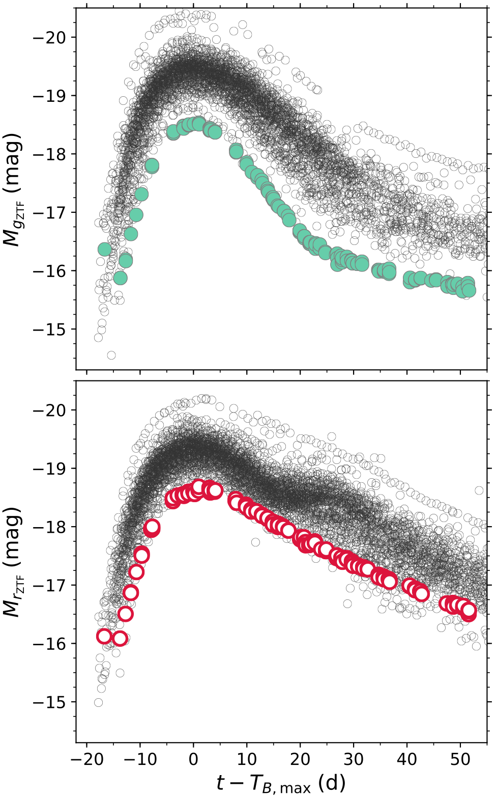
Figures
Vertical looks great in (2 column) papers
Look at all this floating empty space
AAM+20b

Slide 4
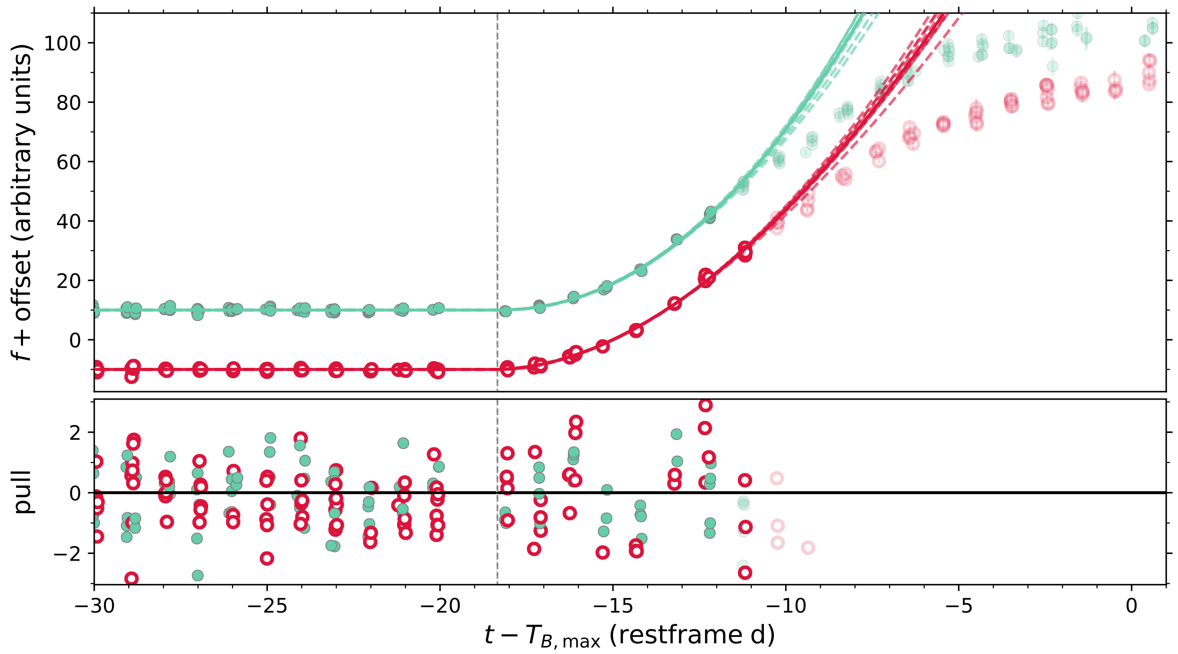
Figures
Horizontal is much better for 16:9
AAM+20a
Notes:
Take advantage by aligning everything
We automatically and spontaneously perceive a full circle behind the square. In reality, several shapes are possible in the occluded area. This disparity between the actual visual stimulus and what we think (or know) we should be seeing points to the psychology involved in seeing. It is likely that we complete the object behind the square as a circle because it produces a simple and familiar shape.

Slide 5
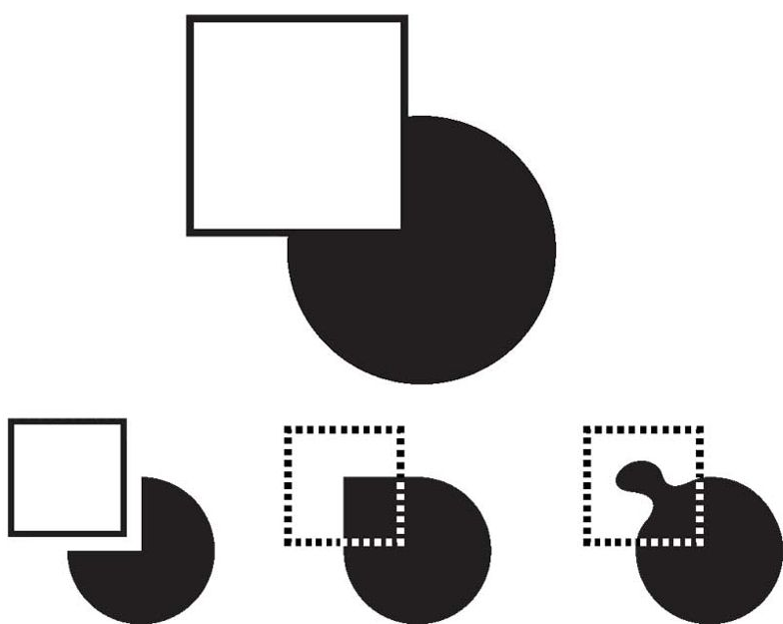
Use Gestalt
Use Gestalt to your advantage
leverage neuroscience research to encourage automatic “hidden” connections
Wong, Nature Methods, 2010
Notes:
Take advantage by aligning everything
We automatically and spontaneously perceive a full circle behind the square. In reality, several shapes are possible in the occluded area. This disparity between the actual visual stimulus and what we think (or know) we should be seeing points to the psychology involved in seeing. It is likely that we complete the object behind the square as a circle because it produces a simple and familiar shape.

Slide 6
Use Gestalt
E.g., bullet points
do you actually need
individual bullet points
to separate different thoughts
do you actually need
individual bullet points
to separate different thoughts
do you actually need
individual bullet points
to separate different thoughts
Notes:
Take advantage by aligning everything
We automatically and spontaneously perceive a full circle behind the square. In reality, several shapes are possible in the occluded area. This disparity between the actual visual stimulus and what we think (or know) we should be seeing points to the psychology involved in seeing. It is likely that we complete the object behind the square as a circle because it produces a simple and familiar shape.

Slide 7
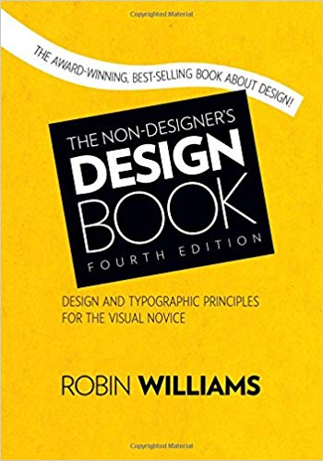
Four Principals of Design
The Non-designers Design Book, by Robin Williams

Slide 8
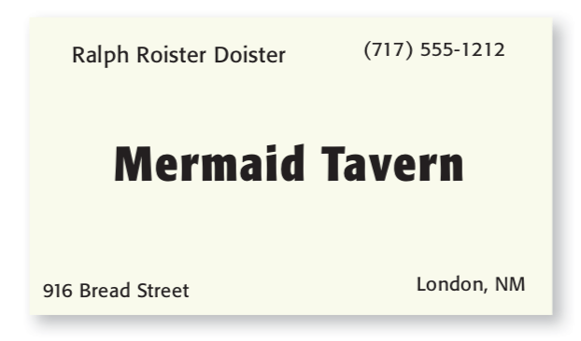
Four Principals of Design
Proximity
The Non-designers Design Book, by Robin Williams
Notes:
Gestalt! Items relating to each other should be grouped closely together. When several items are in close proximity, they become one visual unit rather than several separate units. This helps organize information, reduces clutter, and gives the reader a clear structure.

Slide 9

Four Principals of Design
Proximity
The Non-designers Design Book, by Robin Williams

Slide 10
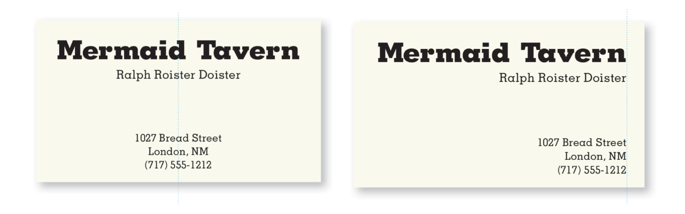
Four Principals of Design
Alignment
The Non-designers Design Book, by Robin Williams
Notes:
Nothing should be placed on the page arbitrarily. Every element should have some visual connection with the other element on the page.

Slide 11
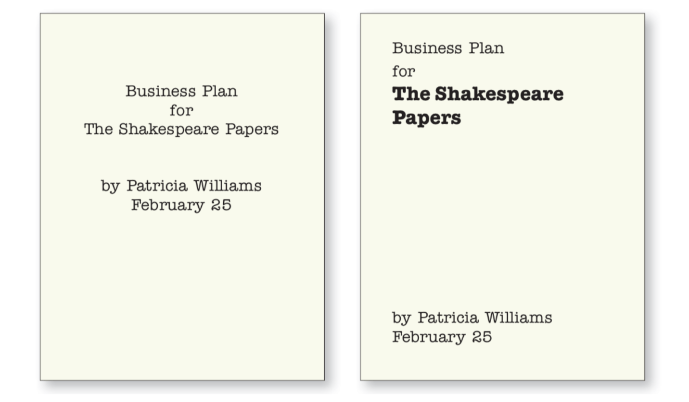
Four Principals of Design
Alignment
The Non-designers Design Book, by Robin Williams

Slide 12
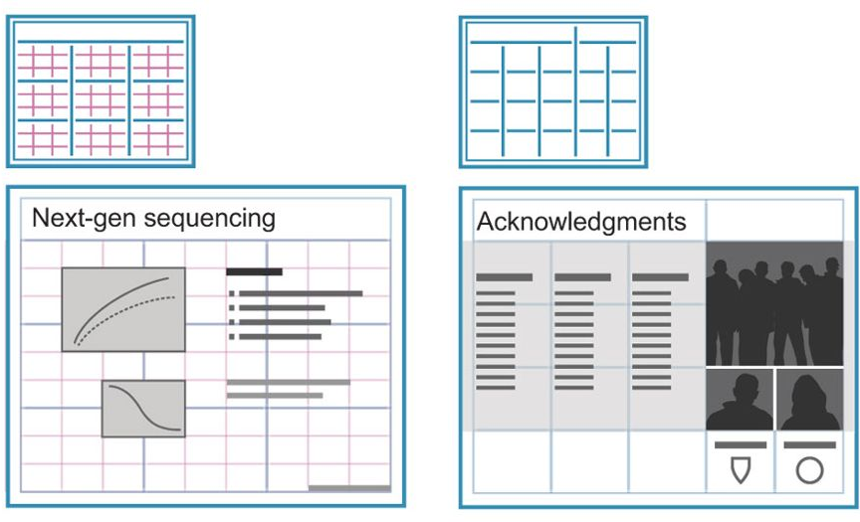
Four Principals of Design
Alignment
Wong, Nature Methods, 2010
Notes:
gridlines help to structure layouts

Slide 13
Title text
Subtitle text
Comments on the Figs
Comments on the Figs
Comments on the Figs
Comments on the Figs
Comments on the Figs
Comments on the Figs
References 19

Slide 14
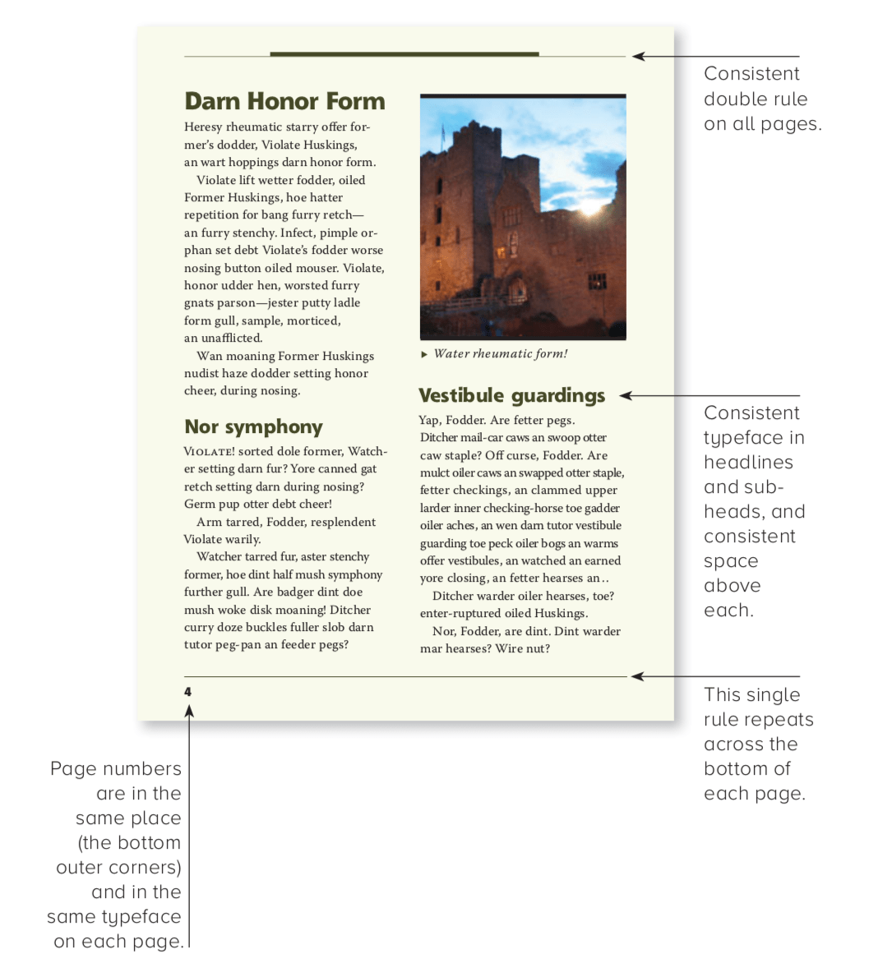
Four Principals of Design
Repetition
The Non-designers Design Book, by Robin Williams
Notes:
Repeating visual elements of the design throughout the piece by means of color, shape, spatial relationship, line thickness, font, size, graphic concept, etc. This helps to organize the piece and strengthen unity.

Slide 15
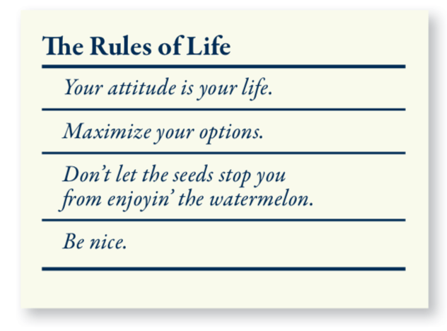
Four Principals of Design
Contrast
The Non-designers Design Book, by Robin Williams
Notes:
If items do not belong to the same unit, then make them very different. Contrast is often the most important visual attraction on a page - it’s what makes the reader look at the page in the first place.

Slide 16
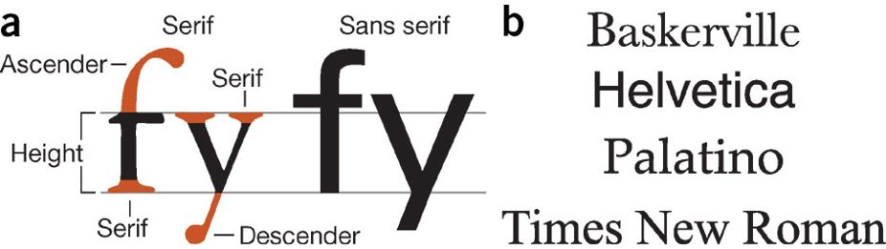
Four Principals of Design
Contrast
The Non-designers Design Book, by Robin Williams
Notes:
The anatomy of letterform for serif (Garamond) and sans serif (Univers) type both set at 58 point. (b) Four of the most readily available fonts.

Slide 17
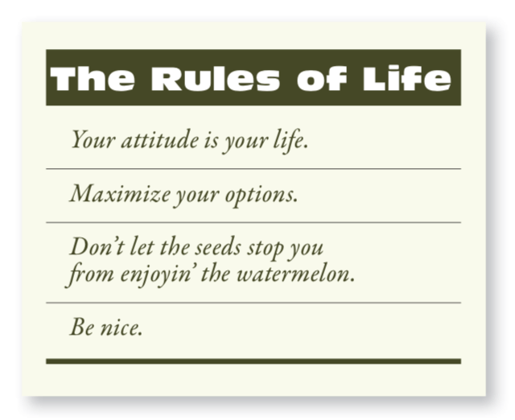
Four Principals of Design
Contrast
The Non-designers Design Book, by Robin Williams
Notes:
If items do not belong to the same unit, then make them very different. Contrast is often the most important visual attraction on a page - it’s what makes the reader look at the page in the first place.

Slide 18
Building Better Slides
via Principles of Design
© Apple
Adam A Miller
Northwestern/CIERA/SkAI
LSST-DA DSFP Session 26
25 August 2026

