Slide 1
Obesity Risk Analytics
Ullas Basavapatna Chandrashekar
Vishrutha Ravi
Notes:
This project focuses on identifying geographic hotspots of obesity risk across U.S. counties using socioeconomic and demographic data. Instead of looking only at obesity rates in isolation, we combine economic conditions, physical inactivity, and population composition to uncover patterns that can help public health agencies prioritize where to focus prevention and intervention efforts. The ultimate goal is to support data-driven targeting of high-risk communities rather than using one-size-fits-all strategies.

Slide 2
Why It Matters?
Health Conditions
High blood pressure and high cholesterol which are risk factors for heart disease.
Type 2 diabetes.
Breathing problems, such as asthma and sleep apnea.
Joint problems such as osteoarthritis and musculoskeletal discomfort.
Gallbladder disease.
Psychological problems such as anxiety and depression.
Low self-esteem and lower self-reported quality of life.
Social problems such as bullying and stigma.
Economic Impact
Obesity costs the U.S. over $170 billion annually in medical expenses and an additional $3–6 billion in lost work productivity
Military Readiness
Just over 1 in 3 young adults aged 17-24 is too heavy to serve in the US military
Ref : https://www.cdc.gov/obesity/basics/consequences.html
Notes:
Obesity is one of the most significant public health challenges in the United States, contributing to chronic diseases such as diabetes, heart disease, and hypertension. The economic burden is also enormous, with obesity-related healthcare costs estimated in the hundreds of billions annually. Importantly, obesity does not affect all communities equally — there are strong geographic, racial, and socioeconomic disparities. Understanding where risk is highest and why allows policymakers to allocate limited prevention resources more effectively and equitably.

Slide 3
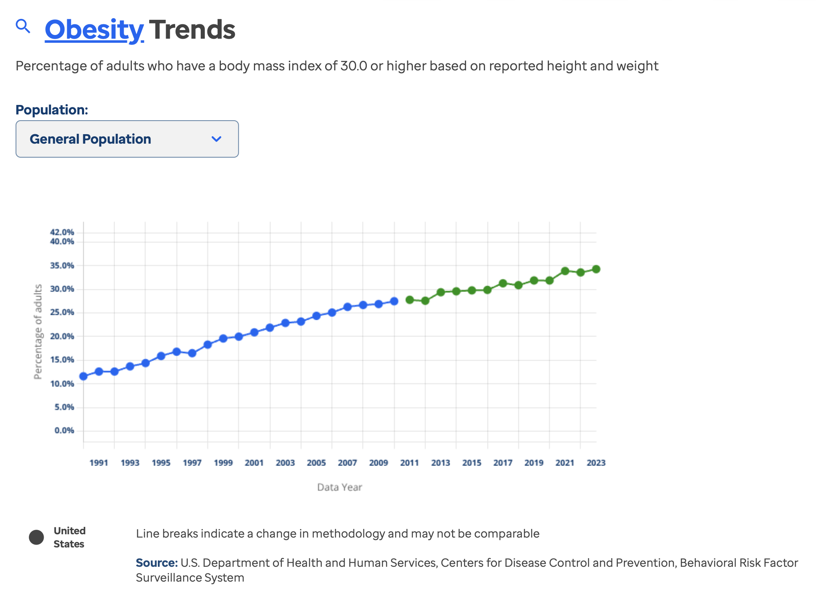

Slide 4
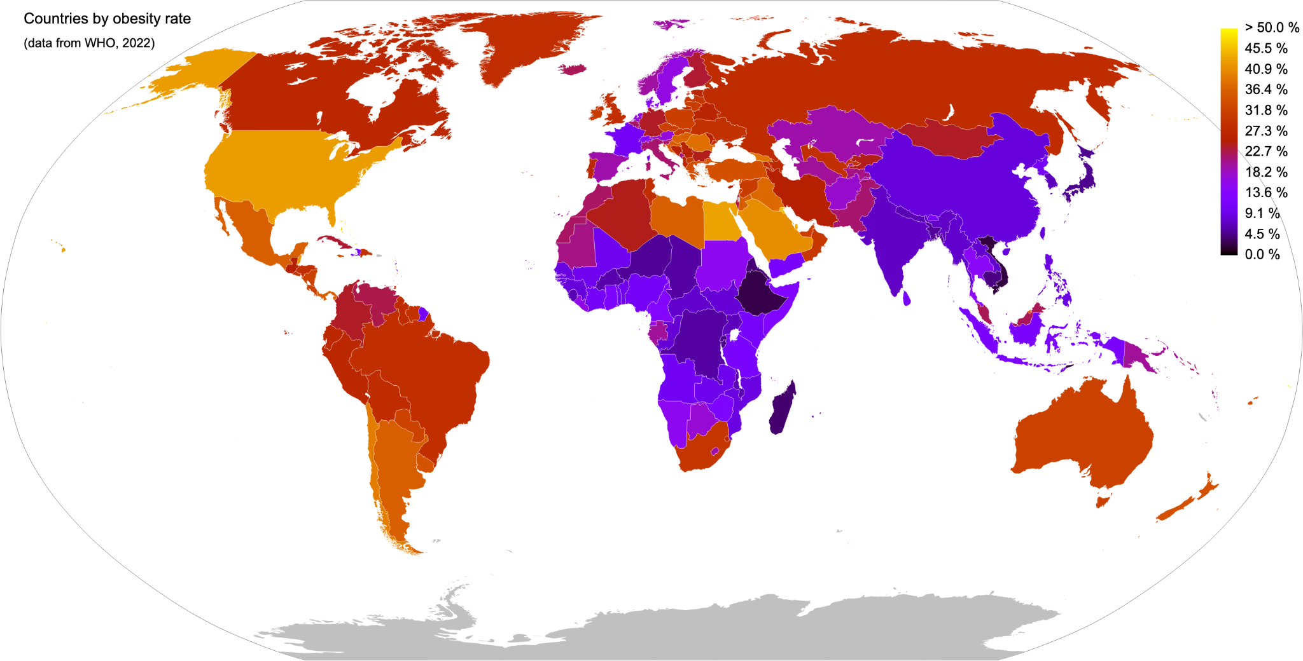

Slide 5
Business Problem & Project Goal
Public health agencies struggle to identify which counties should be prioritized for obesity prevention programs
Obesity is driven by:
Economic stress
Physical inactivity
Low food access
Demographic inequities
Current approaches rely on single-metric thresholds or statewide averages
Our goal: To identify data-driven obesity risk hotspots using multi-factor clustering as obesity is not evenly distributed across the U.S.
Also to predict future obesity rates, so that public health agencies can take actions for improving infrastructure and resources.
Notes:
The central business problem we address is that public health agencies and policymakers often lack precise, data-driven tools to identify which counties should be prioritized for obesity prevention programs. Most existing approaches rely on single variables such as obesity rate alone or broad state-level averages, which hide important county-level differences. However, obesity is not caused by just one factor — it emerges from a combination of poverty, unemployment, income, physical inactivity, education, and population demographics.
Because these risk factors interact in complex ways, it becomes difficult to manually determine where the true high-risk communities are. Our project directly addresses this challenge by using unsupervised machine learning to group counties based on multiple socioeconomic and demographic dimensions simultaneously. Instead of asking, “Which counties have high obesity?”, we ask, “Which counties share the same structural risk patterns?” This allows us to identify true obesity risk hotspots and provide a scalable, data-driven framework for targeting public health resources more effectively.

Slide 6
Public Health Agencies Problems
Agencies don’t know where to intervene first (Resource Allocation Problem)
One-Size-Fits-All Policies Fail Across Diverse Populations as they don’t know which Factors Matter Most in Each County (Equity & Disparity Problem)
State-level averages hide true county-level risk
Funding must be justified with strong quantitative evidence (Political & Budget Pressure)

Slide 7
About Dataset
Category | Example Features (All County level dataset) | Source
Health | Obesity %, Inactivity %, Food Access % | www.ruralhealthinfo.org (2010-2023)
SES | Poverty %, Median Income, Unemployment % | www.ruralhealthinfo.org (2010-2023)
Demographics | % White, % Black, % Hispanic, % Asian, % Native, % Pacific | www.census.gov (2020)
Education | Not high school graduates High school graduates College or associate degree Bachelor's degree or higher | www.ers.usda.gov (2023)
Urban-Rural | Large central metro Large fringe metro Medium metro Small metro Micropolitan Noncore | www.cdc.gov (2023)

Slide 8
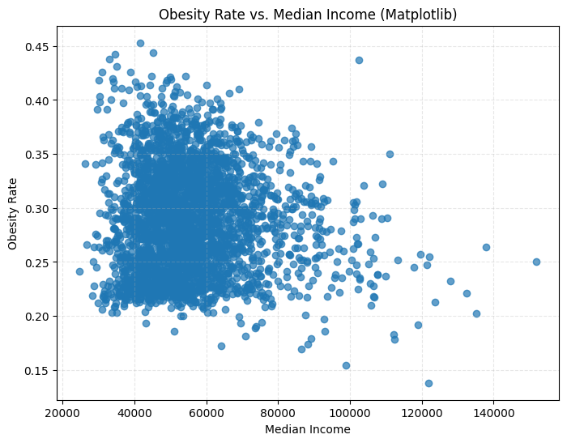
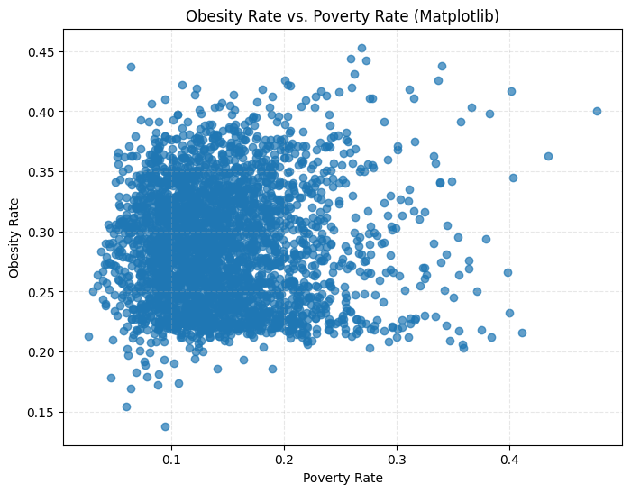
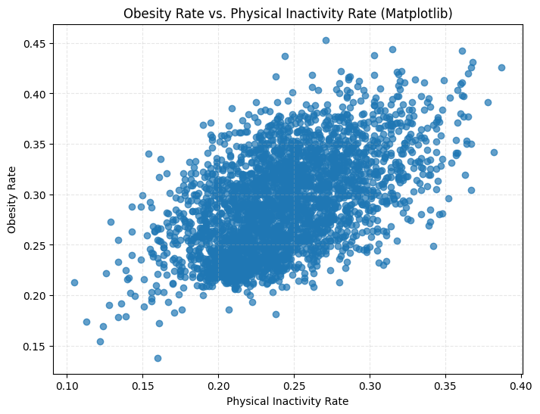
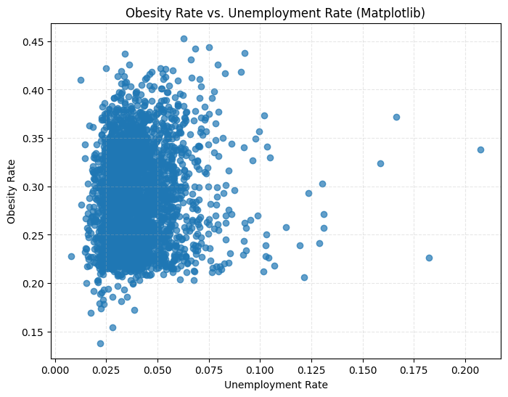
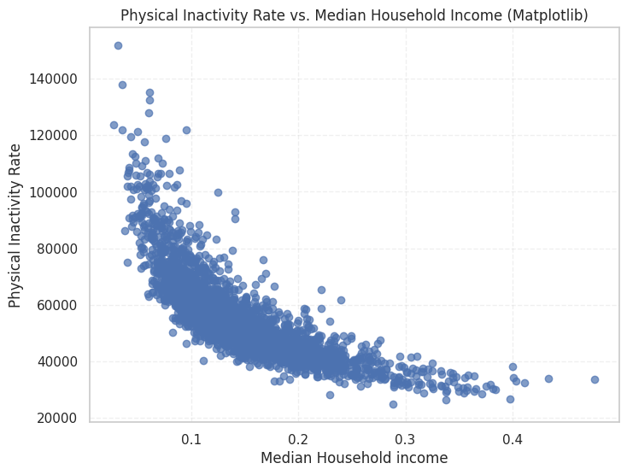
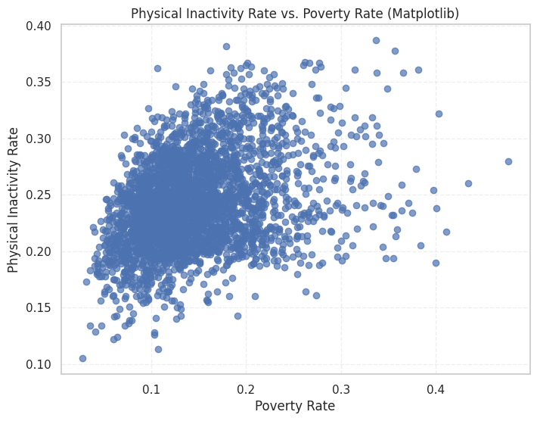
EDA Highlights

Slide 9
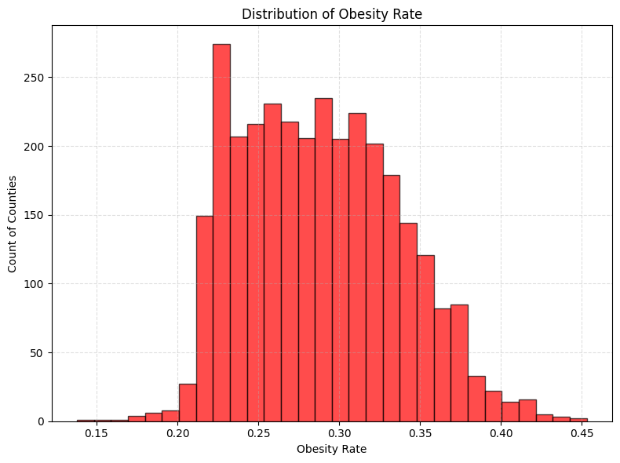
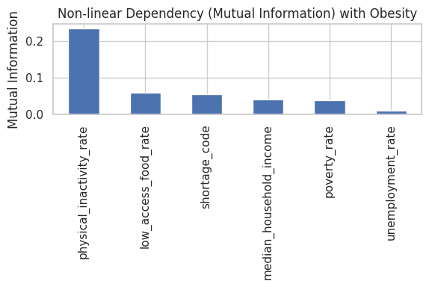
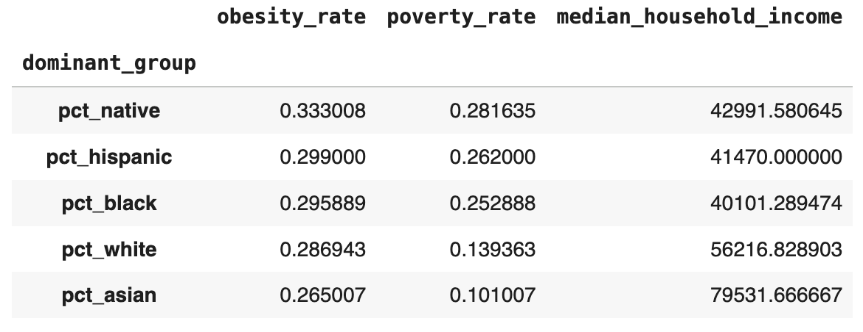
EDA (Continue)

Slide 10
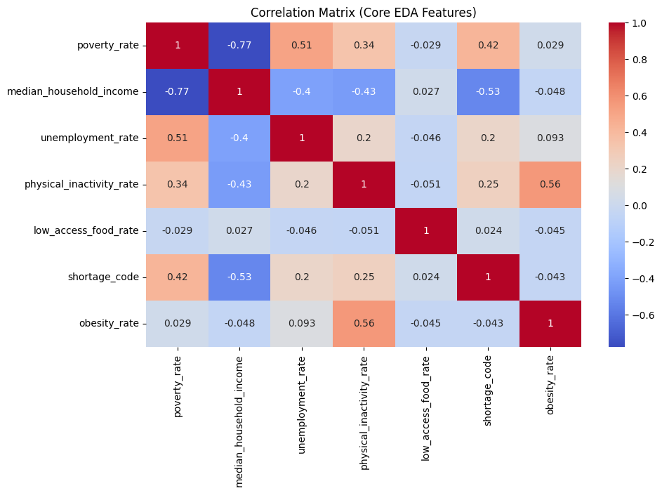

Slide 11
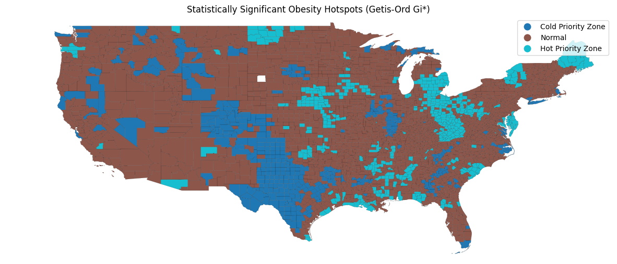
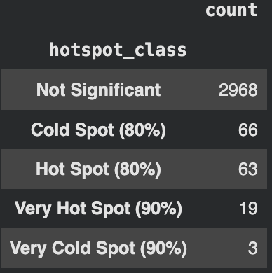
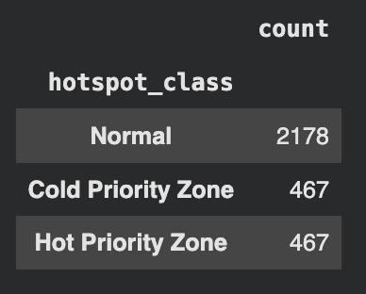
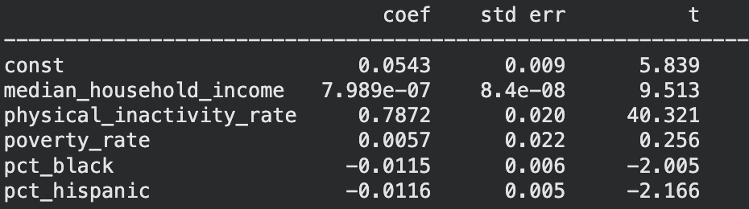
Spatial Statistics
Applied Global Moran’s I on county-level obesity
Mean Neighbors: 5.80
Moran’s I = 0.3396
p-value = 0.001
Confirms statistically significant regional clustering
Causal Modeling
R² = 0.36
F-statistic p < 0.001
Sample = 3,121 counties
GETIS-ORD Gi* Quantile Based
Notes:
Mean Neighbors: 5.80
Obesity is not randomly distributed
Before clustering or prediction, we first tested whether obesity is even spatially structured. Moran’s I shows a value of 0.34 with a p-value of 0.001, confirming strong and statistically significant regional clustering. This validates the use of spatial and regional modeling
dentifies local high-risk obesity clusters
Hotspots require:
High obesity
High-obesity neighbors
95% statistical confidence
Only a small number of extreme emergency zones were detected
Using Getis-Ord Gi-star, we localized statistically significant obesity emergency clusters. These are not just high counties individually, but tightly packed regional high-risk zones that demand coordinated intervention.
Casual Modeling
We estimate the effect of household income on obesity, controlling for physical inactivity, poverty, and demographics using OLS regression across 3,121 U.S. counties.
To move beyond correlation, we estimated a controlled regression model treating physical inactivity as the intervention variable and obesity as the outcome, while controlling for income, poverty, and race. Physical inactivity remains an extremely strong and statistically significant independent driver of obesity, with a coefficient of 0.79 and p-value below 0.001. This means that even after accounting for socio-economic and demographic differences, inactivity alone strongly drives obesity. This provides causal justification for our intervention efficiency simulations.

Slide 12
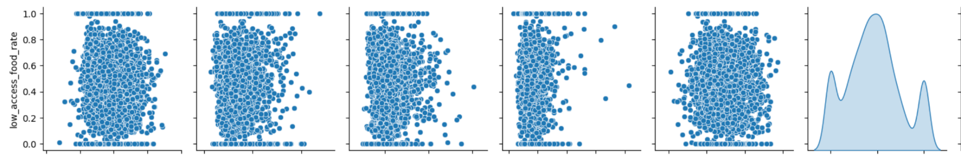
Low Access to Healthy Food

Slide 13
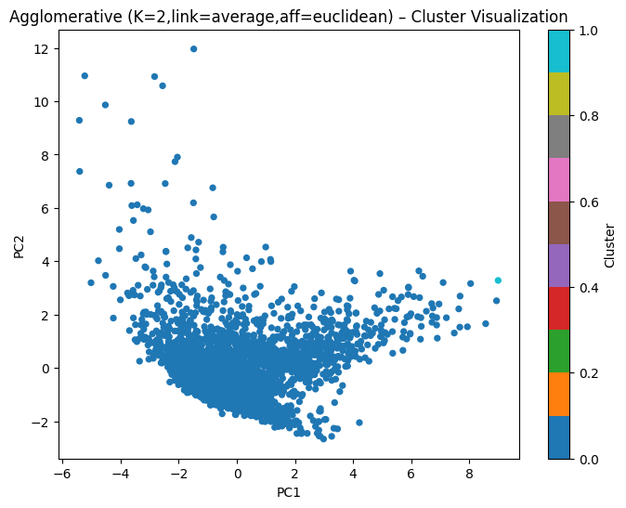
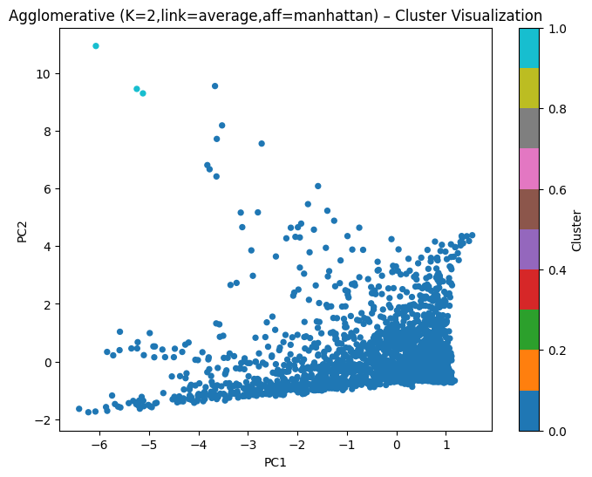
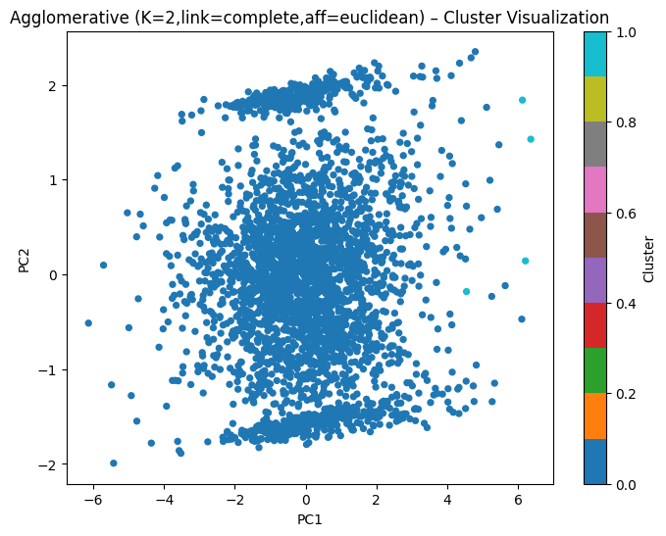
Unsupervised Learning [Target variable - obesity_rate]
all_features = [
"poverty_rate",
"median_household_income",
"physical_inactivity_rate",
"low_access_food_rate",
"unemployment_rate",
"pct_white",
"pct_black",
"pct_hispanic",
"pct_asian",
"pct_native"
]
demo_features = [
"pct_white",
"pct_black",
"pct_hispanic",
"pct_asian",
"pct_native"
]
ses_features = [
"poverty_rate",
"median_household_income",
"physical_inactivity_rate",
"low_access_food_rate",
"unemployment_rate",
]
KMeans, Agglomerative, GMM, Spectral, DBScan, HDBScan
Notes:
We initially explored whether U.S. counties naturally form discrete obesity risk groups using unsupervised learning. However, the data exhibited a largely continuous risk spectrum rather than clearly separable clusters.
We applied multiple unsupervised clustering algorithms to test whether counties naturally fall into distinct obesity risk groups. However, across all evaluation metrics, the clusters showed weak separation and heavy overlap. This indicates that obesity risk behaves as a continuous gradient rather than naturally forming clean categories. Because clustering could not provide actionable segmentation, we transitioned to a supervised learning approach focused on prediction and intervention targeting.
Objective shifted from segmentation → prediction
Predict county-level obesity using:
Economic
Behavioral
Demographic features
Enables:
Model validation (R², RMSE)
Explainability (SHAP)
Policy simulation
System failure detection via residuals

Slide 14
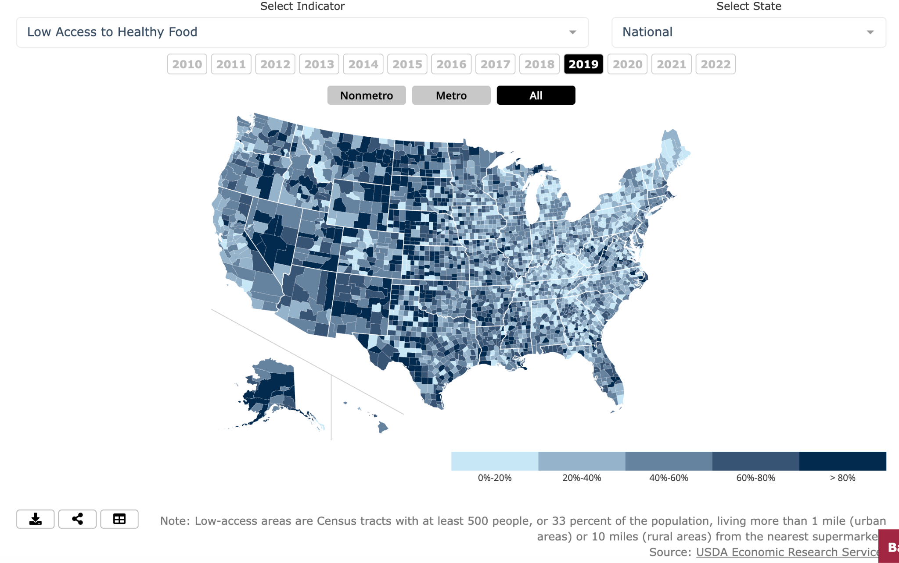

Slide 15
Supervised Learning
Target Variable:
obesity_rate (county-level)
Input Feature Groups:
Economic: poverty, median income, unemployment
Health: physical inactivity, food access
Demographic: racial composition
Learning Task:
Regression
Objective:
Predict obesity
Quantify deviation from expected outcomes
Why Random Forest and Gradient Boosting?
Learn non-linear thresholds
Learn feature interactions automatically
No need to manually engineer interactions
Linear models are ruled out because of the linear relationships (Linear, Ridge, Lasso)
Methods like KNN and SVM rely heavily on distance metrics and scaling assumptions, which are poorly aligned with socioeconomic data.
Neural networks are powerful but require larger datasets and sacrifice interpretability.
Notes:
Since unsupervised learning revealed that obesity risk is continuous rather than clustered, we re-framed the problem as a supervised regression task. Instead of grouping counties, we trained a predictive model to estimate obesity based on socioeconomic, behavioral, and demographic drivers. This allowed us to not only predict obesity accurately, but also to quantify where outcomes deviated from expectations, enabling targeted policy analysis.
Linear models assume linear relationships and additive effects. In public health data, drivers like poverty and inactivity interact in highly non-linear ways. Early EDA and mutual information confirmed strong non-linear dependency. Therefore, linear regression was not flexible enough and would underfit.
KNN works by comparing how close counties are to each other using distance. But in our case, poverty, income, inactivity, and race do not combine into a meaningful geometric distance. Two counties can be numerically close but socially very different. KNN also does not scale well and performs poorly with noisy, real-world public health data.
Neural networks are powerful for images and very large datasets, but our dataset has only a few thousand counties with structured socioeconomic features. A neural network would be overkill, harder to tune, and much harder to explain. Public health agencies need transparent models they can trust.
We trained multiple tree-based regression models using five-fold cross-validation and hyperparameter tuning. Gradient Boosting trained on all feature groups achieved the best performance, explaining approximately 44% of the variance in county-level obesity with a low prediction error.

Slide 16
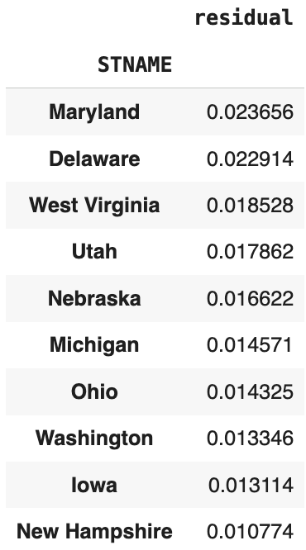
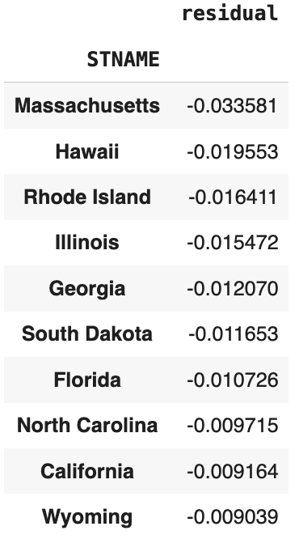
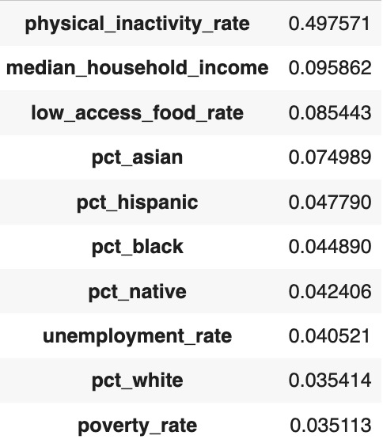
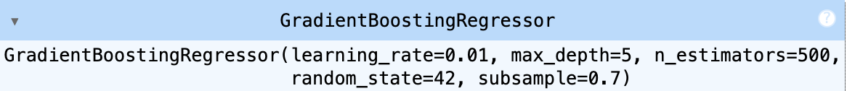
Model output
Models Evaluated:
Random Forest Regressor
Gradient Boosting Regressor
Validation Method:
5-Fold Cross-Validation
Hyperparameter Optimization
Best Performing Model:
Gradient Boosting (All Features)
Final Performance:
R² ≈ 0.44
RMSE ≈ 0.032
NRMSE ≈ 10%
The model learns:
Economic + health + demographic interactions
44% of county-level obesity variance is explained

Slide 17
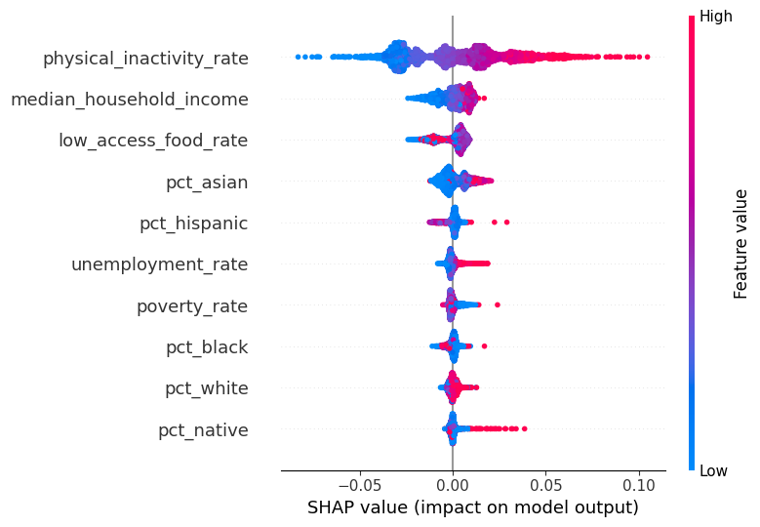
Model explainability using SHAP
Physical inactivity is the dominant driver
But its impact is strongly moderated by income Poverty and race do not act alone — they interact
This confirms compound disadvantage:
SHAP used for:
Global feature importance
Direction of feature influence
Top Drivers Identified:
Physical inactivity (strongest)
Median household income
Low access to food
Economic and demographic features:
Secondary influence

Slide 18
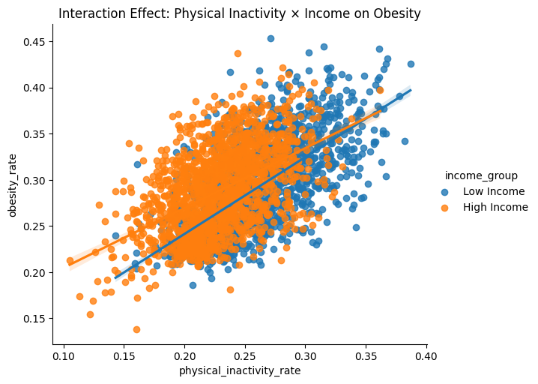
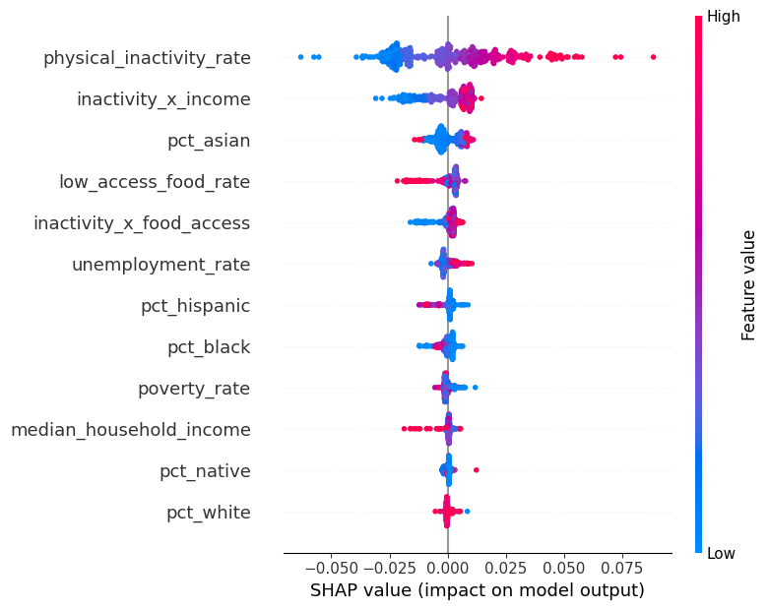
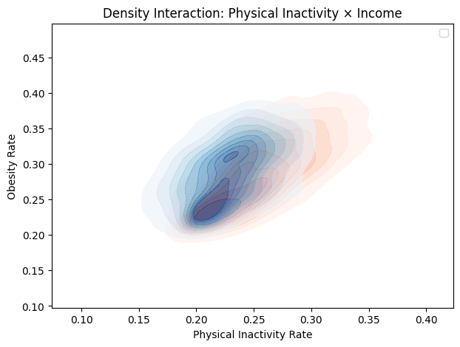
Interaction Result
Notes:
Economic resources buffer the health damage of inactivity.

Slide 19
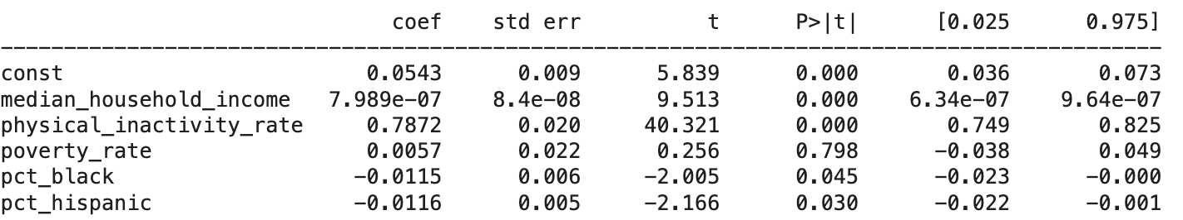
Casual Modeling

Slide 20
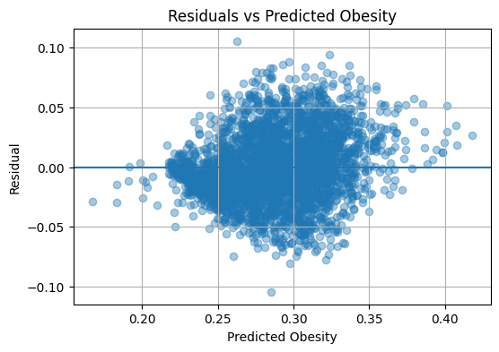
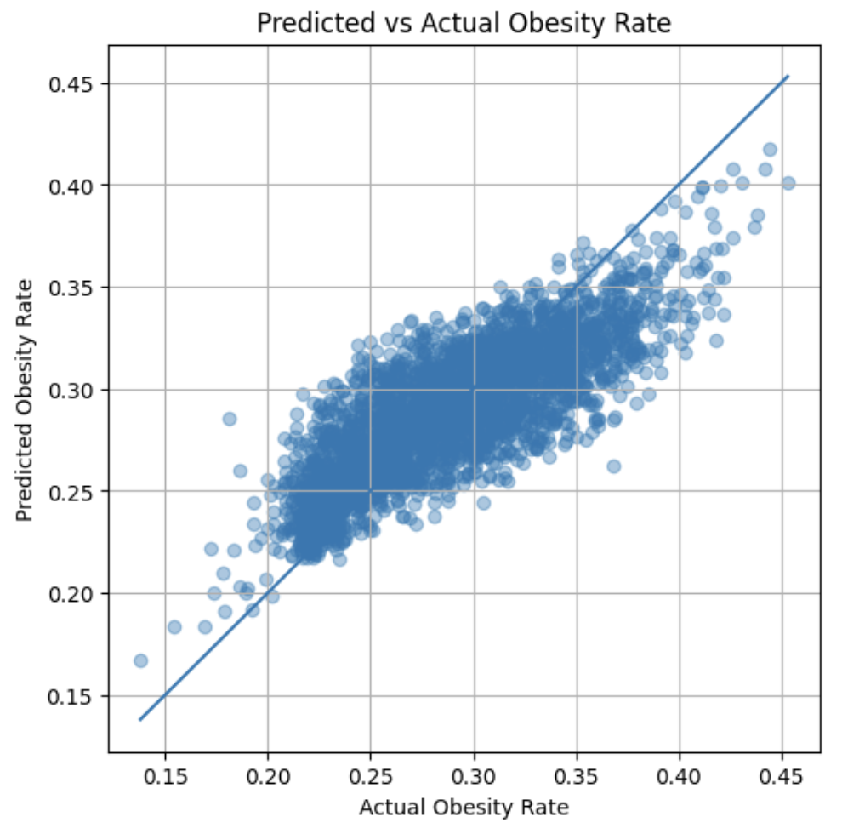
Error Diagnostic
Notes:
To validate model trustworthiness, we analyzed prediction errors in three ways. First, actual versus predicted obesity values align closely along the diagonal, indicating good overall fit. Second, the residual distribution is centered near zero, showing no systematic over- or under-prediction. Third, prediction error is consistent across income quintiles, indicating that the model does not disproportionately fail on low-income or high-income counties. This confirms that our predictions are stable and equitable.
np.float64(0.8159746982153504)

Slide 21
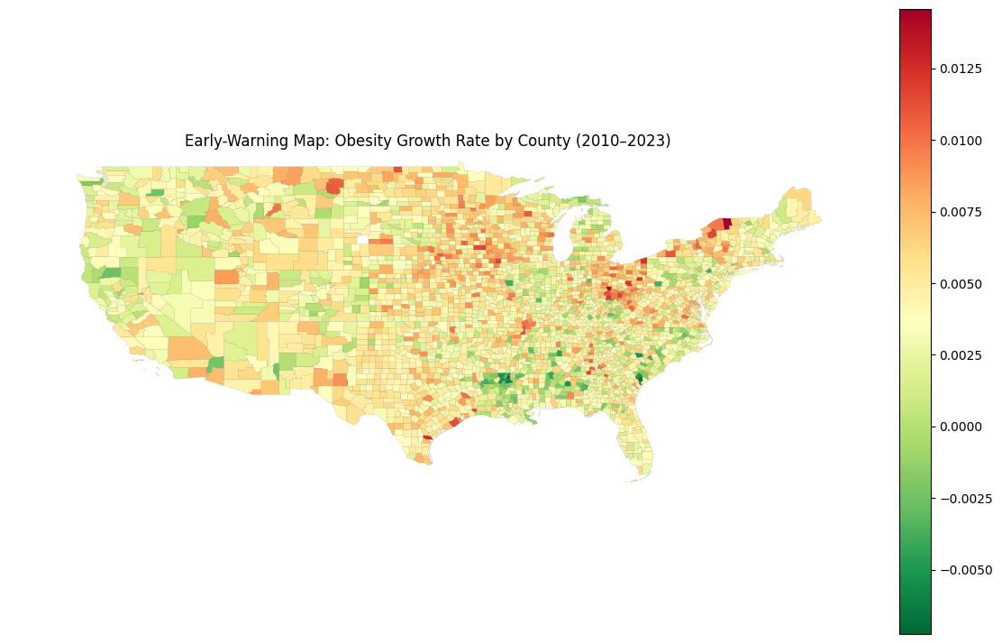

Slide 22
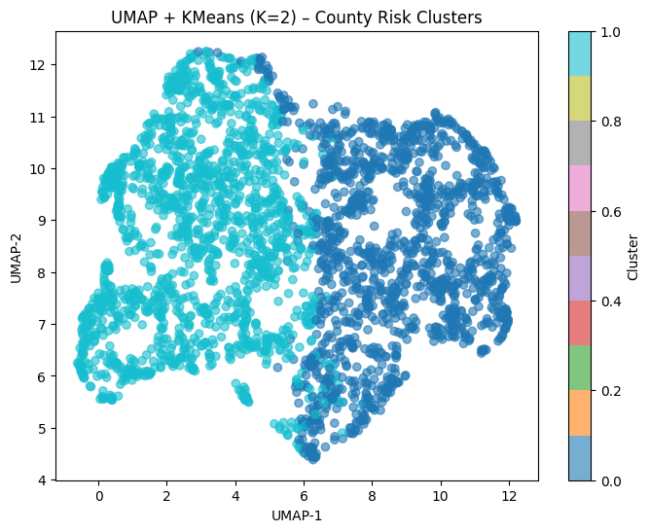
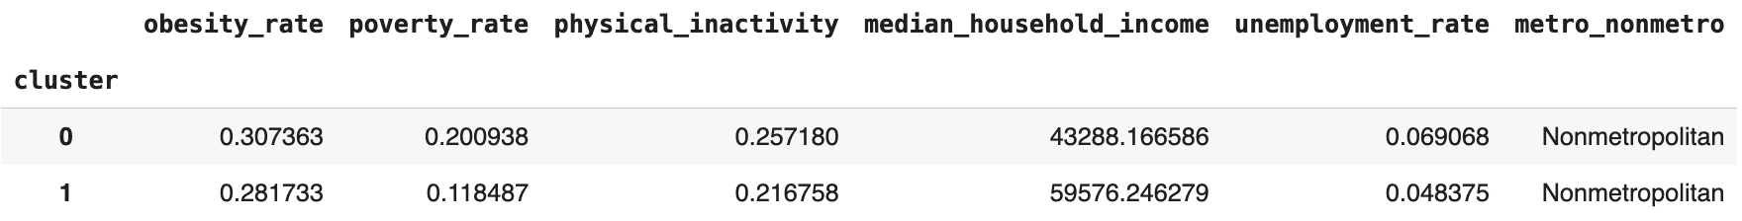
STATIC CLUSTERING (2010–2023 STRUCTURAL RISK)
Structural County Risk (Long-Term Vulnerability)
We aggregated 14 years of data (2010–2023) for each county: • Obesity rate • Poverty rate • Physical inactivity • Median household income • Unemployment rate
We applied multi-algorithm clustering with internal validation: • UMAP + KMeans • PCA + KMeans • Agglomerative • DBSCAN
Best model selected using Silhouette, Davies–Bouldin, and Calinski–Harabasz scores(0.295689, 1.232795,1648.938136)
Outcome: Counties are grouped into structural risk types: • Persistently high obesity & low SES • Moderate risk with mixed socioeconomic conditions • Lower-risk, higher-resource counties
Notes:
This slide captures long-term structural risk. Instead of looking at just 2023, we average 14 years of obesity and its socioeconomic drivers. The clusters represent counties that are structurally trapped in high risk versus those that are consistently low risk. This tells agencies where obesity is a chronic, deeply rooted problem.
From your data, obesity roughly lies in this range:
Min ≈ 0.15
Max ≈ 0.45
Most counties lie between ≈ 0.28 – 0.36
That’s a tight natural range.
So even a 0.02–0.03 difference (2–3%):
Is statistically meaningful
But still looks numerically small
Example:
Cluster 0: 0.307
Cluster 1: 0.281
That’s a ~2.6 percentage point population difference, which is huge at county scale.
Although obesity differs only slightly between the two clusters, the clusters are clearly separated by socioeconomic vulnerability, physical inactivity, and income. This suggests that obesity is structurally embedded in broader economic and access conditions, not just a singular isolated outcome.”
Even small differences in obesity percentage represent thousands of additional affected individuals per county.

Slide 23
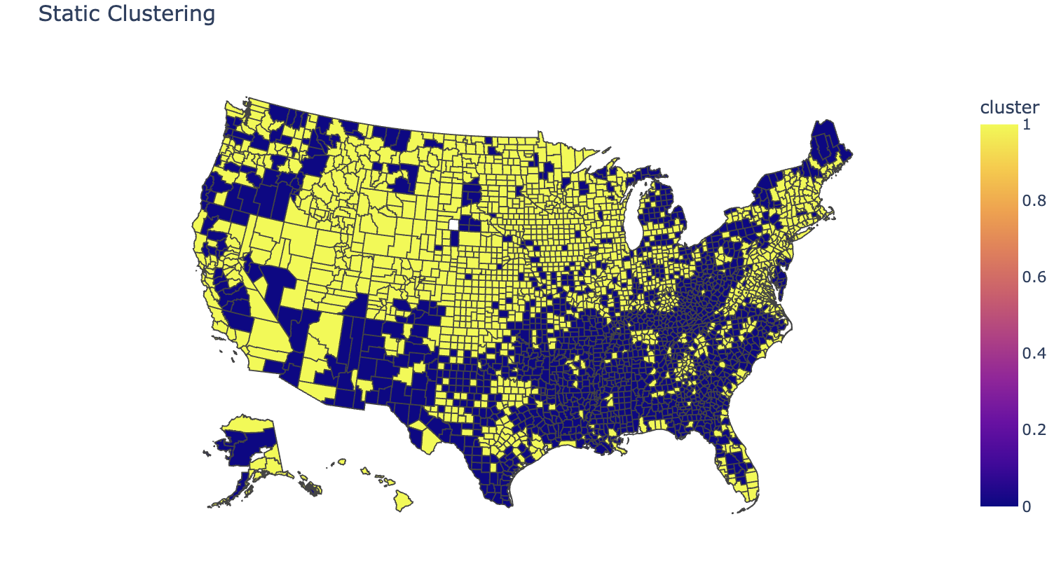
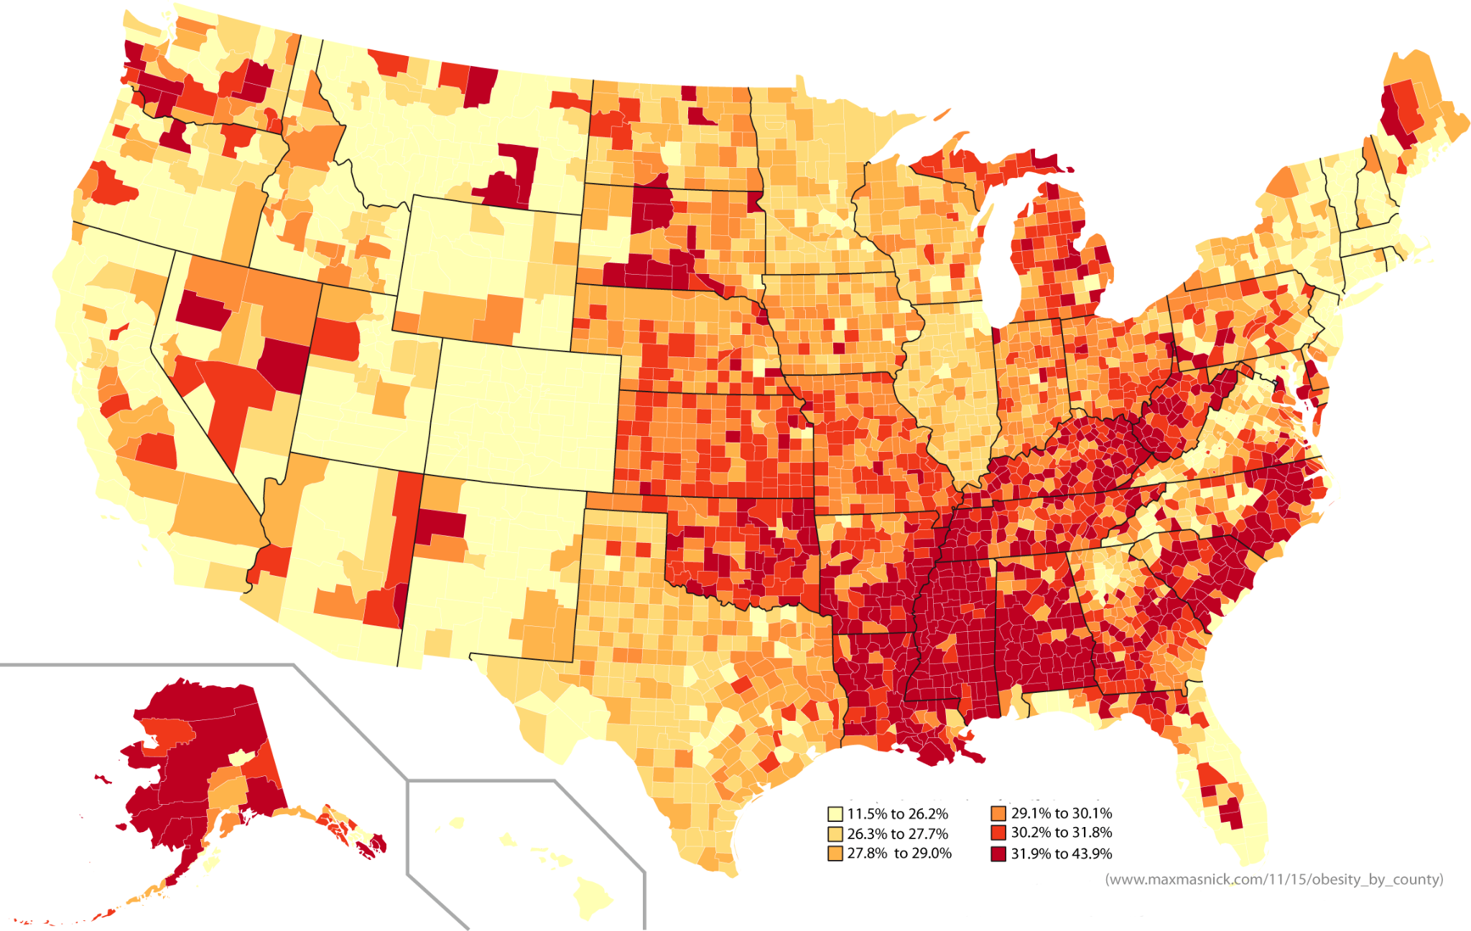

Slide 24
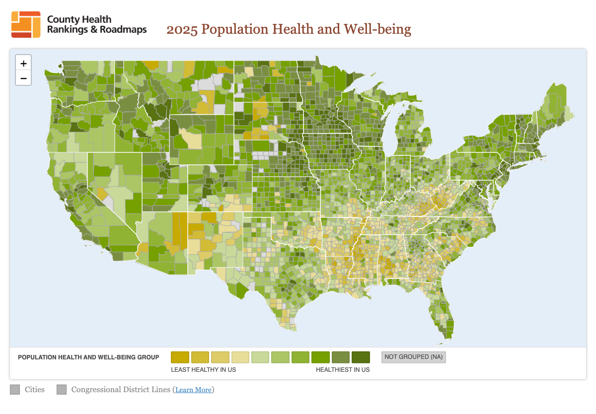

Slide 25
FORECASTING + EARLY WARNING
Early-Warning Forecasting (Near-Term System Failure Detection)
We built a time-aware supervised model using: • Lagged obesity (previous years) • Socioeconomic conditions • Health behavior indicators • Long-term trend slopes
The model predicts: → Next-year obesity rate
We then compute: Residual = Actual Obesity − Predicted Obesity
Interpretation: • Large positive residual → County is doing worse than expected • Large negative residual → County is doing better than expected
This identifies: → Silent system failure counties → Underperforming public health response zones
Key numbers:
2010: ~26.5%
2023: ~31.5%
+18–19% increase
Obesity is not static — it shows a persistent upward national trajectory, justifying long-term forecasting and early-warning modeling.
Notes:
This is our early-warning system. Instead of just predicting obesity, we compare what the model expects versus what actually happens. If a county’s obesity is much higher than predicted, it signals that interventions or health systems are underperforming. This lets agencies detect silent failures before they turn into full-scale public health crises.

Slide 26
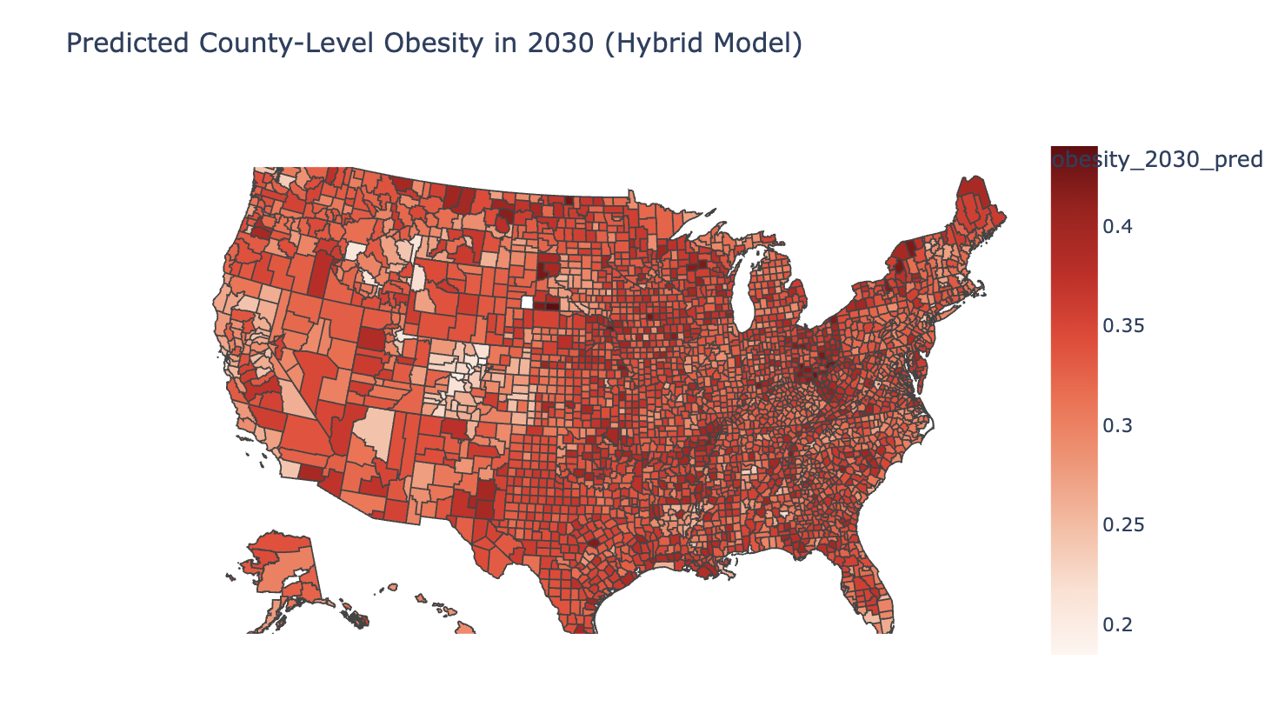
Hybrid ML FORECASTING Model ( 2024 - 2030)
Long-Term Obesity Forecasting to 2030 (Strategic Planning)
Using multi-year temporal patterns, we projected: → County-level obesity rates forward to 2030
R2: 0.69, RMSE: 0.00046
We compute: • Inputs: Lagged obesity, Current drivers, Static cluster,
Trend regime, Slopes
This identifies: • Counties that will remain structurally high-risk • Counties that will newly cross into high-risk • Counties projected to improve
Purpose: → Infrastructure planning → Long-term prevention policy → Proactive hotspot prevention

Slide 27
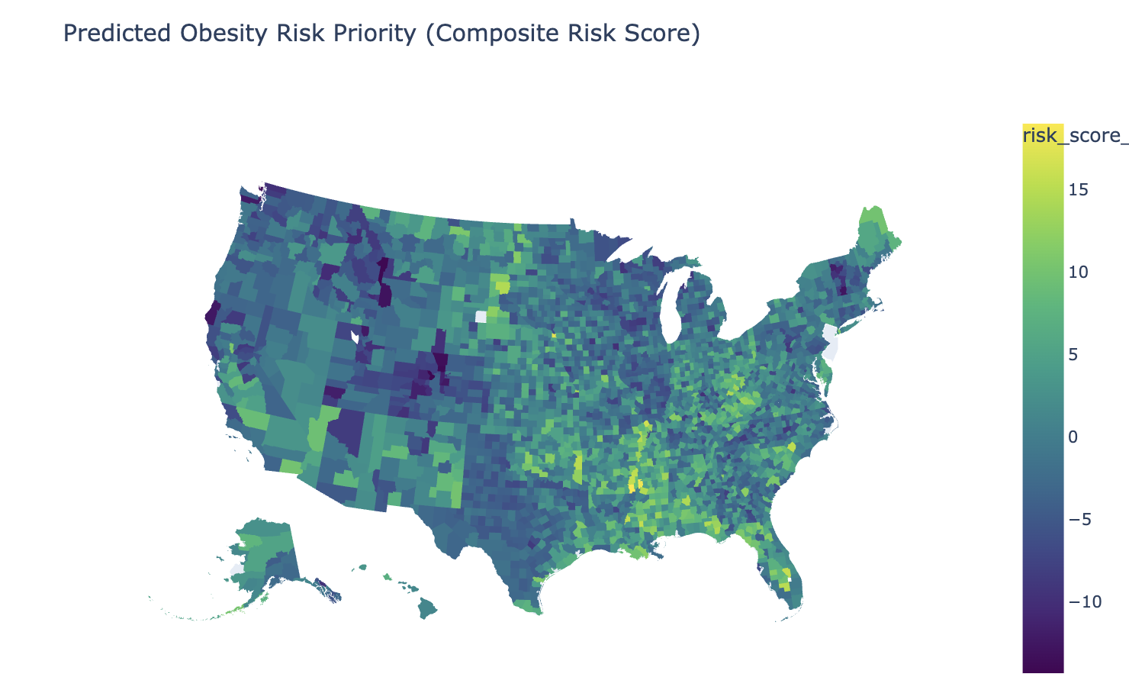
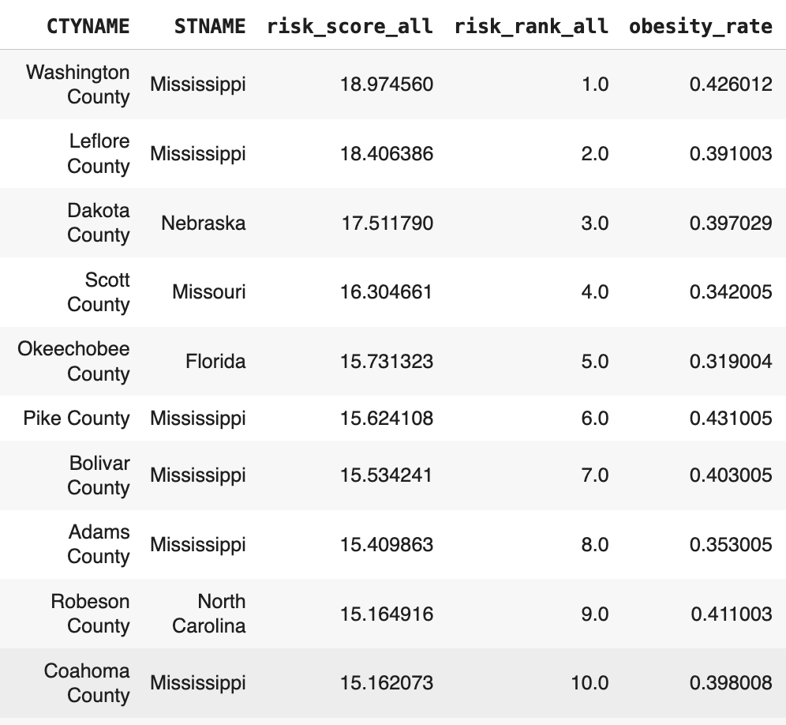
MCDM Risk Scoring (Structural Vulnerability)
Notes:
Supervised learning gave us far more than just predictions. It enabled residual analysis to identify counties performing worse or better than expected, SHAP explainability to understand why obesity is high, and policy simulation to estimate intervention impact. For example, our model predicts that a 10% national reduction in physical inactivity could reduce obesity by about 1.57 percentage points, which corresponds to millions of fewer obesity cases
Supervised learning gave us far more than just predictions. It allowed us to identify counties that perform worse than expected, even after accounting for socioeconomic and behavioral risk. Using SHAP, we found that physical inactivity is the strongest driver of obesity. We then simulated a 10% reduction in inactivity and observed a predicted 1.57 percentage-point national obesity drop, which translates to millions of prevented cases. This transforms our model from a predictor into a policy decision-support system.
Clustering assumes that natural group boundaries exist in the data. However, county-level obesity risk is influenced by gradual changes in income, behavior, and environment, which produces a continuous risk surface rather than discrete classes. Supervised learning is better suited for this epidemiological structure because it models continuous outcomes and allows causal-style simulations.
The MCDM(Multi-Criteria Decision Model) rank tells us which counties have the most dangerous conditions for obesity in the future, even if obesity is low today.
A future-focused vulnerability ranking
A preventive priority list
A structural risk assessment
A non-obesity-based ranking of danger

Slide 28
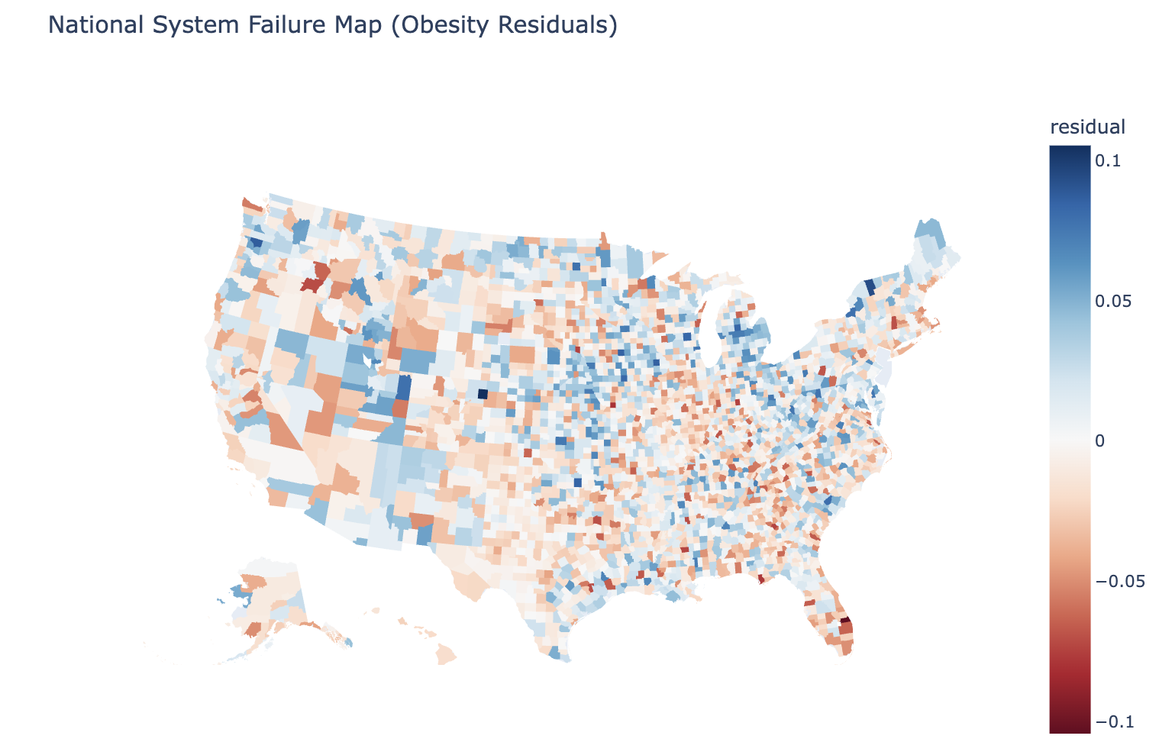
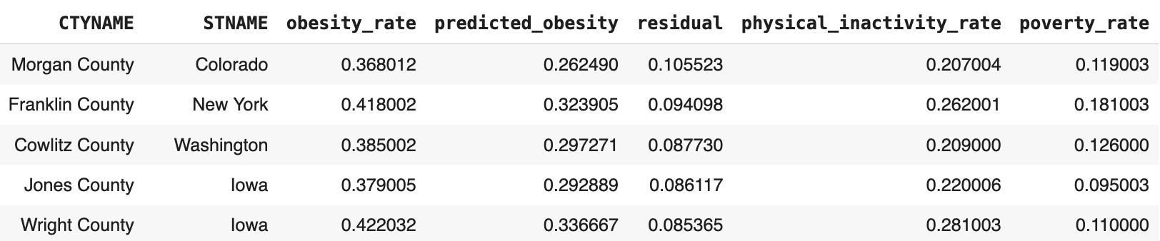
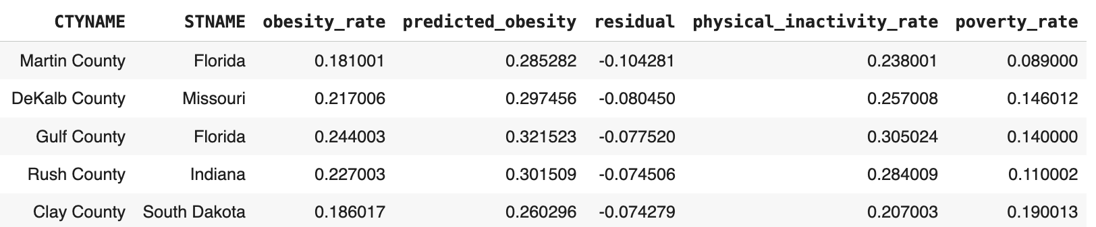
Residual Map
Worst Performing Counties
Best Performing Counties

Slide 29
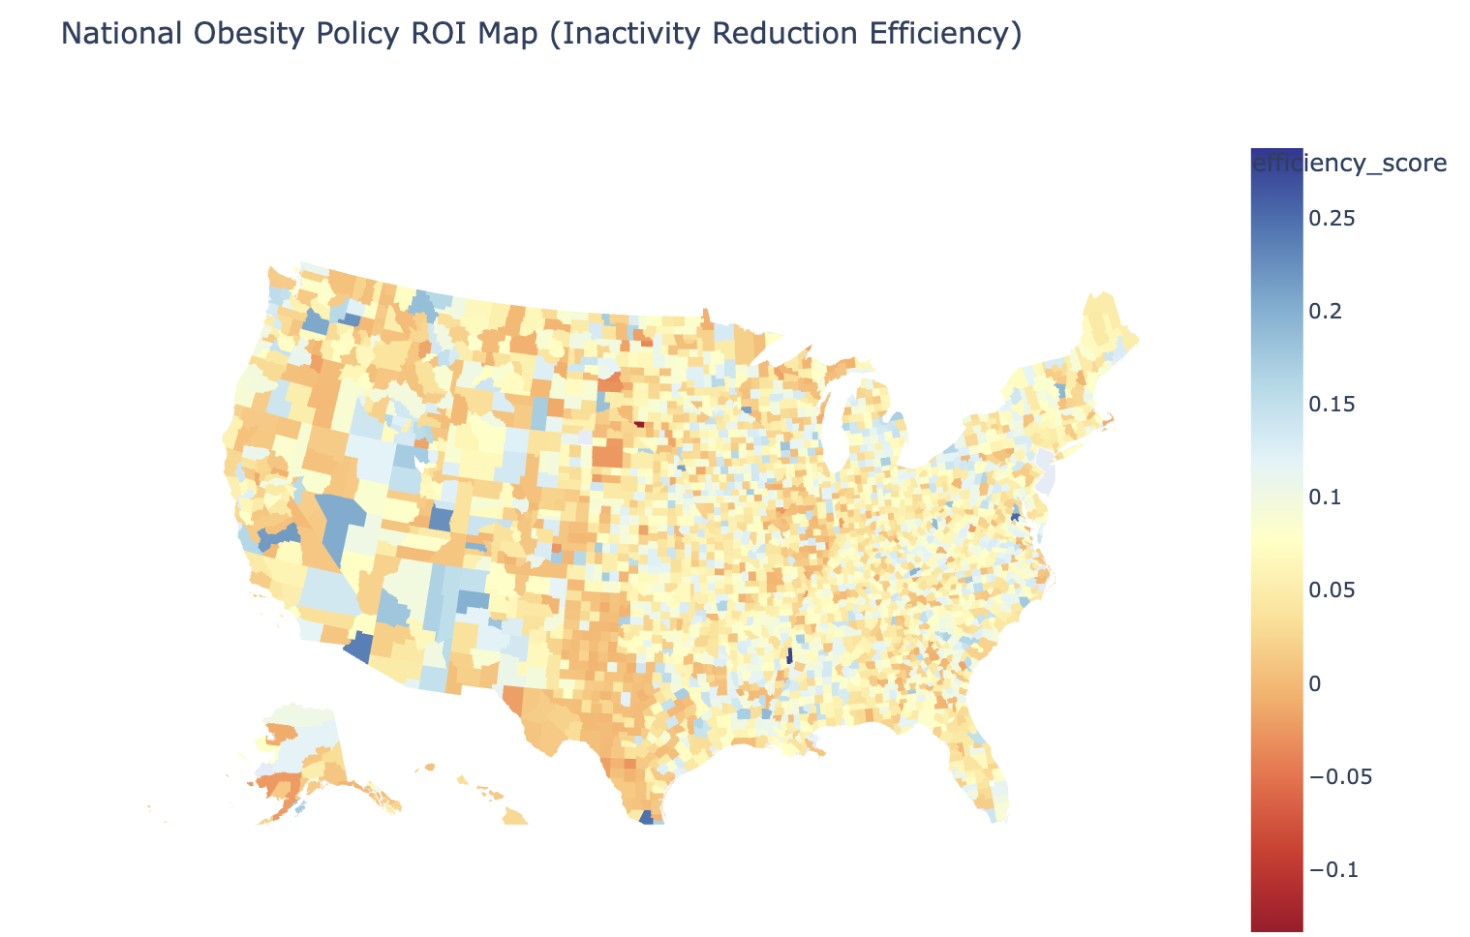
Where Physical Activity Investments Are Most Efficient?
Simulated a 10% reduction in physical inactivity
Computed: Obesity Reduction Potential = Baseline − Simulated Efficiency Score = Reduction / Inactivity Rate
High efficiency counties = best ROI for intervention
These counties show strong obesity response to small activity gains
Allows targeted deployment of fitness infrastructure & programs
More cost-effective than uniform nationwide intervention
Notes:
A uniform 10% reduction in physical inactivity leads to an average national obesity reduction of approximately 1.3–1.6 percentage points. However, efficiency varies widely across counties, enabling targeted high-return intervention planning.
SHAP Which factors matter most
MCDM Risk Where future vulnerability exists
Residuals Where programs are failing or succeeding
Efficiency Score Where activity programs give maximum return

Slide 30
Final Business / Public Health Value
Instead of asking only where obesity is high, this system enables public health agencies to identify:
• Where the health system is underperforming
• Where limited funding will generate the highest obesity reduction
• Which counties represent emergency intervention zones
• Which policy levers should be prioritized first for maximum impact
Where will future hotspots emerge?
This transforms obesity response from reactive reporting to proactive, data-driven intervention planning.
Our system enables governments to prioritize counties using three layers of intelligence: structural vulnerability, early system failure, and long-term future risk.

Slide 31
Limitations
Analysis is based on county-level aggregates, not individual behavior
• Dietary intake and built-environment variables were unavailable
• All relationships are observational and not strictly causal
• The final predictive model explains approximately 70% of obesity variance

Slide 32
Future Work
Integrate individual-level behavioral and dietary data for stronger causal modeling
• Incorporate built-environment features such as walkability, food deserts, and transit access
• Extend to age based, education categorization to address them efficiently
• Explore causal inference models to move beyond association into policy impact estimation

Slide 33
Conclusion
This project transforms obesity analytics from descriptive mapping into an actionable national-scale public health decision support system.
By integrating:
• Machine learning prediction
• Risk-based multi-criteria decision modeling
• Forecasting Model
• And intervention efficiency simulation
The framework enables targeted, cost-effective, and evidence-driven obesity intervention planning.

