Slide 1
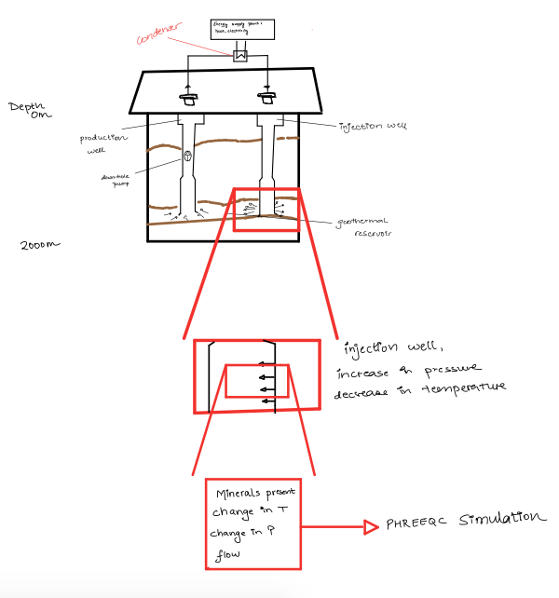

Slide 2

0 m
Injection Well
Depth
Production Well
Minerals Present Change in Temperature
Change in Pressure
PHREEQC Simulation
Increase in Pressure
Decrease in Temperature
2 km

Slide 3
25◦ C, 1 bar
0 m
Injection Well
Depth
Minerals Present Change in Temperature
Change in Pressure
PHREEQC Simulation
150◦ C, 200 bar
150◦ C, 300 bar
Increase in Pressure
Decrease in Temperature
2 km

