Slide 1

#4 Identify vacant properties needing fencing.
Members: Stanley LaGuerre & Smit Shah
Notes:
To make your own presentation slide deck, go to ‘File’ > ‘Make a copy…’

Slide 2
What’s the problem you’re looking to solve?
Identify vacant properties that need a fence.

Slide 3
What was available to you to help solve it?
Two files
Properties in Pompano Beach
Inspection Data
Ideally we need the PERMIT data but for the purposes for this hackathon, we used the data available

Slide 4
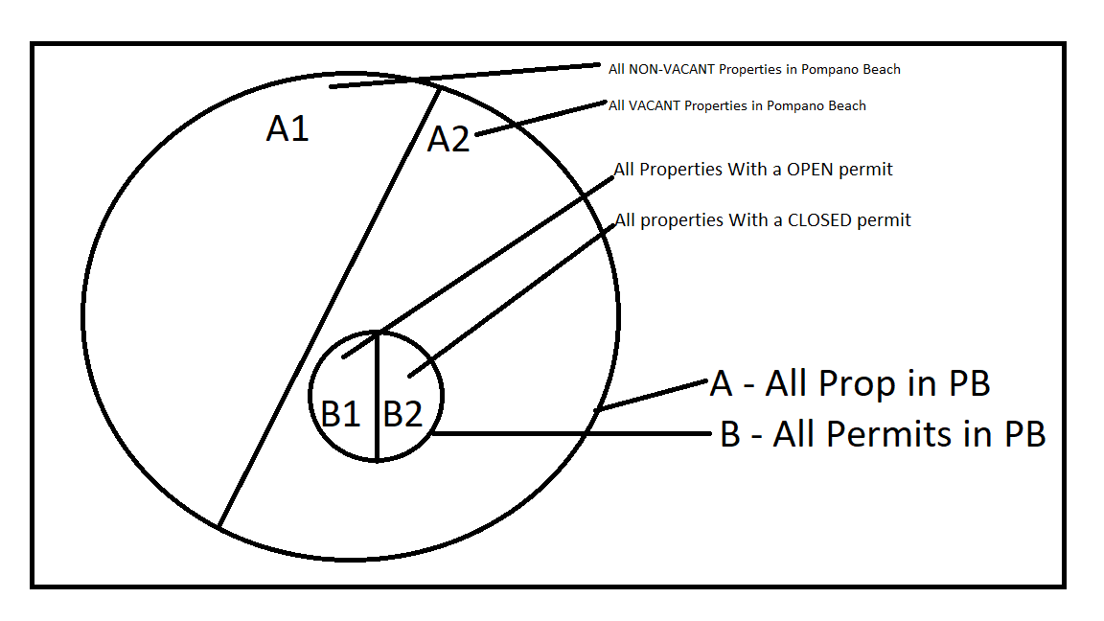
Solution, or steps taken towards the solution.

Slide 5
Solution, or steps taken towards the solution. – cont’d
Created TWO CSV(Comma Separated Values) files that are input in to the software
Read all Properties data (A from Venn Diagram)
Read all Permit data (B from Venn Diagram)

Slide 6
Solution, or steps taken towards the solution. – cont’d
Check if A’s Use Code maps to a “Vacant” status > A2
Take all “VACANT” properties in A and see if they have PERMIT data (In B)
Output currently is A2 <intersection> B

Slide 7
Biggest thing you learned in your group?
City/Government is willing to share data to optimize process and save taxpayers money.

Slide 8
What are the next steps?
Get the correct PERMIT file
Update Code
Build Auto-Update Procedure

Slide 9
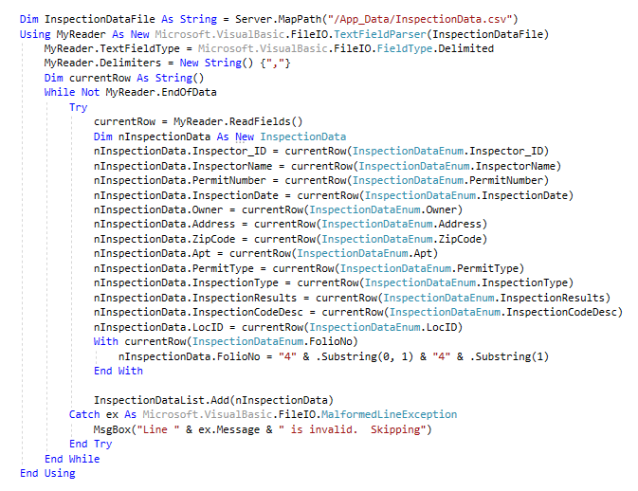
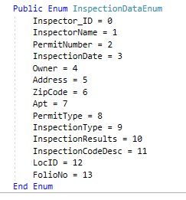
Code Excerpts – Code 1
So 9202080010 becomes
494202080010

Slide 10
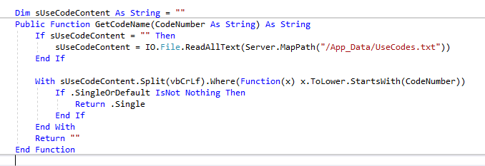
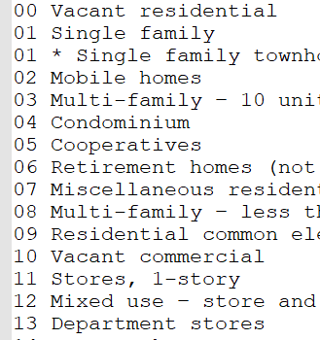
Code Excerpts - 2

Slide 11

Code Excerpts - 3

Slide 12
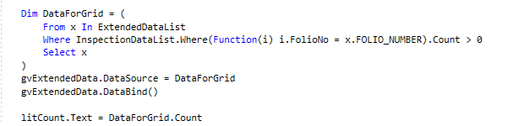
Code Excerpts - 4

Slide 13
The End

