Slide 1
Gentoo Hardened
The Hardened Toolchain
and the Security Perspective
of the Gentoo Linux distribution
by Alexander Gabert
<pappy@gentoo.org>
Bryan Østergaard
<kloeri@gentoo.org>
http://dev.gentoo.org/~pappy/presentations/
gentoo-hardened-fosdem07.pdf

Slide 2
Agenda
What is security?
Software security
Gentoo Hardened
Gentoo Linux
How to protect
The lifecycle

Slide 3

Part 1: What is Security?

Slide 4
What is security?
  physical site security
  software security
  user awareness
  security policy
  cost analysis

Slide 5

What is security?
  physical site security
    access to server racks, workstations
    recycling hard disks and printouts
    access to backup media

Slide 6
What is security?
  software security
    Stackguard, Stackshield, SSP, SSXP
    PaX, execshield, solar designer's nonexecstack
    mandatory access control (SELinux MAC)
    role based access control (Grsecurity RBAC)

Slide 7
What is security?
  software security
    software bugs allowing privilege elevation
    software bugs leading to denial of service
    software bugs exposing information leaks

Slide 8
What is security?
  user awareness
    your passwords
    your personal data
    your bank account
    your emails

Slide 9
What is security?
  security policy
    password policy: renewal, alphanumeric strings
    network access: firewalls, routing, log checking
    legal issues: /etc/issue.net banners
    intrusion detection & forensics (external support)

Slide 10
Part 2: Software security

Slide 11
Software security problems
  fast software development cycles
  software tests expensive, ineffective
  increasing numbers of lines of code
  complexity
  transparency loss

Slide 12
Part 3: Gentoo Hardened

Slide 13
The Gentoo Hardened Project
  PaX/Grsecurity
  SELinux
  RSBAC
  hardened toolchain
  the future of the hardened toolchain (SSXP)
  the future of the hardened toolchain (PIE)

Slide 14
The Gentoo Hardened Project
  PaX/Grsecurity – a winning team
    virtual memory protection (MPROTECT)
    process randomization (PIE)
    role based access control (RBAC)
    filesystem access restrictions
    chroot restrictions
      prevent breakout to real system
      prevent attacking outside processes
    network protections (rand ports, socket restr)

Slide 15
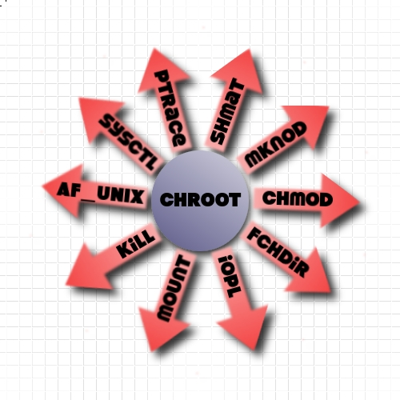
The Gentoo Hardened Project

Slide 16
The Gentoo Hardened Project
  SELinux (see Bryan's presentation)
    integration with another memory protection
      Fedora Core 6 N^X
    policy based mandatory access control
    upstream default policy support
    Gentoo Hardened developers
  RSBAC
    Gentoo Hardened maintainers
    full scale modularized protection system

Slide 17
The Gentoo Hardened Project
  hardened toolchain
    stack smashing protection object code (SSP)
      -fstack-protector-all
    position independent executables (PIE)
      -fPIE
      -pie
    bind now, relro, PLT, GOT

Slide 18
The Gentoo Hardened Project
  the future of the hardened toolchain (SSXP)
    Stack Smashing XOR Protection
      return address xor encoded, two guard values
      guard1 ⊗ retaddr => xor'ed canary on stack
      guard2 ⊗ retaddr => xor'ed retaddr on stack
      integrity of return address, linear overwrite detection
      preferably no function pointers on stack
      -fstack-protector-all -fstack-protector-ssxp
      deter information leaking about PaX randomization
      prevent simple ret2libc attacks aiming at the retaddr
      (formatstring attacks to the stack frame)

Slide 19
The Gentoo Hardened Project
  the future of the hardened toolchain (PIE)
    Kevin Quinn: PIE ABI
    -fPIC vs. -fPIE
    better nonx86 arch support (-K PIC)
    object code for statically linked executables
    PIC, PIE code versus inline assembler
    Just in Time (JIT) Code compilation/generation

Slide 20
Part 4: Gentoo Linux

Slide 21
The Gentoo Linux distribution
  Gentoo Linux Security Advisories
    regular software updates wrt/ critical bugs
  integration of hardened kernel
    architecture support
  hardened toolchain
    apache or dns w/ hardened stage3 in a chroot

Slide 22
The Gentoo Linux distribution
  supporting the Hardened project
    development machines and test systems
    hardened toolchain based on Gentoo toolchain
  new technologies knocking at the door
    Xen virtualization support
    PaX userland changes

Slide 23
Part 5: How to protect

Slide 24
How to protect your systems
  use PaX kernel, PIE+SSP executables
    hardened-sources 2.4 or 2.6
    hardened toolchain (gcc,glibc, binutils)
  use chroots
    exposed services in a hardened stage3 in a chroot
    one chroot for each network exposed service
    read-only bind mounts for user data (html javascript)
    users edit and upload their web data via ssh or ftp to
    another chroot which bind mounts data r/w
  use Grsecurity
    role based access control
    chroot restrictions

Slide 25
How to protect your systems
  keep your software up to date
    check GLSA and security ML
  regular backups of your systems
    consider secondary/fallback cold standby systems
  realize a security policy
    organization and technology

Slide 26
Part 6:
The lifecycle of a secure system

Slide 27
The lifecycle of a secure system
  initial plan for security policy
  organizational implementation
  technical implementation
  verify security policy

Slide 28
The lifecycle of a secure system
  security audit, penetration testing
  improvement, redefinition of security policy
  organizational, technical implementation
  verification of redefined security policy
  goto (1)

Slide 29
Final notes
  know your requirements and goals
  know your tools and security features
  stay informed with current technology

Slide 30
Special Thanks to our contributors and supporters:
florian,
solar@gentoo & Global Netoptex Inc.,
spender@grsecurity & The PaX Team,
FB-INF, Fachhochschule Trier,
The Open Source Labs at Oregon State University,
Method, Pebenito, kloeri, spb, phreak,
kevquinn, jeeves, amir, Kugelfang,
kang, scox, Arnie-, Weeve, Weedy,
Adamant, frogger, Battousai, seemant,
all the other developers at Gentoo.org
and all the helping hands and affiliates at
irc.freenode.org://#gentoo-hardened!

Slide 31
The Gentoo Hardened Project and Gentoo Linux
Thank you for your attention
and enjoy hardening your systems!

