Slide 1
How to be a good upstream
This work is licensed under the Creative Commons Attribution-Share Alike 3.0 United States License. To view a copy of this license, visit http://creativecommons.org/licenses/by-sa/3.0/us/ or send a letter to Creative Commons, 171 Second Street, Suite 300, San Francisco, California, 94105, USA.

Slide 2
About Myself
Betelgeuse

Slide 3
A couple approaches

Slide 4

Ivory Tower

Slide 5
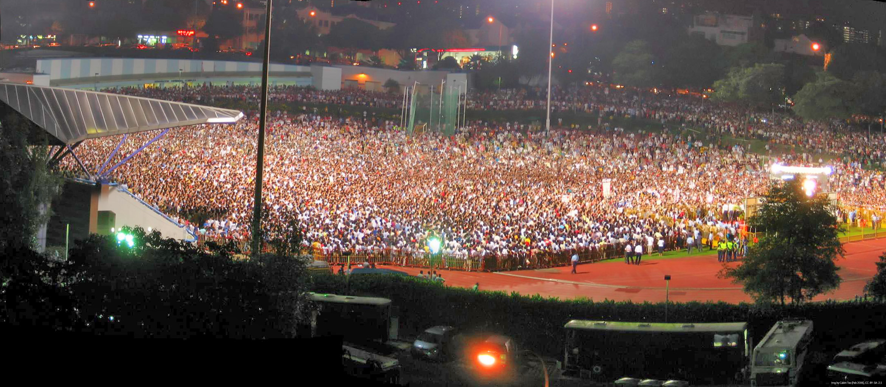
Community

Slide 6
Code Flow
Upstream Hacker
Upstream Release
Upstream QA
Distribution Packaging
Distro QA
End Users

Slide 7
Normal Day of a Packager
Modify
Take Release
Try building
failure
success
Commit
Build script from last release

Slide 8
Goal for Upstreams
If you are a good upstream then a minimal amount of iterations are needed to package things

Slide 9
How to Get Your Project Packaged
Distributions have a means to submit new package
  Gentoo uses bugzilla (bugs.gentoo.org)
Can be just requests with no packaging code involved

Slide 10
About Distro Practises
Distributions have existing frameworks for standard build systems
Well behaving autotools based systems are somewhat well understood and fast to package

Slide 11
Releases
Never change a once released file
  Distributions store hashes
Releases should by default build in release mode
No -Werror in CFLAGS
  Respect the user choice
Document distribution relevant changes in ChangeLogs

Slide 12
When to Release
Release early, release often!

Slide 13
Dependencies
Allow configuring building support for optional dependencies
Don't bundle dependencies
  Zlib security problems
Link dependencies dynamically
Use libtool in autoconf

Slide 14
Versioning
Don't reinvent the wheel
Stick to something you have chosen
Beta > alpha && 0.9 > 0.8.9
0.1 → 10.0 → 11.1 is idiotic
4.0 is a stable release number

Slide 15
Build systems
Don't come up with your own
Use what's standard for the language your project is written in
  Don't use ant for Ruby for example
Scons

Slide 16
Tarballs
Don't include version control directories
  .svn, CVS, .git
Consistent directory structure
  Should unpack consistently
Include version in the file name
Stable URLs
Keep old releases around

Slide 17

Horrors from the Java world
Binary only releases
Maven

Slide 18
Project Management
Be available
  Mailing lists
  IRC
Make it easy to follow progress
  Atom/RSS feeds
  Release announcements
Good bug tracker
  Make it easy to file bugs

Slide 19
Bug flow
End user has a problem
Distribution bug tracker
Upstream bug tracker

Slide 20
What did I forget?

Slide 21
Suggestions?

Slide 22
Other questions?

Slide 23
Dinner time

