Slide 1

CYCLISTIC BIKE-SHARE CASE STUDY
A cASE STUDY IS DEDICATED TO PERFORM DATA ANALYSIS FOR FURTHER USAGE IN MARKETING DEPARTMENT OF A BIKE-SHARE COMPANY IN CHICAGO
DATA [1] IS USED THROUGH THE AGREEMENT [2]
By Ulmeken kaibaldiyeva
April 2024

Slide 2
BUSINESS TASK
Main tasks:
Perform data analysis to determine annual trends for members and casual riders
Perform data analysis to suggest why would casual rider buy and membershop and how digital media department could direct their marketing tactics to result in higher revenue.
Quick review on the data:
Data [1] for the last 14 months (February 2023 – March 2024) contains the following information on each ride, the study will use the highlighted information from according columns within a dataset:
ride_id
rideable_type
started_at (time)
ended_at (time)
start_station_name
start_station_id
end_station_name
end_station_id
start_lat
start_lng
end_lat
end_lng
member_casual
By Ulmeken kaibaldiyeva
April 2024

Slide 3
DATA PROCESSing
Tools used:
MySQL in BigQuery Platform by Google is used in processing and analyzing stages.
Microsoft Excel is used for summarizing and sharing the final results and suggestions.
Data clening:
Check for duplicates: a command below has been applied to check for duplicates in ride_ids:
SELECT
COUNT(DISTINCT (ride_id)) as number_of_ride_id
FROM
bike_share_data.January_2024
Difference in the results of COUNT command and the actual number of rows would indicate the presence of duplicates.
Ensure that there are only two types of program: ”member” and “casual” – this helps to detect misspelling and/or NULL .
SELECT
COUNT(DISTINCT member_casual) AS number_of_types,
FROM bike_share_data.December_2023
The results must be 2 which indicates that the column member_casual has only “member” and “casual” without any misspelling nor NULL values.
By Ulmeken kaibaldiyeva
April 2024

Slide 4
DATa processing
The command below is applied to create a table which contains focused information and to find rides’ durations:
SELECT
ride_id,
rideable_type,
started_at,
ended_at,
TIMESTAMP_DIFF(ended_at, started_at, SECOND) AS difference_in_seconds,
member_casual
FROM
bike_share_data.January_2024;
The results which the query above are saved as new tables with ”_diff” added to the original tables at the end for further calculations and analysis.
The results are kept in seconds to eliminate any confusion in time measurements. However, at the end of the analysis, the seconds are converted to bigger terms.
By Ulmeken kaibaldiyeva
April 2024

Slide 5
Data processing
To check for negative durations which indicates the error(s) in timings of the ride:
SELECT
COUNT(DISTINCT difference_in_seconds),
FROM
bike_share_data.March_2024_diff
WHERE
difference_in_seconds <0
The query above shows how many negative durations are detected in the dataset: it was found that the negative durations are less than 0.01% of the entire number of rows, detailed table can be found in appendix. Therefore, the elimination of negative durations is considered acceptable in this case study.
By Ulmeken kaibaldiyeva
April 2024

Slide 6
DATA processing
The query below is to total number of rides, sum of ride durations, minimum, average and maximum ride duration, and standard deviation for “member” and/or “casual” riders:
SELECT
COUNT(*) AS total_number,
SUM(difference_in_seconds) AS sum_in_seconds,
MIN(difference_in_seconds) AS min_in_seconds,
AVG(difference_in_seconds) AS AVG_in_seconds,
MAX(difference_in_seconds) AS max_in_seconds,
STDDEV(difference_in_seconds) AS stand_deviation_in_seconds,
FROM
bike_share_data.March_2024_diff
WHERE
member_casual='member'AND
difference_in_seconds > 0
There are two restrictions set: 1) to filter the ride type and 2) to eliminate the negative ride durations.
By Ulmeken kaibaldiyeva
April 2024

Slide 7
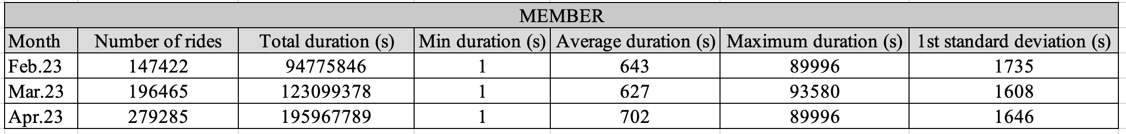
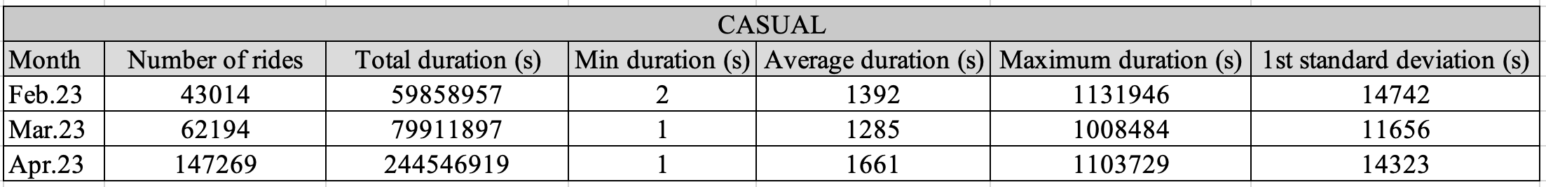
Data analysis
Some statistical measurement of the ride durations on a monthly basis are illustrated below:
Table 1. Statistical data on “member” type for several months.
Table 2. Statistical data on “casual” type for several months.
According to the examples shown above, it can be clearly seen that the average duration and 1st standard deviation values are extremely far from each other with the difference of 3-10 times magnitude. Therefore, average duration values are not considered to the an accurate respresentation, and not taken in further analysis.
By Ulmeken kaibaldiyeva
April 2024

Slide 8
Data analysis
The sum of ride durations over the last 14 months for ”member” and “casual” programs are illustrated in Figure 1. It can be clearly seen that in summer period, the usage of bikes by casual users are significantly higher, while in colder periods the usage of bikes by “member” program are higher.
Figure 2. Total number of rides vs months
Total number of rides over the last 14 months for ”member” and “casual” program users are illustrated in Figure 2. It can be clearly seen that the number of “member” program users are always higher.
From this, it can be concluded that the marketing department should focus on the strategy to encourage casual users to join annual membership program.
Figure 1. Sum of ride durations vs months

Slide 9
Suggestions
Marketing department can use the finding of this study to show the users that membership usage gives many privileges.
The department of marketing and finances should cooperate together to find an optimum pricing and conditions for the annual membership program which would catch users’ attention and think about joining the program.
Figure 2. Total number of rides vs months
In addition, marketing department can try to direct the focus of the potential annual members on a health benefits of riding a bike on a regularly basis.
Figure 1. Sum of ride durations vs months

Slide 10
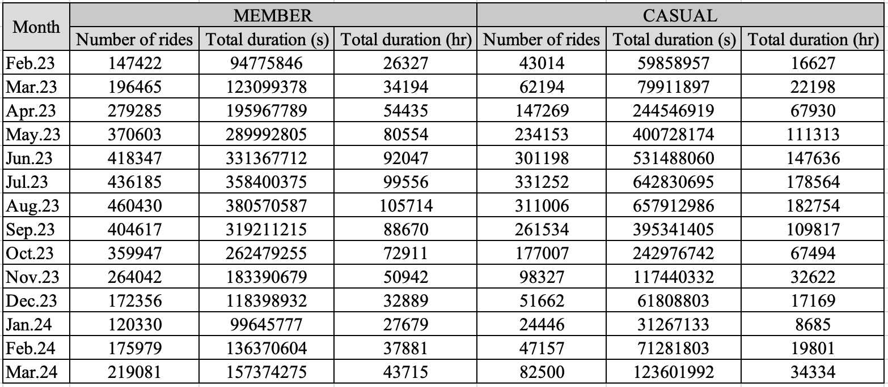
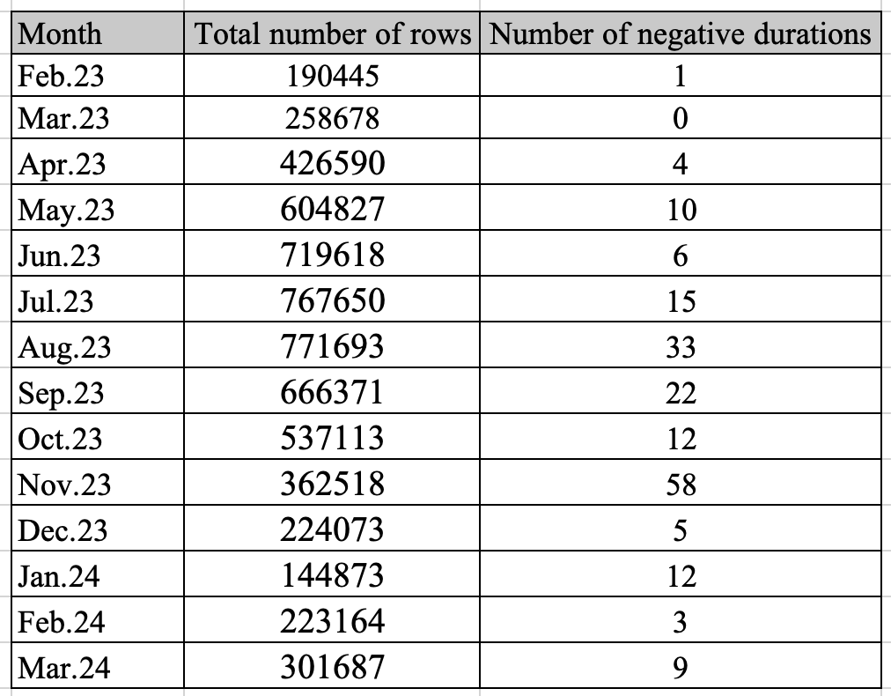
Appendix
Table 3. Calculation results.
Table 4. Number of negative durations over months.
By Ulmeken kaibaldiyeva
April 2024

