Slide 1

EARTH POPULATION CASE STUDY
A cASE STUDY IS DEDICATED TO PERFORM DATA ANALYSIS on Earth total population for years 2019-2028.
The data is taken from Health nutrition and population statistics by the world bank. [link]
By Ulmeken kaibaldiyeva
MAY 2024

Slide 2
BUSINESS TASK
Main tasks:
Perform data analysis to determine trends in the Earth’s total population for years between 2019 and 2028.
Perform data analysis to determine growth rates for separate countries for years between 2019 and 2028.
Perform data analysis to see the difference between males and females for separate countries.
Quick review on the data:
Data for years between 2019 and 2028 contains the following information for each 217 countries, the study will use the highlighted information from according columns within a dataset:
Columns:
Country name
Country code
Series name
Series code
For each year 2019-2028
Rows (series names):
Population, male (% of total population)
Population, female (% of total population)
Population growth (annual %)
Population, total
By Ulmeken kaibaldiyeva
April 2024

Slide 3
Data processing
Tools used:
Google Sheets to process the data and produce the results.
Tableau to visualize the results
Data cleaning:
1. In Google Sheets Tools->Data clean-up->Remove deplicates
2. In Google Sheets Tools->Data clean-up->Trim whitespace
The basic cleaning steps were applied in Google Sheets described above. No duplicated nor whitespaces were found as a result.
Data processing:
1. The entire data sheet were spitted into four different sheets by series names:
Population, male (% of total population)
Population, female (% of total population)
Population growth (annual %)
Population, total
For this, the filter was applied in Series name column filter out specific Series name, copy and used special paste into separate new sheets in the same files. Special paste was used to avoid any shift in the data.
By Ulmeken kaibaldiyeva
April 2024

Slide 4
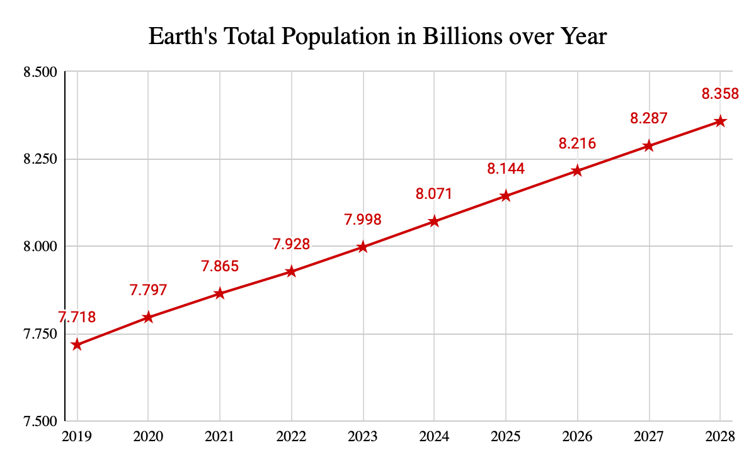
Data analysis
1. Population, male (% of total population) – the column for 2023 year was sorted by steps Data->Sort data->(A to Z). The year of 2023 were chosen as it shows the latest actual values.
Special attention were paid to the countries where male(%) is greater than 60%, this shows the significant difference between males’ and females’ portion in the entire population. As it can be noted, top 5 countries are located in Middle East.
2. Total population – the sums of all countries populations for years 2019-2028 were found using SUM() function in the Google Sheets. The results of calculation are illustrated in Figure 1.
Figure 1. Earth’s total population in billions over years.
By Ulmeken kaibaldiyeva
April 2024

Slide 5
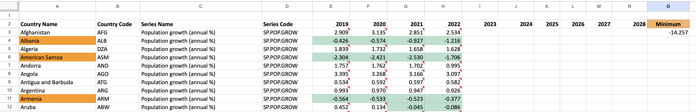
Data analysis
3. Population growth (annual %) – the data is available for years 2019-2022 only. Conditional formatting was applied to highlight negative growth percent – less than zero – with green color.
The countries with negative growth percent at least for the last two years in a row were selected in a new sheet for further analysis.
Thirty six (36) countries were found to have negative growth percentages at least for the last two years in a row. In addition, the differences between total populations of these countries were in 1000 times which didn’t allow to effectively illustrate the negative growth rates in a line chart within the Google Sheets.
Therefore, Tableau was used to illustrate the growth rate in a global map. The visualization can be found by following the Tableau link.
MIN() function was used to find the highest negative growth rate among the given data set. Ctrl + F combination was used to find which country does the minimum value belong to. It was -14.257% in Ukraine in 2022.
By Ulmeken kaibaldiyeva
April 2024

Slide 6
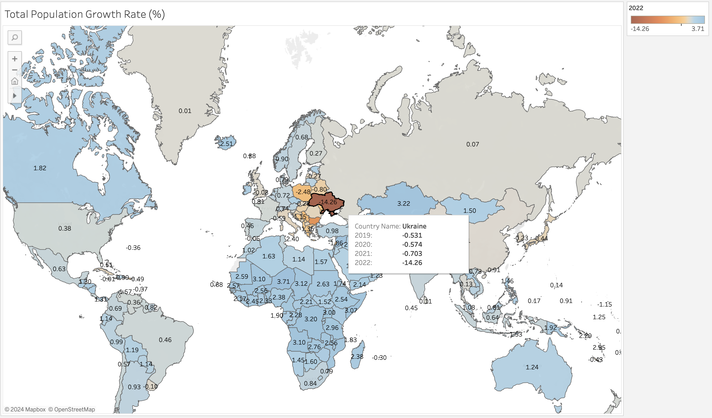
Data analysis
3. Population growth (annual %) – Earth’s population growth rates are visualized in Tableau given below. The range is set to easily distinguish the positive and negative growth rates.
By Ulmeken kaibaldiyeva
April 2024

Slide 7
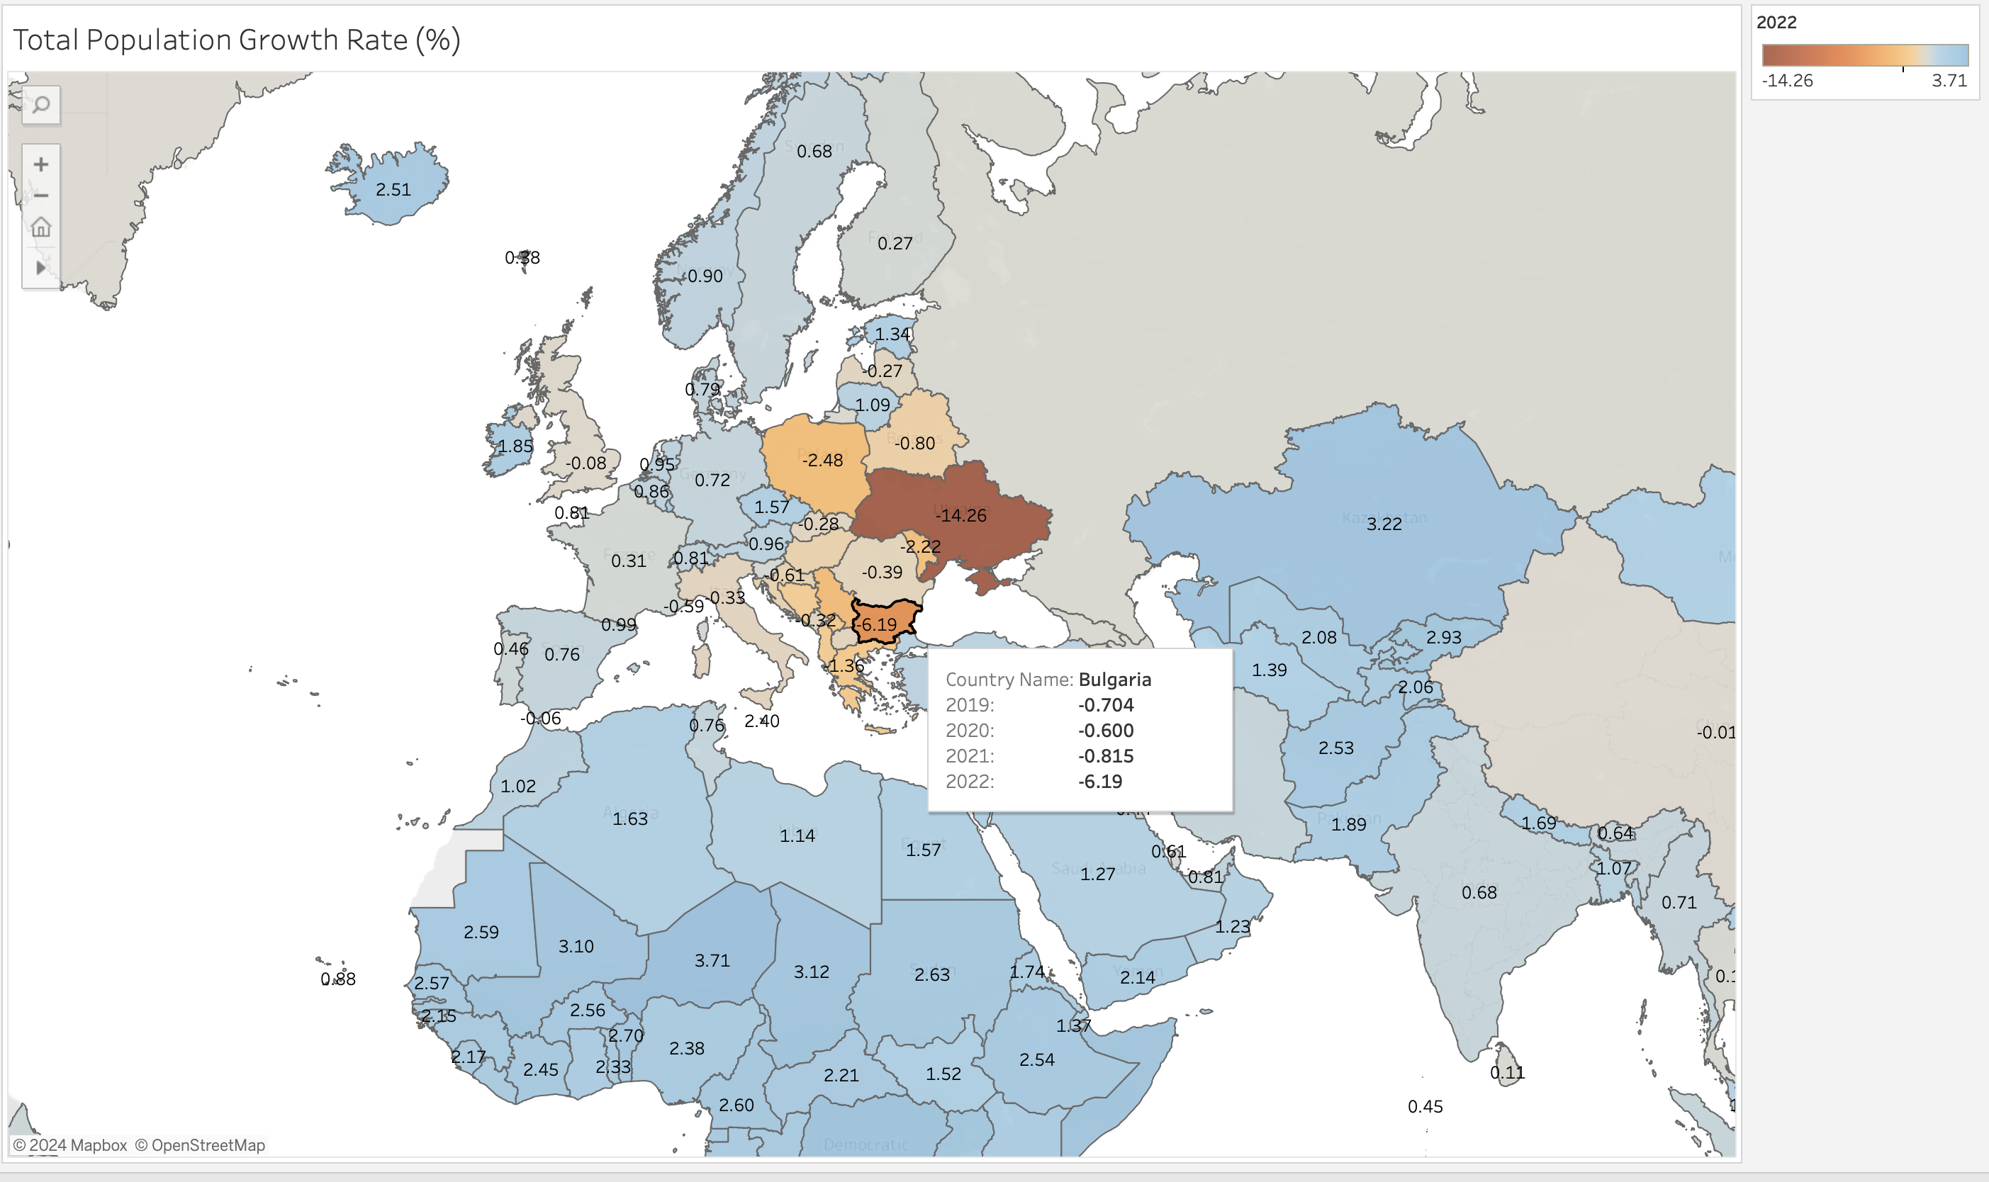
Data analysis
3. Population growth (annual %) – the map is zoomed in where the coloring is mainly for negative growth rate. It was adjusted so that the box with information on the country name and growth rates for the corresponding years appears as to click on the country of interest.
By Ulmeken kaibaldiyeva
April 2024

