Slide 1

PyHIS A cross-platform Python toolkit to access HIS data
Dr. Dharhas Pothina

Slide 2
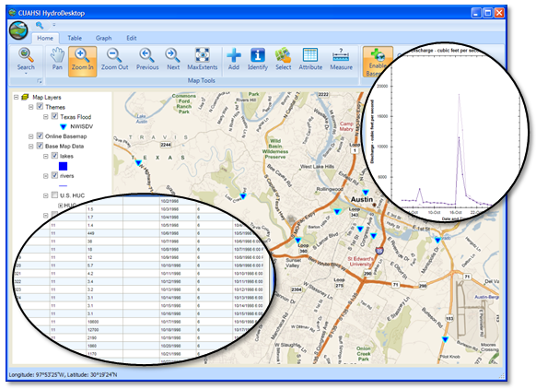
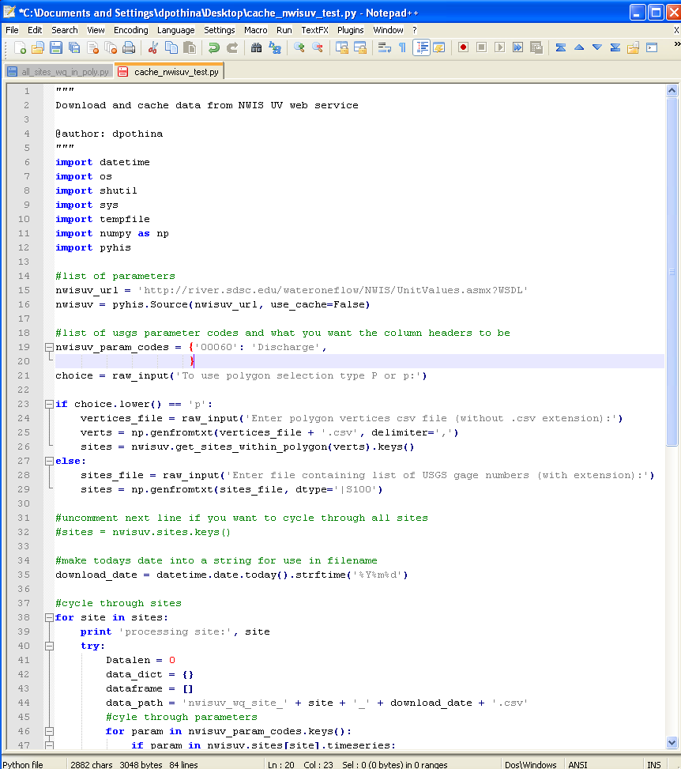
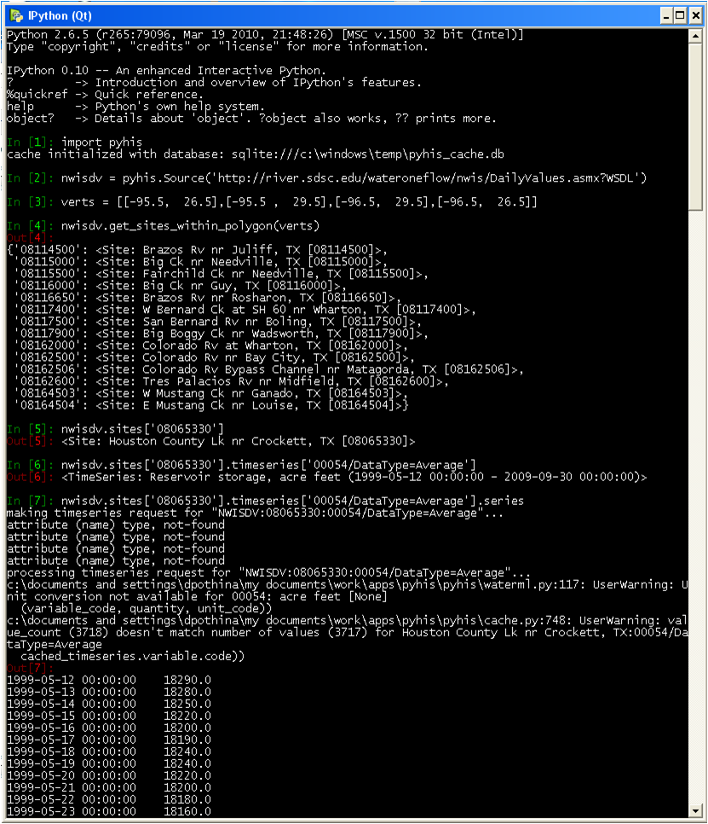
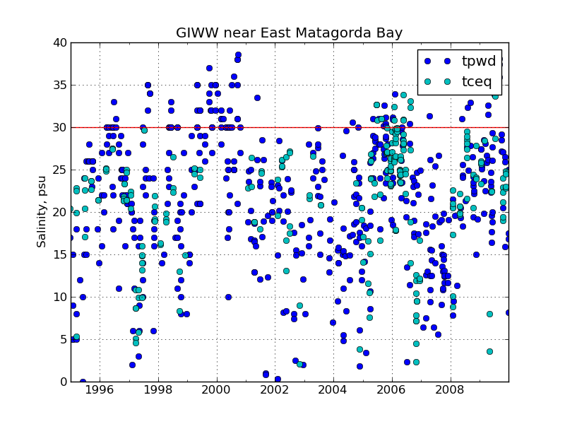

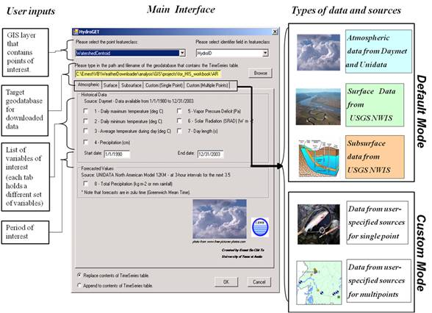
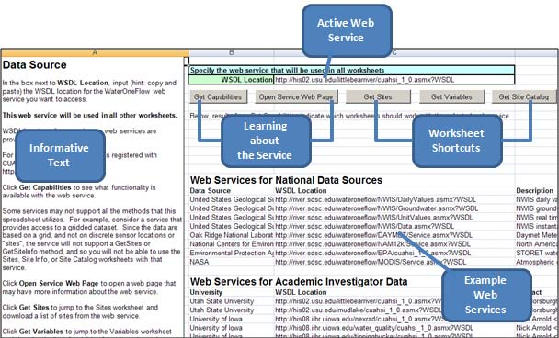
Getting Water Data from CUAHSI-HIS
HydroDesktop
PyHIS
Learn:
SOAP
XML
WaterOneFlow
WaterML
HydroGet
HydroExcel
Custom Software

Slide 3
Why do we need another tool?
Access from Linux / Mac OS X
GUI’s not the best interface for certain workflows
(ex. data harvesting, automated analysis)
SOAP is what I use in the shower
and XML makes my head hurt

Slide 4

PyHIS
HIS
We may need a better logo
HIS
PyHIS - A cross-platform Python toolkit to access HIS data
Python is a cross-platform programming language that has many scientific modules
PyHIS uses Python to implement a medium-level access to HIS data
Low enough to build flexible workflows and scripts
and for use as a back end in larger applications
High enough to not have to know anything about:
Web Services/SOAP/XML/WOF/WaterML/@#!%$&
think of a Matlab or R type interface

Slide 5
Features
Cross-platform. Works on Windows, Linux and Mac OS X
Returns data in pandas data structures. Pandas is a powerful Python data analysis toolkit that allows for time series analysis, statistical analysis and plotting.
Easy export of data to csv and hdf5 formats
Scriptable for custom workflows
Includes convenience functions for common tasks
Automatic caching of data to a local database (sqlite by default, others can be used)
Lazy Loading automatically determines what webservice calls are requires for a particular request and makes them as needed
Open Source, BSD License.

Slide 6
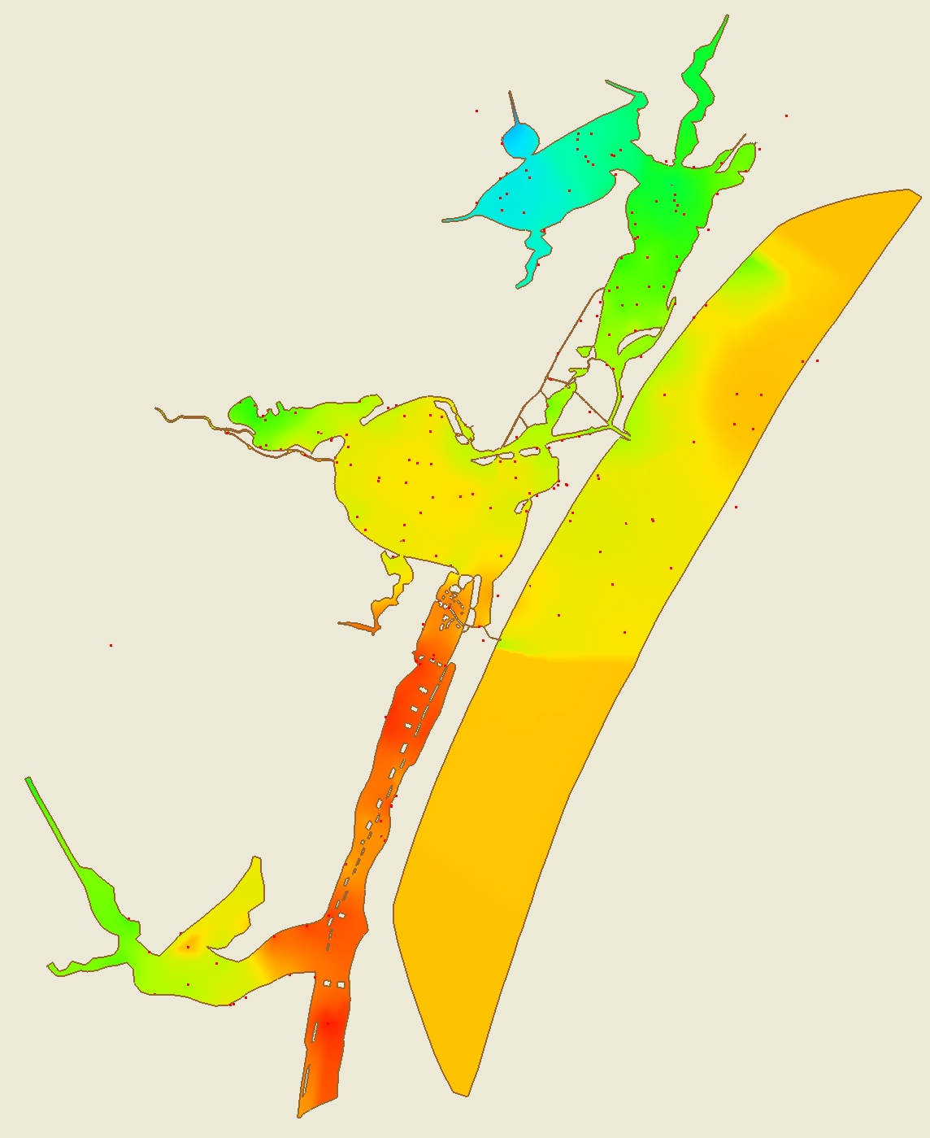
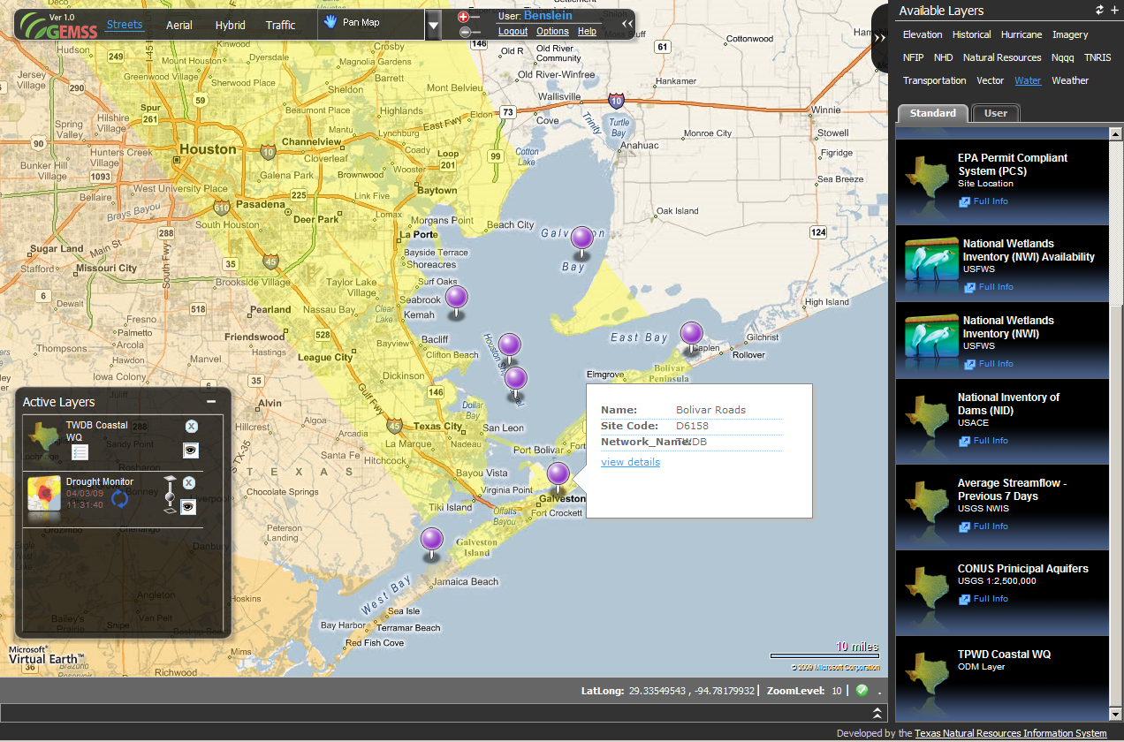
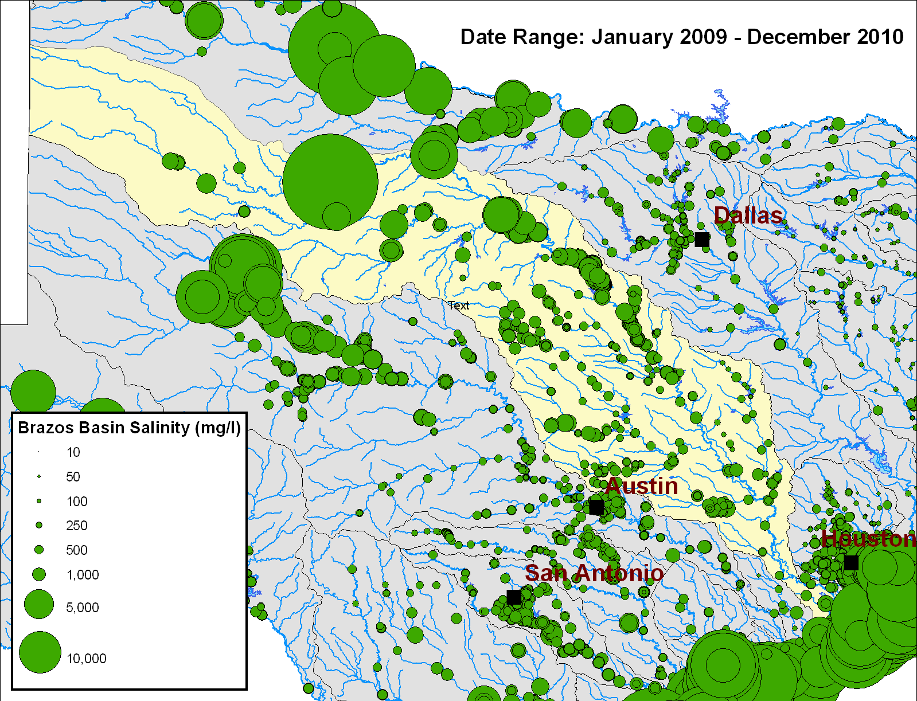
What is PyHIS being used for?
Backend for Water Data for Texas web portal
Backend for revamped TWDB Statewide Lake website
Hydrodynamic model vs field data comparisons
Salinity initial conditions for hydrodynamic models
Statewide spatial analysis.
Caching external data that is available for a limited time window. (Ex. USGS NWIS Instantaneous Values Service)

Slide 7
demo
Follow along at http://packages.python.org/pyhis/tutorial.html

Slide 8
Future work
Improve documentation and tutorial
On the fly, automatic unit conversions
More convenience functions for common tasks/analyses
Bug fixes

Slide 9
availability
Available on the Python Package Index (PyPI): http://pypi.python.org/pypi/pyhis
Development version available on GitHub: https://github.com/swtools/pyhis
Considered alpha quality. Needs better tests and documentation, API may change. Works for HIS services we are interested in (Please report any bugs to us).
Collaboration welcomed for both WOFpy and PyHIS.
Contact Info: dharhas.pothina@twdb.state.tx.us / 512-936-0818

