Slide 1
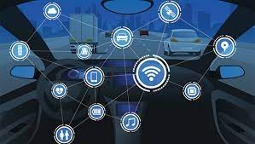
BLOCKCHAIN BEHIND THE WHEEL: ACCELERATING TOWARDS A SMART AUTOMOTIVE ERA
Cecs 574 – topics in distributed computing
Akhil MANCHUKONDA
LAKSHMI PRASANNA UDUMULA
CHERISH KASTURI
JEET PATEL

Slide 2
Abstract & Introduction
Emphasizes the potential for blockchain to enable new business models and improve transparency in the automotive industry.
Global perspective on blockchain's benefits for automotive cyber-resilience.
Numerous operational inefficiencies in Autonomous vehicles: causing injuries, losses, unnecessary causalities.
Security issues with Automotives results in cyberattacks.
Risk of hostile assaults with increasing features.

Slide 3
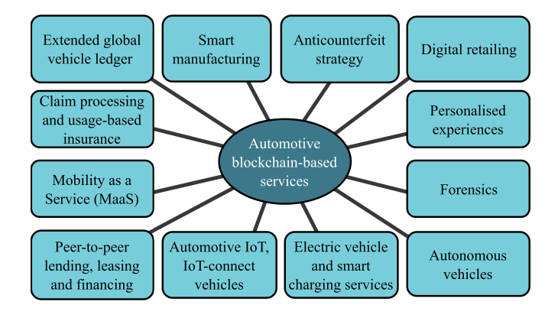
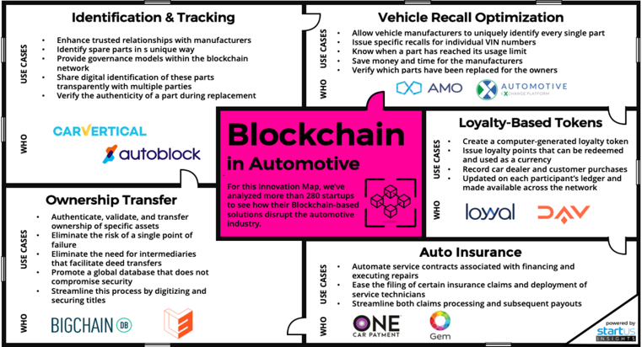
Blockchain & Automotive Industry:

Slide 4
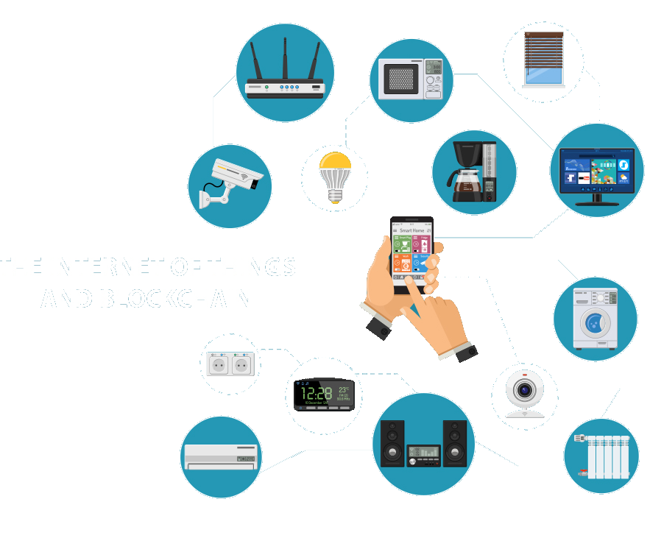
Blockchain IN AUTOMOTIVE industry
Highlights blockchain's role in securing data across multiple industries.
Tamper-proof nature ensures data integrity and transparency.
Immutable transaction records mitigate risks of data modification.
Fundamentals of blockchain technology for creating a secure, decentralized data management platform.

Slide 5
Challenges
Addressing the growing threat of cyberattacks targeting automotive manufacturing.
Reducing costs while streamlining processes and minimizing reliance on intermediaries.
Functional Incompetence due to Data Management.
Transparency over transactions.

Slide 6
Decentralization & Resilience:
Eliminates Single Points of Failure: Spreads data across computers, enhancing resilience and robustness against failures.
Enhances Data Security and Privacy: Distributes data storage, significantly lowering breach risks and improving privacy.
Improves System Transparency and Trust: Offers shared ledger access, boosting transaction transparency and trust.
Facilitates Innovation and Collaboration: Promotes network-wide collaboration, driving innovation and flexible solutions.

Slide 7
Smart Contracts Introduction:
Smart contracts as self-executing contracts without intermediaries.
Enhances security and transparency, beneficial for industries requiring secure transactions.
Example: In autonomous vehicles, smart contracts can securely manage vast data, improving safety and resource efficiency.
Discussion on smart contracts’ benefits for transparent and secure transactions across various industries.

Slide 8
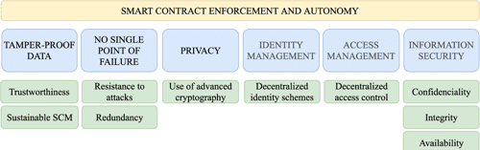
Smart Contracts for Automation and Efficiency:
Use of Smart Contract in Automating transactions and operations.
Interaction with oracles for integrating real-world data into blockchain.
Distinction between strong and weak smart contracts in terms of legal compliance and execution.
Examples of smart contracts in automating insurance claims and vehicle leasing.

Slide 9
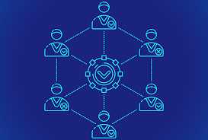
Consensus Mechanisms:
Core to blockchain's integrity, ensuring transactions are valid and secure.
Discusses Proof-of-Work and Proof-of-Stake as mechanisms to achieve consensus.
Each node's agreement is required for adding new blocks, enhancing data security.
Comparison of different consensus mechanisms and their security implications.

Slide 10
Distributed Ledger Technology (DLT):
DLT ensures tamper-resistant data management, crucial for the automotive sector's intricate needs.
This technology enables data sharing and validation across the supply chain without central oversight.
Within automotive, DLT's uses range from smart contract execution to bolstering anti-counterfeit measures.
It aligns with privacy regulations, protecting user data and industry intellectual property in the digital realm.

Slide 11
Privacy Concerns & Solutions in Blockchain:
Public-key cryptography forms the basis of blockchain's privacy capabilities, ensuring confidentiality which is one of the foundational pillars of information security
Challenges In User Identification And Potential Solutions For Enhanced Privacy.
Blockchain's transparency and adherence to regulations such as GDPR and CCPA directly relate to the ways in which user data in the automotive industry is protected
Blockchain's Role In Enhancing Privacy In Connected Vehicles And Personal Data Protection.

Slide 12
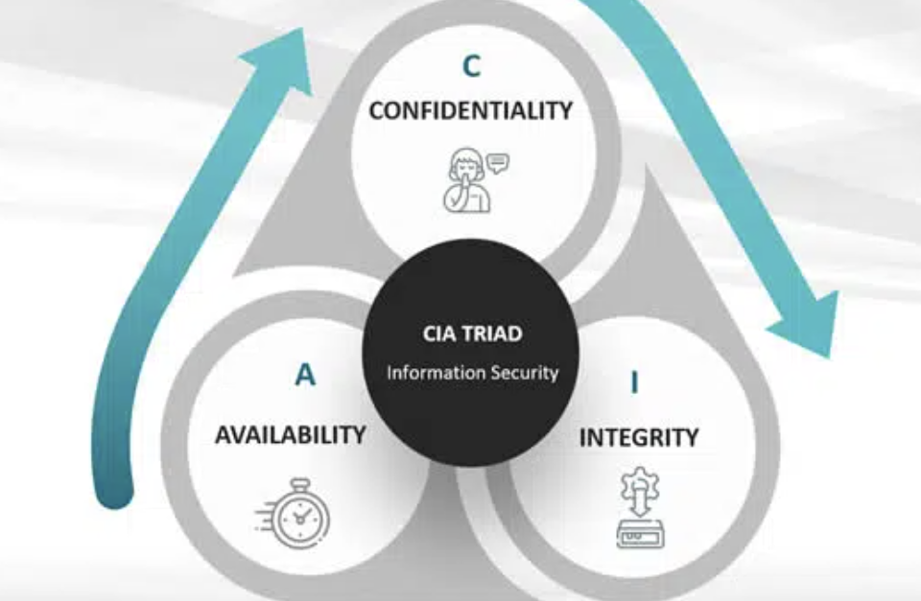
Information Security Pillars:
Emphasizes confidentiality, integrity, and availability in blockchain networks.
Blockchain's approach to maintaining data security and preventing unauthorized access.
Ensuring data integrity through immutable storage and transaction history.
Availability ensured by peer-to-peer distribution, mitigating risks like the 51% attack.

Slide 13
Protecting User Data in the Automotive Industry
Secure and decentralized storage of sensitive customer data.
Blockchain's potential to prevent data breaches and ensure user control over data access.
Compliance with data privacy regulations like GDPR and CCPA through blockchain technology.
Applications in protecting intellectual property rights within the automotive industry.

Slide 14
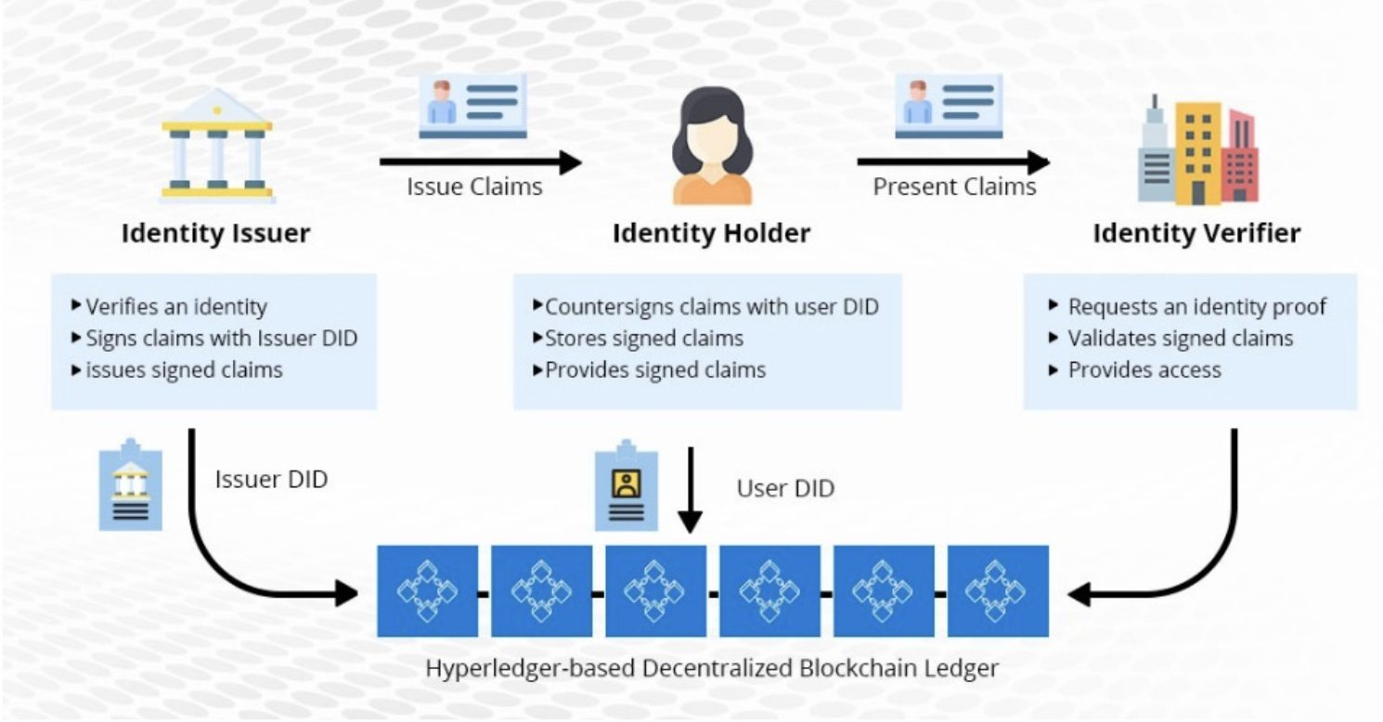
Identity and Access Management:
Decentralized Hyperledger blockchain system facilitating secure digital identity management through verified credential issuance, storage, and authentication processes.

Slide 15
Advanced Blockchain-Based Applications in Automotive:
Smart Manufacturing: Blockchain enables tracking of product versions, warranty issues, and ownership disputes, improving overall quality control.
Extended Global Vehicle Ledger: A secure platform to store, update, and communicate automobile maintenance and ownership history in real time, facilitating better logistics and spare part authenticity.
Anti-counterfeiting Measures: Utilizing blockchain to ensure part authenticity and prevent odometer fraud, with examples like Bosch and TÜV Rheinland developing a digital logbook solution.
Personalization and Digital Retailing: Enhancing customer engagement through blockchain-based loyalty and reward programs, enabling rewards to be used as currency within the network.

Slide 16
Mobility Services and P2P Lending:
Claim Processing and Usage-based Insurance: Blockchain allows for transparent claim processing involving multiple parties and supports usage-based insurance models by securely sharing driving data.
P2P Lending, Leasing, and Financing: Facilitates secure and efficient peer-to-peer transactions for car leasing and rentals, with examples like the pilot project by Visa and DocuSign using blockchain for car leasing.
Mobility as a Service (MaaS): A blockchain platform could connect IoT-connected vehicles, autonomous vehicles, and ride-sharing providers, ensuring secure and seamless transactions and data exchange.

Slide 17
Connected Services and Smart Charging for EVs
Connected Services: Blockchain enables vehicle owners to acquire services like parking and tolls seamlessly, with integration examples like Care wallet.
Smart Charging for Electric Vehicles (EVs): Blockchain supports efficient energy management and billing for EV charging, allowing owners to choose optimal charging times and participate in energy grid stabilization.
Autonomous Vehicles: Highlighting the potential for blockchain to secure data communication between autonomous vehicles and infrastructure, ensuring privacy and data integrity.
Forensics and Security: Blockchain's role in enhancing vehicle forensics and security, aiding in investigations and insurance claims by providing tamper-proof data records.

Slide 18
Conclusion & Future Outlook:
Transformative Potential: Blockchain technology stands to significantly enhance efficiency, security, and transparency in the automotive industry.
Cyber-Resilience: By addressing key challenges like data breaches, fraud, and operational inefficiencies, blockchain contributes to a more resilient automotive ecosystem.
Innovation and Opportunities: Encourages the exploration of new business models and solutions, from smart contracts to advanced mobility services.
Future Directions: Continued research and development are essential to overcome existing barriers and fully realize blockchain's potential in automotive applications.

Slide 19
Thank YOU!

