Slide 1

Cloud Computing
Maxime ESCOURBIAC Sébastien Saint-Martin
ISIMA ZZ2

Slide 2
Outline
I°) Presentation of the concept
- Concept of Cloud computing
- Different type of Cloud
- Usages of Cloud Computing
II°) Advantages
III°) Inconvenient

Slide 3
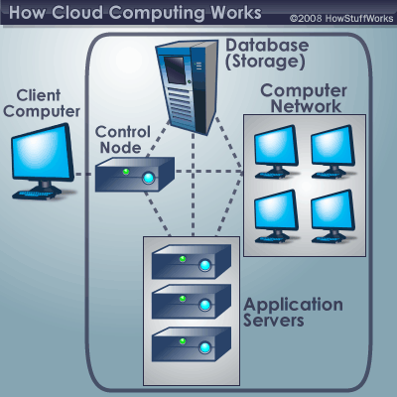
Concept of Cloud Computing
Web-based application consequence
Encapsulation of the structure
Access to the information anywhere
Managed by providers

Slide 4
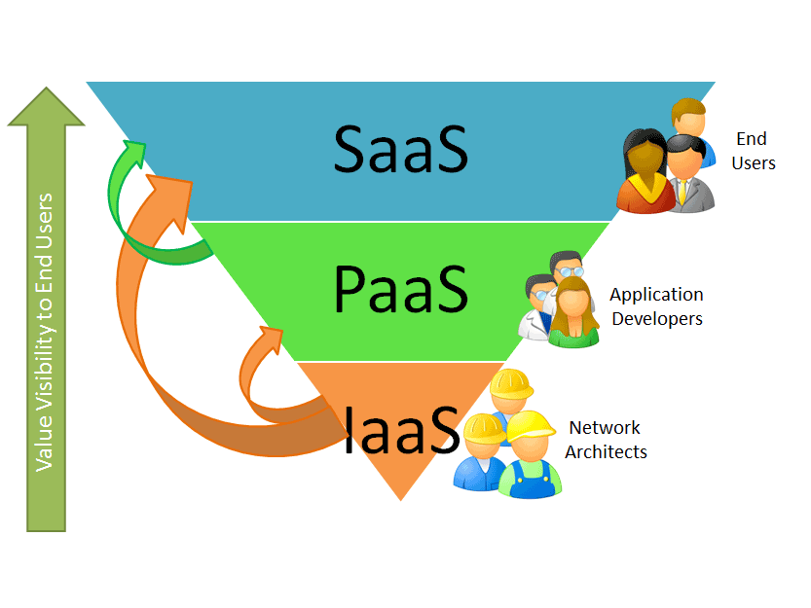
Different types of Cloud
Infrastructure as a service (IaaS)
ex: Hosting a web site
Platform as a service
(PaaS)
ex: Development on Ruby on rails
Software as a service
(SaaS)
ex: Gmail, GoogleDocs

Slide 5

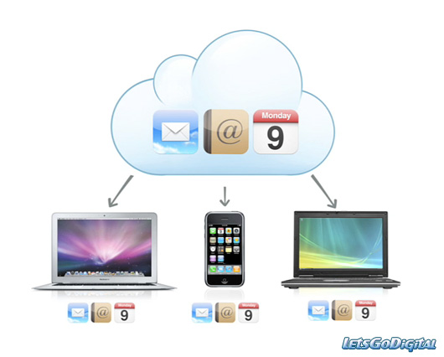
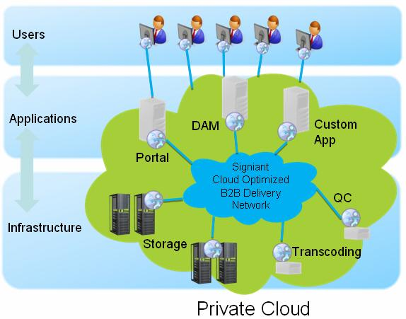
Usage of cloud computing
Online software
Storage Online
Infrastructure substracted

Slide 6

Advantages
Permit huge benefit
and jobs
Easier for society
Cheaper for society
Scalability

Slide 7

Inconvenient
The bandwidth
Confidentiality
Big company
Juridic issue
Ecologic issue

Slide 8

Conclusion
Technology reliable?
Weakness appeared
A new concept based on Cloud computing
Any questions ?

