Slide 1
Create a JSON Schema file for your laboratory data at LAPS project website
Create Empty Directory from JSON Schema
Function: LAPS_1_empty_dir_create_update
Input: JSON Schema
Output: Empty Directory Structure
Populate Directory with Laboratory Data
Manually organize data in the created directory structure based on the JSON schema
Convert Directory to HDF5
Function: LAPS_2_HDF5_from_directory
Input: JSON Schema, Populated Directory
Output: HDF5 File
Store/Exchange HDF5 File
Share, move, or store the generated HDF5 file.
Recreate Directory from HDF5
Function: LAPS_3_create_directory_from_HDF5
Input: HDF5 File
Output: Recreated Directory Structure
Interactive Time Series Plotting
Function: LAPS_4_interactively_plot_timeseries
Input: Recreated JSON Schema, Time Series Data
Output: Interactive Time Series Plot

Slide 2
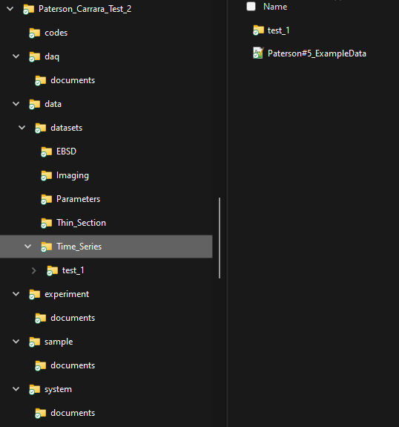
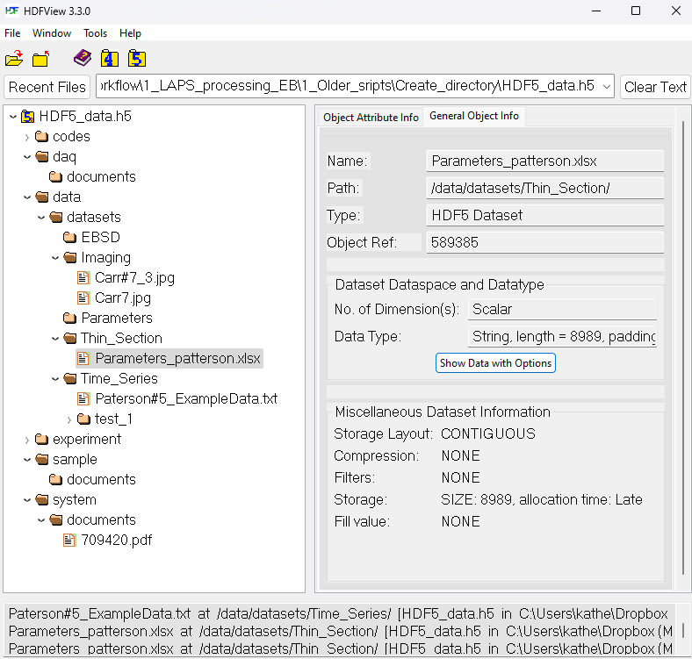
Folder structure to HDF5 file structure

Slide 3
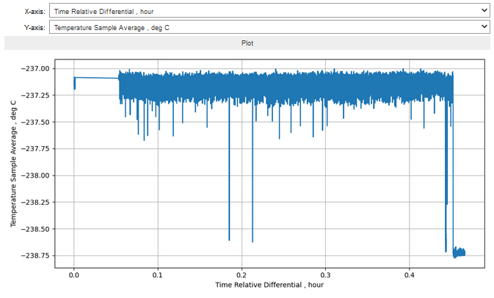
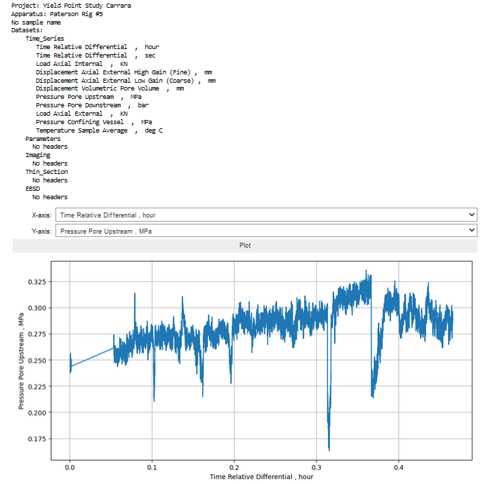
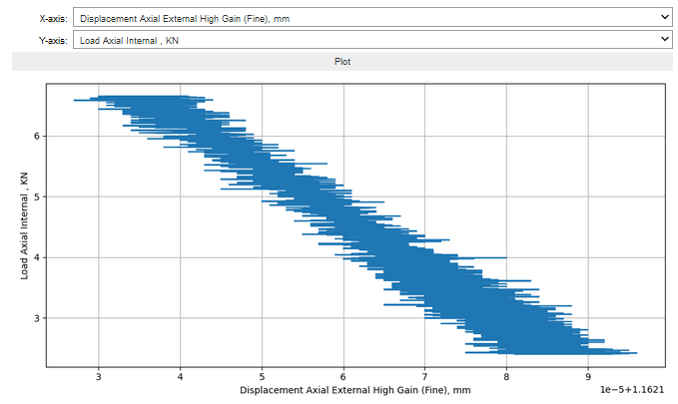
Interactive time series data plotting

