Slide 1
How our coding
assistant works
Language models, CEU AI and FirstRung
Coding 2: Python for Data Analysis
Notes:
Introduction for students who know introductory Python but have not studied language models. The demonstration begins with a request they can recognize, and distinguishes generating code from running it. This is an illustrative worked example, not a transcript of a live model request.

Slide 2
A request and a reply
Your request (the prompt)
Create analysis.py. Load data/raw/hotels_course.csv
and print the number of rows and columns.
An illustrative reply
import pandas as pd
hotels = pd.read_csv("data/raw/hotels_course.csv")
print(hotels.shape)
The reply contains code as text. Python runs that code when you execute the file.
Notes:
Ask students what the three lines would do. This example asks for a root-level Python script, not a notebook, so data/raw/hotels_course.csv is the appropriate relative path when they run it from the course root. The CSV already exists after fetch_data.py. The response on the slide is illustrative; no model was called to produce a transcript. Do not imply that the model has opened the file simply because it can write a plausible read_csv command. Source for read_csv: https://pandas.pydata.org/docs/getting_started/intro_tutorials/02_read_write.html. App behavior: course ceu-ai.py at commit d4e2043041c1b4f7113e15ba0c2dd234e66b8cf6.

Slide 3
Where the reply comes from
A large language model (LLM) generates replies using patterns learned
from many examples of language and code.
Training repeats a prediction exercise on many examples:
1. Predict the next piece of text.
2. Compare the prediction with the example.
3. Adjust numbers inside the model.
The model learns patterns it can use in new requests.
Its learned numbers are called parameters.
Notes:
Describe training as repeated prediction, comparison and numerical adjustment, before naming parameters. Large refers to the scale of the learned model and its training. A neural network is a program composed of connected mathematical operations whose parameters training adjusts. That architecture label is optional here rather than a prerequisite to the explanation. At ordinary use time, the request supplies context to an already-trained model. This slide summarizes next-token pretraining for a generative model; instruction tuning and other later training stages can further shape behavior. Sources: https://huggingface.co/learn/llm-course/en/chapter1/4 and https://huggingface.co/learn/llm-course/en/chapter1/8.

Slide 4
The text comes in pieces called tokens
Software splits text into tokens and converts them to numbers.
A token can be a word, part of a word, or punctuation.
Example sentence
The hotel is expensive.
One possible tokenization
"The" " hotel" " is" " expensive" "."
Each quoted piece is one token. Here, spaces are included
at the start of the following word.
This is an illustration. Different models can split the same text differently.
Notes:
Illustrative tokenization of a complete sentence, not a measured output from the Gemini tokenizer. Quotes mark token boundaries and are not part of the sentence. Leading spaces are shown inside the tokens. Real tokenizers can split words into smaller pieces, and token boundaries differ between models. Tokens are mapped to numeric IDs before the model processes them. Retain the distinction between a token, a word and a character.

Slide 5
Building a reply, one piece at a time
Text so far
import pandas as
One possible next piece
" pd"
Text after adding it
import pandas as pd
The model estimates a probability for each possible next token.
The system selects one, adds it to the text and repeats.
Illustrative sequence. Here the next piece includes a space. Token choices can vary.
Notes:
Before revealing or discussing the second row, ask what students expect after import pandas as. pd is a familiar choice, not the only legal Python alias. This is a schematic code example, not a measured token sequence from a particular model. Actual tokenization may include spaces in the token. In autoregressive generation the model supplies a next-token probability distribution, the generation procedure selects a token, and that token extends the context for subsequent steps. The remote model-serving software handles this generation loop; ceu-ai.py receives the returned reply rather than sampling each token locally. Source: https://huggingface.co/learn/llm-course/en/chapter1/8.

Slide 6
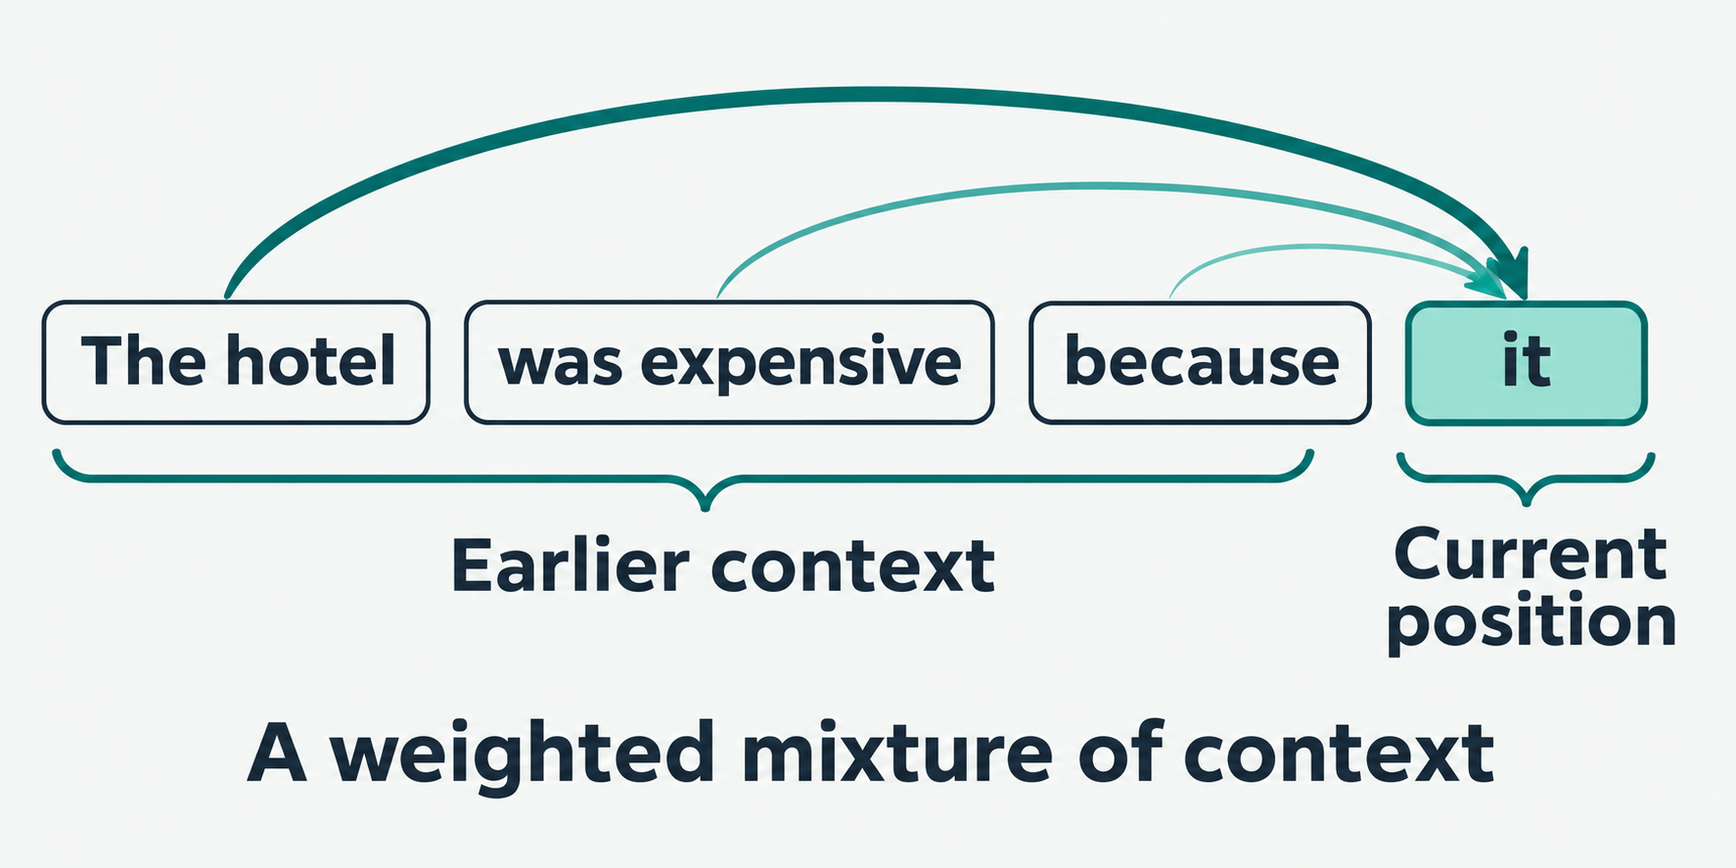
Attention: which earlier words matter?
“The hotel was expensive because it was central.”
What does “it” refer to?
For “it”, the model combines information from earlier text pieces.
Some pieces contribute more than others. This operation is called attention.
The arrows illustrate the idea. They are not measured attention weights.
Notes:
Begin with the pronoun question, which students can answer without knowing any machine learning terms. Then explain the arrows as information from earlier text entering the computation for the current position. The contributions depend on the actual input. In causal self-attention the model computes query/key compatibility scores, turns them into weights, and combines value vectors. Training learns the parameters used for those calculations. Modern generative Transformer models repeat attention, together with other calculations, across multiple heads and layers. Do not describe attention as conscious thought, or the picture as an explanation extracted from a real model. Source: Vaswani et al., sections 3.1–3.3, https://arxiv.org/html/1706.03762v7. Teaching illustration generated with built-in image_gen; original asset and generation prompt are in /Users/uw/.codex/visualizations/2026/08/04/019fcbd7-bd25-7d52-a51d-2de11de14d85/coding2-llm-diagrams/.

Slide 7
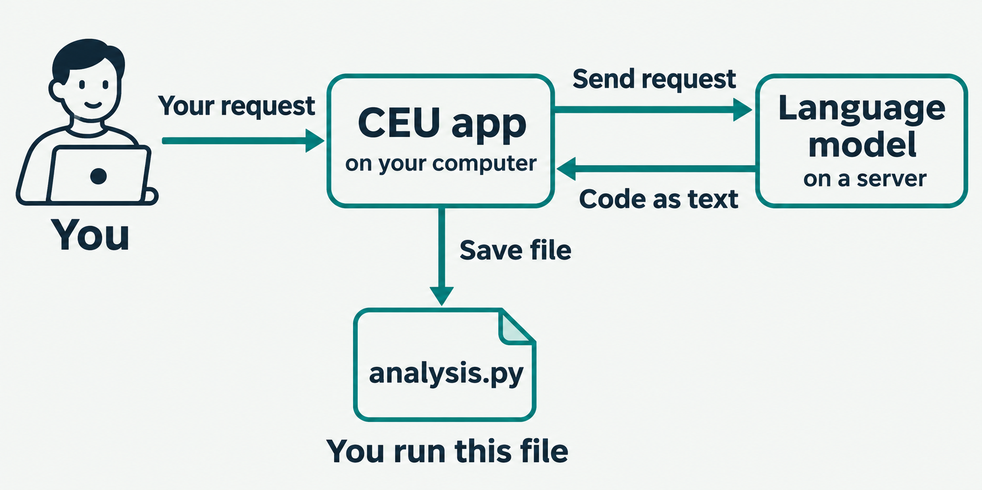
The app around the model
The software that connects the model to the user and handles its inputs
and outputs is called a harness. Our ceu-ai.py app is a small harness.
Notes:
Walk through the same CSV-loading example. Ask: which part actually opens the CSV? Python does, when the student runs the saved script. The remote model can suggest read_csv as text without opening the student’s file. Mentioning a path supplies its name, not its current contents. To base an analysis on actual columns, the request needs column information or an application with appropriate file-reading tools. More capable harnesses can manage tools such as search or code execution; available actions depend on the application. The CEU classroom client never executes generated code. An agent is a system that lets a model choose actions and receive their results repeatedly, a distinction for discussion if students ask. Concrete source: course ceu-ai.py, https://github.com/ulrichwohak/Coding-2-Python-for-Data-Analysis/blob/d4e2043041c1b4f7113e15ba0c2dd234e66b8cf6/ceu-ai.py. Graphic generated with built-in image_gen. Image and full prompt: classroom-harness-v2.png and beginner-revision.json under /Users/uw/.codex/visualizations/2026/08/04/019fcbd7-bd25-7d52-a51d-2de11de14d85/coding2-llm-diagrams/.

Slide 8
The CEU API connects our app to the model
1. Our app sends an HTTPS request to the CEU API.
The service passes the prompt and context to the selected model.
2. The model generates the reply.
The CEU API returns it to our app in an HTTPS response.
HTTP defines rules for requests and responses.
HTTPS encrypts the connection.
The API specifies where to send the request and how to format it.
Our app handles those details for you.
Notes:
Our Python app is the HTTPS client. It sends a POST to the CEU Academic AI /api/v1/llm/chat endpoint with the configured model and messages. The service mediates access to the selected model. The model generates the text; the API returns that text in a structured response. The app reads data.content. CEU API service, model and local app are different roles. Reference: Academic-AI API documentation v2.0, LLM Chat endpoint; course ceu-ai.py, Client.chat. The current course model is gemini-3.1-flash-lite. No claim is made here about the exact infrastructure or internal routing behind the service.

Slide 9
Using our CEU app
From the course folder in the VS Code terminal:
uv run ceu-ai.py
First use: enter the class credentials. The app uses Gemini 3.1 Flash-Lite.
Then type your request, for example:
Create analysis.py. Load data/raw/hotels_course.csv
and print the number of rows and columns.
Open the saved file, inspect the code, then run it and check the result.
Notes:
Use the credentials supplied separately by the instructor. The instructor has fixed the course model to Gemini 3.1 Flash-Lite, following the IT cost estimate supplied on 2 November 2026. Students do not choose a model. The app ignores model choices saved by older versions and stops if the course model is unavailable. Existing text files can be shared with /add path; /new clears conversation context and /quit exits. The app saves proposed files and asks before replacing an existing file. It also creates local backups. Demonstrate this from the repository root so the root-level analysis.py uses data/raw/hotels_course.csv. Notebooks in module folders use ../../data/raw instead. The app protects raw teaching data and credentials from being shared or edited through its file commands. Sources: course README.md and ceu-ai.py, including the local fixed-model revision of 2 November 2026. Model choice: instructor request and supplied CEU IT model list. The prompt and code on these slides are illustrative, not a live model transcript.

Slide 10

FirstRung: help with understanding
FirstRung asks questions about your code and offers support
as you work out the answer.
For the cell from our example:
print(hotels.shape)
An example coaching question:
“What do the two numbers represent?”
Select the cell and choose “FirstRung: Coach me on this cell”.
Open the coaching panel, explain your answer, and ask for a hint if needed.
Notes:
Demonstrate on the same print(hotels.shape) cell so the purpose is concrete. The proposed coaching question is illustrative, not a recorded FirstRung response. The two numbers represent rows and columns in that order. The installed extension supports coaching a notebook cell or an editor selection, asks a question first, and escalates help as needed. Distribute the extension package and course invitation separately if programme membership is used. FirstRung uses its own backend and onboarding; do not imply that it shares CEU credentials or the same selected model. Sources: installed firstrung.firstrung-vscode 0.2.0 package.json, readme.md and extension.js, inspected 2 November 2026. Icon is the unmodified extension asset.

Slide 11
How we use these tools in Coding 2
We first write the analysis together in class.
At the end, each student writes a prompt asking CEU AI
to recreate the analysis in a new file.
You run both versions and compare the data choices,
the code and the results. You explain any differences.
FirstRung focuses on your understanding of the code.
You remain responsible for every result you submit.
Notes:
Keep human-first live coding as the reference analysis. Every student develops an individual reconstruction prompt after building the analysis, then checks what the model omitted, changed or described differently. Code that runs can still answer the wrong question. Debugging homework also permits responsible model assistance, but students execute, test, interpret and explain repairs themselves. FirstRung is introduced as a learning tool without adding a mandatory graded item. The closed-book final exam prohibits AI. Sources: README.md and syllabus at course commit d4e2043041c1b4f7113e15ba0c2dd234e66b8cf6.

Slide 12
What goes to the services
The CEU app sends prompts, conversation, course guidance, the folder tree
and dataset schemas. It also sends files it reads or creates in the chat.
CSV reads send summaries and small previews, not the full dataset.
FirstRung sends the selected work, available output and surrounding
notebook text. In a course programme, it also reports estimates of
time spent working on covered files.
Keep class credentials and personal data out of prompts and shared files.
Notes:
The course app automatically sends harness.md, a filtered folder tree, and schema summaries for the approved course extracts. It may read relevant eligible files on the model’s request, or students can add them explicitly with /add. Shared files refresh from disk, so saved notebook text outputs can be discussed. CSV reads send summaries and up to five preview rows. Credentials, hidden files, environments and private assessment folders are excluded. Use only data permitted to be sent to CEU. FirstRung behaviour follows the existing course-programme disclosure; this publication does not alter it.

