Slide 1


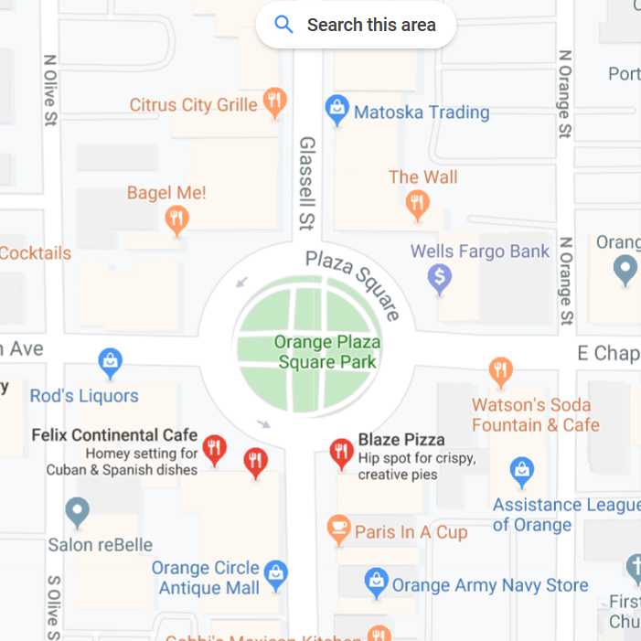
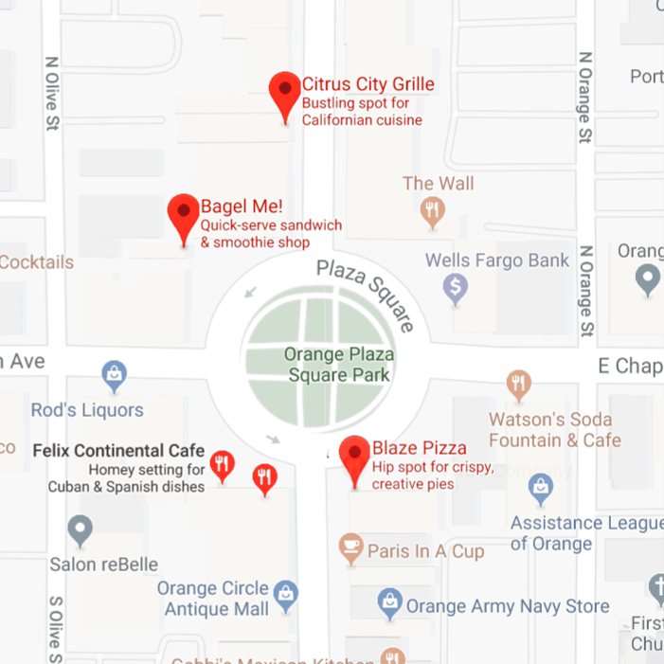
Foodr
David Ulriksen, Gregory Albarian, Alex Vajiac, Michael Fahy
Data Communications/Computer Networks: CPSC 353
When choosing a place to eat, many search the restaurant
and base their decisions on the rating and reviews it receives.
The purpose of Foodr is to do that for you!
It finds the closest restaurants, and picks the best option
according to a Smart Score. Those that are closed
and/or not considered cheap are discarded. The top
three options will be returned as the results, with their
store hours and distance shown.
This Smart score is calculated by considering the following:
Price
Number of Reviews
Rating
Distance
rating*(number of reviews/(price level + 1))
API’s:
Google Places
GeoLocate
References:
Youtube
Stack Overflow
Google’s Github
Not an actual sample image. Just a visual representation

