Slide 1
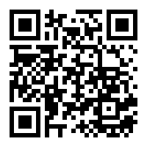

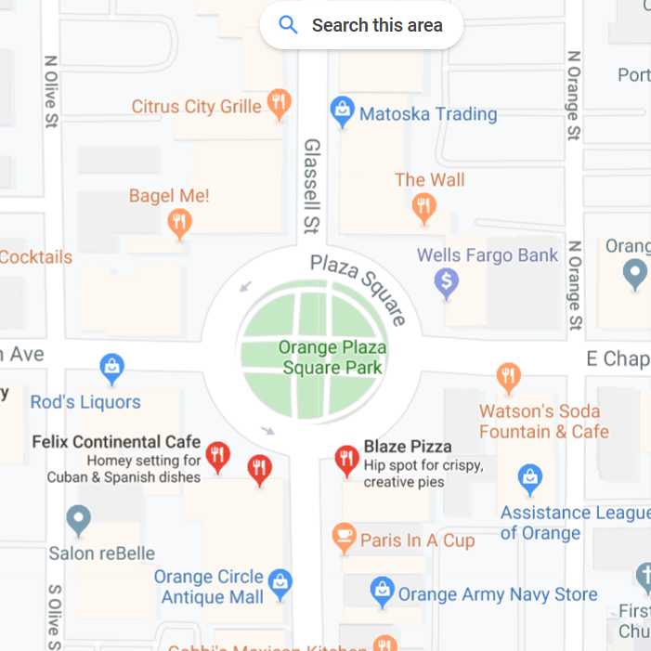
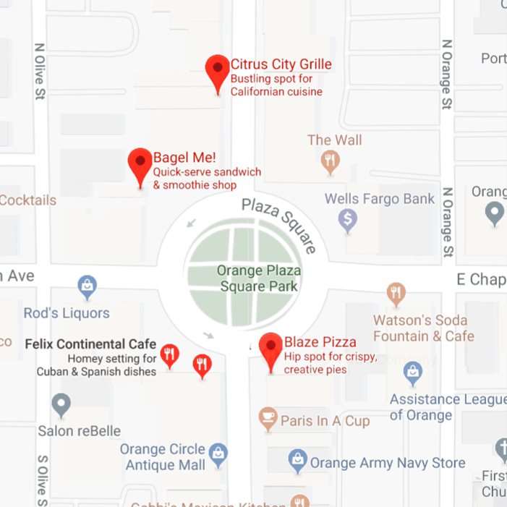
Foodr
When choosing a place to eat, many search the restaurant
and base their decisions on the rating and reviews it receives.
The purpose of Foodr is to do that for you!
It finds the closest restaurants and picks the best option
according to a Smart Score. Those which do not fit within the radius around the user, are expensive, or have low ratings are ranked lower. Only restaurants that are open will be shown.
This Smart score is calculated by considering the following:
Price
Number of Reviews
Rating
Distance
Smart score = (rating*number of reviews)/(price level + 1)
Introduction
Google Maps usually presents restaurants
based on proximity. However, this may be irrelevant because the closest restaurant could be pricey or have low quality food. Instead, more people would want the highest quality food for the best
price.
Authors: David Ulriksen,
Gregory Albarian,
Alex Vajiac
Mentor: Michael Fahy
Class: CPSC 353
Methods
To accomplish this, we used the Google Maps API. This program will get places and their information requested from Google servers based around the user’s current position. We filtered this information to display only restaurants within the radius specified by the user. We are ranking them based on a score we invented. This score is calculated by multiplying the star rating times the number of reviews divided by the price level plus one. We used the formula to rank the restaurants where the higher the number, the better the restaurant. This program helps people find the best food for a proportionally reasonable price. The plus one is there because the price level can be anywhere from zero to four, and we had to ensure there would be no divide by zero issues. Also, when the price level was missing, we set it to five to rank it lower.
API’s:
Google Places
GeoLocate
GitHub repository:
https://github.com/ulrik101/FoodApp
(also accessible by the QR code)
References:
Youtube
Stack Overflow
Google’s Github
https://www.youtube.com/ watch?v=qkSmuquMueA
https://stackoverflow.com/ questions/613183/how-do-i-sort-a- dictionary-by-value
https://stackoverflow.com/questions/ 50704611/next-page-token-google- places
https://developers.google.com/places /web-service/search
Results
Overall, the program worked to all of its
desired specifications. However, one
thing we learned was the Google Maps
API would not give us more than sixty results regardless. We even had some extra time
to add a new feature that helped the
user find free food. However, by
running the program, it was realized
the presence of free food was extremely
rare.
Not an actual sample image. Just a visual representation

