Slide 1


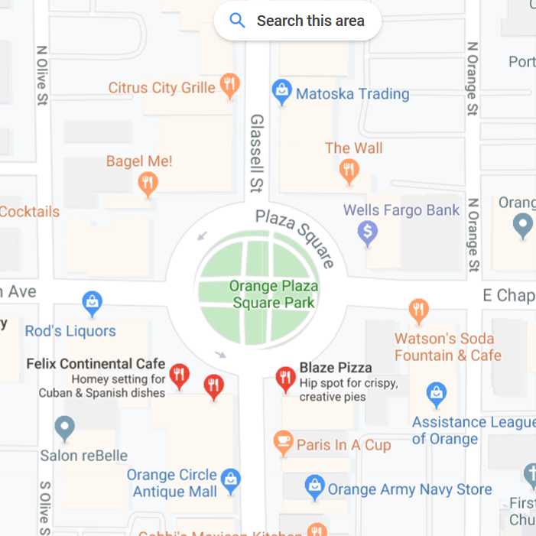
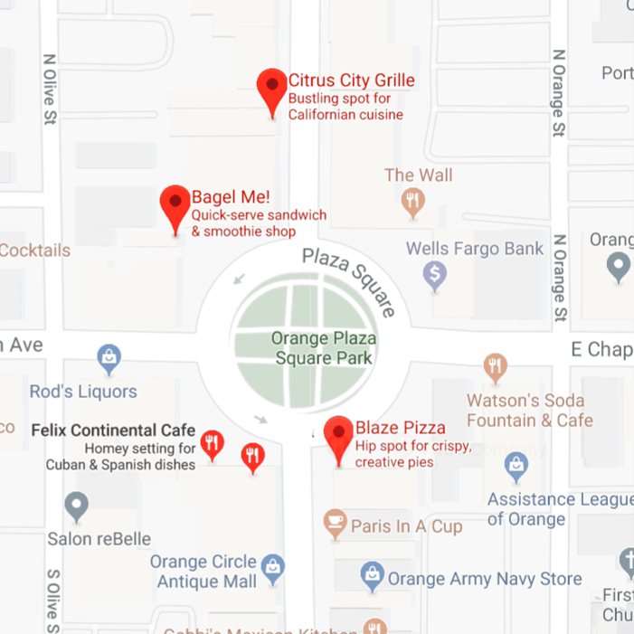
Foodr
When choosing a place to eat, many search the restaurant
and base their decisions on the rating and reviews it receives.
The purpose of Foodr is to do that for you!
It finds the closest restaurants, and picks the best option
according to a Smart Score. Those that are closed
and/or not considered cheap are discarded. The top
three options will be returned as the results, with their
store hours and distance shown.
This Smart score is calculated by considering the following:
Price
Number of Reviews
Rating
Distance
(rating*number of reviews/(price level + 1))
Introduction
Google Maps usually presents restaurants
based on location. However, since many
restaurants may be close this may be
irrelevant. Instead, more people would
want the highest quality food for the best
price.
Authors: David Ulriksen,
Gregory Albarian,
Alex Vajiac
Mentor: Michael Fahy
Class: CPSC 353
Methods
In order to accomplish this we used the
Google Maps API. This will get places
and their information requested from
Google servers based around the user’s
current position. We obviously filtered
this information to display only restaurants
within the radius specified by the user. We
are ranking them based on a score we
invented. This score is calculated by
multiplying the star rating times the
number of reviews divided by the price
level plus one. We used this to rank the
restaurants by the score. This helps people
find the best food for proportionally good
price. The plus one is there because the
price level can be anywhere from zero to
four and we had to ensure there would be
no divide by zero issues.
API’s:
Google Places
GeoLocate
Results
Overall, the program worked to all of its
desired specifications. However, one
thing we learned was the Google Map
API would not give us more than sixty
results. We even had some extra time
to add a new feature that helped the
user find free food. However, by
running the program it was realized
the presence of free food was extremely
rare.
References:
Youtube
Stack Overflow
Google’s Github
https://www.youtube.com/ watch?v=qkSmuquMueA
https://stackoverflow.com/ questions/613183/how-do-i-sort-a- dictionary-by-value
https://stackoverflow.com/questions/ 50704611/next-page-token-google- places
https://developers.google.com/places /web-service/search
Not an actual sample image. Just a visual representation

