Slide 1


Pain Perception Workshop Experiment 1
Subjective Pain Perception

Slide 2
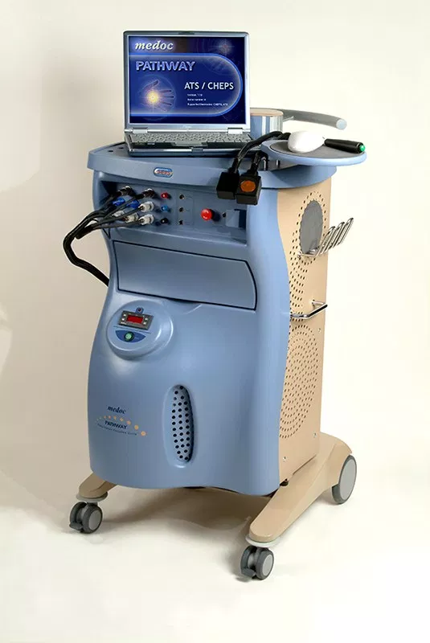
EXPERIMENT: Stimulaiton
Heat pain stimuli
  Heat pain stimuli will be applied with a CE certified thermode
  The stimuli are all in a range where they cannot damage your skin (max. 50°C).

Slide 3
Time for everyone (who has singed the consent form) to try the stimulus

Slide 4


Slide 5
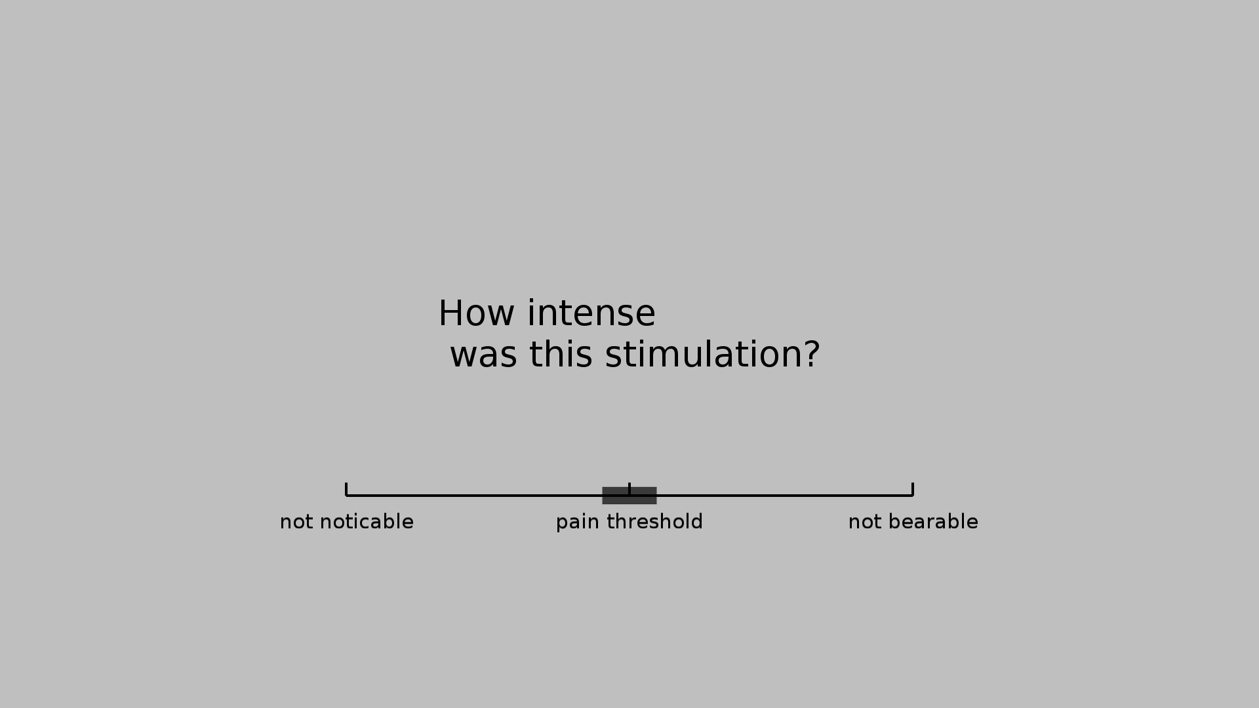
Introduction to rating scale

Slide 6
Calibration of thermode
  9 stimuli with a duration of 22.5 seconds
  Different intensities
  Will be applied to left forearm
  A rating scale will appear after each stimulus
  If the stimulus is too hot – lift the thermode with your right hand. This stimulus should be rated later as unbearable
  The stimuli that will be applied CANNOT induce damage to your skin, but some of them will feel painful
  Note that your rating now will allow us to find the right intensity during the experiment

Slide 7
(Note down temperatures!)

Slide 8

Task
2-back-task
  Button press while letter is still on screen: 15 pts
  Button press directly after letter was shown: 12 pts
  Missed or incorrectly pressed: -5 pts

Slide 9
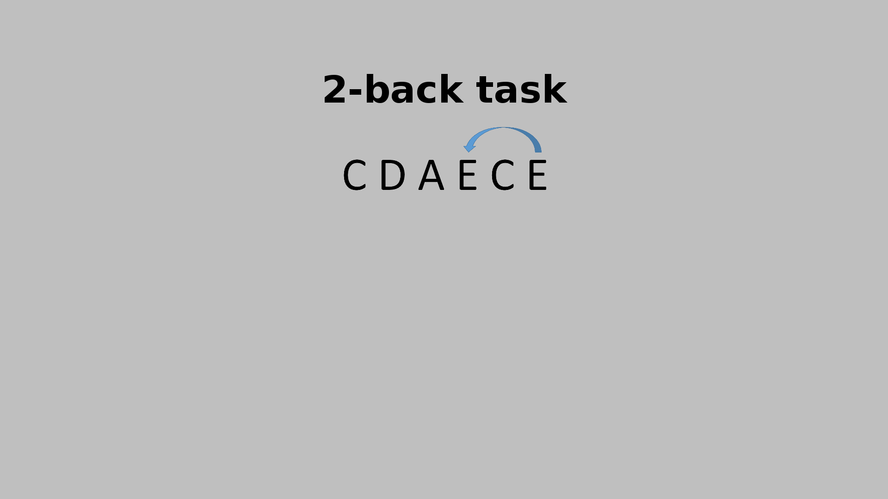
2-back task – start screen

Slide 10

2-back task – screen

Slide 11
Training: 2-back-task

Slide 12
Task
Control task
  Same letters on screen, but no task

Slide 13
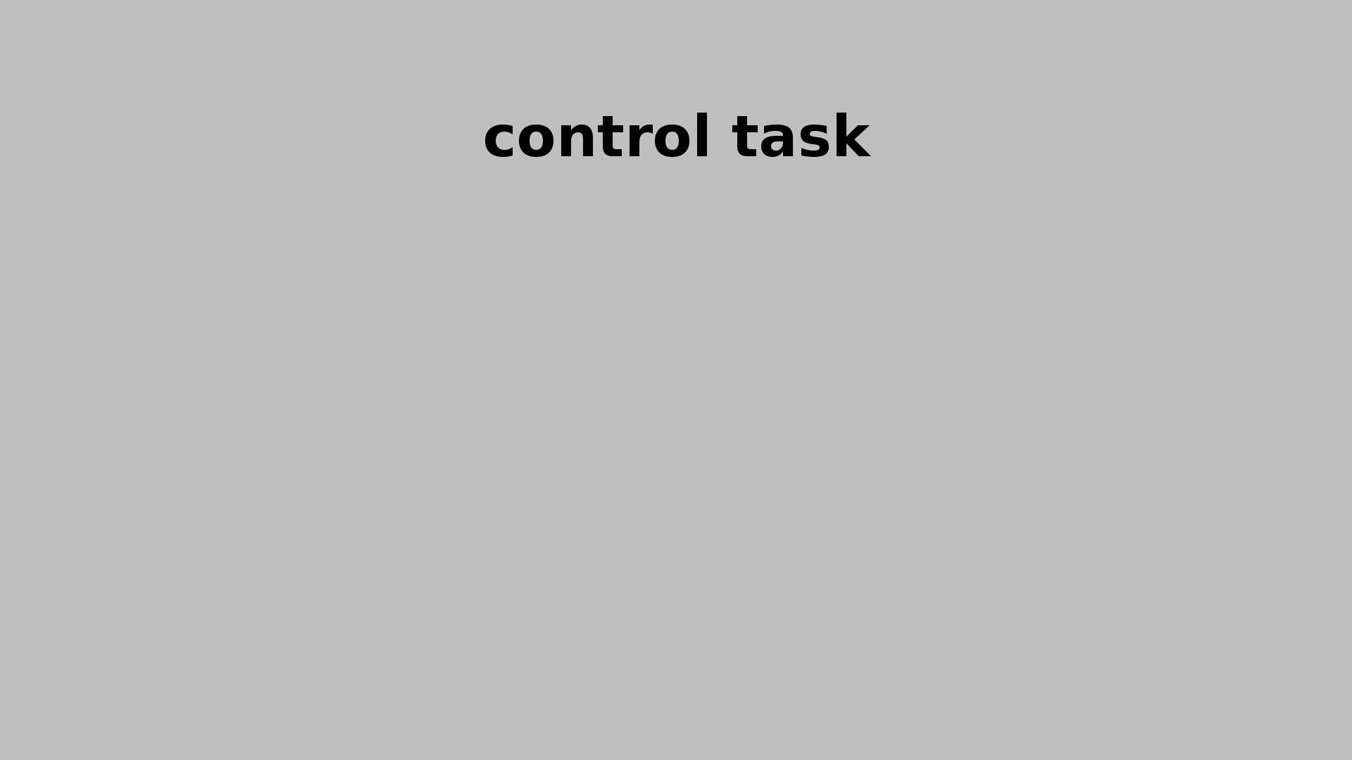
Control task – start screen

Slide 14

Control task – screen

Slide 15
Demo-Experiment
Duration ca 10 minutes

Slide 16
Analysis and background

Slide 17
Attentional modulation of pain
  Working memory load leads to...
    Reduced pain perception
    Pain related modulation on different levels in the central nervous system:
      the cortex
      the brain stem
      the spinal cord
  Directing attention to a painful stimulus increases its unpleasantness

Slide 18
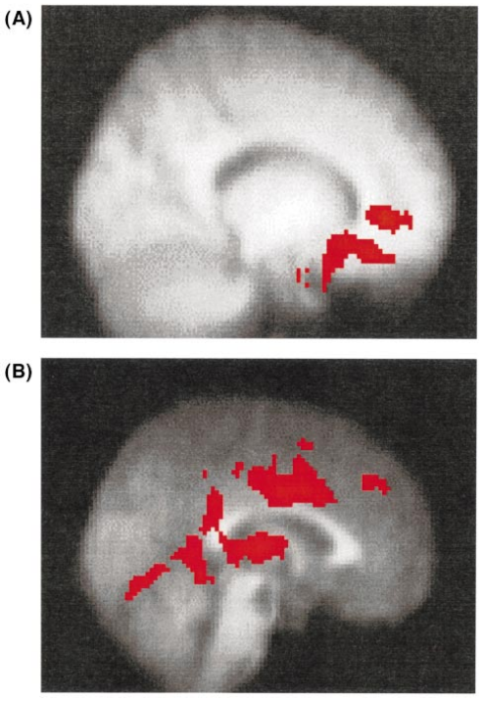
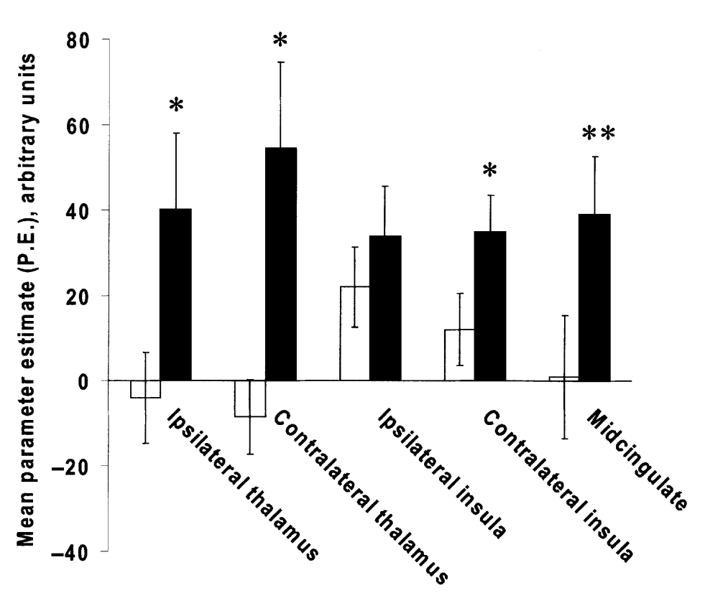
Attentional modulation of pain – CORTEX
Increased cingulate cortex activity:
  Increased activity:
  areas associated with affective devision of ACC and orbitofrontal regions
Reduced cingulate cortex activity:
  Reduced activity:
  pain matrix
(Stroop white,
control black)
[Bantick et al., Brain, 2002]

Slide 19
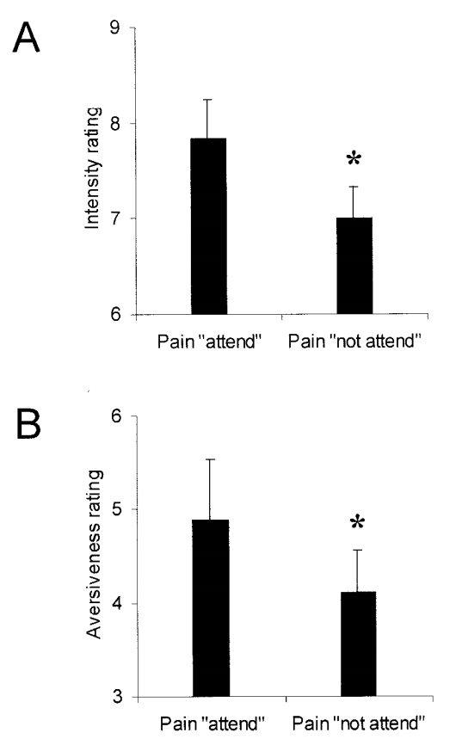
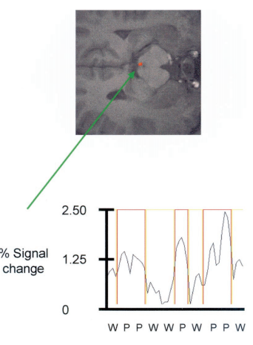
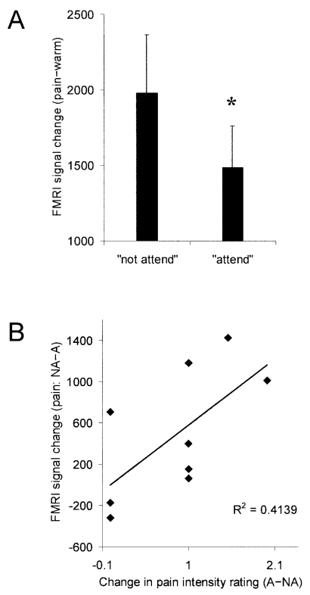
Attentional modulation of pain – BRAIN STEM
  Pain perception scores are higher for attended stimuli
  Increased activity in periaqueductal gray during when distracted during pain stimulation
[Tracey et al. , J Neurosci, 2009]

Slide 20
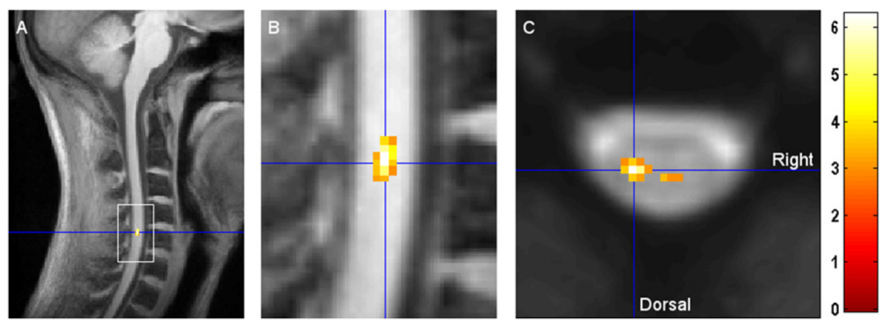
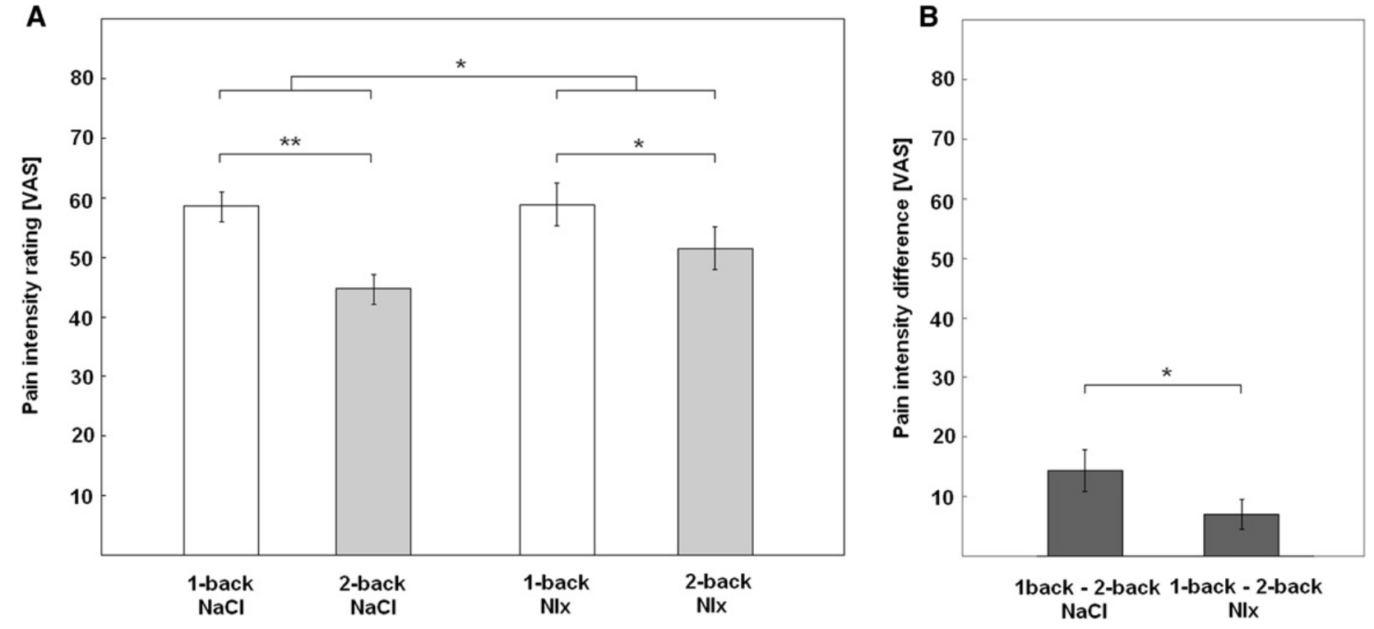
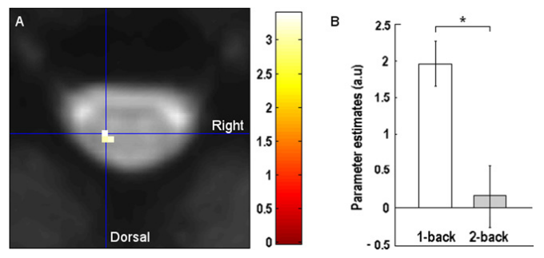
Attentional modulation of pain – SPINAL CORD
  Reduced pain related responses in the spinal cord
  Naloxone (opioid anagonist) reduces this effect
[Sprenger et al., Current Biol, 2012]

Slide 21
Pain-specific modulation of cognition
  Interference of pain with cognitive processes
    Working memory
    Episodic memory
  Acute and chronic pain
    Impaired memory in chronic pain patients

Slide 22
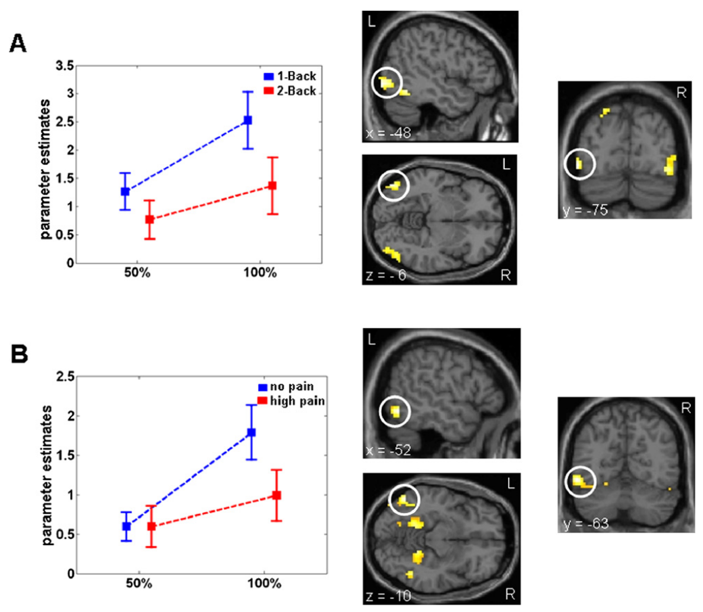
Pain-specific modulation of visual object processing
  Modulation of object representation in the ventral visual stream by working memory and pain
  Connectivity analysis reveals different sources:
    Working Memory: inferior parietal cortex
    Pain: rACC

Slide 23
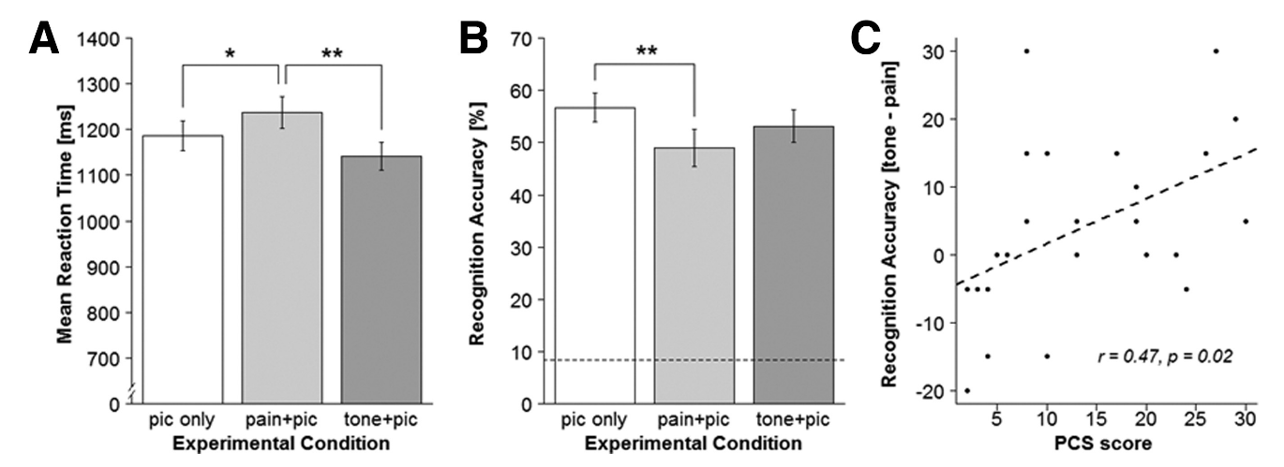
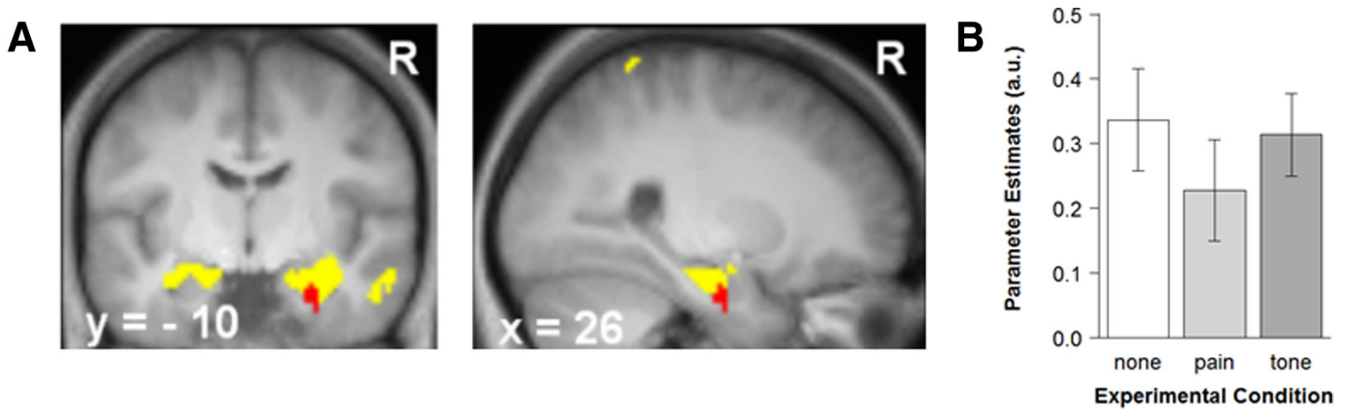
Pain-specific modulation of cognition
A) effect on categorization task
B) effect on recognition task
c) augmented effect in subjects with high pain catostrophizing scores
  Pain specific reduction of neuronal activity in the right anterior hippocampus

Slide 24
Calibration plot
Explain calibration plot

