Slide 2
Build Your First AI Agents
with Microsoft's Agent Academy
Nick Doelman & Ulrikke Akerbæk
European Power Platform Conference 2026 • #EPPC26

Slide 3
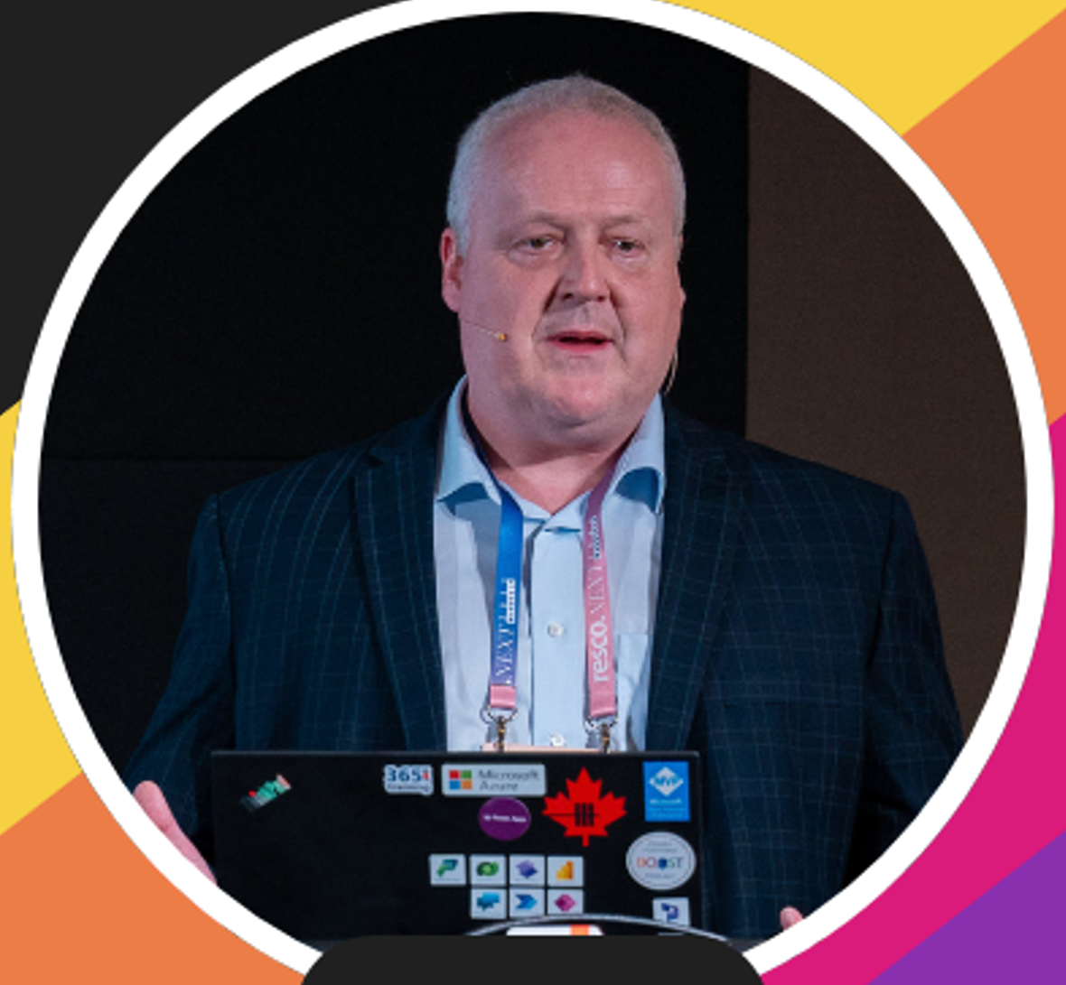
Nick Doelman
Independent Power Platform Architect
Canada
nick@readyxrm.com
@readyxrm
www.nickdoelman.com
Power Platform BOOST Podcast

Slide 4
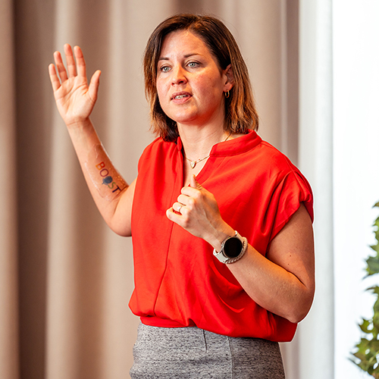
Ulrikke Akerbæk
Power Platform Practice Lead, Itera
Norway
me@ulrikke.rocks
@ulrikkeakerbk
ulrikke.akerbak.com
Power Platform BOOST Podcast

Slide 5
Power Platform BOOST Podcast
Co-hosted by Nick Doelman and Ulrikke Akerbæk
Weekly conversations on Power Platform, Copilot Studio,
AI agents, and everything in between.
Find us wherever you get your podcasts.

Slide 6
Who Are You?
What is your name?
Where are you from?
What is your background?
What do you expect from today?

Slide 7
Housekeeping
Workshop environments are ready — credentials on your handout
Install Microsoft Authenticator if you haven't already
Set up a dedicated browser profile for the workshop tenant
Environments will expire 30 days after the workshop
Lab guide: microsoft.github.io/agent-academy/recruit/

Slide 8
Tips for Labs
Open the lab guide on your phone, tablet, or a second screen
Or use Windows split-screen alongside the browser
Ask your neighbours — collaboration is encouraged!
Raise your hand if you need help — we're here.

Slide 9
Foundations

Slide 10
What Is Agent Academy?
Microsoft's hands-on curriculum for building agents with Copilot Studio
Three tiers of training:
Recruit → Operative → Commander
Today: Recruit — 13 lessons from zero to deployed agent
Course site:
microsoft.github.io/agent-academy

Slide 11

Meet BIT!
BIT is the Agent Academy mascot.
He guides us through the missions and lessons today.
Recruit → Operative → Commander
Your goal today:
Complete all missions and claim your Recruit badge!

Slide 12
What Are Agents?
LLMs — the AI engine behind conversational agents
Reason over language, generate contextual responses
RAG — grounding responses in your organisation's data
Retrieval-Augmented Generation: retrieve then generate
Orchestration — coordinating knowledge, skills, and actions
Decides which tool to call, when, and how
Agents combine all three to understand, reason, and act.

Slide 13
Declarative vs. Autonomous Agents
Declarative Agents
You write the rules.
The agent follows your prompts
and instructions precisely.
Predictable and controlled.
Great for specific, repeatable tasks.
Built in Module 03 today.
Autonomous Agents
The agent decides how to act.
Uses AI reasoning to choose actions,
respond to events, and adapt.
More powerful, less predictable.
Best for proactive, event-driven work.
Introduced in Module 10 today.

Slide 14
Copilot Studio: The Four Building Blocks
Knowledge
What your agent knows.
SharePoint, Dataverse, websites, files.
Tools
What your agent can do.
Connectors, Agent Flows, APIs.
Instructions
How your agent behaves.
Persona, tone, rules, and focus.
Triggers
When your agent acts.
Conversation-started or event-driven.
All visible on the Overview page.

Slide 15
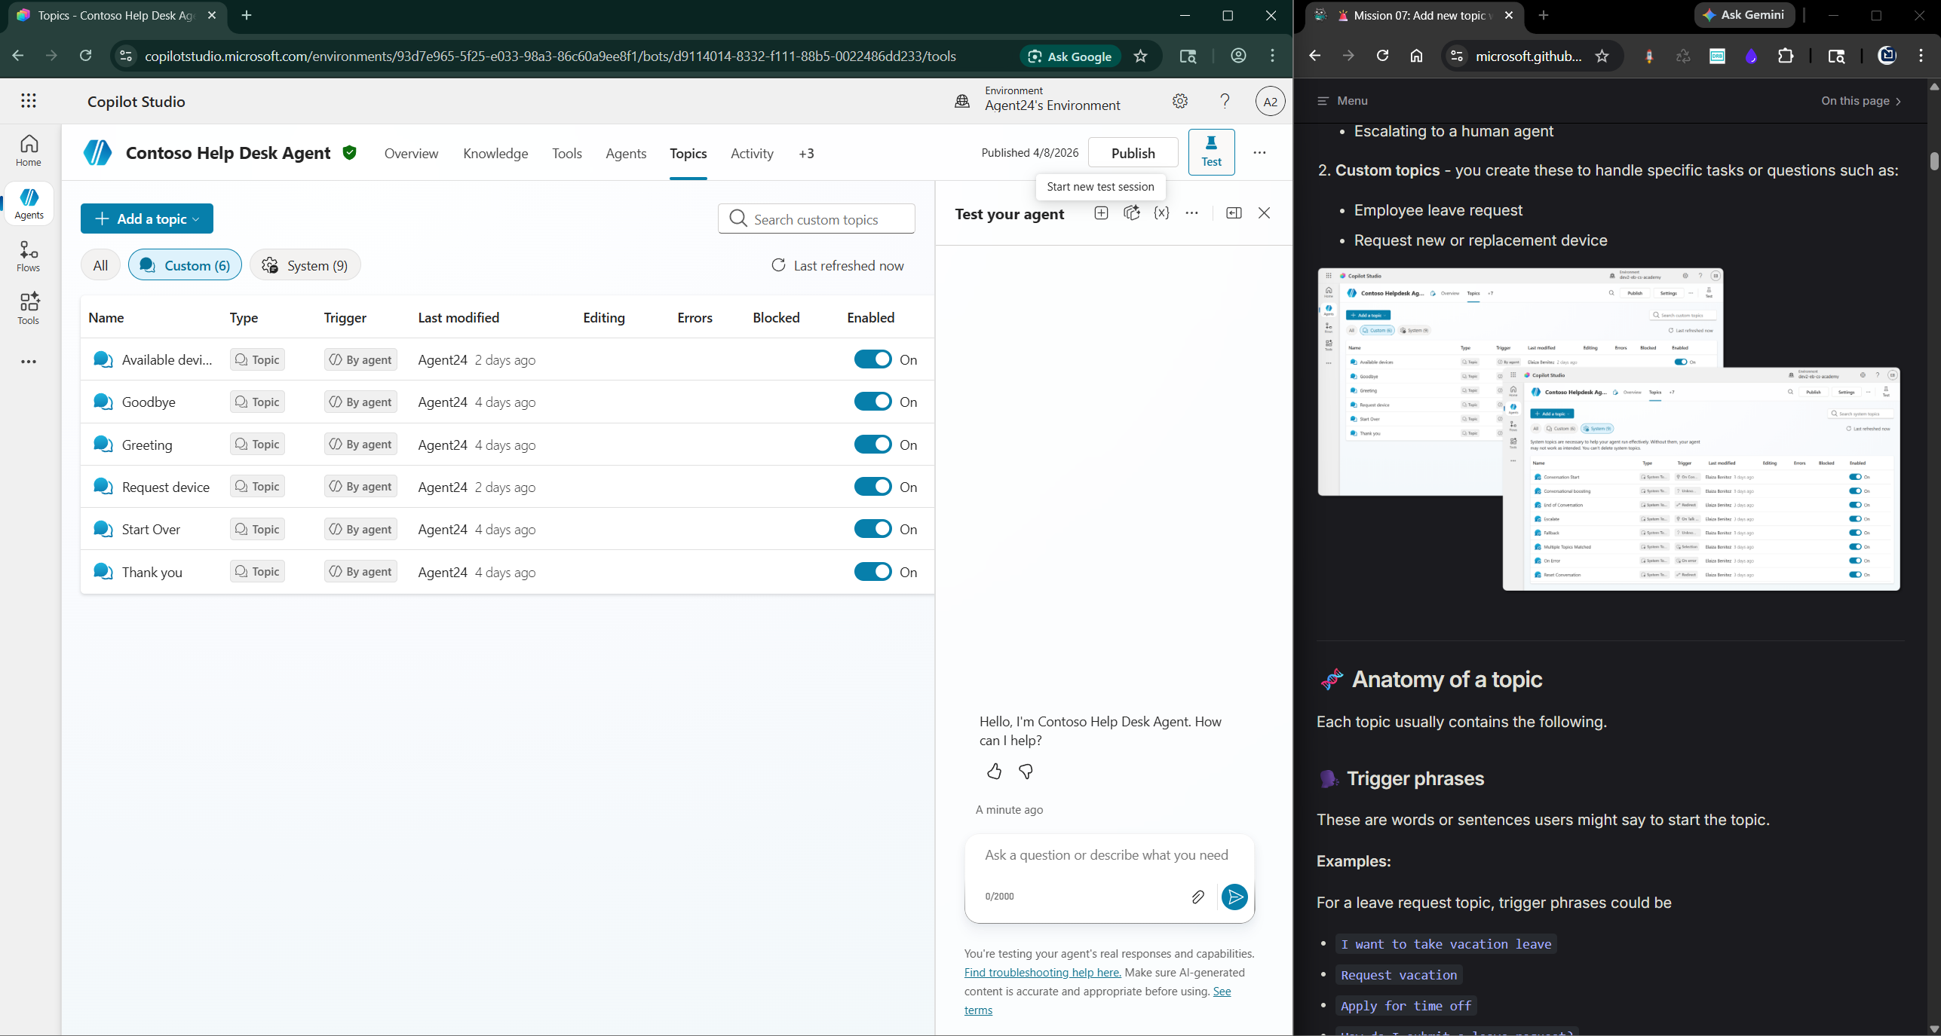
The Copilot Studio Overview Page ★ New
Every agent lands on the Overview page — your main workspace.
What you'll find (scroll down):
Instructions — system prompt, up to 8,000 chars
Triggers — event-based activation
Knowledge — SharePoint, files, websites
Tools — connectors, Agent Flows, APIs
Topics — conversational entry points
Channels is under the +8 overflow tab — not on the canvas!
Test pane always visible on the right.

Slide 16
Agenda
09:00 Intro and foundations
10:00 Mission #1 — Your first agent
10:45 Mission #2 — Build (Declarative, Solutions, Custom)
12:00 Lunch
13:00 Mission #3 — Enhance (Topics, Cards, Flows)
14:30 Mission #4 — Deploy (Triggers, Publishing)
15:30 Mission Complete (Licensing, badge, wrap-up)
16:00 All done!

Slide 17
Mission Briefing
Mission #1: Your First Agent
Lesson 05: Using a Pre-Built Agent
Mission #2: Build
Lesson 03: Declarative Agents
Lesson 04: Creating a Solution
Lesson 06: Custom Agent from Conversation
Mission #3: Enhance
Lesson 07: Add Topics With Triggers
Lesson 08: Add Adaptive Cards
Lesson 09: Add an Agent Flow
Mission #4: Deploy
Lesson 10: Add Event Triggers
Lesson 11: Publish Your Agent
Mission Complete
Lesson 12: Understanding Licensing
Lesson 13: Claim Your Recruit Badge
Plan your first real agent
Free Play Challenge
Between missions — build your own variation!

Slide 18
FRAGO (Fragmentary Order)
FRAGO communicates only what has changed:
new tasks, updated objectives, shifted conditions
In this workshop, a FRAGO slide means:
the UI changed after the lab guide was written, OR
there is a known glitch — here's the fix
FRAGO overrides the lab guide for that step.

Slide 19
Mission #1:
Your First Agent

Slide 20
Lesson 05: Using a Pre-Built Agent
Use a prebuilt template to get your first agent running.
Browse the template gallery in Copilot Studio
Pick a template, customise it, and test it
Your first win of the day!

Slide 21
Lesson 05: Step by Step
1. Open Copilot Studio
Navigate to your environment → Create
2. Browse Templates
Explore the prebuilt gallery → pick one
3. Customise
Adjust the agent name, greeting, instructions
4. Orchestration Setting
Agent Settings → ensure Generative AI is ON
(Yes — Responses will be dynamic...)
5. Test
Open the test pane
Have a conversation with your agent
🕐 ~30 minutes

Slide 22
FRAGO: Generative AI Orchestration
In Agent Settings → Orchestration, ensure this is selected:
● Yes — Responses will be dynamic, using available
tools and knowledge as appropriate.
If set to "No — Use classic orchestration" your agent
will not use knowledge sources effectively.
Switch it to Yes and Save.

Slide 23
FRAGO: Force Newest Version Dialog
When publishing you may see a "Force newest version" checkbox.
This is a new feature (ignore it for this lab).
Click Publish without checking the box.

Slide 24
FRAGO: Open Teams in the Browser
If asked to open the Teams desktop app:
→ Click "Use the web app instead"
If Teams desktop opens, simply close it.
We use the Teams web app for all publishing steps.

Slide 25
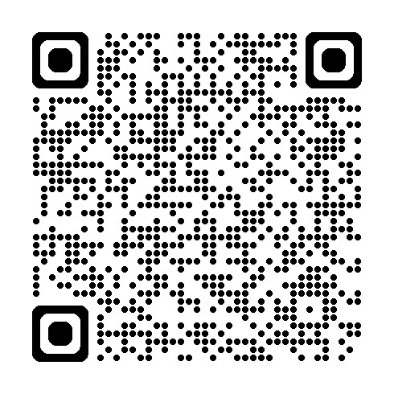
Let's Go! — Mission 05: Using a Pre-Built Agent
CODENAME:
OPERATION SAFE TRAVELS
TIME:
~30 min • Difficulty: ★☆☆
PRODUCTS:
Microsoft Copilot Studio • Microsoft 365 • Microsoft Teams
TAGS:
Prebuilt Agents
Scan the QR code or visit:
microsoft.github.io/agent-academy/recruit/mission-05

Slide 26
Mission Debrief #1
Mission Debrief #1
Q1: What are the four building blocks in Copilot Studio?
Q2: Declarative vs. autonomous — key difference?
Q3: What did you customise in your prebuilt agent?
Pair up:
Share what you built with the person next to you.
Take turns demoing — 2 minutes each.

Slide 27
Mission #2: Build
Creating & Packaging Agents

Slide 28
Lesson 03: Create a Declarative Agent
Build an agent grounded in a system prompt.
You write the instructions — the agent's personality and purpose
Connect it to Microsoft 365 Copilot
Key skill: prompt engineering for agents

Slide 29
Lesson 03: Step by Step
1. Create a new agent
Start from blank → name your agent
2. Write the system prompt
Define purpose, tone, and boundaries
3. Add to M365 Copilot
Configure the declarative agent channel
4. Test in Copilot
Verify the agent responds correctly
within M365 Copilot
Good prompting principles:
Be specific about scope and tone
Define what the agent should NOT do
Set the knowledge grounding rules
🕐 ~60 minutes

Slide 30
FRAGO: Publish to Teams — Modal Failure
If publishing to Teams shows an error modal:
→ Close the modal using the X (top-right corner)
→ Wait 1–2 minutes for Teams to catch up
→ Publish again from Copilot Studio
Teams propagation takes a few minutes. Be patient!

Slide 31
FRAGO: Developer Mode Delay
If your declarative agent doesn't appear in M365 Copilot:
→ Wait 2–3 minutes and refresh
→ Publish the agent again from Copilot Studio
→ Try in a fresh browser tab or incognito window
Known delay in tenant propagation. Not a failure!

Slide 32
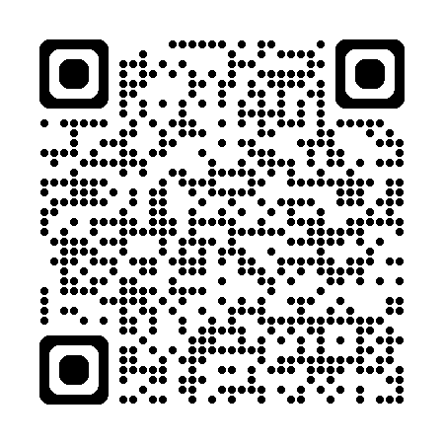
Let's Go! — Mission 03: Deploy a Declarative Agent
CODENAME:
OPERATION COPILOT EXTENSION
TIME:
~60 min • Difficulty: ★☆☆
PRODUCTS:
Microsoft Copilot Studio • Microsoft 365 • Teams
TAGS:
Declarative Agents
Scan the QR code or visit:
microsoft.github.io/agent-academy/recruit/mission-03

Slide 33
Lesson 04: Creating a Solution
Solutions package your agent for reuse and deployment.
Move agents between environments (dev → test → production)
Manage dependencies and version control
Think of it as the shipping container for your agent.

Slide 34
Lesson 04: Step by Step
1. Create a new solution
Power Apps maker portal → Solutions → New
2. Add your agent
Add → Existing → Bot → your agent
Include all dependencies
3. Set as preferred solution
Settings → Advanced → Preferred solution
4. Review components
Agent, topics, connections, flows
Everything that travels together
5. Export (optional)
Managed or unmanaged ZIP
Managed = no customisation in target env
🕐 ~45 minutes

Slide 35
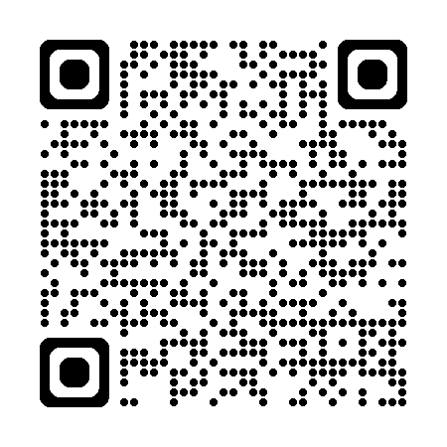
Let's Go! — Mission 04: Creating a Solution
CODENAME:
OPERATION CTRL-ALT-PACKAGE
TIME:
~45 min • Difficulty: ★☆☆
PRODUCTS:
Microsoft Copilot Studio • Microsoft Power Platform
TAGS:
Solutions • ALM
Scan the QR code or visit:
microsoft.github.io/agent-academy/recruit/mission-04

Slide 36
Lesson 06: Create Agent from Conversation
Build an agent grounded in knowledge sources.
Connect SharePoint, files, or websites as knowledge
The agent uses RAG to retrieve and generate answers
This is where agents get smart.

Slide 37
FRAGO: Set the AI Model to GPT-4.1
During agent creation, verify the AI model is GPT-4.1:
Overview page → Details → "Select your agent's model"
Choose GPT-4.1 from the dropdown
GPT-4o was retired in October 2025.
GPT-4.1 is the current default — verify it is selected.

Slide 38
Lesson 06: Step by Step
1. Home → describe your agent
Type what you want it to do in natural language
AI provisions name, instructions, knowledge
2. Review AI suggestions
Accept or dismiss each suggestion
Suggestions are session-only — don't dismiss accidentally
3. Add knowledge sources
Knowledge → + Add knowledge → SharePoint
Enter your SharePoint site URL
4. Test with real questions
Ask something only in your SharePoint data
Check sources cited in the response
🕐 ~75 minutes

Slide 39
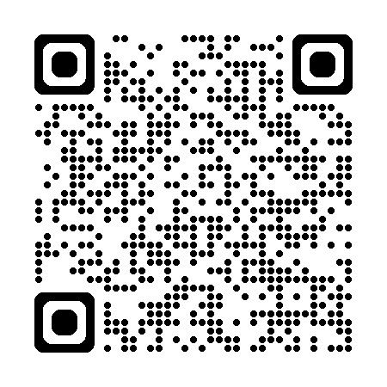
Let's Go! — Mission 06: Create a Custom Agent
CODENAME:
OPERATION AGENT FORGE
TIME:
~75 min • Difficulty: ★☆☆
PRODUCTS:
Microsoft Copilot Studio • SharePoint • Microsoft Learn
TAGS:
Declarative Agents • Knowledge Grounding
Scan the QR code or visit:
microsoft.github.io/agent-academy/recruit/mission-06

Slide 40
Mission Debrief #2
Mission Debrief #2
Q1: What is the role of a system prompt in a declarative agent?
Q2: Why package an agent into a solution?
Q3: How does knowledge grounding change agent answers?
Share your IT Help Desk agent:
Ask it something only answerable
from the SharePoint knowledge source.
Did it cite a source? Did it get it right?

Slide 41
Mission #3: Enhance
Topics, Cards & Flows

Slide 42
Lesson 07: Add Topics With Triggers
Topics let you control exactly how the agent responds.
Define custom question-and-answer paths
Triggers detect when a user asks about a subject
When AI alone isn't enough — Topics give you precision.

Slide 43
Lesson 07: Step by Step
1. Topics tab → + Add a topic → From blank
2. Name it and add trigger phrases
Phrases the user might say to start this topic
3. Build the conversation flow
Message nodes, Question nodes, Conditions
Add branching logic by user response
4. Add Power Fx filter (Adaptive Card lab)
Concatenate("Status eq 'Available'
and AssetType eq '", Topic.VarDeviceType, "'")
5. Test your topic
Trigger the topic from the test pane
Walk through the full conversation path
🕐 ~60 minutes

Slide 44
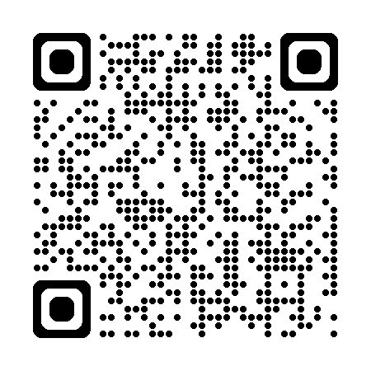
Let's Go! — Mission 07: Add a Topic with Triggers
CODENAME:
OPERATION STAY ON TOPIC
TIME:
~60 min • Difficulty: ★☆☆
PRODUCTS:
Microsoft Copilot Studio • SharePoint
TAGS:
Topics & Dialogs • Triggers • Power Fx
Scan the QR code or visit:
microsoft.github.io/agent-academy/recruit/mission-07

Slide 45
Lesson 08: Add Adaptive Cards
Adaptive Cards give your agent a rich, interactive UI.
Display forms, buttons, and data inside the chat
Use Power Fx to bind card data to SharePoint lists
Collect structured input — not just free text
This is where your agent starts looking professional.

Slide 46
Lesson 08: Step by Step
1. Design the Adaptive Card
Use Adaptive Card Designer or build in Copilot Studio
2. Bind to SharePoint data
Power Fx to pull list items into the card
3. Add card to your topic
Insert as a Message node in your conversation flow
4. Handle user input
Capture what the user submits via the card
Store in topic variables for downstream use
Timing note:
This lab typically takes 60–90 min.
Allocate buffer time — new to JSON? Longer.
🕐 ~45 min (allow up to 90)

Slide 47
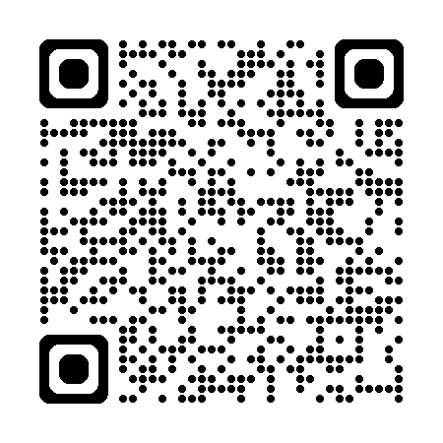
Let's Go! — Mission 08: Enhance with Adaptive Cards
CODENAME:
OPERATION INTERFACE UPLIFT
TIME:
~45–90 min • Difficulty: ★☆☆
PRODUCTS:
Microsoft Copilot Studio • SharePoint
TAGS:
Adaptive Cards • Power Fx
Scan the QR code or visit:
microsoft.github.io/agent-academy/recruit/mission-08

Slide 48
Lesson 09: Add an Agent Flow
Agent Flows connect your agent to back-end automation.
Trigger Power Automate directly from a conversation
Pass Adaptive Card input to a flow for processing
Your agent can now do things — not just talk.

Slide 49
What's New: Agent Flows vs. Workflows
Agent Flows ✅ GA — use these today
Power Automate-style canvas
Available in all environments
Tightly integrated with topic nodes
Billed within Copilot Studio
Left sidebar → Flows → New Agent flow
Workflows 🔬 Preview — early release only
New redesigned visual canvas
Agent nodes + Prompt nodes
Node-level testing
Early-release environments only
If you see it: explore after the lab!

Slide 50
Lesson 09: Step by Step
1. In the topic: + → Add a tool → New Agent flow
Agent Flows designer opens
2. Add a Send Email action
Use the Office 365 Outlook connector
Configure recipients, subject, body
3. Publish the flow
Save, publish, return to Copilot Studio
4. Connect flow to topic
Add a tool → select your published flow
Map Adaptive Card variables to flow inputs
5. Test end-to-end
Chat → Card → Submit → Flow → Email
The full loop!
🕐 ~30 minutes

Slide 51
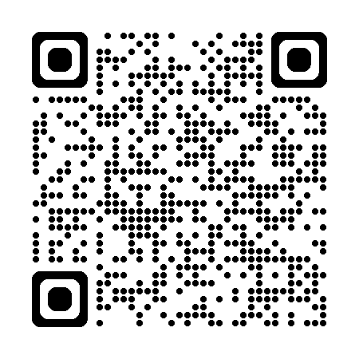
Let's Go! — Mission 09: Add an Agent Flow
CODENAME:
OPERATION AUTOMATION POWERHOUSE
TIME:
~30 min • Difficulty: ★☆☆
PRODUCTS:
Copilot Studio • Power Automate • Outlook • SharePoint
TAGS:
Automation • Agent Flows
Scan the QR code or visit:
microsoft.github.io/agent-academy/recruit/mission-09

Slide 52
Mission Debrief #3
Mission Debrief #3
Q1: What is a Topic trigger, and when would you use one?
Q2: How do Adaptive Cards improve the user experience?
Q3: What connects a card submission to a back-end action?
Demo your end-to-end flow:
Chat → Card → Submit → Email sent.
2 minutes each — show your neighbour!

Slide 53
Mission #4: Deploy
Events, Publishing & Going Rogue

Slide 54
Lesson 10: Add Event Triggers
Event triggers make your agent act on its own.
Respond to things that happen — not just questions
A new SharePoint item, a schedule, an external event
The agent doesn't wait to be asked — it acts.

Slide 55
FRAGO: Author / Created By Column
When testing the trigger, the flow may fail:
"Author Display Name" is not available in the SharePoint list view.
Fix: Add "Created By" to the All Items list view.
Open the Tickets list → All Items view → Edit columns
→ Add "Created By" → Save
Then re-test your trigger.

Slide 56
Lesson 10: Step by Step
1. Overview page → Triggers → + Add trigger
Search for "SharePoint"
Select "When an item is created"
2. Configure the trigger
SharePoint site URL + list name
3. Build the autonomous action
Send an email via Outlook connector
4. Test the trigger
Add a new item to SharePoint list
Wait for email notification to arrive
"Test Trigger" icon on the trigger card
Important:
Generative AI must be ON (Settings → Orchestration)
Cloud flow is created automatically behind scenes
🕐 ~45 minutes

Slide 57
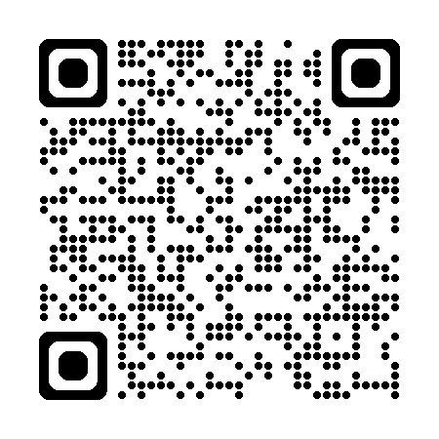
Let's Go! — Mission 10: Add Event Triggers
CODENAME:
OPERATION GHOST ROUTINE
TIME:
~45 min • Difficulty: ★☆☆
PRODUCTS:
Copilot Studio • Power Automate • Outlook • SharePoint
TAGS:
Automation • Triggers • Autonomous Agents
Scan the QR code or visit:
microsoft.github.io/agent-academy/recruit/mission-10

Slide 58
Lesson 11: Publish Your Agent
Ship it. Deploy to where your users are.
Publish to Microsoft Teams — available in the Teams app store
Publish to M365 Copilot — integrated into the Copilot experience
Your agent goes from prototype to production.

Slide 59
FRAGO: Finding the Channels Tab
Channels is NOT on the Overview page canvas.
To reach Channels:
1. Open your agent → Overview page
2. Click +8 in the top tab bar
(next to the "Overview" tab)
3. Select Channels from the dropdown
The lab says "Select Channel in the top navigation" — correct.
The +8 overflow is where it lives in the new UI.

Slide 60
FRAGO: 'This App Cannot Be Found'
When publishing to Teams you may see:
"This app cannot be found."
→ Click Close
→ Wait 2–3 minutes (Teams propagation delay)
→ Return to Copilot Studio and publish again
Trial environment: Publish requires the Copilot Studio Authors role.
If Publish is greyed out, ask your facilitator.

Slide 61
Lesson 11: Step by Step
1. Publish the agent
Overview page → Publish button → Confirm
2. Deploy to Microsoft Teams
Overview → +8 → Channels
→ Microsoft Teams → Add to Teams
3. Deploy to M365 Copilot
Channels → M365 and Teams → publish
4. Open Teams web app
Find your agent → test it live
Admin approval:
In production, org admins approve agents
In your sandbox env, you have admin rights
Free Play Challenge!
Once published: adapt your agent for
a real scenario from your organisation.
🕐 ~30 minutes

Slide 62
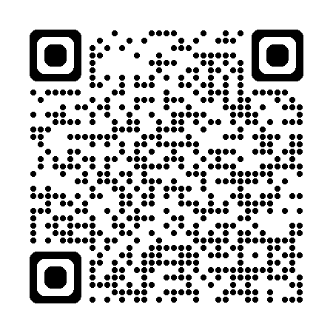
Let's Go! — Mission 11: Publish Your Agent
CODENAME:
OPERATION PUBLISH PUBLISH PUBLISH
TIME:
~30 min • Difficulty: ★☆☆
PRODUCTS:
Microsoft Copilot Studio • Microsoft 365 • Teams
TAGS:
Publishing • Channels • Deployment
Scan the QR code or visit:
microsoft.github.io/agent-academy/recruit/mission-11

Slide 63
Mission Debrief #4
Mission Debrief #4
Q1: Event triggers vs. waiting for user input — when do you use each?
Q2: What are the two main publishing channels?
Q3: What is the "trick" to finding the Channels tab in the new UI?
Who deployed to Teams?
Show us your live agent
in the Teams web app.
Free Play results — share your twist!

Slide 64
Mission Complete
What's Next

Slide 65
Lesson 12: Understanding Licensing
Copilot Credits (June 2026)
Replaced "messages" in September 2025
Pay-as-you-go:
$0.01 per credit
Capacity pack:
$200/month for 25,000 credits
M365 Copilot licensed users:
No credits consumed on internal channels (fair use)
AI Models (June 2026):
Default: GPT-4.1
(GPT-4o retired Oct 2025)
New options: GPT-5, Claude Sonnet 4.5/4.6, Mistral 3.5
Premium AI tools = higher credit rate
Trial (30 days, extendable):
Full capabilities except publishing
Publishing needs Copilot Studio Authors role
June 2026: Teams classic chatbot app retired.
Create and manage agents via Copilot Studio web.

Slide 66
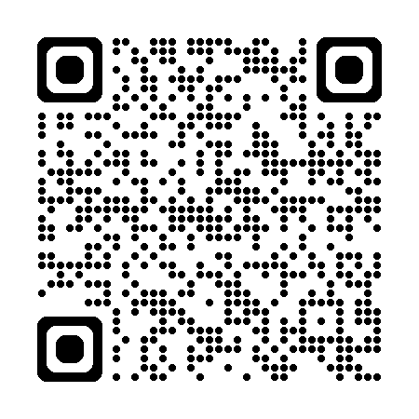
Let's Go! — Mission 12: Understanding Licensing
CODENAME:
OPERATION KNOW WHAT YOU OWE
TIME:
~15 min • Difficulty: ★☆☆
PRODUCTS:
Microsoft Copilot Studio • Microsoft 365
TAGS:
Licensing • Copilot Credits
Scan the QR code or visit:
microsoft.github.io/agent-academy/recruit/mission-12

Slide 67
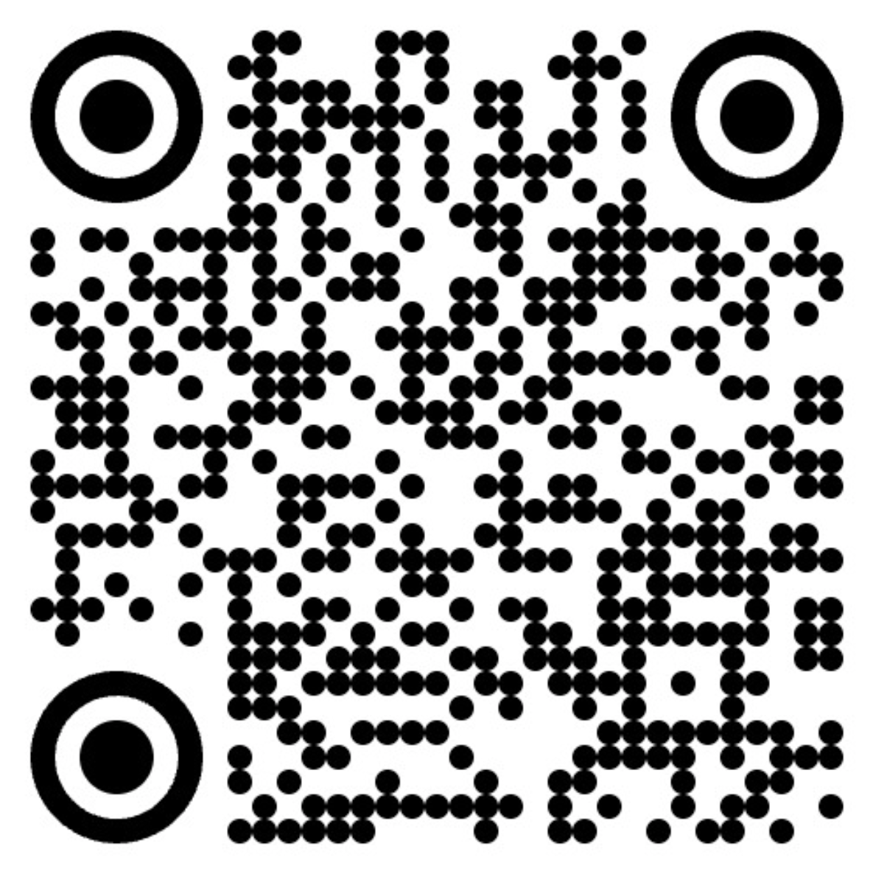
Claim Your Recruit Badge!
You made it through all missions!
Scan the QR code or visit:
aka.ms/agentacademy-live/graduate
What's next?
Operative: deeper patterns and advanced scenarios
Commander: enterprise-scale architecture (coming soon)
Special Ops: YAML, MCP, CLI, and beyond

Slide 68
Let's Go! — Mission 13: Secure Your Recruit Badge
CODENAME:
OPERATION COURSE COMPLETION
TIME:
~5 min • Difficulty: ★☆☆
PRODUCTS:
Microsoft Copilot Studio
TAGS:
Course Completion • Badge
Scan the QR code or visit:
aka.ms/agentacademy-live/graduate

Slide 69
Plan Your First Real Agent
5 minutes. Think about next week.
What will you build first when you're back at your desk?
Who is it for?
Which pieces from today will you use?
Write it down. Share with the room if you're brave.

Slide 70
Keep Building
Agent Academy
microsoft.github.io/agent-academy
Copilot Studio Docs
learn.microsoft.com/copilot-studio
What's New
.../whats-new (check monthly!)
Trial Signup
aka.ms/TryCopilotStudio
Usage Estimator
aka.ms/copilotstudioestimator
M365 Developer Tenant (free)
developer.microsoft.com/microsoft-365
BOOST Podcast
Weekly Power Platform community insights
with Nick and Ulrikke
Power Platform Community
community.powerplatform.com

Slide 71
Don't be an expert.
Play, experiment, explore.
— Nick & Ulrikke, Power Platform BOOST Podcast

Slide 72
What's Next in Agent Academy?
Recruit ✅ You are here
13 lessons, zero to deployed agent
Operative → Next level
Deeper agent patterns
Advanced knowledge & multi-agent
microsoft.github.io/agent-academy/operative
Commander (coming soon)
Enterprise architecture, governance, ALM
Special Ops — Bonus missions
YAML Specialist
Microsoft Learn MCP Server
Copilot Studio + MCP
Power Platform CLI MCP Server
Agent Academy on YouTube
Copilot Studio Agent Academy playlist
youtube.com/@mspowerplatform
BOOST Podcast
Travelling Circus — wherever we go, we build!

Slide 73
Q&A
Questions?
Nick Doelman
nick@readyxrm.com • @readyxrm
Ulrikke Akerbæk
me@ulrikke.rocks • @ulrikkeakerbk
#EPPC26 • #AgentAcademy • #PowerPlatform

Slide 74
Thank You!
Thank you for building with us today.
Please rate this session in the EPPC app.
Your feedback makes the next workshop better.
#EPPC26 • #AgentAcademy • #PowerPlatform

