Slide 1
🌿 DISASTER MITIGATION
🤖 ROBOTICS
🌱 ENVIRONMENT
RAPIDLY REPLACEABLE
MODULAR BAMBOO
FLOOD BARRIER
An Eco-Friendly Parallel Bandalling System with Arduino-Based Telemetry
Grade 10 • Bislig City National High School
Valenzuela · Taperla · Cuanan · Nable · Lim · Embodo
🎍 🎋 🎍 🎋 🎍

Slide 2




INTRODUCTION & THE PROBLEM
SLIDE 01
Climate Vulnerability
High-Cost Fixes
The Philippines faces ~20 typhoons annually, causing severe river overflows & catastrophic flash floods.
Reinforced concrete dikes require massive capital and cannot adapt to localized failures.
Maintenance Deficit
Data Isolation
Traditional solid river barriers are difficult and expensive to repair after high-velocity debris damage.
Vulnerable zones lack real-time telemetry to instantly warn riverside families when water breaches thresholds.
🎍 Bambusa blumeana (Kawayan Tinik) offers a nature-positive, low-cost alternative.

Slide 3

PROPOSED SOLUTION
& RESEARCH QUESTION
SLIDE 02
Modular Hydrodynamic Barrier
Rapidly repairable parallel bandalling structure of mature Bambusa blumeana (Kawayan Tinik) — designed for quick part-replacement without full teardown.
Electronic Telemetry Unit
Arduino Uno + solar-ready framework linked to an HC-SR04 ultrasonic sensor for continuous, real-time water level logging.
Remote Alert Interface
GSM SIM800L module broadcasts localized emergency SMS notifications directly to community households when an active surge is detected.
Research Question: Can a rapidly replaceable, variable-spaced Bambusa blumeana bandalling system establish a low-velocity wake zone to reduce riverbank erosion while maintaining >90% real-time water level warning accuracy?

Slide 4
METHODOLOGY — BARRIER MECHANICAL DESIGN
SLIDE 03
Longitudinal Parallel Groyne Placement
01
Barriers are positioned offshore, parallel to the riverbank slope at acute angles of 45°–60° — not as a blunt wall but as a deflecting structure.
Deflecting the Thalweg
02
The strategic angle trains the river's thalweg (fastest, deepest current path) away from the fragile soil of the bank line, reducing erosive energy.
Rapid Replaceability Framework
03
Bambusa blumeana stalks are anchored via a variable-spaced modular guide rail. Individual damaged stalks can be unbolted and replaced without compromising the entire structure.

Slide 5
METHODOLOGY
Computational Modeling Argument
SLIDE 04
Discretization Concept (CFD)
Large Eddy Simulation (LES)
A river is a continuous chaotic system. CFD breaks water into tracking 'cells' (meshing). Our framework tracks individual particle fields to map velocity gradient changes.
Instead of DNS (requires supercomputers), we use p5.js macro-behavior simulation mimicking an LES model — tracking primary kinetic energy paths to observe velocity drops through the barrier.
Domain Boundary Conditions
INFLOW
NO-SLIP
OUTFLOW
Steady high-velocity current (heavy flood stage) entering the zone
Rough bark surface of Bambusa blumeana where water loses momentum on contact
Downstream zone where water behaves under reduced pressure constraints

Slide 6
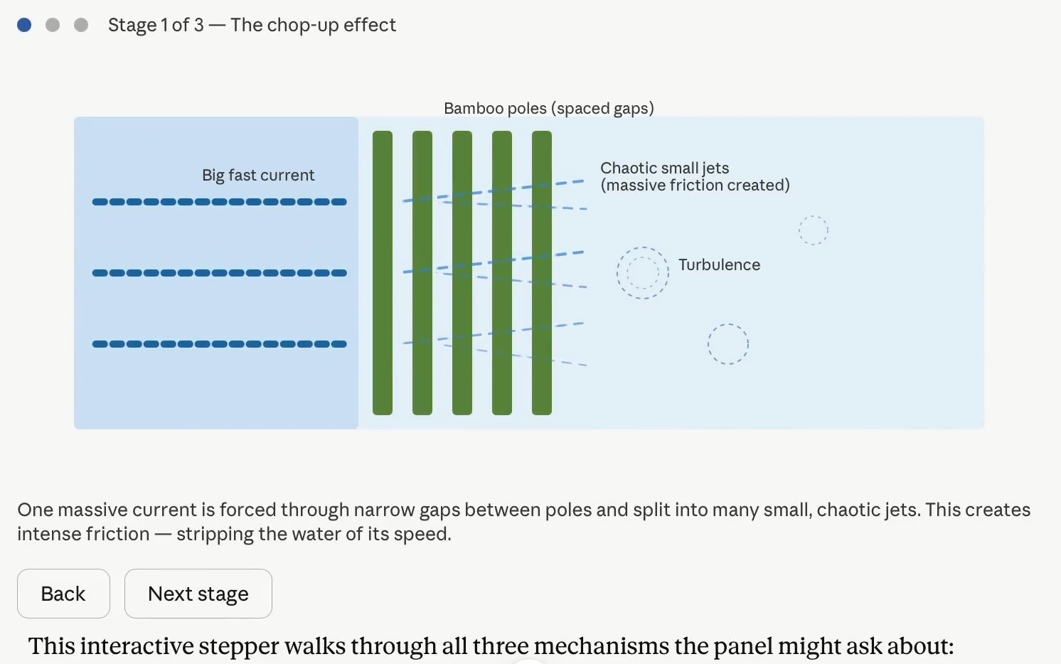
METHODOLOGY
Flow Velocity Visualization
SLIDE 04b
Interactive simulation showing the chop-up effect, thalweg deflection, and wake zone formation through the bamboo barrier

Slide 7



METHODOLOGY — DATA COLLECTION & PROTOCOLS
SLIDE 05
Velocity Attenuation Profiles
Quantifying Sediment Accretion
Mechanical current meter deployed at 3 depths: surface, mid-column, and riverbed floor — capturing comprehensive bamboo disruption data across the entire water column.
Erosion Pins (calibrated in mm) driven along the riverbank behind the barrier matrix — tracking soil loss vs. natural silt deposition in the calm wake zone.
Replaceability & Deployment Logs
Sensor Validation Protocols
Manpower and exact time recorded to swap a damaged pole section — proving low-maintenance advantage over concrete alternatives.
Digital water level logs cross-checked against manual ruler readings every 30 minutes during active testing — targeting >90% validation accuracy.

Slide 8
EXPECTED RESULTS
Structural Capabilities & Anticipated Outputs
SLIDE 06
~20 MPa
~95 MPa
>90%
Compressive
Strength
Tensile
Strength
Sensor
Accuracy
Excellent resistance vs. hydrostatic flood pressures
Comparable to structural timber; withstands debris impacts
Electronic validation vs. manual physical benchmarks
Anticipated Operational Outputs
🌊
🌱
🔧
Friction Effect Proven
Active Sediment Accretion
Low-Cost Upkeep
Measurable velocity reduction converts aggressive erosive currents into a protective 'Wake Zone' near the bank.
Velocity drop causes suspended silt to precipitate, naturally rebuilding and stabilizing the riverbank toe.
Structural breaches fixable by a small team in minutes with hand tools — no heavy machinery or concrete required.

Slide 9

DISCUSSION & THEORETICAL SIGNIFICANCE
SLIDE 07
STRUCTURE
Salzer et al. (2018)
HYDRO
Ali (2024)
Confirms Bambusa blumeana possesses excellent engineering properties rivaling conventional wood and timber in structural strength and resilience.
Validates Bamboo Bandalling Techniques — permeable stalk configurations successfully reduce local fluid velocities, shift the thalweg, and initiate natural soil accretion.
TELEMETRY
Magnaye et al. (2024)
POLICY
DENR (2020)
Demonstrates ultrasonic sensor frameworks regularly achieve over 90% accuracy in volatile open-water environments — confirming our electronic design is highly viable.
The Department of Environment and Natural Resources explicitly supports Kawayan Tinik in native bio-engineering programs for riverbank stabilization.

Slide 10

CONCLUSION
A Nature-Positive Blueprint for Community Resilience
SLIDE 08
Eco-Friendly Strength
Bambusa blumeana provides an incredibly strong, low-cost, and carbon-sequestering alternative to carbon-heavy concrete infrastructure — with compressive strength of ~20 MPa and tensile strength of ~95 MPa.
Practical Modular Advantage
By shifting focus from 'portability' to 'rapid modular replaceability,' the project directly answers real-world community issues — enabling localized defenses to be permanently established and effortlessly maintained by rural residents.
Scalable Community Defense
The system can be quickly constructed, maintained, and repaired by local communities — offering an affordable, nature-aligned blueprint for climate resilience across riverside villages in the Philippines.
🎍 Bislig City National High School · Grade 9 · Disaster Mitigation Research 🎍

