Slide 1
FREE PUBLIC TOOL / OCTOBER 2026
The Agentic AI Career Playbook
A free playbook for anyone who can communicate. No signup, nothing to buy, and it runs in the browser.
Arup Banerjee · October 2026
Unlearn, relearn, stay relevant.
Personal project built on my own time. Not affiliated with or endorsed by my employer; views are my own.
Notes:
The core skill for working with AI agents is communication plus ownership, not coding.
The playbook is free forever, with no signup and nothing to buy. Module 1 needs nothing installed; the only prerequisite is an AI chat assistant the learner already uses, or a friend for the paper version.
Not accredited, not a vendor certification, and no job guarantees.
Source: /workspace/presentations/architecture/career-playbook-architecture.md (verified against commit 4dd4953).

Slide 2
WHO IT'S FOR
Delegation is the skill, and many people already have it
01
02
03
Back to work
Outside software
Developers
People returning to work, including homemakers, and career changers. Running a home already means briefing and checking work.
Nurses, teachers, and shop owners already hand off tasks, say what done looks like, and check the result.
Including 30-year Java veterans. Their unlearning: hands off the keyboard, and drop the "I'll just do it myself" reflex.
Personal project built on my own time. Not affiliated with or endorsed by my employer; views are my own.
02 / 09
Notes:
Who it is for, as listed on the landing page: people returning to work (including homemakers), career changers, professionals outside software, and developers (including 30-year Java veterans).
The nurse, teacher, and shop-owner examples are fictional illustrations, not real people or testimonials.
Mission: unlearn the "I'll just do it myself" reflex, write a clear brief, stay the accountable owner, and leave with proof you can show.
Source: /workspace/presentations/architecture/career-playbook-architecture.md (verified against commit 4dd4953).

Slide 3
THE METHOD
Brief it, check it, own it
01 BRIEF IT
02 CHECK IT
03 OWN IT
The five-line Brief Card
BEFORE THE WORK
“Tell me what you think is wrong and what you plan to change.”
Explain-It-Back
In two sentences, without looking: what was wrong, what changed, and how you know it's fixed.
1
Intent
what you want
2
Context
what the agent needs to know
agent does the work
3
Constraints
what it must not do
Done when
how you'll check that it worked
AFTER THE WORK
“List every change you made, and why.”
Ownership Log
One line per delegation: date, what I asked for, what changed and why, how I checked, would I undo it?
4
5
Examples
what good looks like
Delegate the typing, not the responsibility.
Personal project built on my own time. Not affiliated with or endorsed by my employer; views are my own.
03 / 09
Notes:
The method taught in Module 1 (Hands Off the Keyboard, 60–90 min): the five-line Brief Card (Intent, Context, Constraints, Done when, Examples), two checkpoints, the Explain-It-Back test, and the Ownership Log.
Ownership Log rows hold: date, asked for, what changed and why, how checked, would undo.
Diagram (native shapes, built from the Infographic A spec in career-playbook-nlm-source.md): the Brief Card's five lines, the before and after checkpoints, then the Explain-It-Back test and the Ownership Log.
Source: /workspace/presentations/architecture/career-playbook-architecture.md (verified against commit 4dd4953).

Slide 4
MODULE 1: HANDS OFF THE KEYBOARD
Module 1 in one journey
01
Pick a bug card one of four fictional cards: spreadsheet, flyer, web page, or Java.
02
Delegate with zero hands get an AI assistant to fix it without typing in the card yourself.
03
Check it two checkpoints, then explain the fix back in two sentences.
04
Score yourself Hands count, Owner Score out of 10, and a rank: Golden Hands to Old Habits.
05
Leave with proof a Brief Card and an Ownership Log, saved in your browser to copy or download.
Personal project built on my own time. Not affiliated with or endorsed by my employer; views are my own.
04 / 09
Notes:
Module 1, Hands Off the Keyboard: 60–90 minutes, available now.
Bug cards: A spreadsheet (garden.csv), B flyer (flyer.txt), C web page (signup.html), D Java (TuneUp.java). All fictional.
Round 1: fix the bug through an AI assistant without typing in the card. Then the key ideas, the two-brief comparison, and Stay the owner: two checkpoints, Explain-It-Back, Ownership Log.
Rematch: Hands = lines typed by hand. Owner Score out of 10 from 8 checkboxes. Rank: 0 Hands = Golden Hands, 1–3 = Twitchy Fingers, 4+ = Old Habits; "Eyes Closed" if the result was not checked.
Artifact: Brief Card and Ownership Log saved in the browser; copy as text, download a template, then Clear my data.
NotebookLM Infographic B was planned for this slide; the storyboard uses numbered steps instead to keep layout variety.
Source: /workspace/presentations/architecture/career-playbook-architecture.md (verified against commit 4dd4953).

Slide 5
SEE THE TOOL
Clear communication changes outcomes
20/100
66/100
5 lines
Vague brief for a fictional bike-shop bot: "Not safe for customer traffic"
The same bot with a five-line brief
Intent, Context, Constraints, Done when, Examples
Scores from the free Agent Health Checker, a heuristic check. Author's run on Oct 1, 2026.
Personal project built on my own time. Not affiliated with or endorsed by my employer; views are my own.
05 / 09
Notes:
Same fictional bike-shop bot, two briefs, scored in the free Agent Health Checker: vague brief 20/100, "Not safe for customer traffic"; five-line brief 66/100. Author's run on October 1, 2026, as reported on the Module 1 page.
The Health Checker is a heuristic check, not a guarantee of agent quality.
The five lines are the Brief Card fields: Intent, Context, Constraints, Done when, Examples.
Source: /workspace/presentations/architecture/career-playbook-architecture.md (verified against commit 4dd4953).

Slide 6
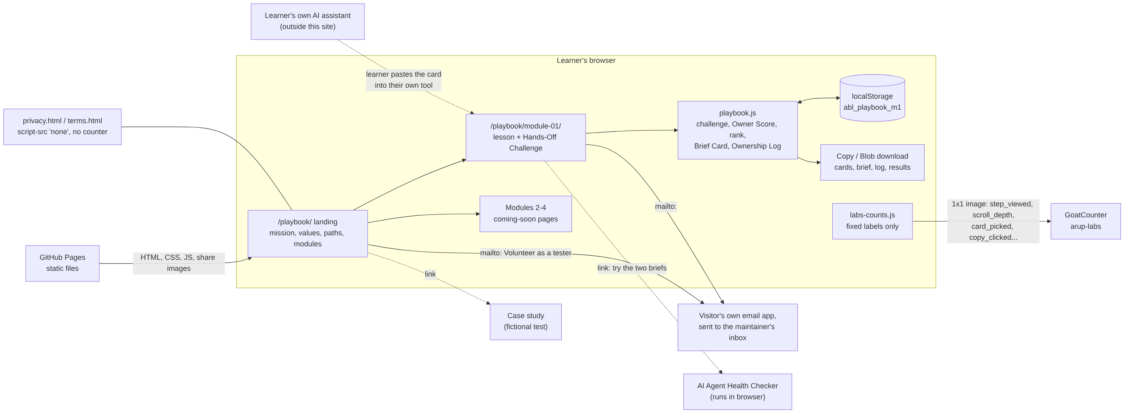
HOW IT'S BUILT
Static pages, one script, the learner's browser
GitHub Pages serves HTML, CSS, and playbook.js
localStorage holds progress (abl_playbook_m1)
mailto: is the whole volunteer signup
Personal project built on my own time. Not affiliated with or endorsed by my employer; views are my own.
06 / 09
Notes:
Static HTML and CSS plus one vanilla JS file, playbook.js. No framework, no build, no dependencies, no backend. Hosted on GitHub Pages.
All state is client-side in one localStorage key, abl_playbook_m1: challenge rounds, Brief Card fields, Ownership Log rows. connect-src 'none' blocks script network calls.
labs-counts.js sends only fixed labels (step_viewed, scroll_depth, card_picked, copy_clicked) to GoatCounter, on the live host, skipped for DNT/GPC.
Volunteering is a mailto: link opened in the visitor's own email app; the site has no form.
Diagram: career-playbook-architecture.png from the architecture doc, unchanged.
Source: /workspace/presentations/architecture/career-playbook-architecture.md (verified against commit 4dd4953).

Slide 7
PRIVACY BY DESIGN
We never see the learner's work
01
02
03
Stays on device
Labels only
No-script pages
Typed work, scores, and logs live in one localStorage key. "Clear my data" erases it.
Anonymous counts use fixed labels only. Never sent: typed words, score, rank, names, or email.
The Terms and Privacy pages load no scripts (script-src 'none') and are not counted.
Personal project built on my own time. Not affiliated with or endorsed by my employer; views are my own.
07 / 09
Notes:
Challenge entries, Hands count, rank, Owner Score, Brief Card, and Ownership Log never leave the browser: localStorage key abl_playbook_m1. Clear my data erases it.
GoatCounter receives page views, section reached, scroll bucket, and fixed button labels, on the live host only, skipped when DNT or GPC is on. Never sent: typed words, score, rank, names, email, title, referrer, or query string.
Terms and Privacy: script-src 'none', no counter. IP address and user agent reach GitHub Pages and GoatCounter as with any web request (disclosed on the Privacy page).
Text a learner pastes into their own AI assistant leaves the browser, outside this site; the lesson warns against real names, health details, account numbers, or passwords.
NotebookLM Infographic C was planned here; the storyboard uses three cards to keep layout variety.
Source: /workspace/presentations/architecture/career-playbook-architecture.md (verified against commit 4dd4953).

Slide 8
SCALE, LIMITS, AND OPERATIONS
Module 1 scales for free; three limits remain
Progress is per device: no sync, and a private window or cleared browser data loses it.
Volunteer intake is one inbox, with every tester email handled by hand.
Volunteer and navigation clicks may be undercounted in Chromium browsers.
CAPACITY
About 850,000 Module 1 loads a month fit under GitHub Pages' 100 GB soft cap, with no per-user compute or storage cost.
Personal project built on my own time. Not affiliated with or endorsed by my employer; views are my own.
08 / 09
Notes:
GitHub Pages: soft bandwidth limit of 100 GB per month. Module 1 weighs about 117 KB uncompressed (HTML 60 KB + playbook.js 23 KB + CSS + counter), so about 850,000 uncached loads per month. The landing page (about 55 KB) is about 1.8 million.
No per-user compute or storage cost, because state lives in each browser.
Limits: progress is per device (disclosed); volunteer signup is mailto only and lands in one personal inbox; volunteer_clicked and nav_clicked use sendBeacon, which the pages' connect-src 'none' blocks, so Chromium may undercount them. Copy, card, round, step, and scroll counts are fine.
Also: the help bot does not know the playbook yet.
Source: /workspace/presentations/architecture/career-playbook-architecture.md (verified against commit 4dd4953).

Slide 9
ROADMAP (TARGETS) AND THE ASK
Next: three steps on the roadmap, and testers to help
Milestone | Target | What it adds
Modules 2–4 | Oct 17, 2026 (target) | See the Tool, the Hands-Off Challenge, Stay the Owner
Modules 5–7 | Target, no date set | No-code and developer paths (Java & Spring Boot)
Module 8 | Target, no date set | Agent Proof Check: self-scored, with a public rubric
The ask | Now | Volunteer testers, coders and non-coders, by email
All dates are the author's targets, not commitments. Volunteer via the mailto: link on the playbook page.
Personal project built on my own time. Not affiliated with or endorsed by my employer; views are my own.
09 / 09
Notes:
Roadmap, from the site copy and plan: Modules 2–4 by October 17, 2026; no-code and developer paths (Modules 5–7): test tables, a broken help-bot brief, and a Proof Page for no-code learners; a Java & Spring Boot sample agent on a free mock model, a break-fix lab, and a Proof Kit repo for developers; Module 8, Agent Proof Check (Owner and Builder tracks), self-scored with a public rubric.
All dates are the author's stated targets, not verified delivery or commitments. Whether Modules 2–4 ship on the stated date is unknown.
The ask: volunteer testers, coders and non-coders. "Volunteer as a tester" is a mailto: link with a prefilled subject and body; the site has no form.
Not accredited, not a vendor certification, and no job guarantees. The Agent Proof Check is not proctored and not accredited.
All examples in this deck are fictional.
Source: /workspace/presentations/architecture/career-playbook-architecture.md (verified against commit 4dd4953).

