Slide 1
FREE PUBLIC TOOL / ARCHITECTURE BRIEF
GLP-1 Support: a free, private organizer
A browser-only notebook for people on, changing, or coming off GLP-1 medicines. It organizes; it doesn’t advise.
Not medical advice. Not for emergencies.
It does not diagnose, does not give or calculate doses, and does not advise starting, stopping, or changing any medicine.
Emergency: call 911.
Personal project · Prepared October 6, 2026
Not medical advice. Sample data only. Personal project built on my own time. Not affiliated with or endorsed by my employer; views are my own.
Notes:
GLP-1 Support: a free, browser-only organizer. It organizes; it never advises.
Say up front: not medical advice, not for emergencies; emergency, call 911. Every example uses sample data only.
Source: glp1-support-architecture.md (verified against commit 4dd4953, prepared Oct 6, 2026), medical disclaimer and section 1.

Slide 2
WHY IT EXISTS
The gap after the prescription
A lot happens between appointments.
In the CAMP study
2,628 adults at one U.S. academic health system
88%
got medication instructions
27%
got a referral to any other service, such as nutrition counseling
37.7%
of those who stopped: insurance stopped covering the medicine, the most common reason
INSTRUCTIONS
88%
said they got medication instructions (CAMP)
COST
68%
said cost influenced starting or continuing (Navitus)
REFERRALS
27%
got a referral to any other service, such as nutrition counseling (CAMP)
FILLING
1 in 3
had trouble filling a prescription, most often out of stock (GoodRx)
THE PRESCRIPTION
Sources: Tewksbury et al., Frontiers in Nutrition, Sept. 8, 2026 (CAMP, 2,628 adults) · Navitus Pulse Survey, Jan 2026 (2,000 users) · GoodRx Research via YouGov, Aug–Oct 2025 (585 users).
Not medical advice. Sample data only. Personal project built on my own time. Not affiliated with or endorsed by my employer; views are my own.
02 /
Notes:
In the CAMP study (2,628 adults at one U.S. academic health system), 88% got medication instructions, but only 27% got a referral to any other service, such as nutrition counseling. Among those who stopped, the most common reason was that insurance stopped covering the medicine (37.7%).
That leaves a lot for people to keep track of on their own.
Visual: native diagram 'Around the prescription' built from Infographic A in glp1-support-nlm-source.md. Also: 68% of 2,000 GLP-1 users said cost influenced whether they started or continued (Navitus Pulse Survey, Jan 2026); more than 1 in 3 of 585 users had trouble filling a prescription, most often out of stock (GoodRx Research via YouGov, Aug–Oct 2025). CAMP: Tewksbury et al., Frontiers in Nutrition, Sept. 8, 2026.
Source: glp1-support-architecture.md, section 1 'Why it exists'.

Slide 3
WHAT IT DOES
Six tools, one private notebook
Daily log with a 7-day summary
Protein, fluids & fiber checklist
Strength & muscle tracker
Maintenance / coming off planner
Insurance & refills dates and questions
Questions for my prescriber
Shown with sample data only.
01
Daily log
Sample: “Nausea: mild · Fluids: 6 cups.” 7-day summary.
02
Protein, fluids & fiber
Daily checklist with general reference ranges, “not a prescription.”
03
Strength & muscle
Weekly tracker based on the CDC adult guideline.
04
Maintenance / coming off
The plan agreed with the prescriber, 30/60/90-day check-ins.
05
Insurance & refills
Prior-auth and refill dates. “A checklist, not insurance advice.”
06
Questions for my prescriber
Pick topics, then print or download the list.
ALWAYS VISIBLE Not medical advice · Emergency: 911
Took too much: Poison Help 1-800-222-1222 · Crisis: call or text 988
Not medical advice. Sample data only. Personal project built on my own time. Not affiliated with or endorsed by my employer; views are my own.
03 /
Notes:
Six tabs: Daily log; Protein, fluids & fiber; Strength & muscle; Maintenance / coming off; Insurance & refills; Questions for my prescriber.
All notes stay in the browser; examples use sample data only ('Add 3 sample days').
Visual: native 3x2 tile diagram built from Infographic B in glp1-support-nlm-source.md, sample data only. CDC adult guideline: 150 minutes of moderate activity plus muscle-strengthening on 2 or more days.
Source: glp1-support-architecture.md, section 2.

Slide 4
SAFETY BY DESIGN
It organizes, it never advises
01
02
03
Never advises
Sourced red flags
Fixed messages
It does not diagnose, does not give or calculate doses, and does not advise starting, stopping, or changing any medicine.
Never points to sources of medication.
A red-flag card summarizing two Medication Guides (“not a complete list”), always visible.
The red-flag text is static and sourced.
On save, fixed messages point to the care team or 911 when a red flag is ticked, a symptom is marked severe, or vomiting or diarrhea is moderate or severe.
Emergency? Call 911. Took too much? Poison Help 1-800-222-1222. In crisis? Call or text 988.
“No alert doesn’t mean you’re okay.” “This tool can’t judge how serious a symptom is.”
Not medical advice. Sample data only. Personal project built on my own time. Not affiliated with or endorsed by my employer; views are my own.
04 /
Notes:
Safety wording is copied from the page as described in glp1-support-architecture.md: medical disclaimer, section 2 (Daily log and Insurance guardrails, 'Always visible'), section 7 (safety-content integrity).
Brand names of the two Medication Guides are left out on the slide by the deck rules; the doc names them.
No screenshot source was on the box, so the outline's annotated screenshot became three cards.

Slide 5
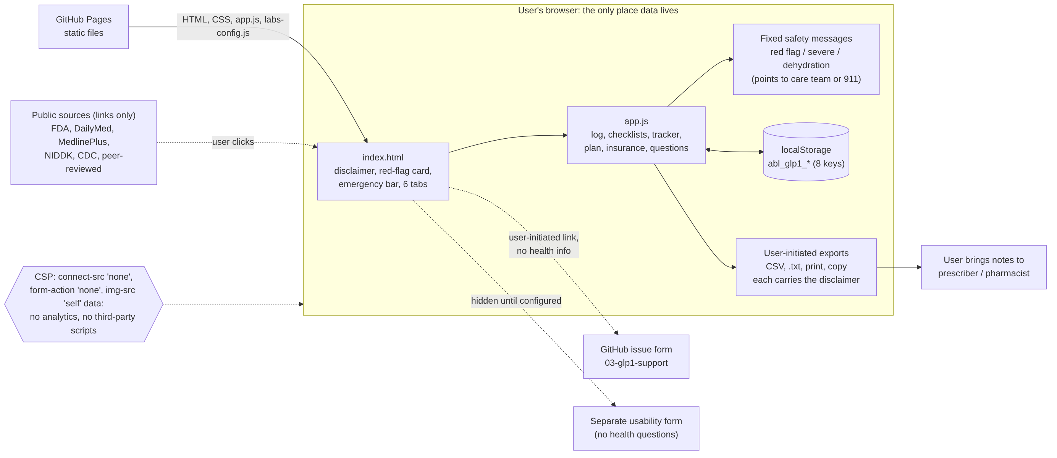
HOW IT’S BUILT
Architecture: the browser is the only place data lives
Read it left to right
Static files on GitHub Pages and one script, app.js.
Data sits in localStorage: abl_glp1_* (8 keys).
The strictest CSP in Labs: connect-src 'none', form-action 'none'.
No analytics script, no third-party code.
Not medical advice. Sample data only. Personal project built on my own time. Not affiliated with or endorsed by my employer; views are my own.
05 /
Notes:
Diagram: glp1-support-architecture.png from the architecture doc, unchanged.
100% client-side. Static HTML, CSS, and vanilla JavaScript on GitHub Pages. Storage keys are all prefixed abl_glp1_ (8 keys). CSP sets connect-src 'none', form-action 'none', img-src 'self' data:. The page never loads labs-counts.js.
Source: glp1-support-architecture.md, sections 3, 4 (architecture diagram), and 7.

Slide 6
DATA AND PRIVACY
What leaves the browser: nothing the user types
No analytics, no account, no signup.
Exports happen only when the user acts, and each carries a disclaimer.
The author can’t see or recover what is saved.
The host logs visitors’ IPs for security, and the page says so.
STAYS HERE, ON THIS DEVICE
ONLY IF YOU EXPORT
CSV, a plan or question list, print, or copy
Ordinary, unencrypted copies. Each carries the not-medical-advice line.
Everything typed is saved in the browser’s local storage.
The maker can’t see or recover it. “Clear my data” wipes it.
No analytics, account, cookies, ads, or third-party scripts.
Honest footnote: the page is hosted on GitHub Pages, which logs visitor IP addresses for security; the maker doesn’t receive those logs. Not a medical record: not connected to any doctor, pharmacy, or health plan.
Not medical advice. Sample data only. Personal project built on my own time. Not affiliated with or endorsed by my employer; views are my own.
06 /
Notes:
Short answer: nothing the user types leaves the browser unless the user exports it. No analytics, no account, no signup. Exports (CSV, .txt, print, copy) only when the user acts; each carries the disclaimer. GitHub Pages logs visitors' IPs for security (disclosed on the page); the author doesn't receive these logs.
Visual: native diagram 'Where your information goes' built from Infographic C in glp1-support-nlm-source.md.
Source: glp1-support-architecture.md, sections 3 and 5.

Slide 7
GOVERNANCE
Governance: sourced, dated, reviewed
01
Checked against FDA Medication Guides Content last reviewed September 30, 2026. Labels change, and the page says so.
DONE
02
Legal-risk memo fixes applied Wording, Terms, and export-disclaimer fixes (commit 913dbb9).
DONE
03
Bug form forbids health info It requires ticking “I did not include personal health information.”
DONE
04
Live page matches the commit index.html and app.js hash-checked against 4dd4953 on October 6, 2026.
DONE
05
Attorney consult still open The memo recommended one. Whether an attorney has reviewed the page is unknown.
OPEN
Not medical advice. Sample data only. Personal project built on my own time. Not affiliated with or endorsed by my employer; views are my own.
07 /
Notes:
Content was last reviewed September 30, 2026 against the FDA Medication Guides and the FDA Drug Safety Communication of January 13, 2026, among others.
Commit 913dbb9 (Sep 30, 2026, 12:20 PM PT) applied the legal memo's wording, Terms, and export-disclaimer fixes. The memo is an AI-prepared issue-spotting memo, not legal advice.
Bug reports go to GitHub issue form 03-glp1-support.yml, which requires the no-health-info tick.
Live index.html and app.js were hash-checked against commit 4dd4953 on Oct 6, 2026, and matched.
Open: attorney review is unknown; the memo recommended a low-cost consult.
Source: glp1-support-architecture.md, header, sections 3, 6, 9.

Slide 8
SCALE AND LIMITS
Scale and limits: static files go a long way
~970K
100 GB
0
uncached page loads a month fit under the cap (page weight about 103 KB)
GitHub Pages soft bandwidth limit per month
data-breach surface: no backend, so no scaling cost
THE TRADE-OFFS
Data is per device: no backup and no cross-device use.
The help bot runs on a single box: one process, no failover.
Not medical advice. Sample data only. Personal project built on my own time. Not affiliated with or endorsed by my employer; views are my own.
08 /
Notes:
Page weight is about 103 KB uncompressed (HTML 42 KB + app.js 37 KB + CSS + config), so 100 GB is about 970,000 uncached loads per month before gzip and caching help.
GitHub Pages soft limits: 100 GB bandwidth per month, 1 GB site, 10 builds per hour.
No backend means no scaling cost and no data-breach surface. It also means no backup and no cross-device use.
The Telegram help bot is one Python process with no failover; it was not running when checked.
Source: glp1-support-architecture.md, section 8 (GitHub Pages limits from docs.github.com, fetched Oct 6, 2026).

Slide 9
DIRECTION
Direction: stay local-only
Area | Next step | Will not do
Feedback | Set up the usability form (no health questions) | Add analytics
Content | Re-check DailyMed labels before wider promotion | Add dosing tools
Help bot | Refresh the bot FAQ | Add AI chat
Data | Keep every note on the user’s device | Add accounts or sync
Why: the legal-risk memo lists these features as ones that would raise risk.
Not medical advice. Emergency: call 911. Took too much: Poison Help 1-800-222-1222. Crisis: call or text 988.
Not medical advice. Sample data only. Personal project built on my own time. Not affiliated with or endorsed by my employer; views are my own.
09 /
Notes:
Roadmap (only what the repo and drafts support): configure the separate usability form; re-check DailyMed labels before any wider promotion; refresh the bot FAQ.
The legal memo lists features that would raise risk if added (dosing tools, accounts or sync, analytics, AI chat), so the stated direction is to stay local-only.
Close: Not medical advice. Emergency: call 911. Took too much: Poison Help 1-800-222-1222. Crisis: call or text 988.
Source: glp1-support-architecture.md, section 9 and closing disclaimer.

