Slide 1

CS 2114 / FINAL PRESENTATION
SlayVT
Deck-building strategy
at Virginia Tech
Inspired by Slay the Spire
https://github.com/ultra-dog/SlayVT
SLAYVT / VIRGINIA TECH
01 / 09
Notes:
SlayVT is our Virginia Tech-themed, turn-based deck-building strategy game inspired by Slay the Spire. Repository: https://github.com/ultra-dog/SlayVT
Visual sources: conceptual cover illustration generated for this presentation; Virginia Tech palette reference: https://brand.vt.edu/identity/color.html

Slide 2
01 / MVP
What we built
Build a deck across a 15-floor run
Read enemy intent and spend limited Energy
Choose events, shops, and Rest Sites
Defeat the final boss to finish the run
THE METEOROLOGIST
HEAT +
COLD −
Reverse temperature
for bonus damage
SLAYVT / VIRGINIA TECH
02 / 09
Notes:
Players build a deck during a 15-floor run. The Meteorologist uses Heat and Cold; switching a target’s temperature causes reversal damage. Combat reveals enemy HP and intent, so the player must spend limited Energy on offense, defense, or setup. Events, shop, and rest site provide noncombat decisions; the run ends after the boss.

Slide 3
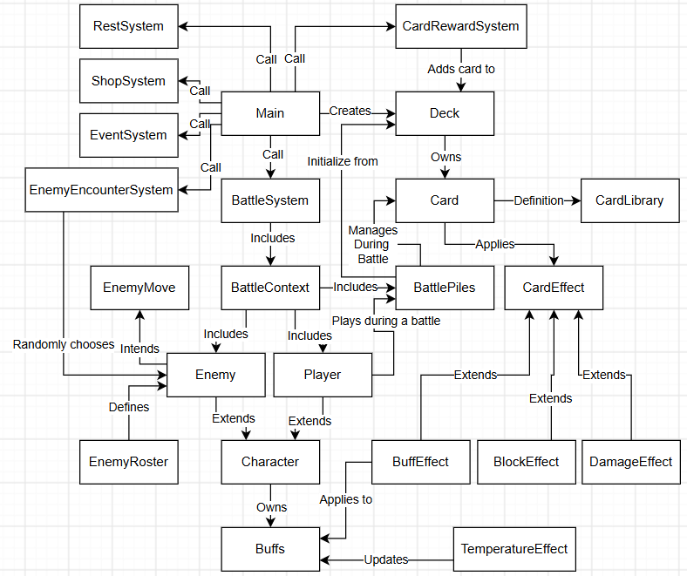
01 / MVP
System
diagram
Main coordinates
rooms and battles.
BattleContext groups
the player, enemies,
and card piles.
SLAYVT / VIRGINIA TECH
03 / 09
Notes:
This is the current system diagram already included in the repository README. Main coordinates rooms and battles. BattleSystem uses BattleContext, which groups Player, Enemy and BattlePiles; cards apply CardEffect behavior.

Slide 4
01 / MVP
Spec changes and stretch goals
CUT FOR TIME
TEAM-DESIGNED
Relics and potions
Some planned cards and events
Further balance and encounter refinement
Original cards and temperature mechanic
A foundation for a future game mod
Our priority: finish a working core game loop
SLAYVT / VIRGINIA TECH
04 / 09
Notes:
We reduced scope to finish a working game: relics and potions were removed; card and event counts were cut; balance and encounter variety remain limited. The team designed the cards and the Meteorologist’s temperature system rather than delegating that creative work to GenAI. A separate Steam Workshop mod is a possible continuation, not a requirement of this Java deliverable.

Slide 5
02 / DEMO
Live demo
01
Start a short run
Test Mode and room choices
02
Play a battle
Enemy intent, Energy, temperature reversal
03
Make a room choice
An event or a Rest Site
04
Try an invalid input
Show the menu recovering
SLAYVT / VIRGINIA TECH
05 / 09
Notes:
Live demonstration, about two minutes. Start a short run in Test Mode. Show a battle with enemy intent and limited Energy, trigger a temperature reversal, visit an event or Rest Site, and demonstrate recovery from an invalid menu choice.

Slide 6
03 / REFLECTION
What was harder than expected
Scope to spec
A room needs input handling, state changes,
output, and invalid-input checks.
Spec to code
A two-option Rest Site still needs upgraded
behavior for every upgradeable card.
UI trade-off
The numbered selection works, but large decks
make scrolling cumbersome.
SLAYVT / VIRGINIA TECH
06 / 09
Notes:
Scope to spec: each room needed input, state changes, output, and invalid-input handling, revealing more structural complexity than the initial idea suggested. Spec to code: a two-option Rest Site seemed simple, but upgrading required each card to define an upgraded state. Our card-selection UI works as a long numbered list and can be cumbersome with a large deck.

Slide 7
03 / REFLECTION
How our view of scoping changed
WEEK 3
NOW
What features
can we add?
What can we finish
and verify?
Estimate effort for each subsystem
Define the smallest playable version
Reserve time for testing and UI
Cut lower-priority features early.
SLAYVT / VIRGINIA TECH
07 / 09
Notes:
In Week 3 we focused on the feature idea. Now we see scoping as a time budget and a dependency map. We would estimate each subsystem, specify its smallest usable version, and leave deliberate time for testing and UI.

Slide 8
04 / GENAI REFLECTION
How we used GenAI
AI-ASSISTED
EXAMPLE: BATTLECONTEXT
Initial structure and test drafts
Names, UI ideas, and refactoring
One place for battle state
private final Player player;
private final ArrayList<Enemy> enemies;
private final BattlePiles piles;
TEAM-DESIGNED
Cards, temperature,
and core combat decisions
Fields excerpt from the project
SLAYVT / VIRGINIA TECH
08 / 09
Notes:
Our team used GenAI to help scope the initial structure, write tests, propose enemy and event names, refine UI, and suggest BattleContext. We designed the cards, temperature mechanic, and core combat decisions. The example on this slide is a real fields excerpt from SlayVT/src/SlayVTGame/BattleContext.java. The attribution of the original suggestion follows our team account.

Slide 9
04 / GENAI REFLECTION
What we learned from GenAI
USEFUL
FRICTION
Fast drafts and refactoring
Help with unfamiliar languages
Generic visuals and excess code
Time and token cost
Next: our C# mod experiment
A playable prototype helped us explore beyond the languages we knew.
SLAYVT / VIRGINIA TECH
09 / 09
Notes:
GenAI accelerated drafting and refactoring, but generic designs, unnecessary code, and token use added costs. A separate C# mod experiment already produced a playable character prototype, according to our team account. This is separate from the Java class project. In future projects, we plan to use AI to bridge technical gaps while reviewing its output and keeping ownership of game design.

