Slide 1


HERBAL AI
A Digital Repository of Philippine Herbal Medicine
with AI-Assisted Preparation Guides
Capstone Defense Presentation
Kevin C. Mercado, Devon Descipulo, Eumar Cabaluna
Bachelor of Science in Information Technology
Notes:
Introduce Herbal AI and the team. Kevin C. Mercado serves as Project Manager and Backend Developer. Source: Herbal_AI_SRS_v3.docx and Herbal_AI_SPMP_v3.docx.

Slide 2
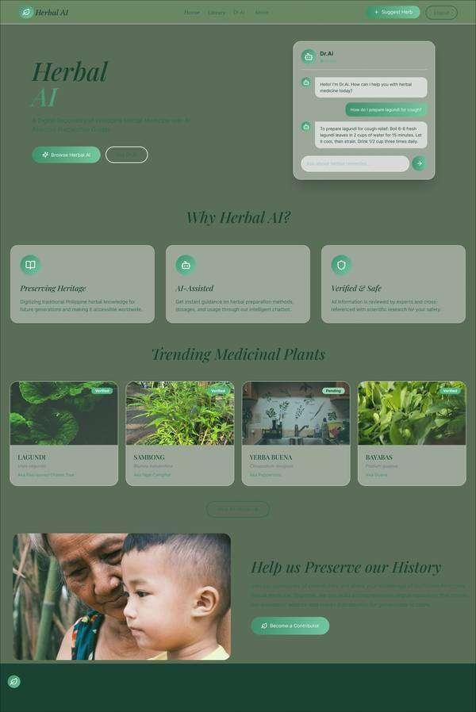
The problem Herbal AI addresses
02
Traditional knowledge is useful, but access is fragmented and safety context is inconsistent.
Herb information is scattered across oral tradition, social posts and disconnected references.
People may confuse similar plants or follow preparation advice without dosage and warning context.
Community knowledge needs a review process before it becomes public.
Project response
One searchable repository with moderated content and grounded AI explanations.
Sources: SRS sections 1.1, 1.2 and 3.8
CORDOVA PUBLIC COLLEGE, COLLEGE OF COMPUTER STUDIES
Notes:
Explain the information fragmentation, preparation risk and misidentification risk documented in the SRS. The screenshot is the project homepage captured in the SRS.

Slide 3
Objectives and system scope
03
Verified herb library
Search approved Philippine medicinal plants by name, category and medicinal use.
Dr. AI
Retrieve approved repository facts, then explain them clearly with safety limits.
Community contribution
Accept herb suggestions and publish them only after administrator review.
Account and collaboration
Support secure sessions, profiles, discussions, comments and private messages.
Scope boundary
The system provides traditional-knowledge guidance. It does not diagnose, prescribe or replace professional medical care.
Sources: SRS sections 1.2, 1.3 and 3.2
CORDOVA PUBLIC COLLEGE, COLLEGE OF COMPUTER STUDIES
Notes:
Connect each objective to a feature demonstrated later. State the medical boundary clearly before discussing Dr. AI.

Slide 4
System architecture
04
Browser
Next.js 16 + React 19
API
Express 5 + Socket.io
Data
PostgreSQL + Prisma
AI and media
Gemini + Cloudinary
HTTPS / JSON
Prisma / SQL
Embeddings / synthesis
The API owns validation, authorization and external service access.
Socket.io delivers authenticated messages and notifications.
Secrets stay in ignored backend environment files.
Sources: README architecture overview and Herbal_AI_SDD_v2.docx
CORDOVA PUBLIC COLLEGE, COLLEGE OF COMPUTER STUDIES
Notes:
Walk from the browser to the API, database and external services. Emphasize that frontend code does not receive Gemini or database secrets.

Slide 5
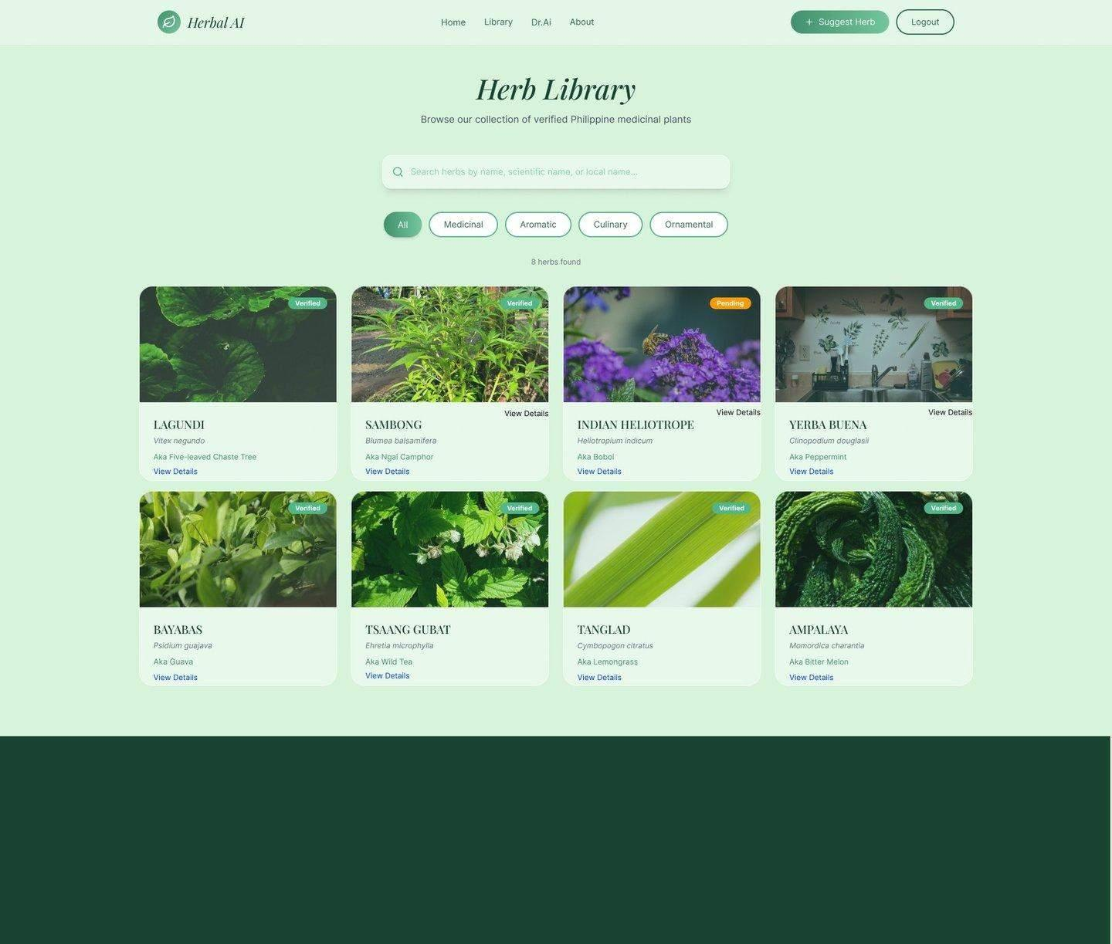
Verified medicinal-plant library
05
Repository functions
Approved entries only in the public catalog
Search by local, Cebuano or scientific name
Category filters and paginated results
Preparation, dosage and warning details
Verified status and meaningful image text
10
DOH validated plants seeded in the catalog
Sources: SRS FR-HERB-001 to FR-HERB-005 and browser evidence
CORDOVA PUBLIC COLLEGE, COLLEGE OF COMPUTER STUDIES
Notes:
Demonstrate search, filters and a detail page. Explain that suggestions do not appear here until approval.

Slide 6
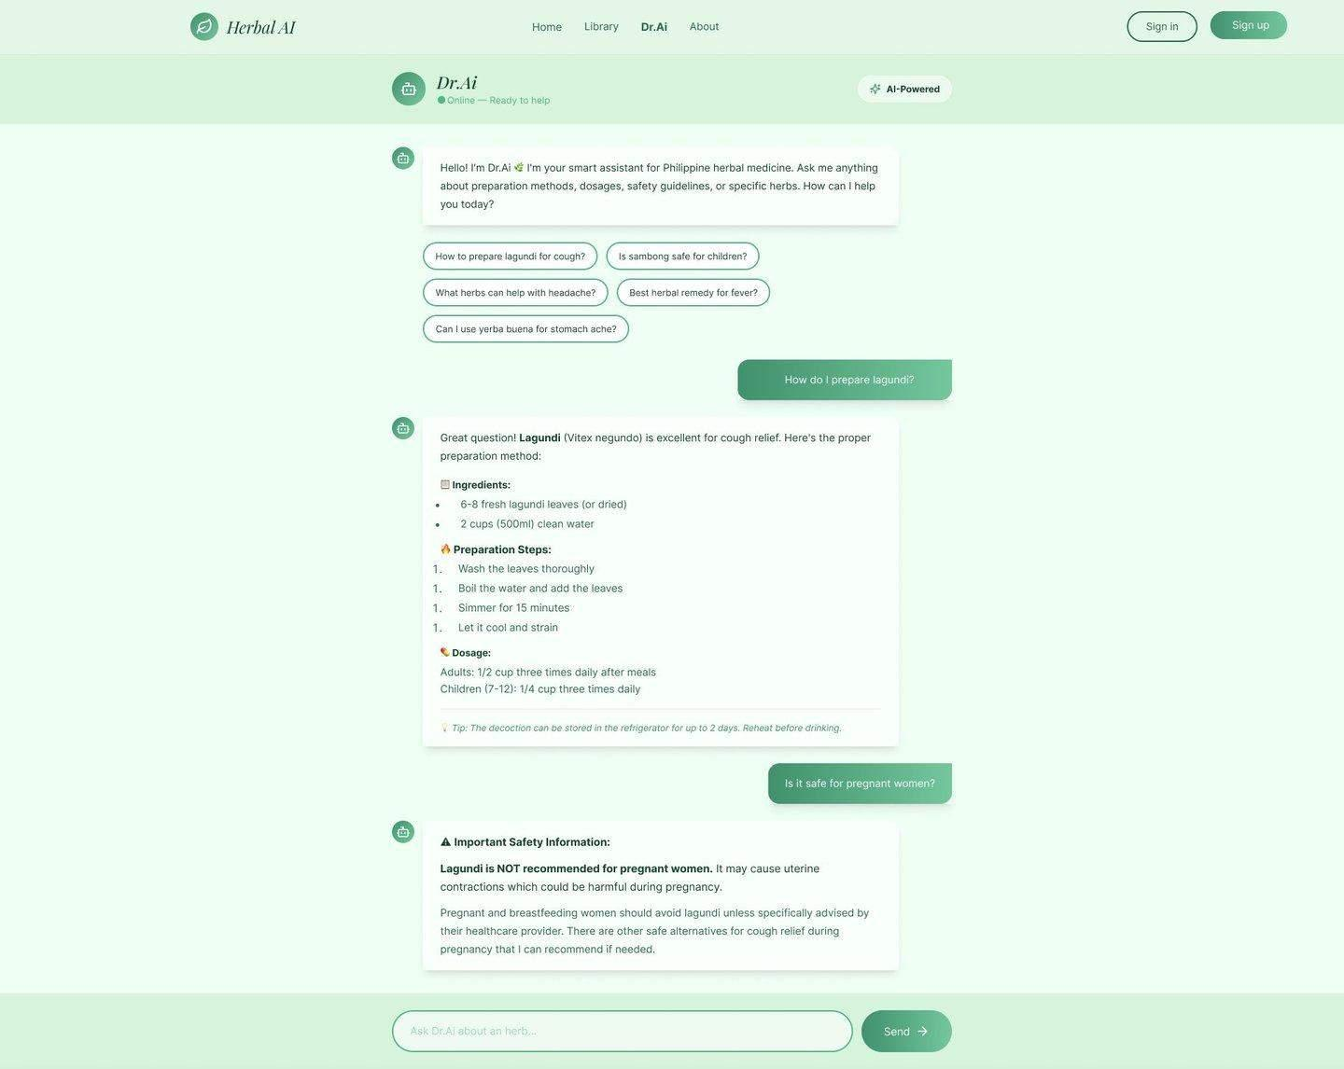
Dr. AI uses retrieval before explanation
06
1
Retrieve
Find relevant approved herb and knowledge-base records.
2
Constrain
Reject unrelated sources and retain dosage, warnings and scope.
3
Explain
Rewrite the short source text into a clear answer with attribution.
Safety rule
No relevant approved source means no invented herb dosage.
Sources: SRS FR-CHAT-001 to FR-CHAT-005 and ADMIN_CRUD_RAG rehearsal
CORDOVA PUBLIC COLLEGE, COLLEGE OF COMPUTER STUDIES
Notes:
Use the tested live knowledge-base retrieval example. Dr. AI included the unique managed fact and cited the exact active source. Unknown herbs produced no source or dosage.

Slide 7
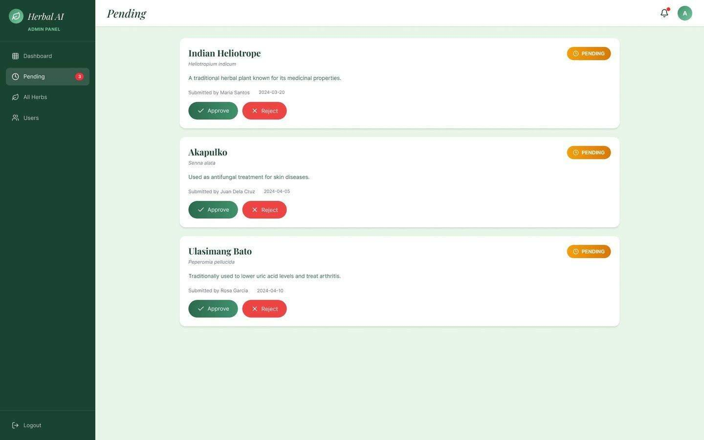
Contributor and administrator workflow
07
1
Contributor submits
2
Pending review
3
Admin approves or rejects
4
Catalog and notification update
Verified browser lifecycle
Create, publish, edit, RBAC denial, audit and delete all passed with temporary-data cleanup.
Sources: SRS FR-SUG and FR-ADMIN families
CORDOVA PUBLIC COLLEGE, COLLEGE OF COMPUTER STUDIES
Notes:
Show how pending content remains hidden. Mention that all administrative knowledge-base create, edit, status and delete actions now generate audit records.

Slide 8
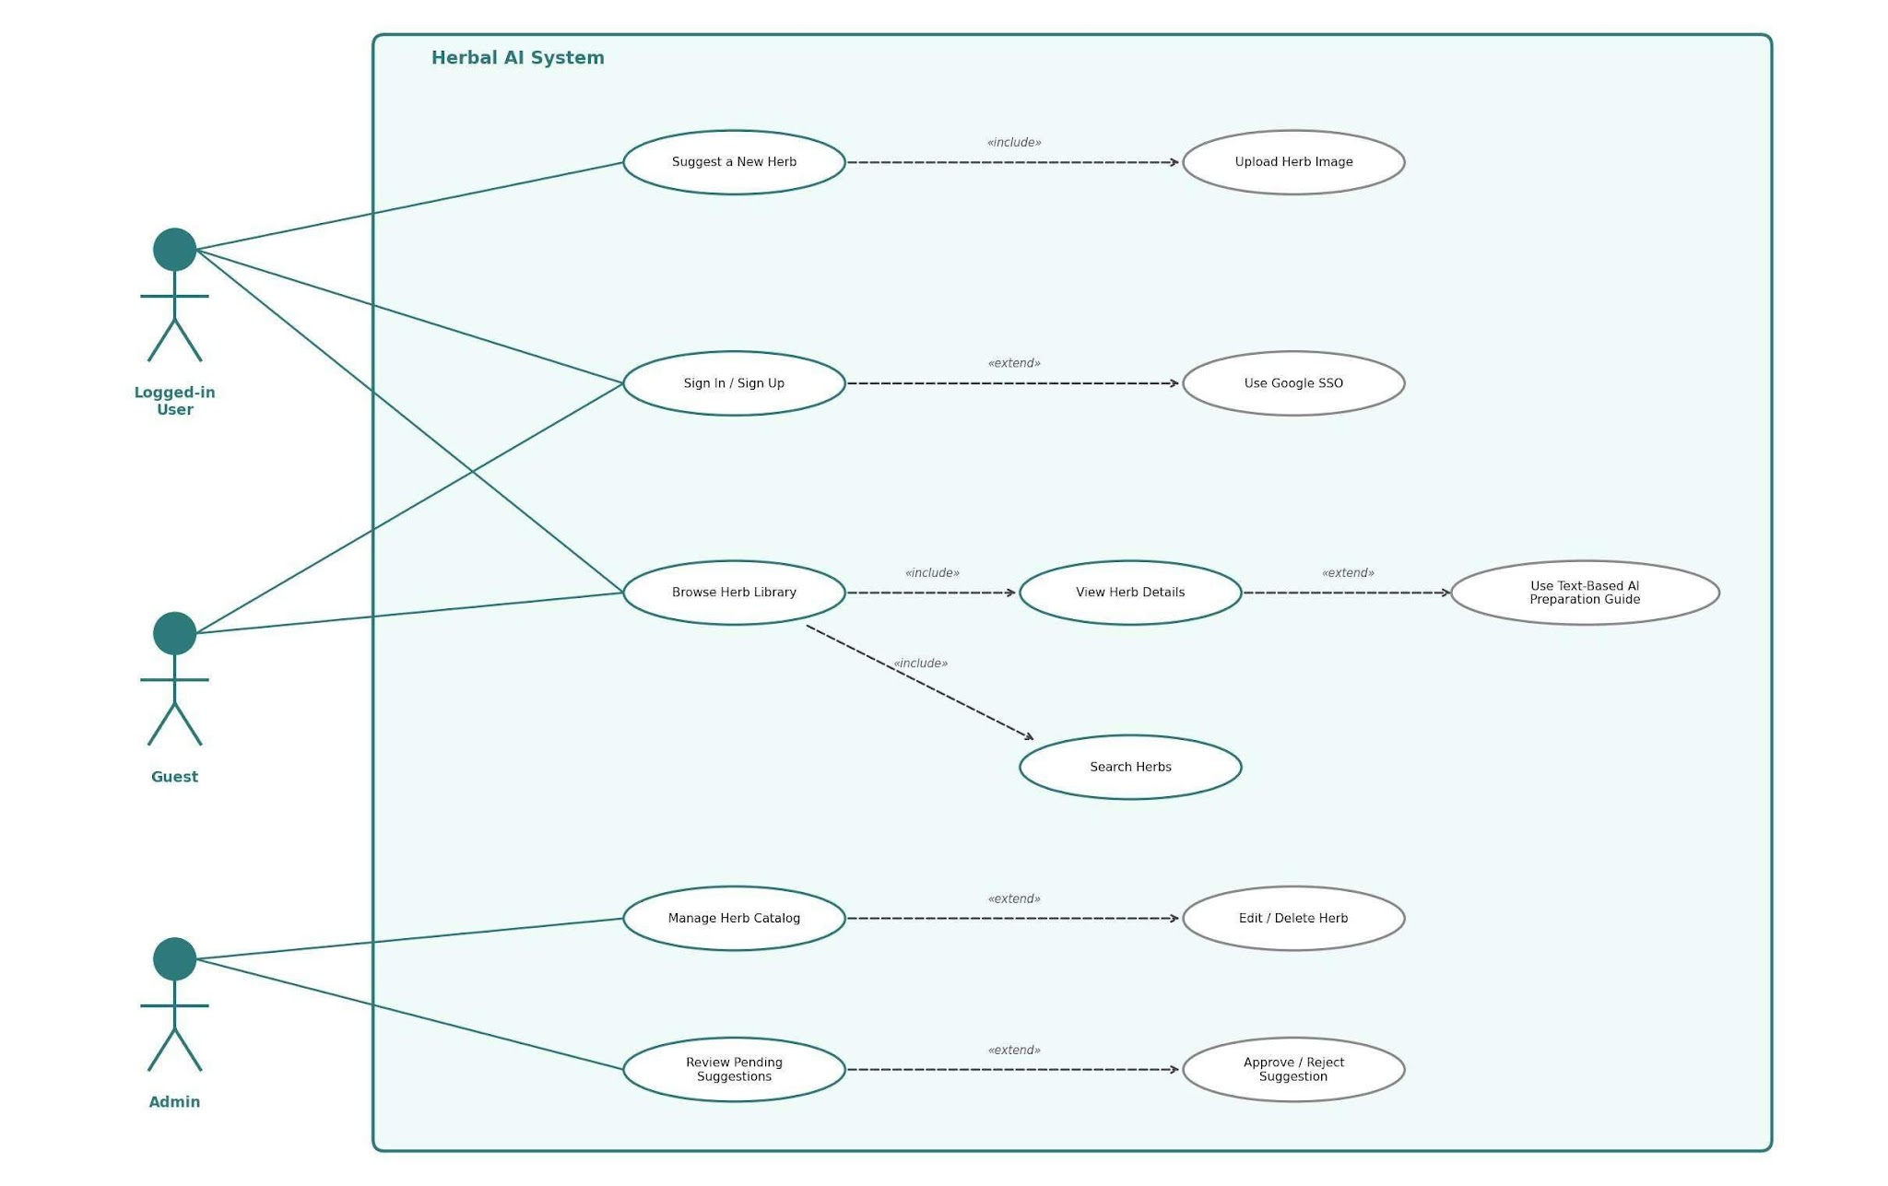
Roles and collaboration features
08
Guest
Browse verified herbs, view details and open sign-in.
Contributor
Use Dr. AI, suggest herbs, join discussions, comment and message.
Administrator
Moderate submissions, manage users, herbs, knowledge and audit history.
Real-time evidence
Two authenticated users exchanged messages and received Socket.io delivery without reloading.
Sources: SRS use-case diagram and community/messaging rehearsal
CORDOVA PUBLIC COLLEGE, COLLEGE OF COMPUTER STUDIES
Notes:
Distinguish permissions by role. Then summarize the forum, herb comments and private messaging tests.

Slide 9
Security and trust controls
09
Authentication
Short access tokens, rotating refresh tokens and logout revocation
Authorization
Server-side role checks protect every administrative route
Input safety
Validation, parameterized database operations and upload signature checks
Secret handling
Backend-only keys, ignored environment files and sanitized production errors
AI safety
Approved-source retrieval, no-source refusal and medical disclaimer
Account recovery
Single-use verification and reset links with expiry and concurrency protection
Actual Gmail verification and password-reset links passed with isolated test-account cleanup.
Sources: authentication tests, recovery rehearsal and SDD security design
CORDOVA PUBLIC COLLEGE, COLLEGE OF COMPUTER STUDIES
Notes:
Do not show credentials during the defense. Explain that the delivered email tests used a temporary alias and that password values never entered the evidence.

Slide 10
Verification baseline
10
83 / 83
backend tests passed across 14 files
34 / 34
functional API checks passed
26 / 26
emulated accessibility width scans passed
Sources: V&V report and readiness assessment, updated 8 September 2026
CORDOVA PUBLIC COLLEGE, COLLEGE OF COMPUTER STUDIES
Notes:
The chart shows the evidence score by weighted area. Clarify that 88 out of 100 is an internal readiness indicator, not an academic grade.

Slide 11
Local performance improved, staging remains open
11
Local PR-001 result
2,636 ms
five-run local p95 / maximum
Target: 3,000 ms
Post-login profile
37.5 ms
first /auth/me end-to-end
9.1 ms inside Express
PR-004 and PR-005 still require database-proximate staging.
Source: Docs/PERFORMANCE_FOLLOWUP_2026-09-07.md
CORDOVA PUBLIC COLLEGE, COLLEGE OF COMPUTER STUDIES
Notes:
Explain that the homepage met the local sample target after splitting static and interactive sections. Do not claim production acceptance. Login still took about five seconds against the remote database.

Slide 12
Team contribution allocation
12
Kevin C. Mercado
50%
Project Manager and Backend Developer
Planning, architecture, authentication, database, integration, testing and documents
Devon Descipulo
25%
Backend Developer
API, database and AI integration support
Eumar Cabaluna
25%
Frontend Developer
Responsive UI, frontend integration and usability support
Sources: SDD and STD contribution matrices
CORDOVA PUBLIC COLLEGE, COLLEGE OF COMPUTER STUDIES
Notes:
State that the allocation totals 100% and records Kevin as the highest contributor. The allocation should remain consistent across formal documents.

Slide 13
Current readiness and remaining gates
13
88
Remaining acceptance gates
Five real UAT participants and signed summary
Staging performance for PR-004 and PR-005
Production deployment, TLS and recovery evidence
Physical-device and full WCAG review
Adviser and panel signatures
out of 100
Ready for a controlled local capstone presentation
The score measures internal evidence. The adviser and panel make the academic decision.
These items remain visible in the documentation. The project does not claim 100% acceptance.
Source: Capstone presentation readiness assessment
CORDOVA PUBLIC COLLEGE, COLLEGE OF COMPUTER STUDIES
Notes:
Present the limitations directly. Explain that VPS and domain work is deferred by choice, so local rehearsal readiness remains the honest claim.

Slide 14
Defense demonstration flow
14
01
Public catalog
Search Lagundi and open its verified details.
02
Dr. AI
Ask a preparation question and point to the source and disclaimer.
03
Contributor
Show suggestion, profile, community and Messenger flows.
04
Administrator
Review moderation, herb/knowledge management and audit history.
05
Evidence
Close with tests, performance limits and readiness gates.
Fallback plan
Keep screenshots ready for Google OAuth, email and Gemini if the presentation network fails.
Source: DEFENSE_DEMO_SCRIPT.md and LOCAL_PRESENTATION_RUNBOOK.md
CORDOVA PUBLIC COLLEGE, COLLEGE OF COMPUTER STUDIES
Notes:
Use the production-mode local launcher before the presentation. Do not expose passwords or environment files. Keep the live demo focused and under control.

Slide 15
HERBAL AI
Verified local functionality, clear evidence boundaries and a practical path to final acceptance
Questions?
Kevin C. Mercado
Project Manager and Backend Developer
Notes:
Invite questions. If asked whether the project is complete, answer that local functional verification is complete while UAT, staging performance, deployment and reviewer acceptance remain open.

