Slide 1
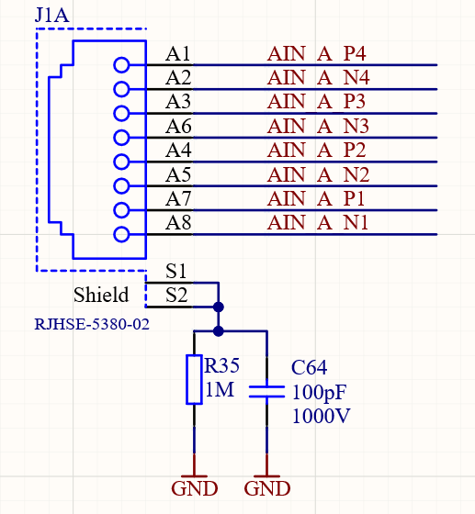
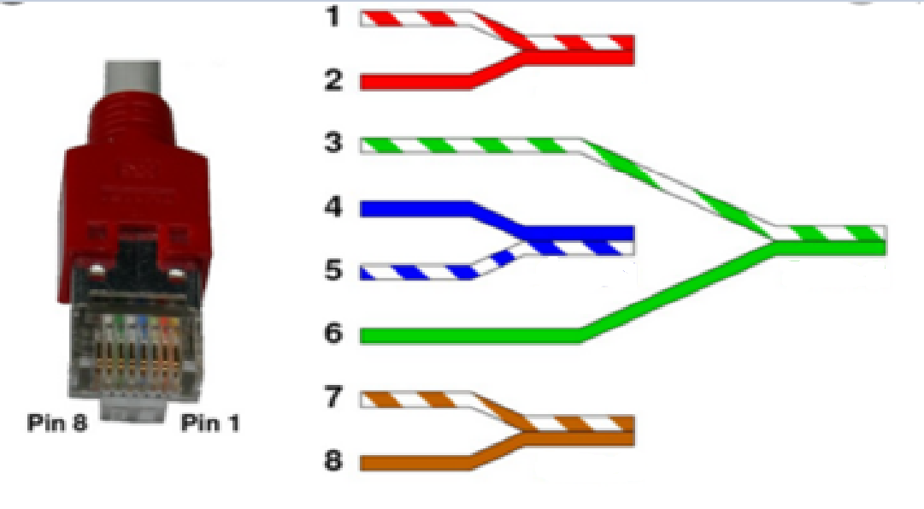
P4
N4
ADC4
P3
P2
N2
ADC3
N3
ADC2
P1
N1
ADC1

Slide 2
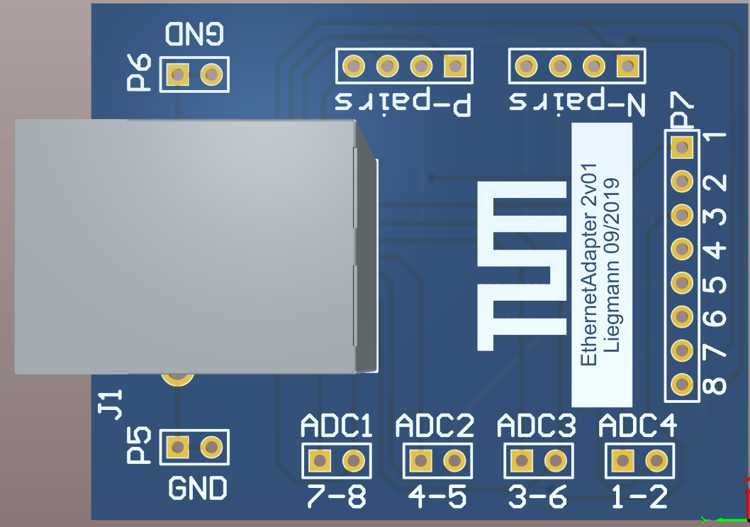
P N
P N
P N
P N

