Slide 1
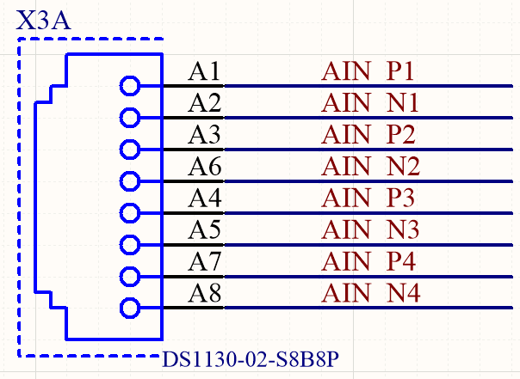
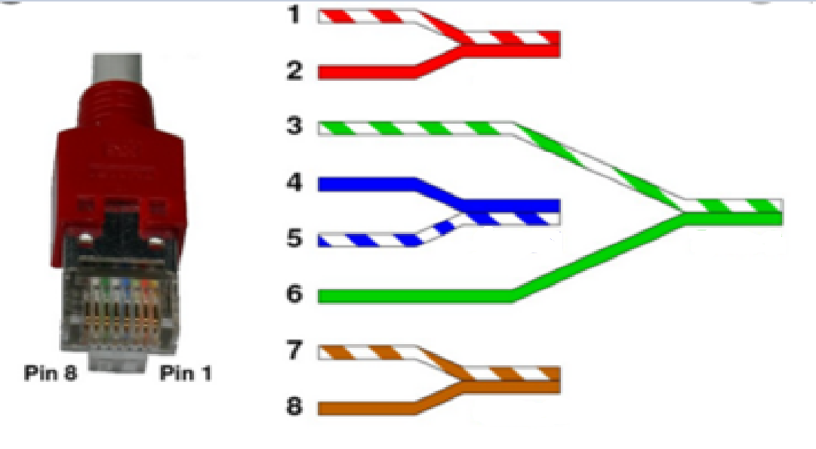
P1
N1
ADC1
P2
P3
N3
ADC2
N2
ADC3
P4
N4
ADC4

Slide 2
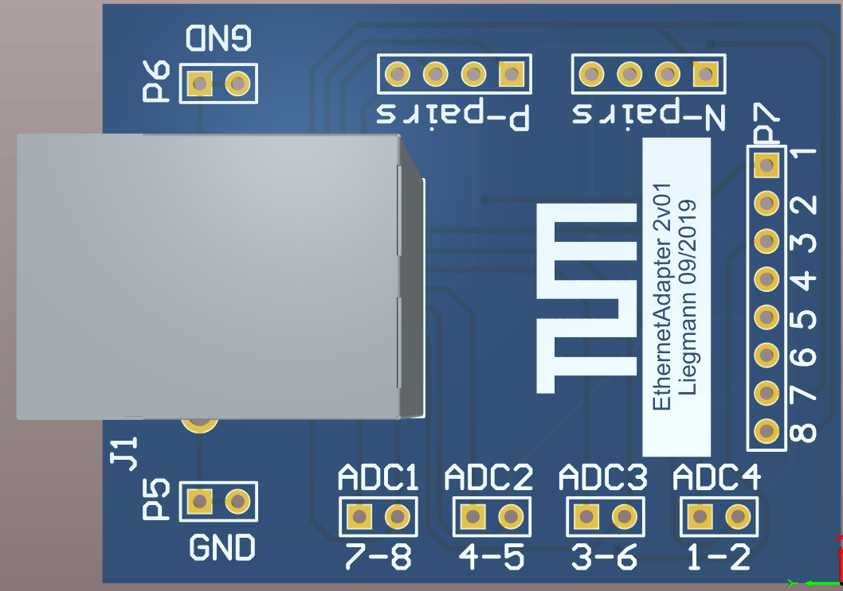
ADC4
ADC3
ADC2
ADC1
P N
P N
P N
P N

Slide 4
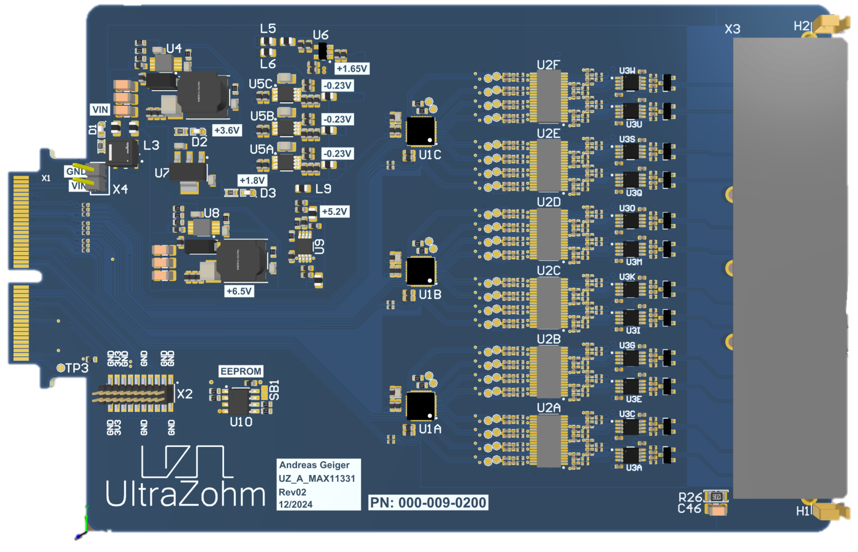

Slide 5
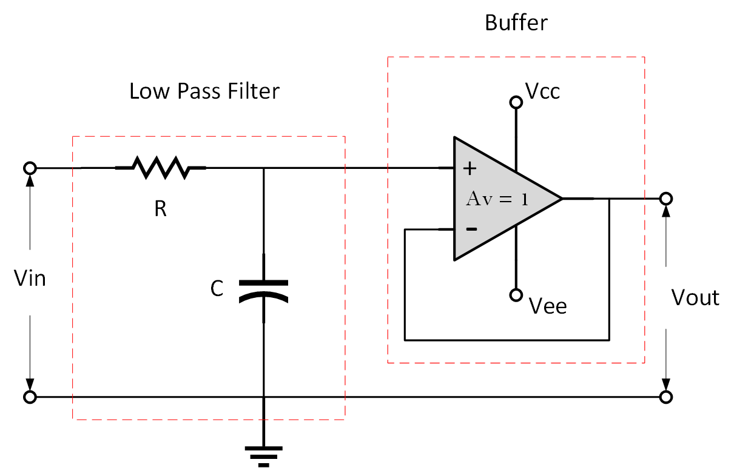
R_{pt1}
C_{pt1}

