Slide 1

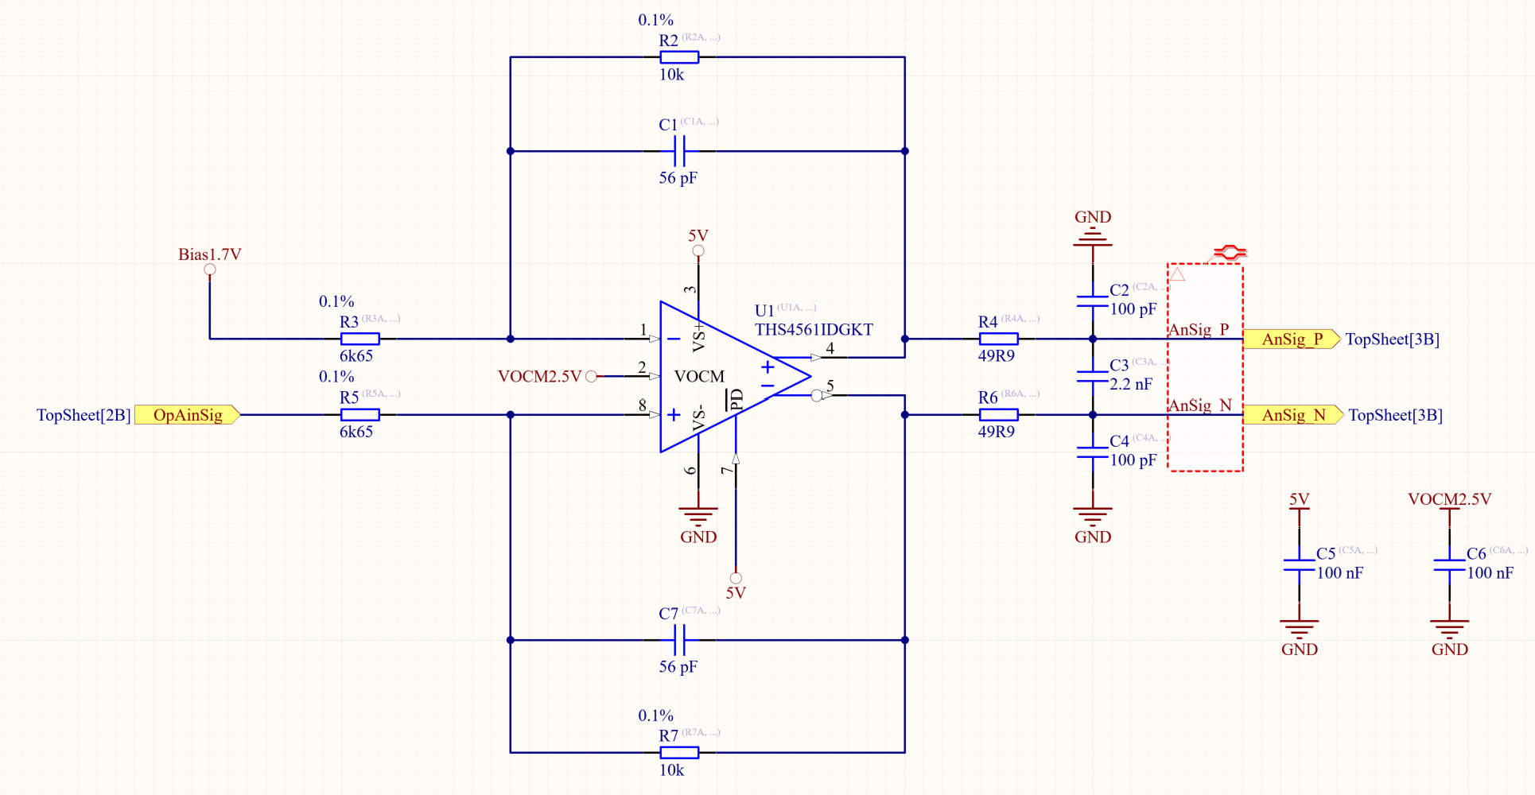
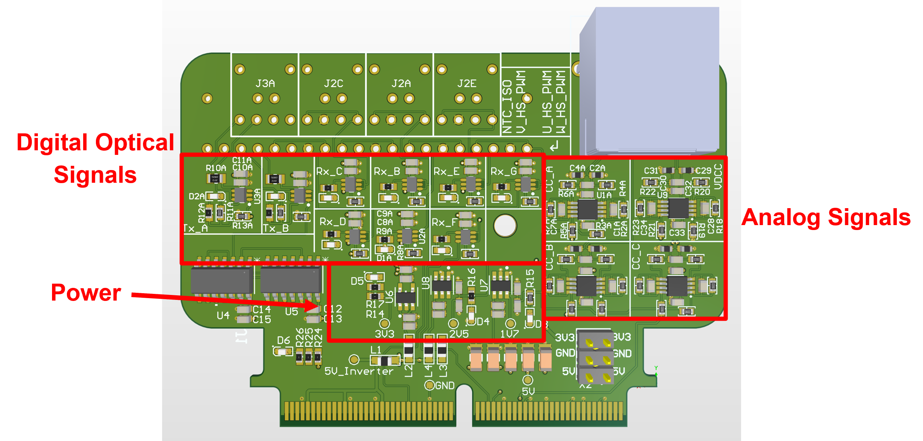
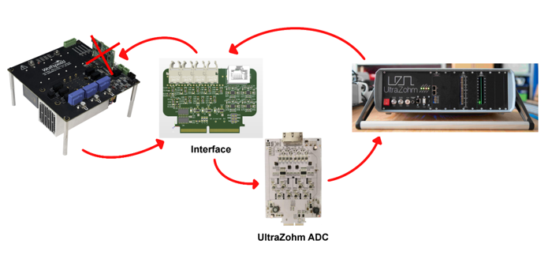
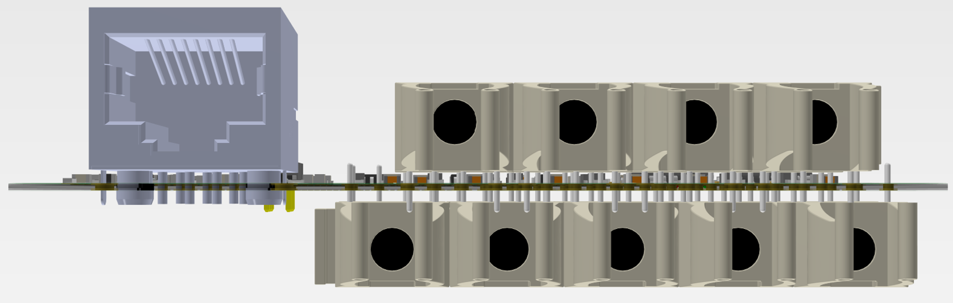
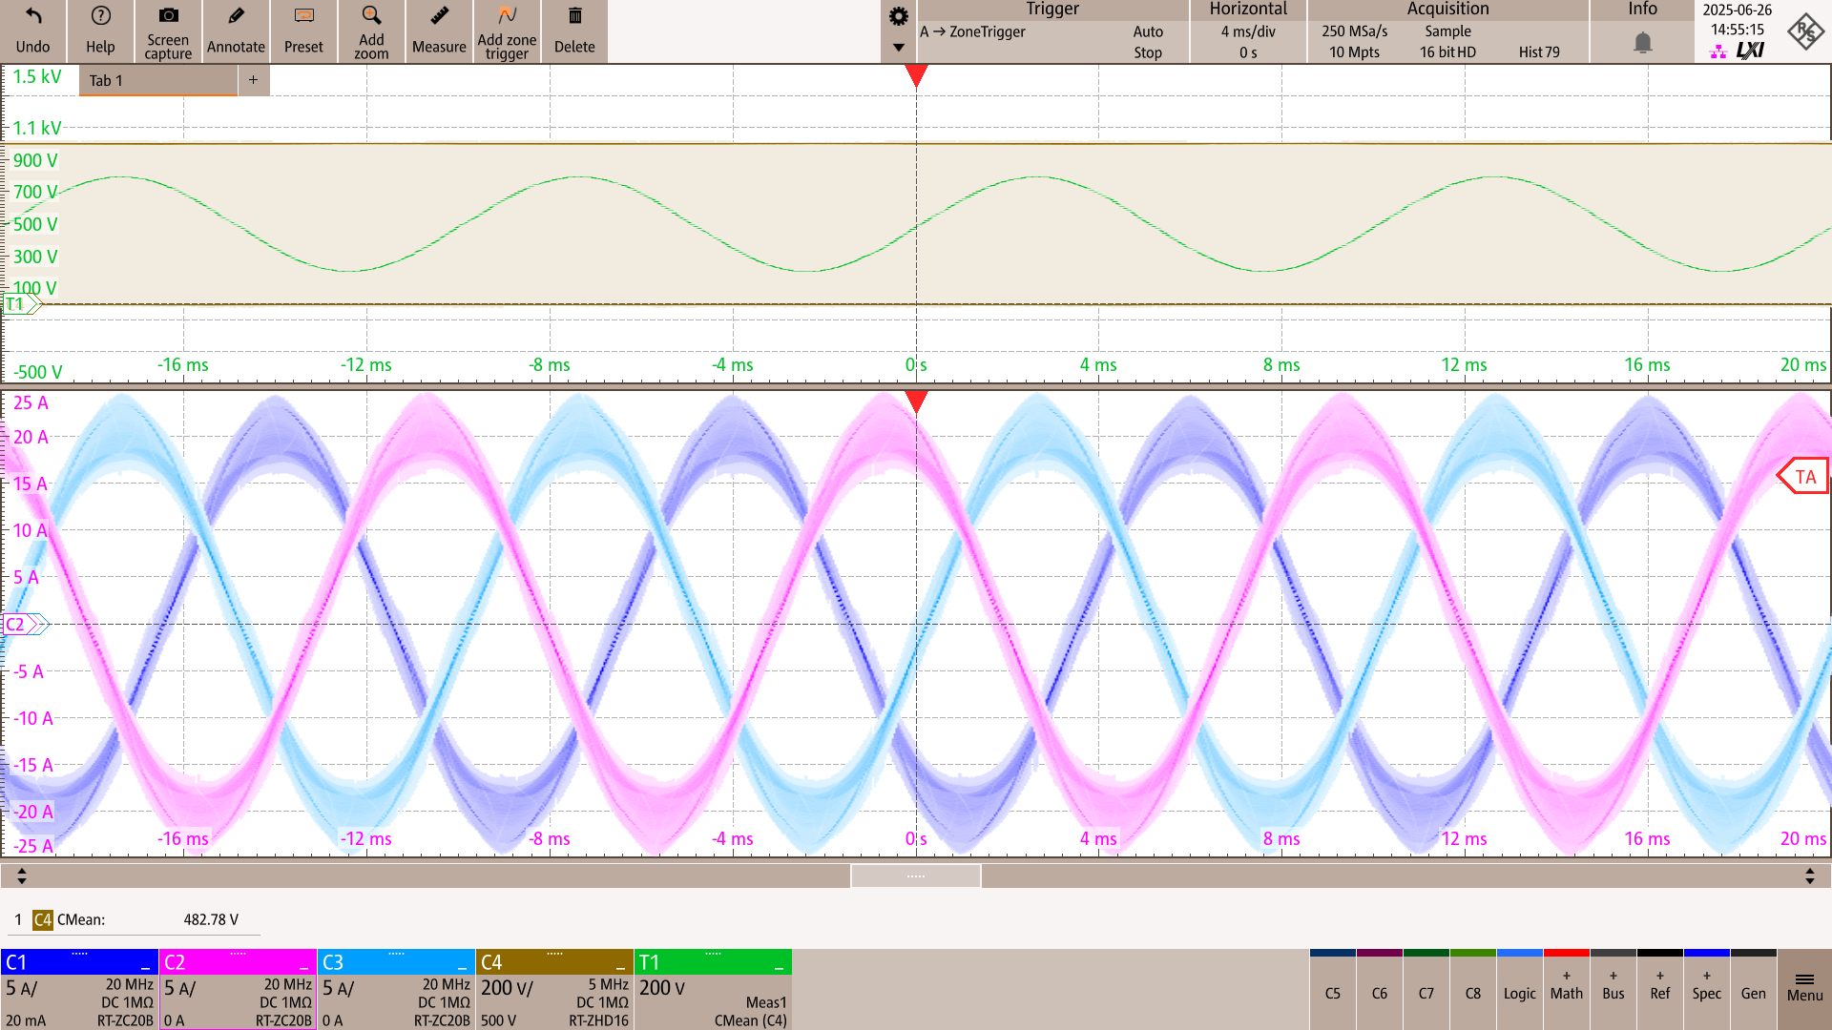
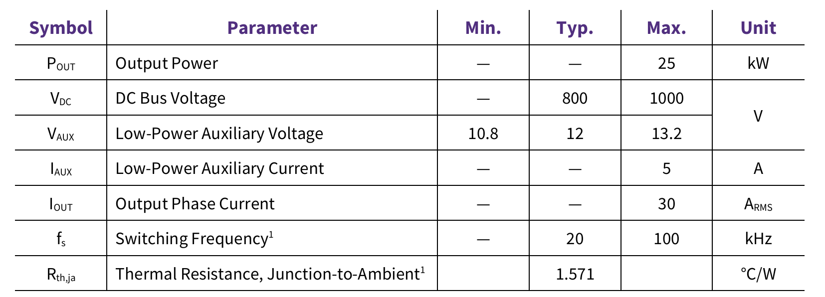
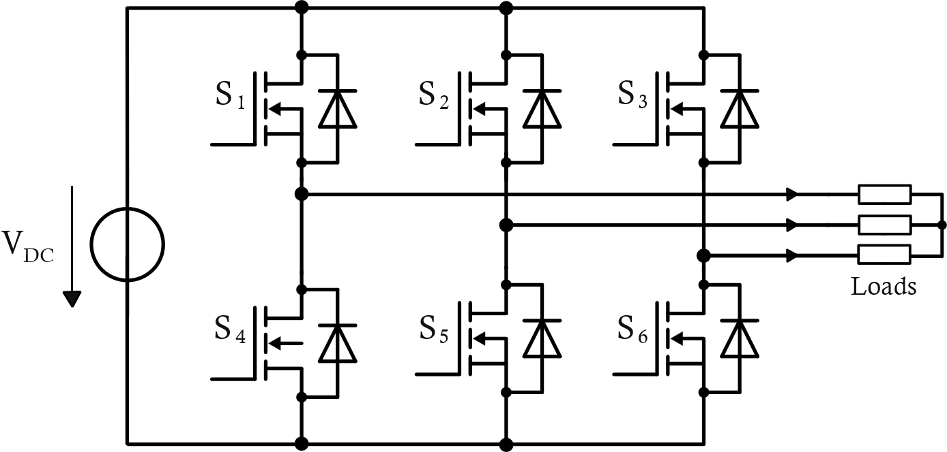
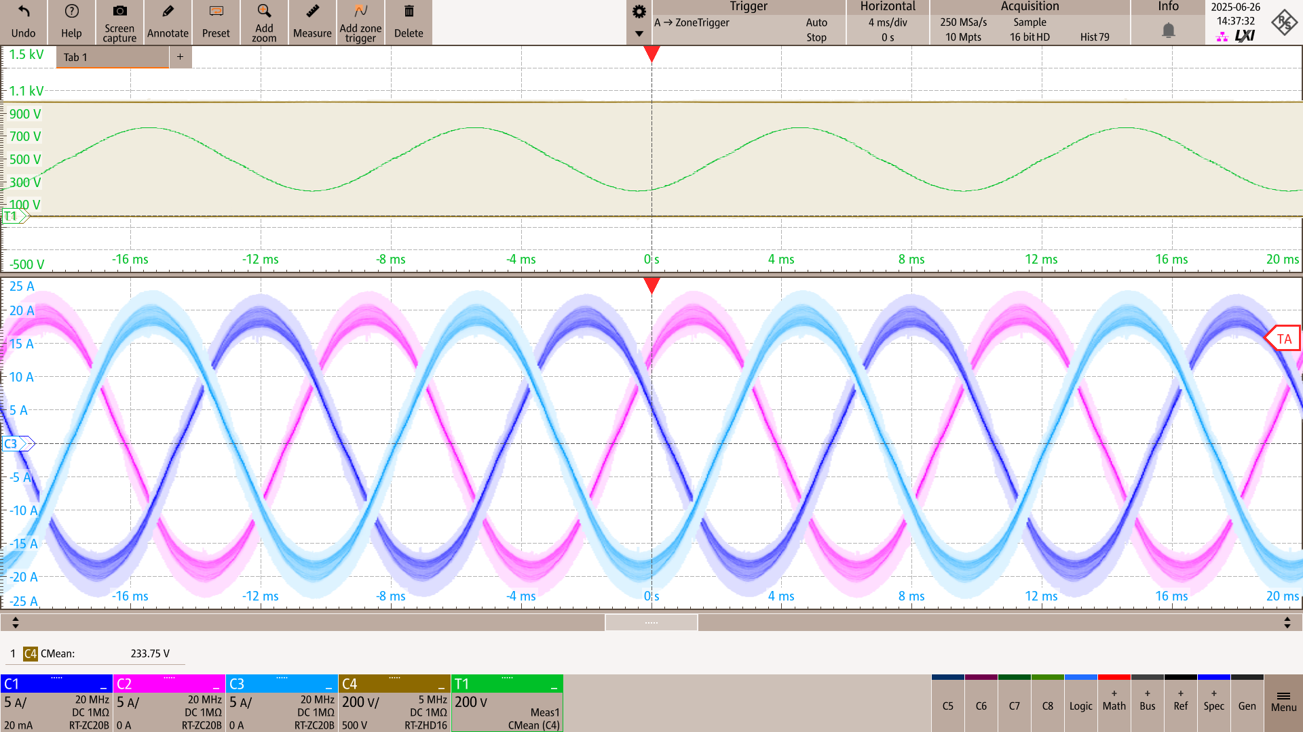
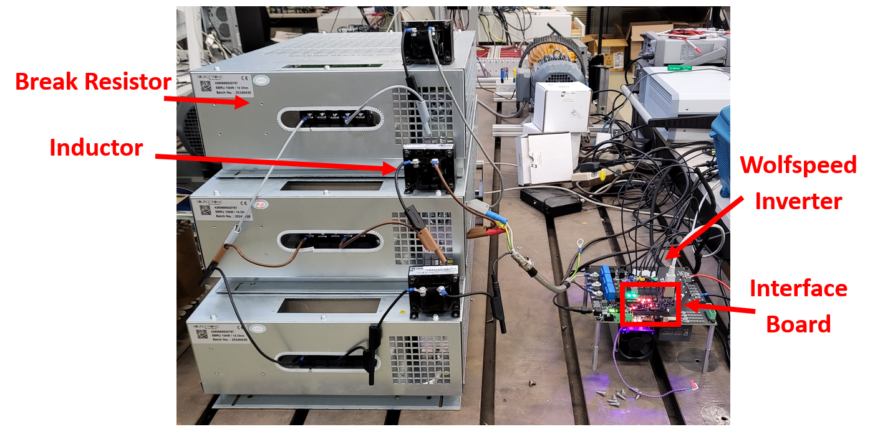
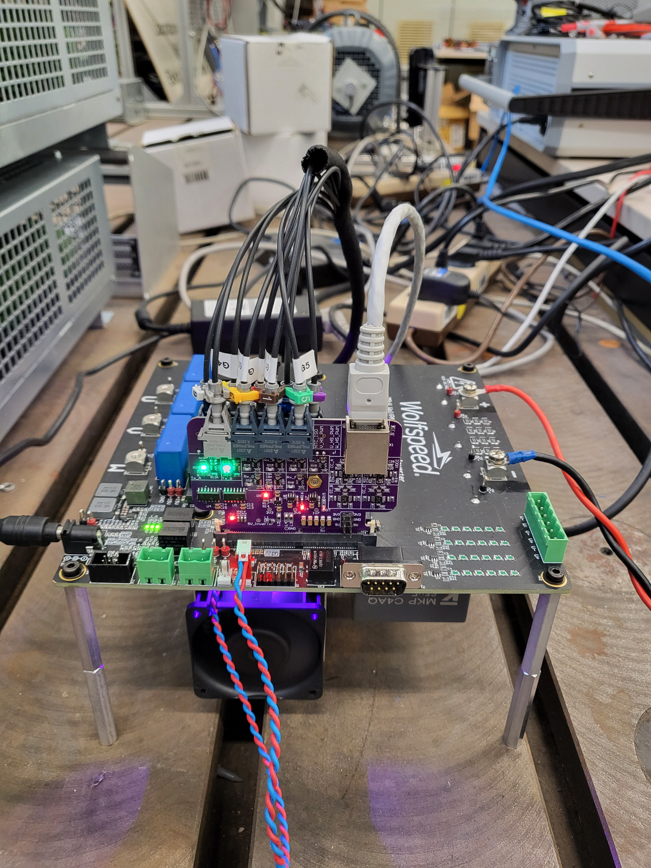
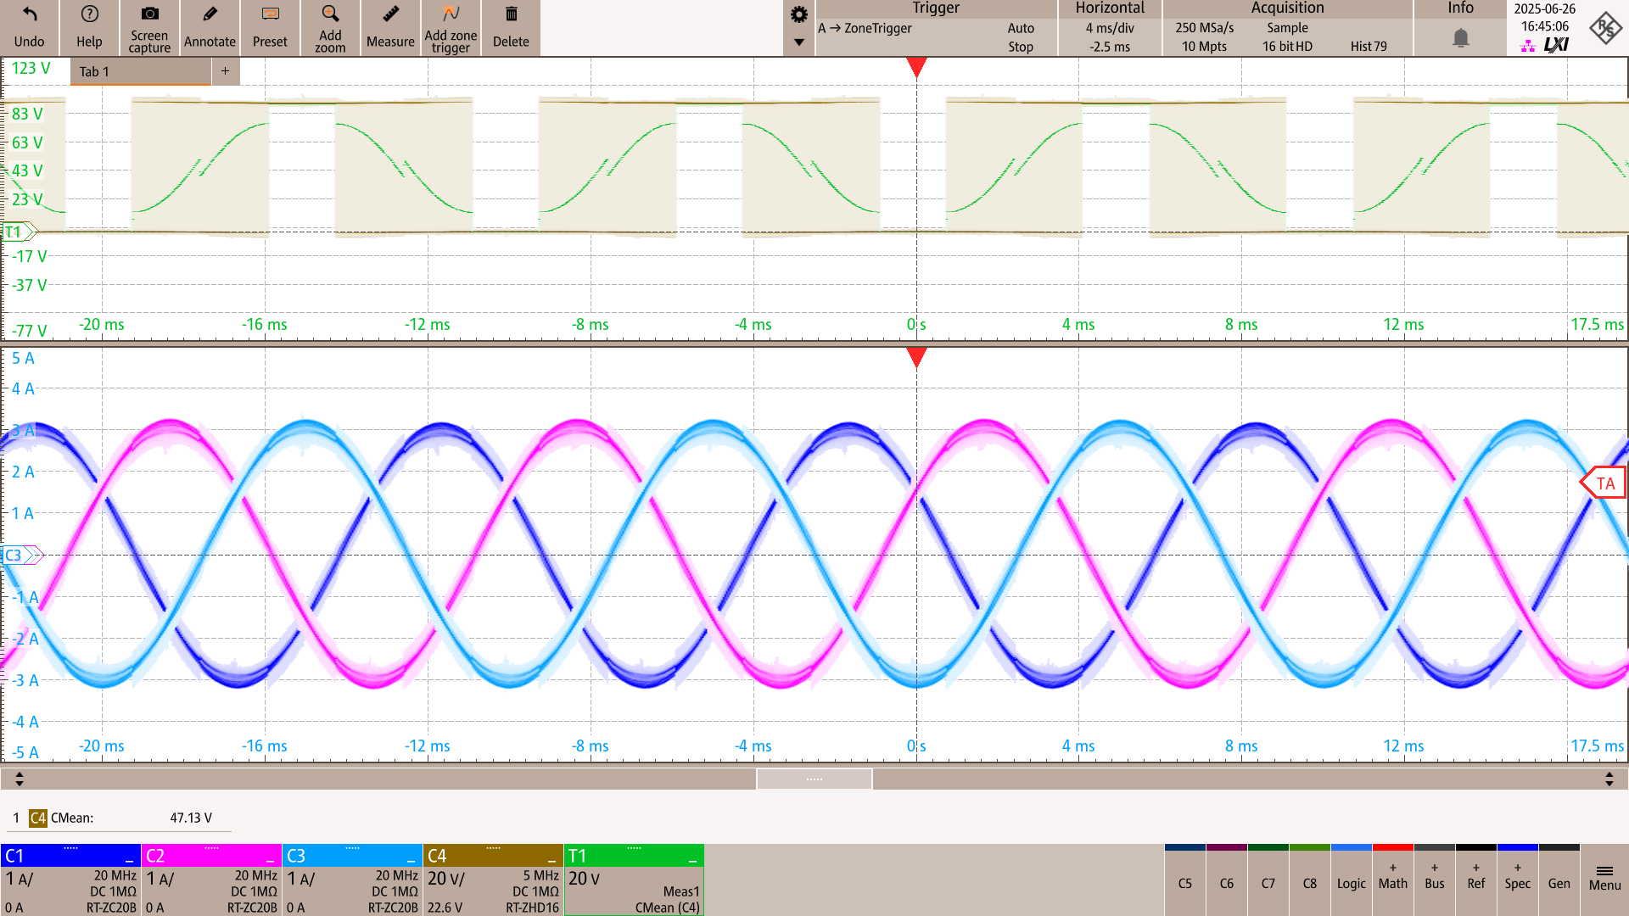
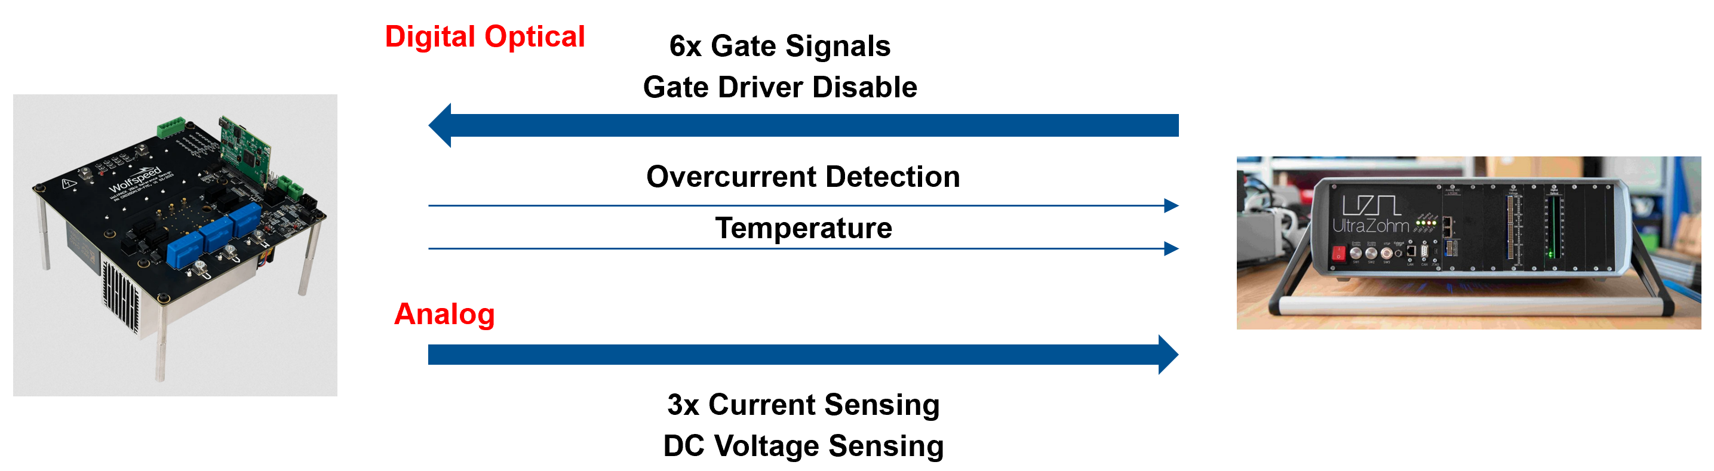
Scan for UltraZohm PCB Documentation
INTERFACING A 2-LEVEL SILICON CARBIDE INVERTER TO ULTRAZOHM
INTRODUCTION
TESTING AND VALIDATION
Design and testing of an interface board to connect the Wolfspeed CRD25DA12N-FMC 25kW three-phase inverter with UltraZohm. The design process involves the schematic circuit analysis of the Wolfspeed inverter, analog and digital signal circuit path design, power supply design, and PCB layout optimization. An RJ45 Ethernet connector is used to transfer analog signals, and digital optical transmitters and receivers are used for digital signal transmission.
Trend towards complex control algorithms
Texas Instruments control card limitations
Off the shelf inverter for UltraZohm testing
Inverter comes in multiple different power levels (20kW, 200kW, 300kW)
Outlook for a 3-level inverter from Wolfspeed
The assembled interface board was validated through a structured testing process before integration with the Wolfspeed inverter and UltraZohm.
Board bring-up: Power rails (5 V, 3.3 V, 2.5 V,1.7 V) were verified using LEDs and external headers. Signal pathways were tested using TI docking station
Digital gate signal testing: With the board connected to the inverter but no DC-link voltage applied, oscilloscope measurements confirmed that all six PWM signals were correctly transmitted from UltraZohm to the inverter.
Analog sensing verification: The DC-link was varied up to 750 V, and UltraZohm readings confirmed correct scaling by the interface board. Phase current sensing was also validated, with signals matching theoretical gain and offset characteristics.
Integrated inverter operation: After verifying signal integrity, the inverter was operated with an RL-load. Sinusoidal three-phase output currents were achieved with DC-link input power up to ~10 kW, demonstrating stable performance of both analog and digital circuit paths.
For the analog circuitry, single-ended signals from the inverter are converted into differential signals and amplified by a gain of 1.515 using the THS4561 fully differential amplifier, ensuring higher noise immunity and compatibility with the 5V input range of UltraZohm’s ADCs.
OBJECTIVE AND SCOPE
Oscilloscope measurement at switching frequency 25kHz, 999V / 9.61A DC-link input
Interface Design:
Schematic-level analysis of the Wolfspeed inverter
Analog sensing signal circuit path design
Digital signal circuit path design
Power supply design
PCB layout optimization
Board Testing:
Board bring-up
Validation of analog sensing and digital signal path designs
Digital gate signal transmission test
DC-link voltage and output phase current sensing test
RL-load test with power
Oscilloscope measurement at switching frequency 100kHz, 999V / 8.33A DC-link input
DESIGN AND DEVELOPMENT
The interface board transmits two groups of signals: digital optical signals (PWM gate driver signals, overcurrent detection, NTC temperature, gate driver disable) and analog signals (three output phase currents and the DC-link voltage). Resolver and output voltage sensing signals were omitted.
Oscilloscope measurement of Positive Negative Discontinuous PWM
Seongmin Park – Technical University of Munich
Supervisor: M.Sc. Eyke Aufderheide – Chair of High-Power Converter Systems

