Slide 1
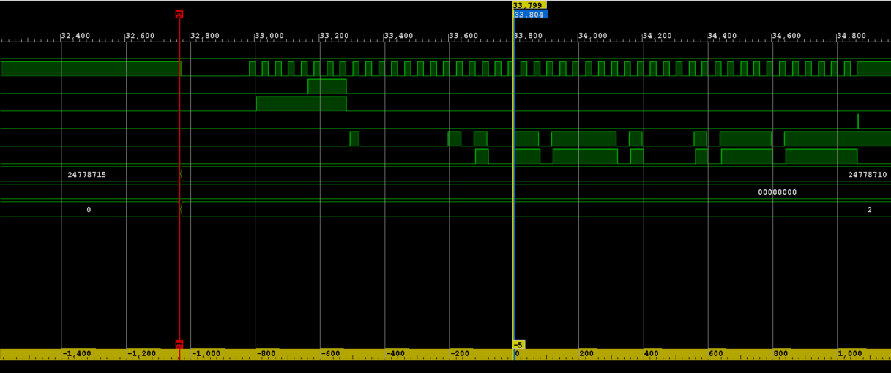
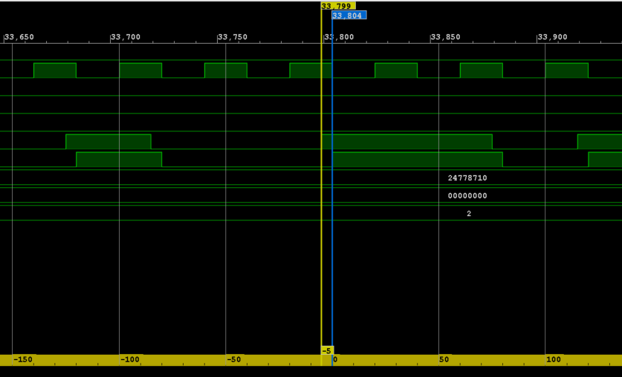
sampling on falling edge
Clock
clock rising
data_in
sampled_data_in
data on line

Slide 2
