Slide 1
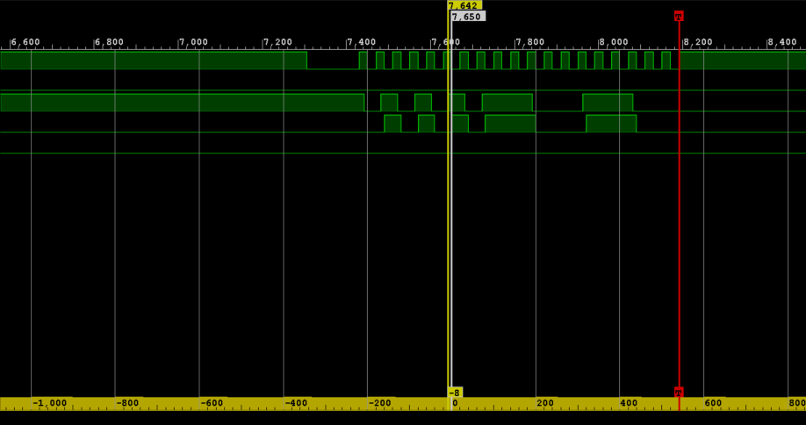
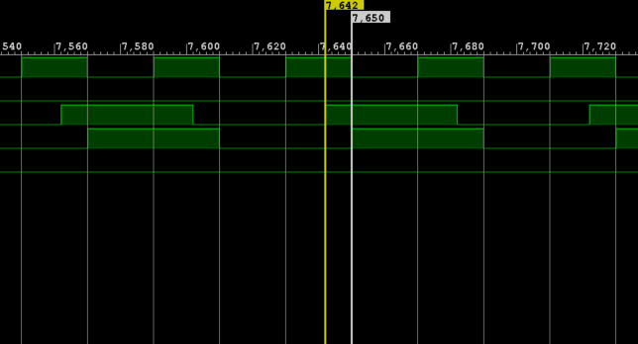
Clock
sampling on falling edge
data_in
clock rising
sampled_data_in
data on line

Slide 2
