Slide 1
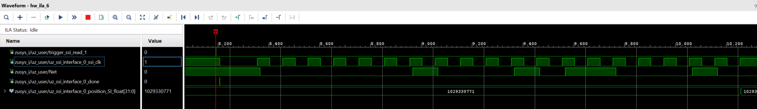
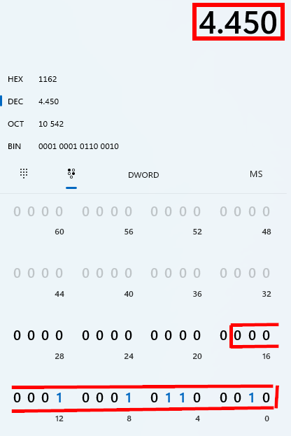
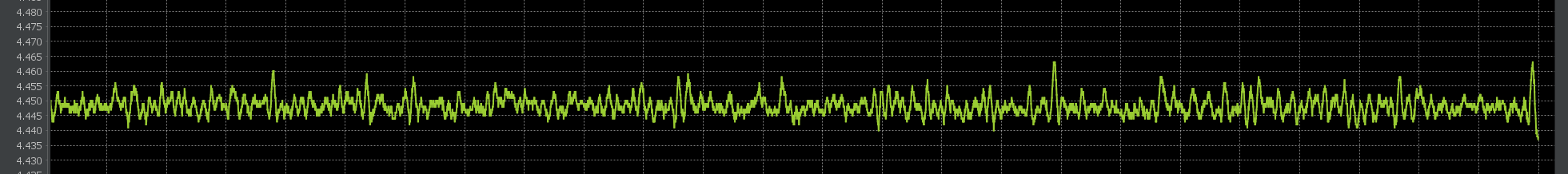
0
0
0
0
0
0
1
0
0
0
1
0
1
1
0
0
0
1
0
f_ssi_clk: 1 MHz, f_trigger: 20 kHz, 19bit SSI encoder
standstill, Bitpattern in ILA equals 4450, which is the value that is read in the JavaGUI
Position noise of the raw value: ~13 ticks = 13/((2^19)-1) * 2 * pi = 0.16 milli rad = 0,009 ° mechanical position

Slide 2
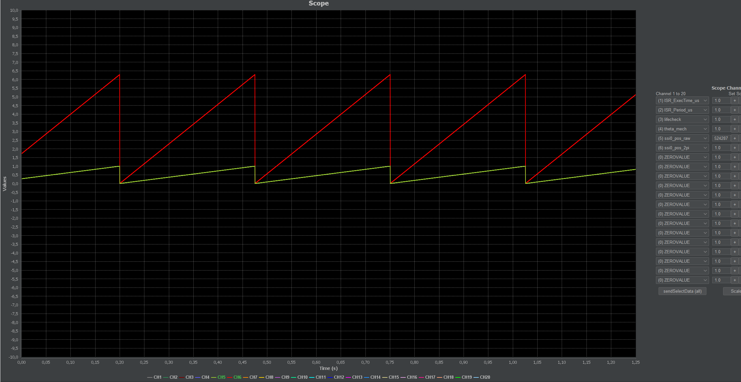
f_ssi_clk: 1 MHz, f_trigger: 20 kHz, 19bit SSI encoder
Const rotation from a stepper motor,
Disturbance free readout of the position.
Red: mech position in rad
Green: raw mech position normalized to max value

