Slide 1
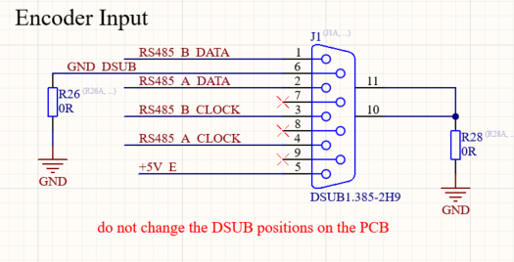
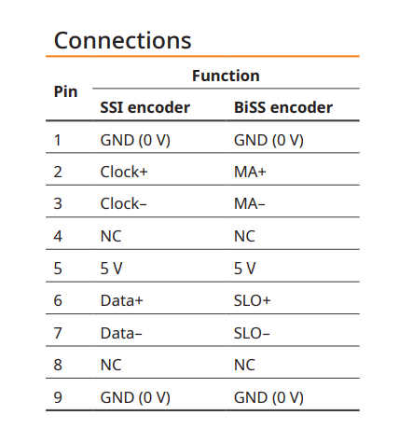
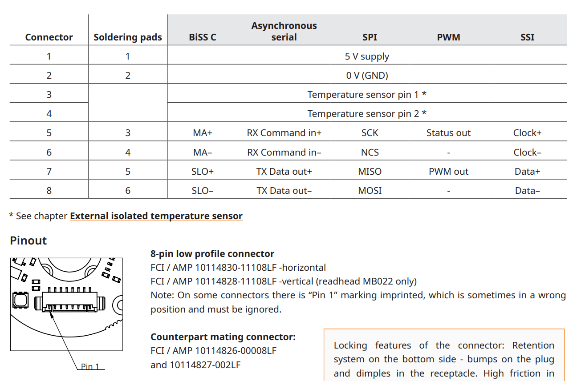
D-Sub9 uz_d_endat
D-Sub9 RLS Kabel
Pin | Function
1 | Data-
2 | Data+
3 | Clock-
4 | Clock+
5 | 5 V
6 | GND
7 | NC
8 | NC
9 | NC

Slide 2
D-Sub9 uz_d_endat
D-Sub9 RLS Kabel
Pin
1 braun
2 weiß
3 rosa
4 grau
5 rot
6 blau
7 grün
8 gelb
5 V
GND
Pin | Function
1 | Data-
2 | Data+
3 | Clock-
4 | Clock+
5 | 5 V
6 | GND
7 | NC
8 | NC
9 | NC

Slide 3
D-Sub9 uz_d_endat
D-Sub9 RLS Kabel
Pin
1 braun
2 weiß
3 rosa
4 grau
5 rot
6 blau
7 grün
8 gelb
5 V
GND
Pin | Function
1 | Data-
2 | Data+
3 | Clock-
4 | Clock+
5 | 5 V
6 | GND
7 | NC
8 | NC
9 | NC
FCI to D-Sub9 uz_d_endat
Pin FCI (color) | Function | Pin D-Sub9 uz_d_endat
Brown | 5 V | 5
White | GND | 6
Pink
Gray
Red | Clock+ | 4
Blue | Clock- | 3
Green | Data+ | 2
Yellow | Data- | 1
9

