Slide 1
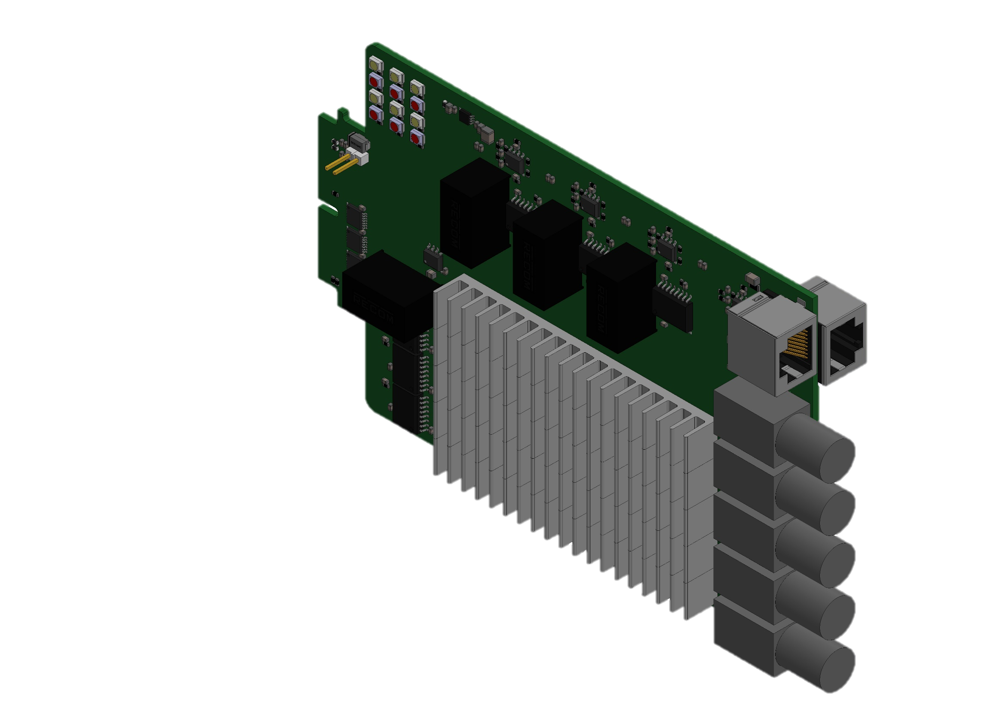
+24V Fan Connector
6x Gate-Signals
3x Phase to DC- Voltage
Fault LEDs
1x Enable
1x DC Current
6x Overcurrent
3x Phase-Current
6x Fault
1x DC+ to DC- Voltage
6x Temperature
4x Current Valid
+24V
DC+
+5V
+3.3V
DC-
GND
Phase a
Phase b
Phase c

Slide 2
