Slide 1
Clinical and beacons data analysis
Konstantinos Tsampras
UP1083865
Supervisor: Vasileios Megalooikonomou

Slide 2
The task
Load and preprocess a clinical dataset with clinical evaluations of each participant.
Train a model to categorize participants based on frailty from their clinical data.
Load and preprocess the beacons dataset, comprised of timestamps of participants entering rooms.
Extract features from the beacons dataset and merge the two datasets.
Perform a clustering on the unified dataset and an exploratory analysis of the results.

Slide 3
Clinical dataset (Pre-processing)
Preprocessing:
Turn values to numerical
Use NaN for values like “test_not_realizable” and 999.
Fill NaN with the median

Slide 4
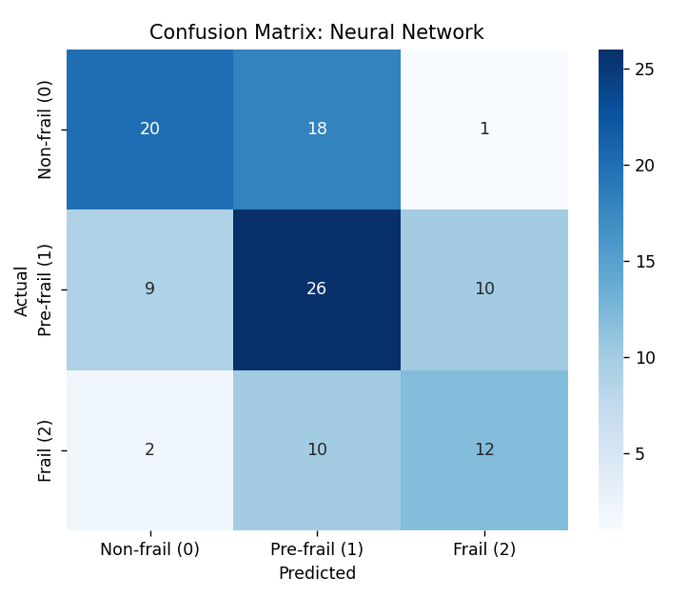
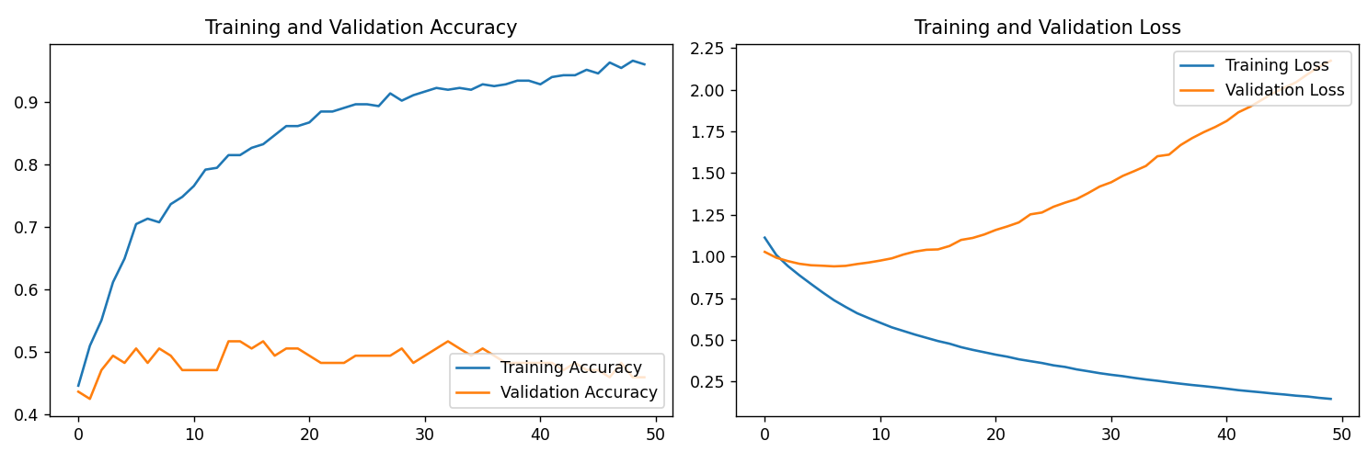
Clinical dataset (neural network)
Split 80-20.
Two hidden layers with ReLU.
Adam optimizer, sparse categorical Crossentropy loss function.
50 Epochs with a batch size of 8.
50% accuracy.

Slide 5
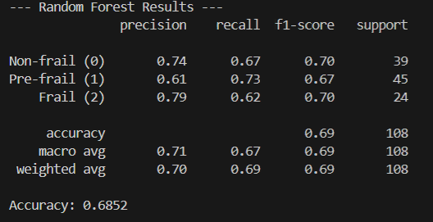
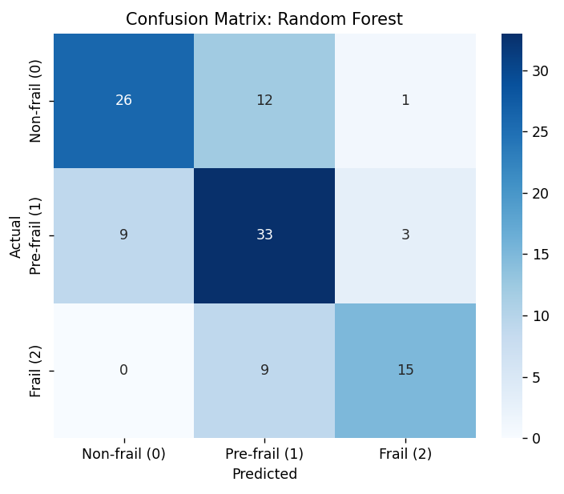
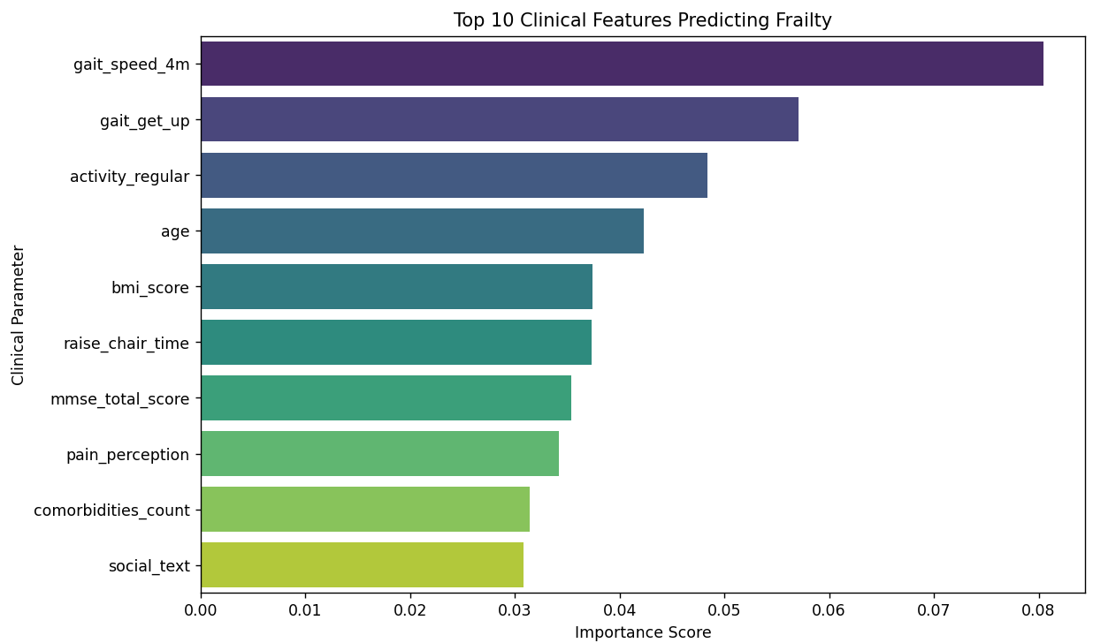
Clinical dataset (Random forest)
80-20 split.
100 decision trees.
Imbalance addressing.

Slide 6
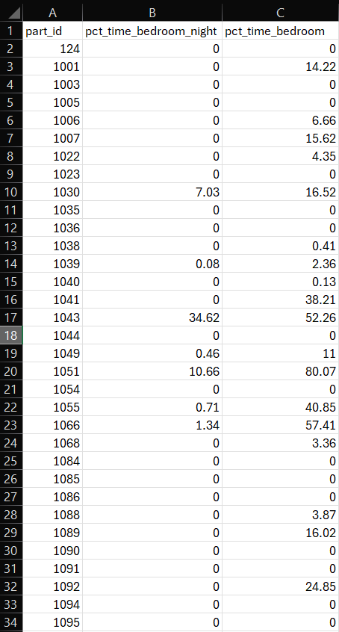

Beacons dataset (Pre-processing)
Renaming wrong labels (LuvingRoom->Livingroom).
Keeping the separation (Livingroom2 != Livingroom).
Fix continuity issues (remove timestamps with the same room twice in a row).
Extract features:
% of time in bedroom
% of time in bedroom (night)
% of time in bathroom
% of time in bathroom (night)
% of time outdoors
Room changes
Room changes (night)
Room changes per day
Average time per room

Slide 7
Merging
After reviewing dataset issues and trying to keep the dimensions under 10 the final features after the merging are:
gait_speed_4m
gait_get_up
raise_chair_time
activity_regular
age
room_changes_total
room_changes_at_night
percentage_outdoor
average_time_per_room
average_room_changes_per_day

Slide 8
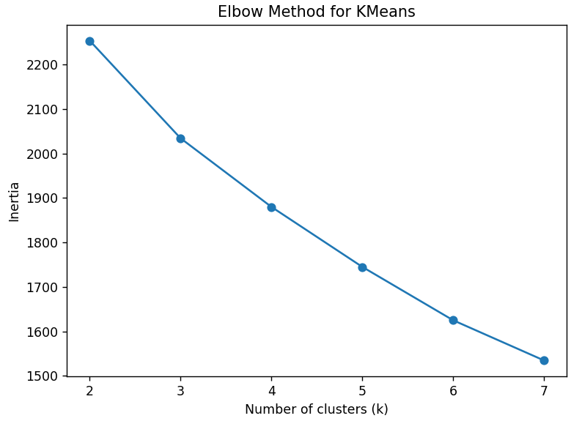
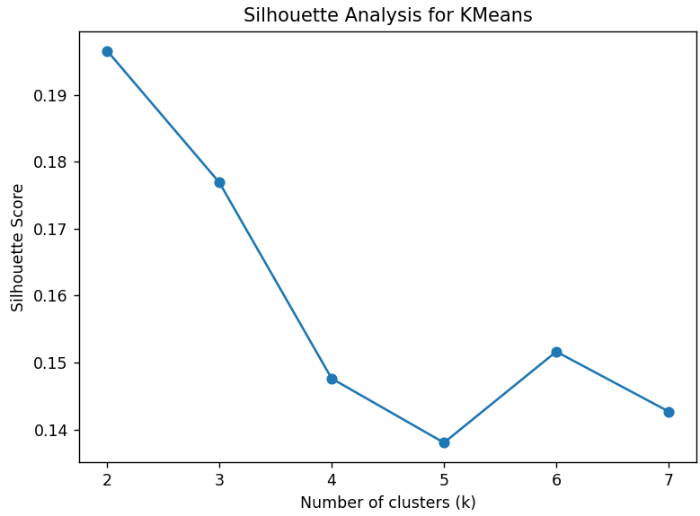
Clustering
Kmeans was used as the clustering algorithm.
No specific value of k showed promising signs in the elbow method or the silhouette analysis. So, 3 was selected.

Slide 9
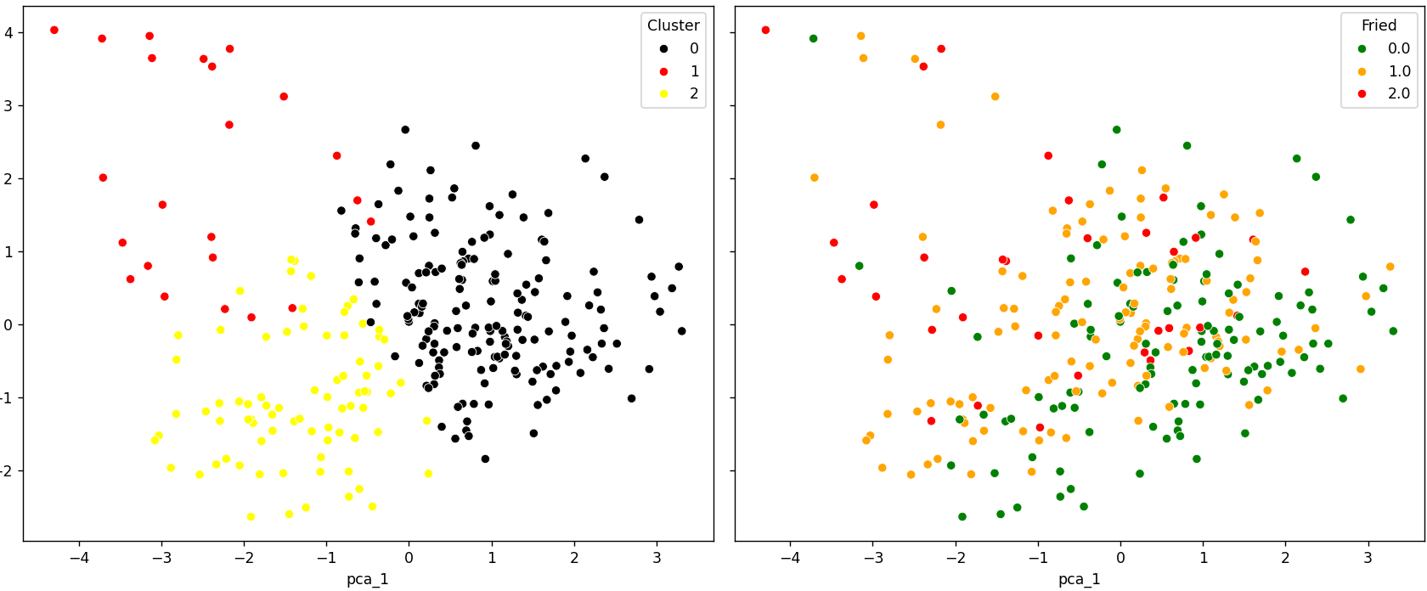
Results 2D PCA

Slide 10
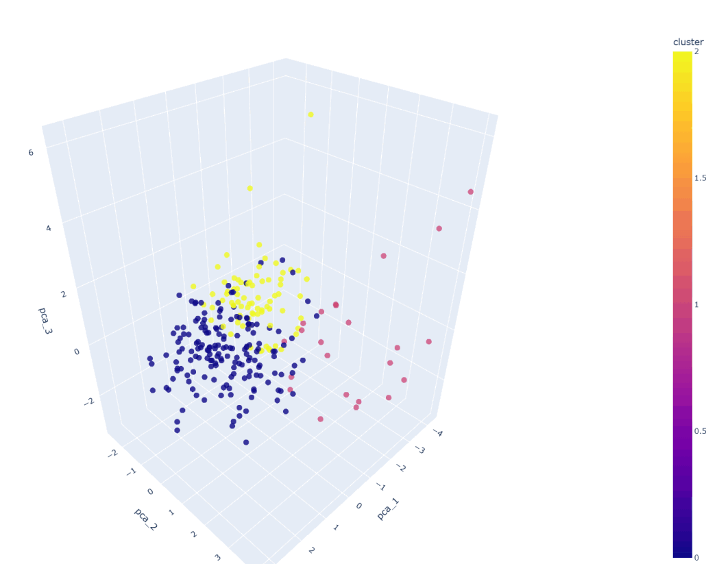
Results 3D
PCA

Slide 11
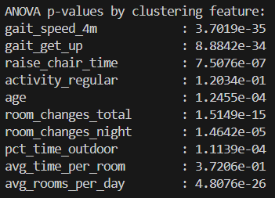
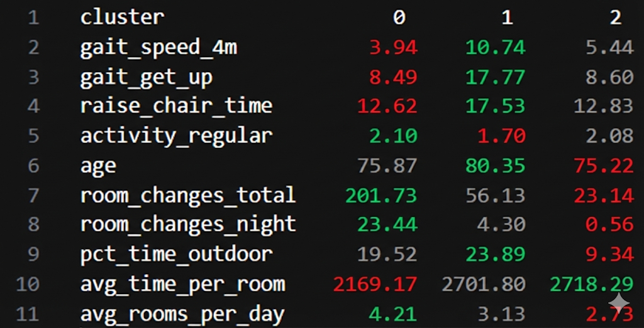
Numerical results
Mean fried score of each cluster
Cluster 0: 0.569 (167 participants)
Cluster 1: 1.391 (23 participants)
Cluster 2: 0.759 (79 participants)
Cluster 0: The most athletic with the smallest fried score, most room activity
Cluster 1: Oldest and least athletic, highest fried score, average room activity
Cluster 2: Almost as athletic and young as 1, fried score a little bit higher than 1, least room activity
Seems like room activity (as measured here) does not always mean less/more frailty.

Slide 12
Thank you for your attention.
Any questions?
https://github.com/ultrongr/BigData_beacons/

