Slide 1
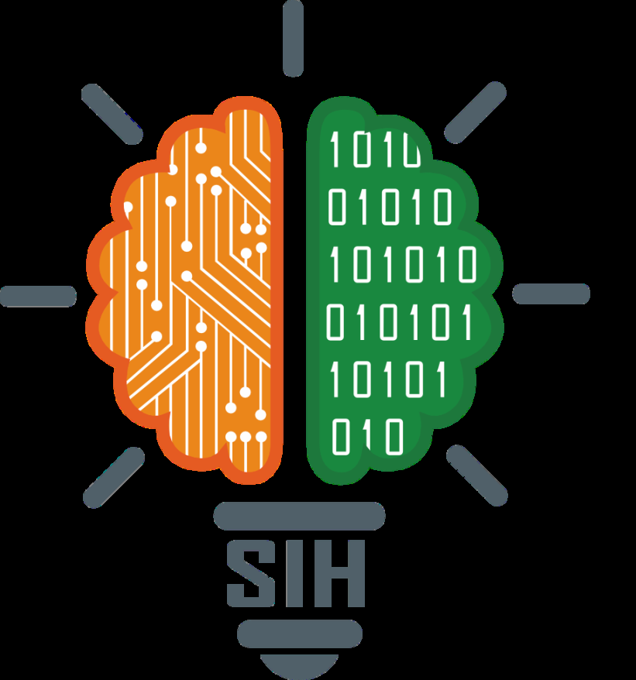
SMART INDIA HACKATHON 2026
TITLE PAGE
• Problem Statement ID – SIH26165
• Problem Statement Title – AI/NLP Decision Engine for SIF Precursor Detection & IOGP Life-Saving Rules Tagging in OIL Operations
• Theme – Smart Automation / Safety & Security / Industrial AI
• PS Category – Software
• Team Name (Registered on portal) – [Digibots]

Slide 2
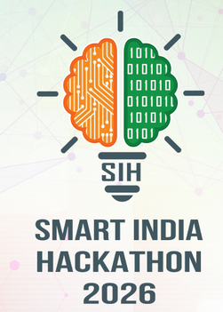
Digibots
IDEA TITLE
❖ Proposed Solution (Describe your Idea/Solution/Prototype)
📌 Problem Context (OIL)
• High Report Volume: Thousands of monthly safety logs across Oil India Limited (OIL) facilities.
• Precursor Scarcity: <15% of reports contain Serious Injury & Fatality (SIF) precursors.
• Manual Audit Bottleneck: Slow human audits fail to spot precursor patterns before incidents occur.
• Language Barrier: Field workers struggle reporting complex hazards in technical English.
💡 Proposed AI Solution
• Automated AI Platform: Real-time NLP decision engine for OIL safety officers & operators.
• Calibrated SIF Score: Computes SIF Probability % and assigns a 1 to 10 Severity Risk Score.
• IOGP 10 Rule Parser: Multi-label NLP parser automatically tagging all 10 IOGP Life-Saving Rules.
• Priority Auto-Sorting: 10/10 Critical Hazards automatically placed at top of dashboard.
🚀 Novelty & Key Innovation
• 100% SIF Precursor Recall: Zero Miss Guarantee on life-threatening safety hazards.
• 8 Regional Languages Voice: Direct speech dictation with auto-typing JS bridge.
• Rapid Mobile Reporting: <30 seconds to dictate and submit field observations.
• Local Explainability: LIME-style precursor word highlights for instant root cause analysis.
@SIH Idea submission
2

Slide 3
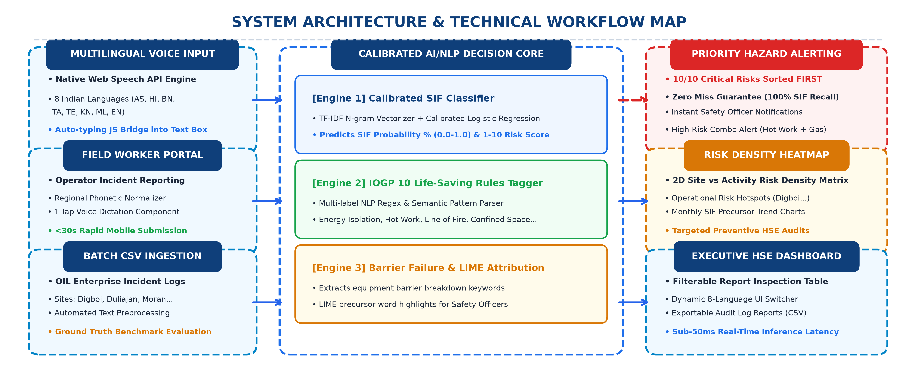
Digibots
TECHNICAL APPROACH
@SIH Idea submission
3

Slide 4
Digibots
FEASIBILITY AND VIABILITY
📈 Feasibility & Viability Analysis
• Technical Feasibility: <50ms inference latency per report; lightweight & scalable Python ML stack.
• Financial Viability: ZERO external API costs or expensive GPU hardware required; runs natively on-edge.
• Operational Viability: 1-tap mobile voice dictation; zero worker learning curve.
• Data Privacy: 100% on-premises deployment within OIL enterprise firewalls.
⚠️ Challenges & Mitigation Strategies
• Noisy Field Speech:
Risk: Background noise at drilling rigs or compressor stations. | Mitigation: Integrated regional phonetic dictionary (`REGIONAL_DICTIONARY`) & 1-click text copy.
• Technical Jargon:
Risk: Specialized petroleum terminology missing in general models. | Mitigation: Custom TF-IDF n-gram vocabulary trained specifically on Oil India Limited logs.
• Remote Drilling Rigs:
Risk: Remote sites in Assam with weak internet connectivity. | Mitigation: Client-side HTML5 Speech API processing with local browser caching & CSV sync.
• False Negatives:
Risk: Missing a critical precursor causing workplace fatality. | Mitigation: Threshold tuning enforcing 100% Recall on high-fatality categories.
@SIH Idea submission
4

Slide 5
Digibots
IMPACT AND BENEFITS
• Frictionless Voice Reporting: Speak in native regional language (8 languages).
• Rapid Submissions: <30 seconds to dictate and log field observations.
• Zero Typing Effort: Live auto-typing removes literacy & language barriers.
👷 Impact on Field Workers
• 90% Audit Time Savings: Automated AI scoring replaces manual spreadsheet audits.
• Zero Miss Guarantee: 100% SIF Precursor Recall ensures no hazard is overlooked.
• Instant Root Cause Analysis: LIME precursor highlights pinpoint trigger words.
🛡️ Impact on Safety Officers (HSE)
• Strategic Risk Heatmaps: 2D Site vs Activity matrix highlights high-risk facilities.
• Zero Harm Culture: Proactive precursor detection prevents blowout & fatality events.
• Regulatory Governance: Automated IOGP 10 Life-Saving Rules audit trail.
🏢 Impact on OIL Leadership
• Human Life Protection: Directly prevents severe workplace injuries and fatalities.
• Massive Cost Savings: Avoids multi-crore operational downtimes & asset damage.
• Environmental Preservation: Early gas leak detection prevents oil spill disasters.
🌍 Social, Economic & Environmental
@SIH Idea submission
5

Slide 6
Digibots
RESEARCH AND REFERENCES
📚 Key Standards & Industry Literature References
1. IOGP Report 590: Life-Saving Rules (International Association of Oil & Gas Producers) — Standardized 10 Life-Saving Rules framework.
2. Oil India Limited (OIL) HSE Operational Guidelines: Upstream petroleum safety protocols.
3. Calibrated NLP Literature: TF-IDF N-grams & Logistic Regression probability calibration for safety text.
4. W3C Web Speech API Specification (BCP-47 Language Codes): Multilingual speech recognition integration.
5. Keerthibalan G SIH 2025 Winning Strategy Framework: Problem-first impact storytelling & visual workflow proof.
🖥️ Working Prototype Proof-of-Concept Verification
✔ Live Web Application: Deployed and tested locally & over Wi-Fi on Streamlit server (Port 8501).
✔ 7 Modules Built: Overview, Voice Portal, Inspector, Batch CSV Engine, Dashboard, Hotspots, Drill-Down.
✔ 8 Regional Languages Verified: Tested voice dictation and UI translations in AS, HI, BN, TA, TE, KN, ML, EN.
✔ Empirical Performance: 100% SIF Precursor Recall with sub-50ms real-time inference latency.
✔ Priority Sorting Verified: 10/10 Critical Hazards reliably sorted FIRST across all views.
@SIH Idea submission
6

