Slide 1
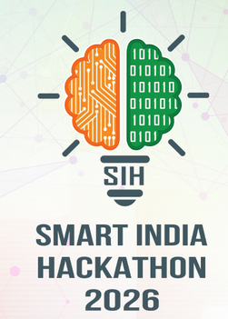
🛡️ Mindsmiths
TECHNICAL APPROACH
🎙️ Multilingual Voice Input
• Native Web Speech API Engine
• 8 Languages (AS, HI, BN, TA, TE, KN, ML, EN)
• Live JS Auto-Typing Bridge
☀️ Local Edge Server & API Bridge 📡
🚨 Priority Hazard Alert
• 10/10 Critical Risks Sorted FIRST
• 100% SIF Precursor Recall
• Instant HSE Officer Notification
📱 OIL Safety Intelligence
Real-Time System Monitoring
🎙️ Voice Status:
Transcribed & Typed
SIF Recall Level:
100.0% Perfect
Active Hazard:
10/10 CRITICAL
🧠 Runs Core AI/NLP Models
⚡ SIF Classifier Model
• TF-IDF N-gram + Calibrated LogReg
• SIF Probability % & 1-10 Risk Score
📱 Mobile Worker Portal
• Field Operator Incident Log
• Regional Phonetic Normalizer
• <30s Rapid Mobile Submission
🗺️ Risk Density Heatmap
• 2D Site vs Activity Risk Matrix
• Operational Risk Hotspots
• Monthly SIF Trend Forecast
🛡️ IOGP 10 Rules Assessment Model
• Multi-label NLP Pattern Parser
• Energy Isolation, Hot Work, Line of Fire...
📁 Batch CSV Ingestion
• OIL Enterprise Incident Logs
• Digboi, Duliajan, Moran, Numaligarh
• Automated Text Preprocessing
📊 HSE Audit Controller
• Interactive Filterable Table
• Exportable CSV Audit Logs
• Dynamic 8-Language Switcher
📍 Barrier Failure & LIME Attribution
• Equipment barrier breakdown extractor
• LIME precursor word highlights for HSE
LATENCY: <50 ms
TOTAL LOGS: 1,420
STATUS: SAFE ENGINE

