Slide 1

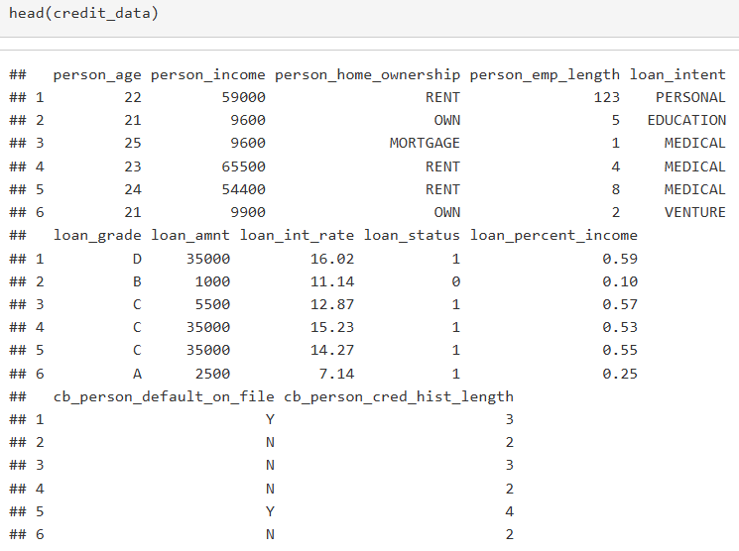
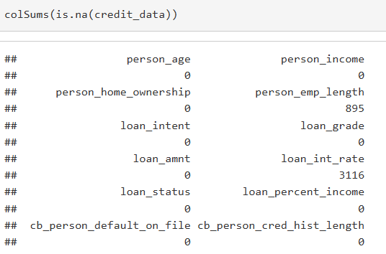
SMART QUESTION 2: CAN WE PREDICT LOAN DEFAULT?
[ R Code: str() / head() / colSums(is.na()) ]
Build a model to estimate probability of loan default using borrower demographics and financial variables.
Outcome Variable: loan_status (0 = No Default, 1 = Default)
Binary classification problem
Method: Logistic Regression
Variables: Income, Emp. Length, Home Ownership, Loan Amount, Interest Rate, Loan % Income, Age, Credit History
Split: 70% Train / 30% Test
Borrower
Logistic
Regression
Default?

Slide 2
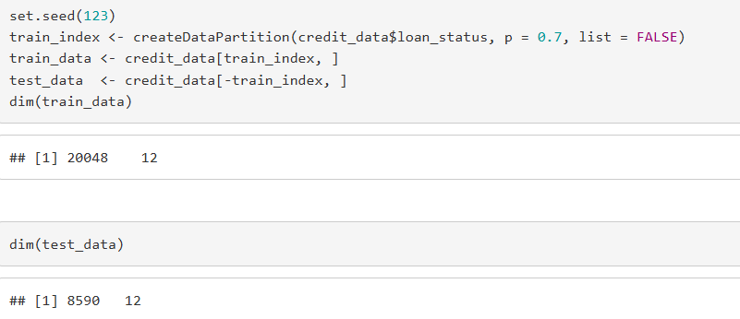
DATA PREPARATION
[ R Output: str(), head(), dim(train_data), dim(test_data) ]
Clean and structure the data before modeling.
Loaded credit_risk_dataset.csv
Checked missing values → removed with na.omit()
loan_status → factor (R needs categorical for classification)
Categorical vars → factors: home_ownership, loan_intent, loan_grade, cb_default_on_file
Train-Test Split: 70% train / 30% test | set.seed(123)

Slide 3
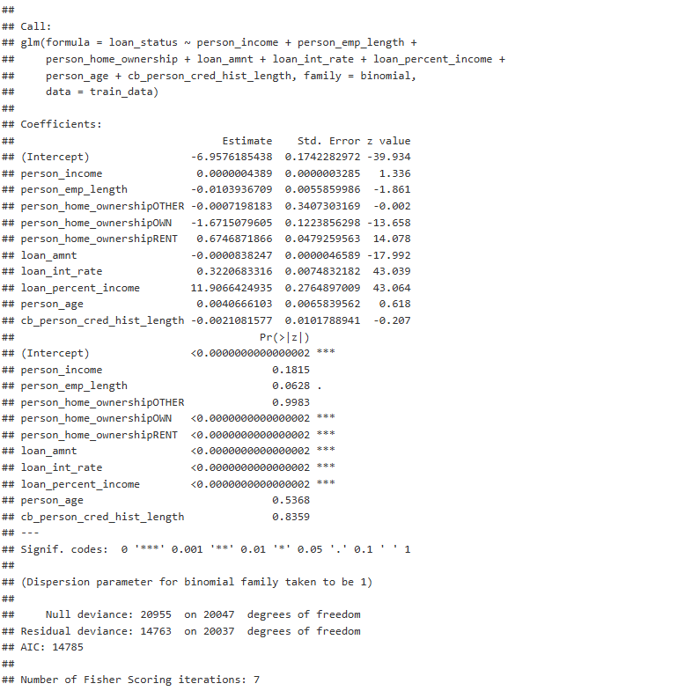
LOGISTIC REGRESSION MODEL
[ R Output: summary(model_logit) ]
glm() with family = binomial trains the model on 70% of data.
Response variable is binary → Logistic Regression
Outputs probability (0 to 1) of default for each borrower
Threshold = 0.5 → probability > 0.5 classified as Default
8 predictors: income, emp. length, home ownership, loan amt, interest rate, % income, age, credit history
summary(model_logit) shows which variables are significant

Slide 4
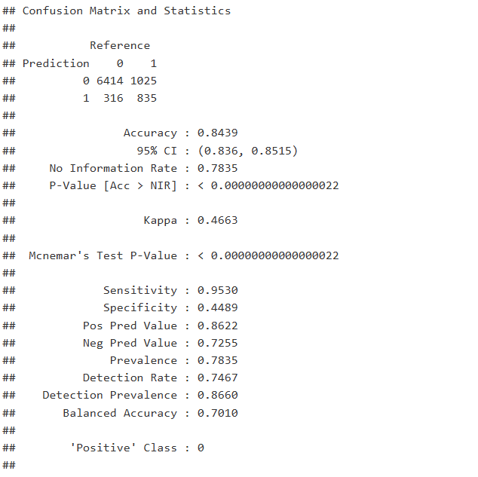
CONFUSION MATRIX
[ R Output: confusionMatrix() ]
Breaks down predictions into 4 categories to reveal what kind of mistakes the model makes.
True Negative (TN): Predicted safe → Actually safe ✓
True Positive (TP): Predicted default → Actually default ✓
False Positive (FP): Predicted default → Actually safe (False Alarm)
False Negative (FN): Predicted safe → Actually default (Missed!)
For banks — FN is the costliest mistake (missed defaults = lost money)

Slide 5
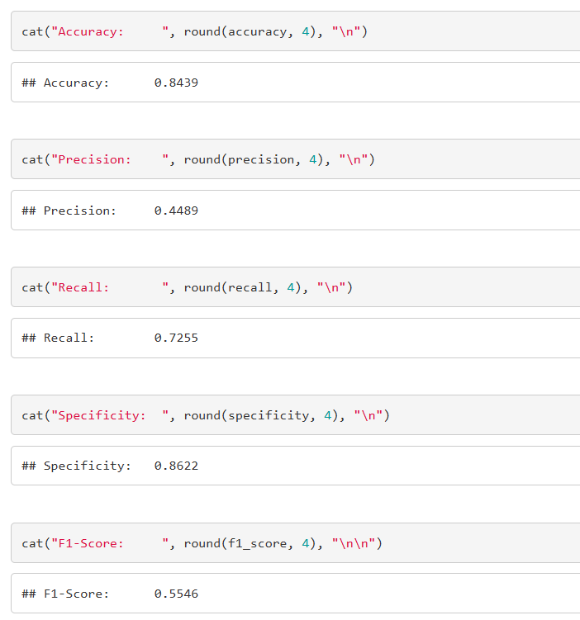
PERFORMANCE METRICS
[ R Output: Accuracy / Precision / Recall / F1-Score printout ]
Multiple metrics give a complete picture of model performance.
Accuracy 84.39%: Overall correct predictions
Precision 44.89%: When we flag a default, we're right 44.89% of the time
Recall 72.55%: We catch 72.55% of actual defaults,
miss 27.45%
F1-Score 0.5546: Balanced measure combining precision & recall
AUC 0.8478: Strong discrimination between defaulters and non-defaulters

Slide 6
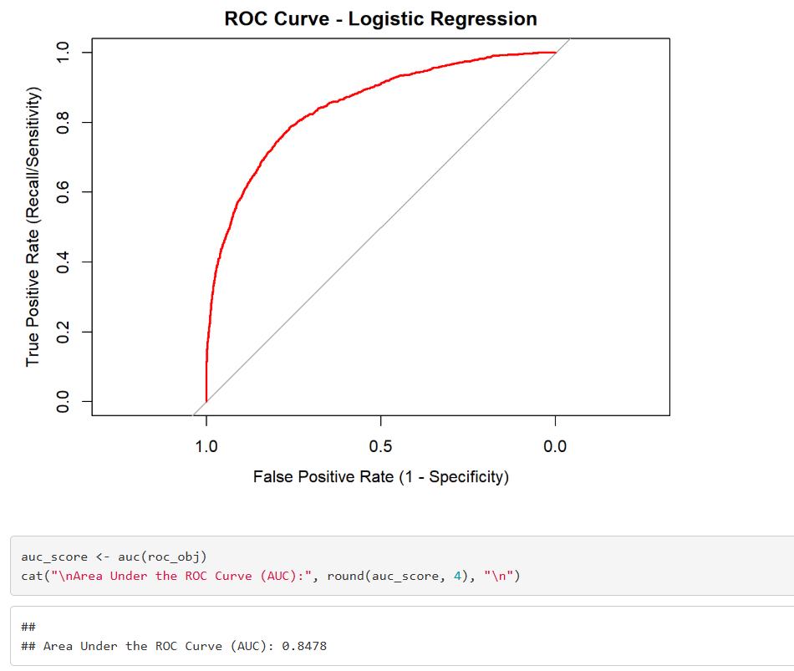
ROC CURVE & AUC
[ ROC Curve plot from R ]
The ROC curve evaluates model performance across all possible thresholds, not just 0.5.
X-axis: False Positive Rate | Y-axis: True Positive Rate
Diagonal line = random guessing (AUC = 0.5)
Our curve bends toward top-left → better than random
AUC = 0.5 → random | AUC = 1.0 → perfect
Our AUC = 0.8478 → Good model

Slide 7
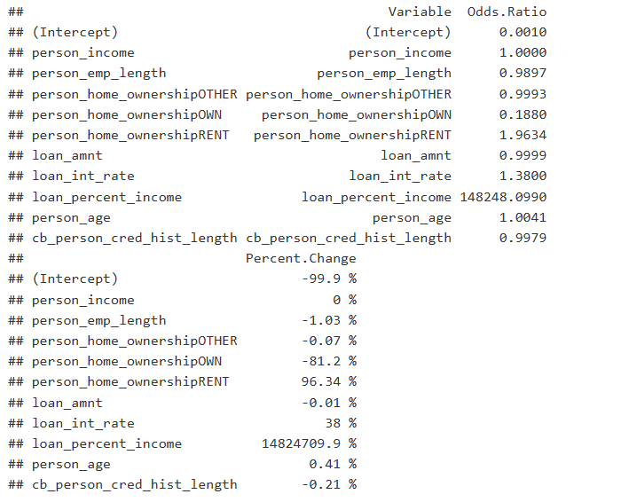
KEY RISK FACTORS – ODDS RATIOS
[ R Output: Odds Ratios table / exp(coef()) ]
Odds ratios show which variables increase or decrease default risk.
Odds Ratio > 1 → Increases Risk | Odds Ratio < 1 → Decreases Risk
↑ Interest Rate - strongest risk increaser
↑ Loan % of Income - higher burden = higher risk
↓ Home Ownership - owners are more financially stable
↓ Employment Length - longer tenure = lower risk
↓ Loan Amount - slight protective effect

Slide 8
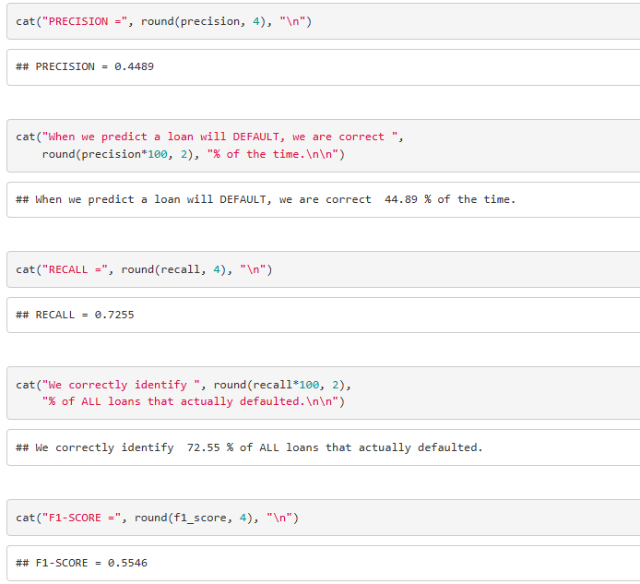
PRECISION VS. RECALL TRADE-OFF
[ R Output: Precision / Recall / F1 printout ]
For banks, missing a real default is more costly than a false alarm.
Precision 44.89% → 55.11% of flagged loans are false alarms
Recall 72.55% → we miss 27.45% of actual defaults
False Positive: bank reviews a safe loan → minor cost
False Negative: bank misses a default → loses principal
Can lower threshold (0.5 → 0.4) to improve recall, but creates more false alarms
F1-Score is the best single metric here, balances both

Slide 9
CONCLUSION
Logistic regression is an effective baseline model for loan default prediction.
84.39% accuracy and AUC 0.8478 → strong predictive performance
Interest rate and loan-to-income ratio are the strongest default risk drivers
Homeowners and longer-employed borrowers show significantly lower default risk
Recall 72.55% → model still misses 27.45% of actual defaults (main limitation)
Banks can use predicted probabilities to prescreen applicants and set interest rates
Future Work: Try Random Forest / Gradient Boosting | Optimize threshold | Cross-validation

