Slide 1


Group Presentation
PROJECT 2:
IMPLEMENTING REGRESSION-BASED AND CLASSIFICATION MODELING TECHNIQUES
Ulugbek Islomov
Maurice Goode
Soumae Patidar

Slide 2
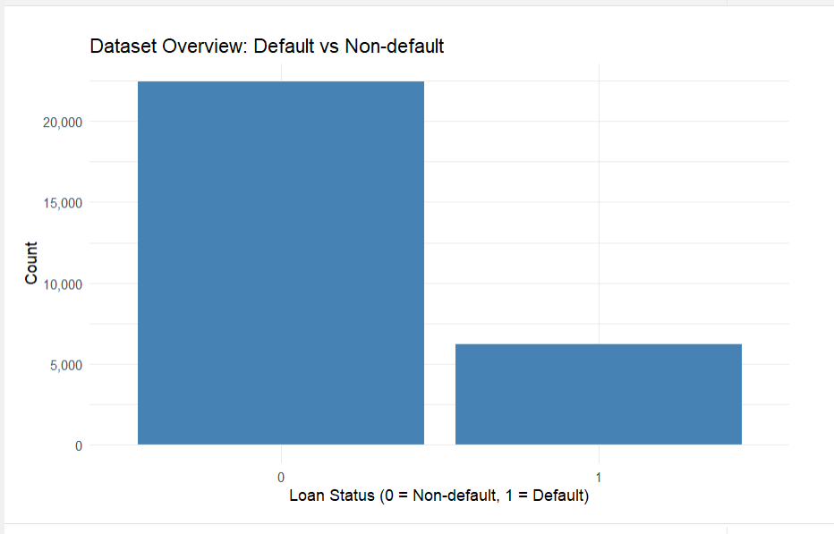

INTRO
Main Message : We combine statistical and machine learning methods to understand pricing, risk, and their relationship.
Objective
Understand pricing (interest rate)
Predict default risk
Analyze pricing–risk relationship
SMART Questions
1. What drives interest rates?
2. What predicts default probability?
3. Does interest rate affect default?
Methods
Linear regression
Logistic regression
Tree-based models
Concept diagram
Borrower Characteristics
↓
Loan Grade (Risk)
↓
Interest Rate (Pricing)
↓
Default (Outcome)

Slide 3
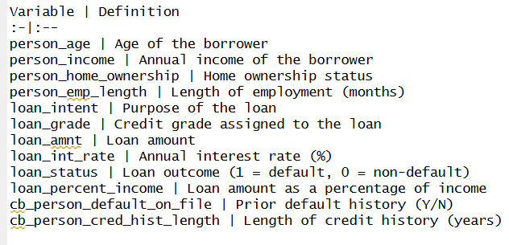
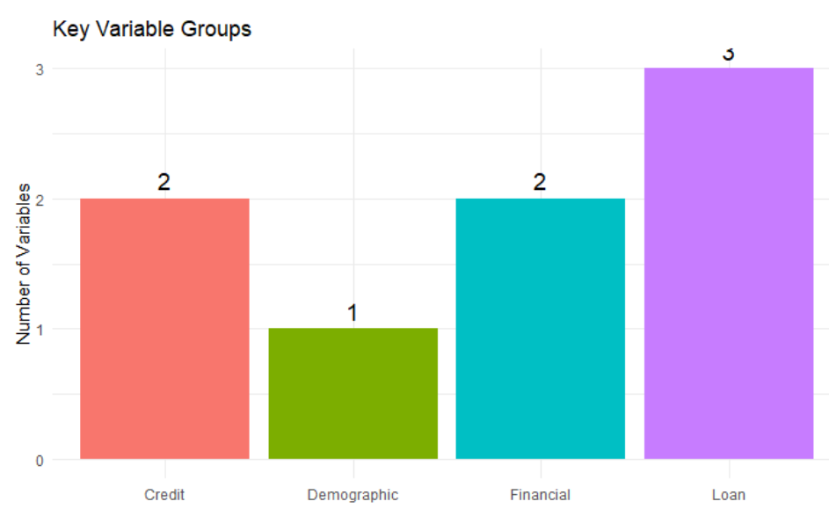
Variable Definitions:
DATA AND VARIABLES
Dataset Overview:
Source: Kaggle
Name: credit_risk_dataset.csv
Observations: ~ 32,000
Variables: 12 borrower and loan characteristics
Target variable: loan_status (1 = default, 0 = non-default)
Nature: Consumer lending data

Slide 4
SMART QUESTION 1: DO BORROWER CHARACTERISTICS AFFECT INTEREST RATE?
Main Message : Research question and conceptual relationship between borrower risk and pricing.
Borrower Characteristics Used in the Project
Age
Home ownership status
Annual income
Employment length
Credit history length
Prior default history
Loan intent (purpose)
Loan amount & burden
💥
Outcome: Interest Rate
Pricing vs borrower profile
Role of loan grade
Regression + tree methods
Loan Grade
Interest Rate
Borrower

Slide 5
MODELING STRATEGY
Main Message : Analytical Roadmap
A METHOD FLOWCHART:
EDA
Model 1
Model 2
ANOVA
Diagnostics
Trees
Conclusion
🔍
🤖
⚙️
📊
🩺
🌲
✅
💥
Inference problem
Model 1: borrower variables
Model 2: + loan grade
Regression trees:
with grade
without grade

Slide 6
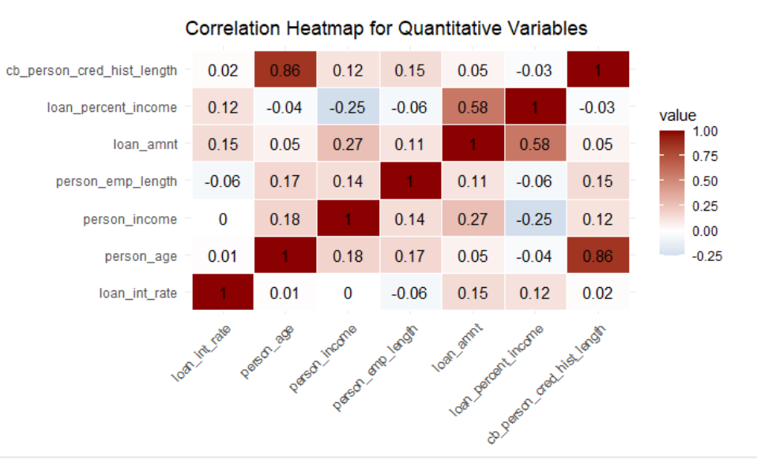
INITIAL EVIDENCE: WEAK DIRECT RELATIONSHIPS
Main Message : Borrower characteristics alone show weak direct association with interest rate.
💥
Small correlations
Weak linear patterns
Borrower effects limited
Risk signal exists

Slide 7
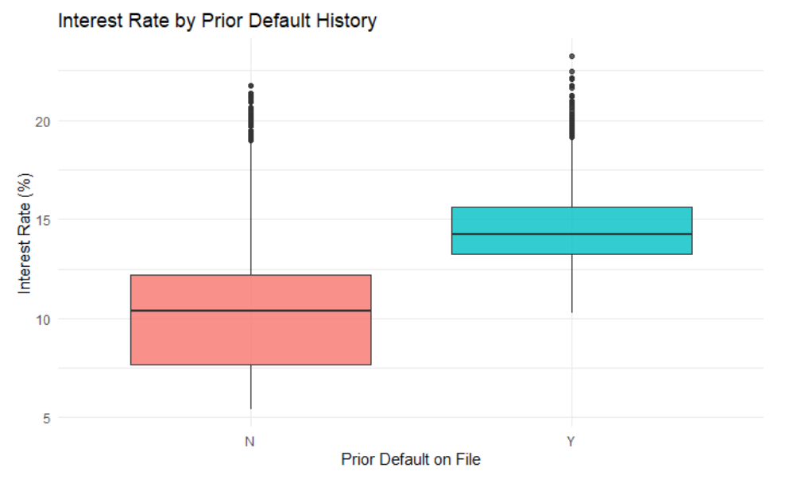
CATEGORICAL RISK SIGNAL: PRIOR DEFAULT MATTERS
Main Message : Among borrower characteristics, prior default history shows the clearest early pricing signal
💥
Clear group difference
Default history -> higher rates
Risk already priced in

Slide 8
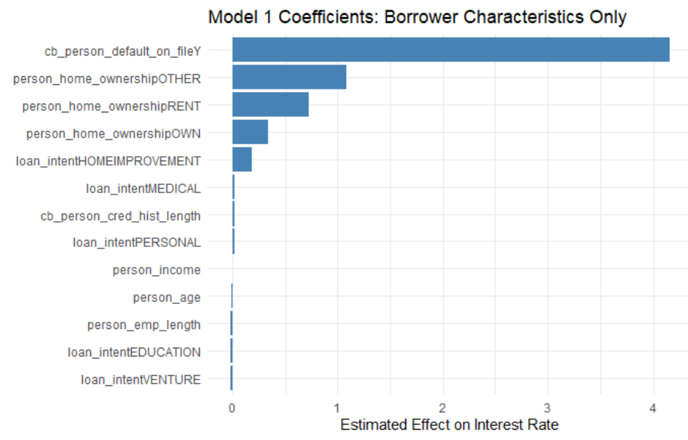
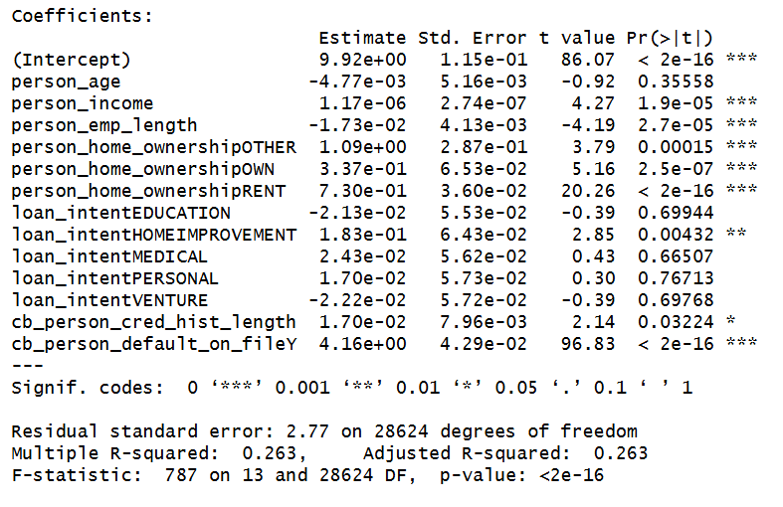
MODEL 1: BORROWER CHARACTERISTICS ONLY
Main Message : Borrower variables matter statistically, but explain only a moderate portion of pricing.
💥
Several variables significant
Prior default strongest
R² = 26.3%
Moderate explanatory power

Slide 9
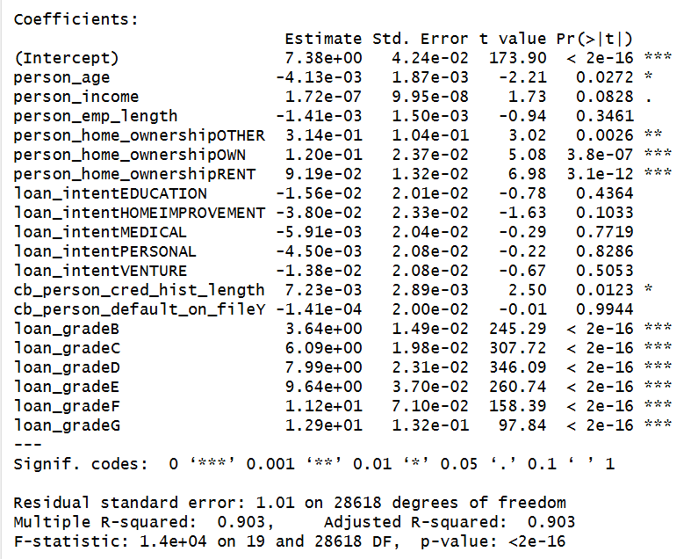
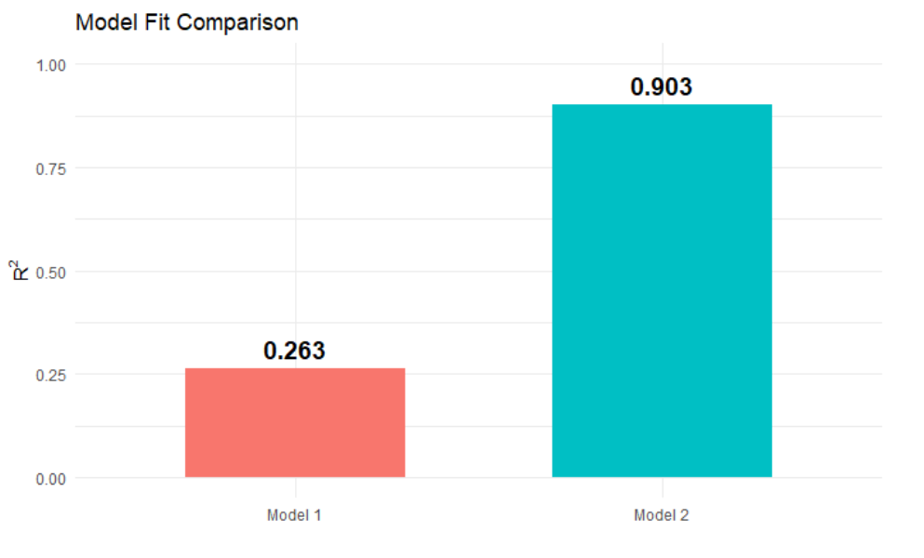
MODEL 2: LOAN GRADE CHANGES THE STORY
Main Message : Loan grade dramatically improves model fit and dominates pricing
💥
Adding loan grade
R²: 26.3% → 90.3%
Borrower effects weaken
Grade absorbs risk information

Slide 10
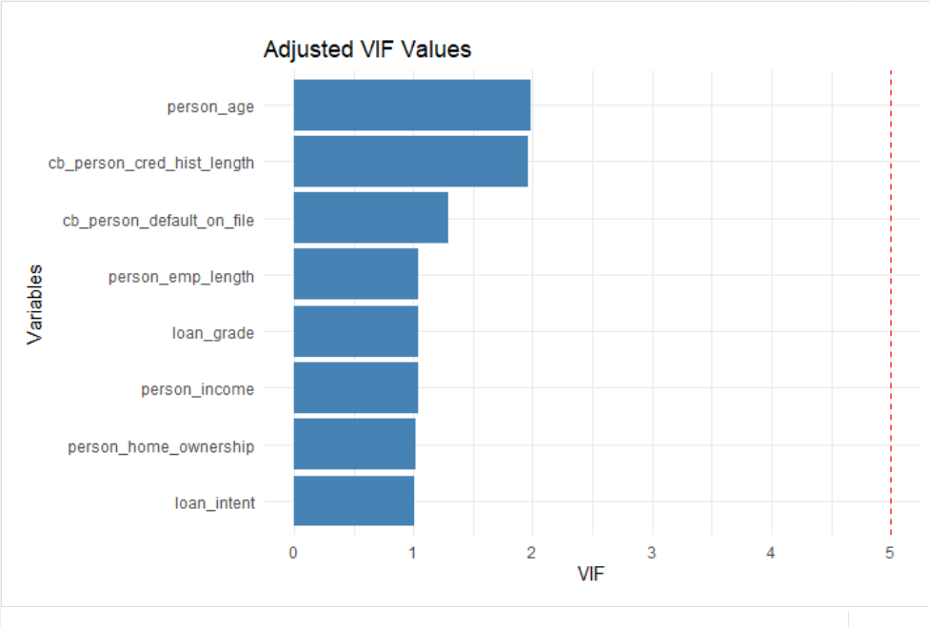
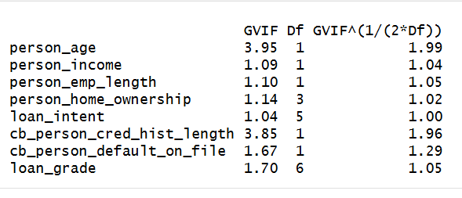
MULTICOLLINEARITY CHECK: ARE PREDICTORS REDUNDANT?
Main Message : The regression model does not suffer from multicollinearity, ensuring stable and reliable coefficient estimates.
💥
Multicollinearity assessed using VIF
All adjusted VIF values close to 1
Maximum VIF ≈ 2 (well below threshold 5)
No strong correlation among predictors
Loan grade does not introduce redundancy
Model coefficients are stable and reliable

Slide 11
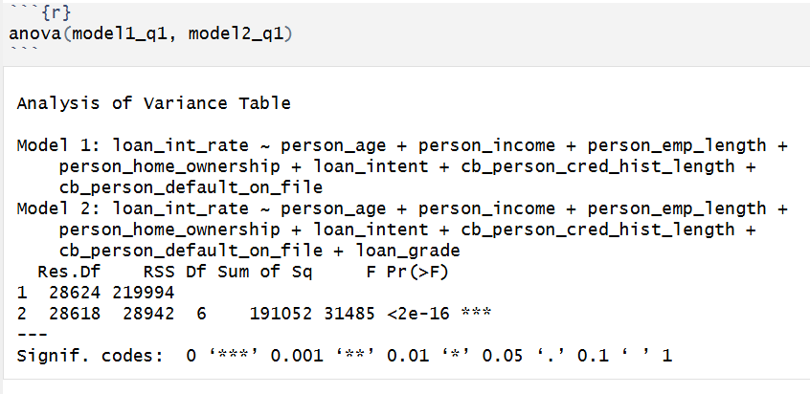
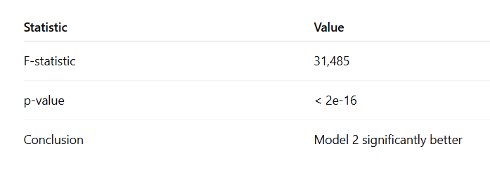
ANOVA CONFIRMS THE IMPROVEMENT
Main Message : The improvement from adding loan grade is statistically decisive.
💥
Large RSS reduction
F = 31,485
p < 2e-16
Model 2 significantly better

Slide 12
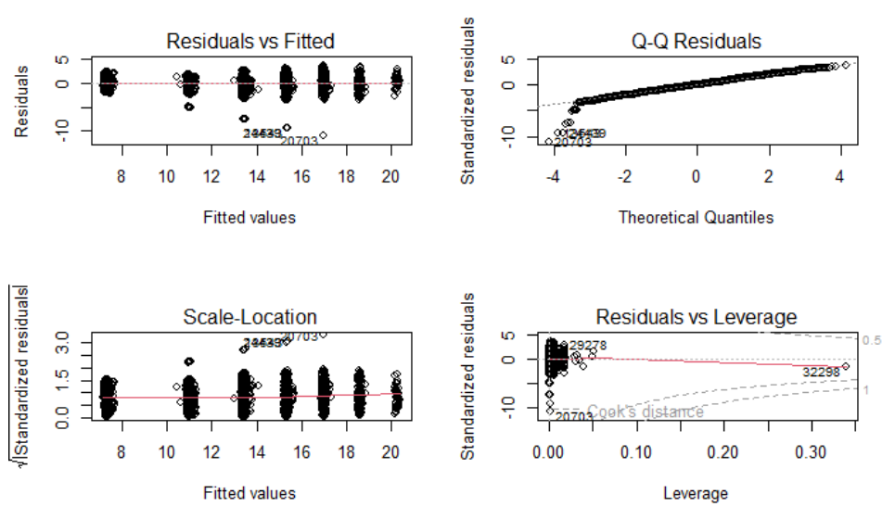
MODEL DIAGNOSTICS: THE REGRESSION IS RELIABLE
Main Message : Regression assumptions are reasonably satisfied
💥
No strong pattern
Variance mostly stable
No dominant outliers
Minor tail deviations only

Slide 13
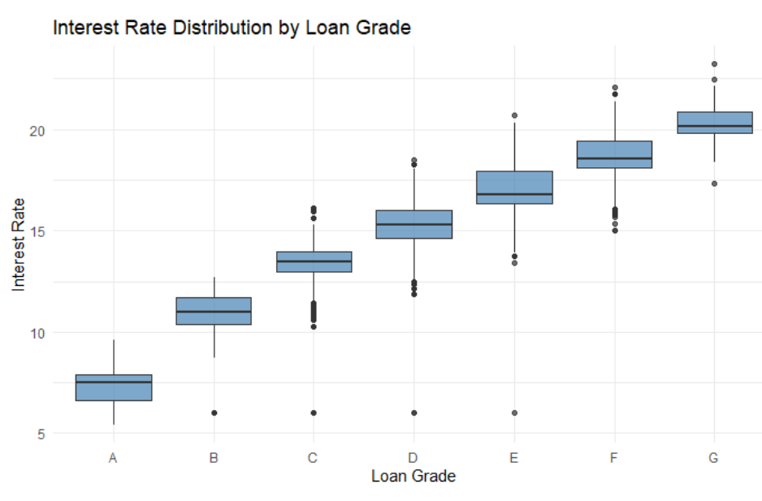
KEY VISUAL RESULT: INTEREST RATE RISES BY LOAN GRADE
Main Message : Loan grade provides the clearest visual summary of the pricing mechnism.
💥
Clear upward trend
A -> G monotonic increase
Strong evidence of
risk-based pricing

Slide 14
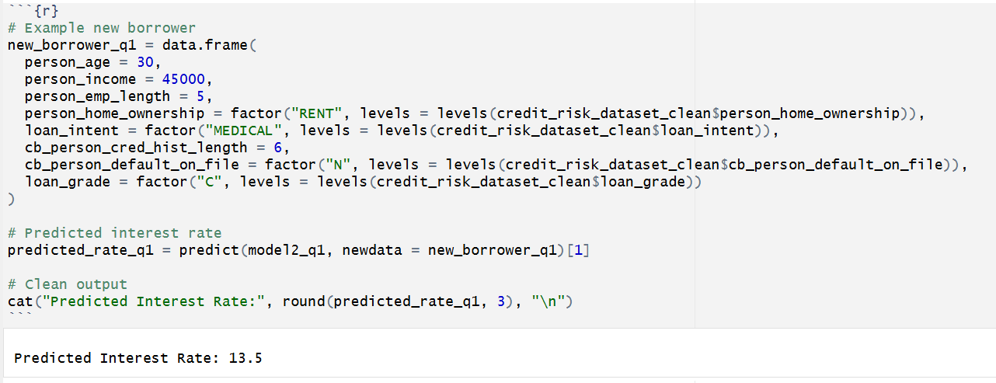
PREDICTION TOOL: ESTIMATING INTEREST RATE FOR A NEW BORROWER
Main Message : The model can be operationalized as a practical pricing tool.
💥
Input borrower profile
Predict interest rate
Practical decision-support
Not exact institutional rule

Slide 15
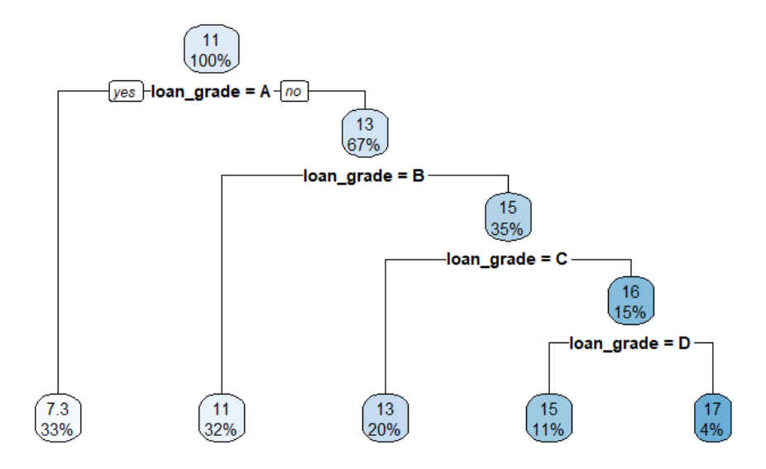
REGRESSION TREE WITH LOAN GRADE
Main Message : The tree confirms that pricing is dominated by loan grade.
💥
First split: loan grade
Sequential risk ladder
No borrower variables used
Rule-based pricing

Slide 16
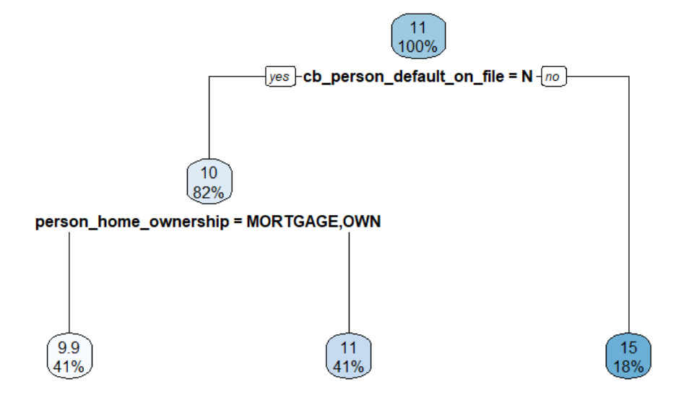
REGRESSION TREE WITHOUT LOAN GRADE
Main Message : Without loan grade, borrower-level pricing drivers become visible
💥
Without grade:
prior default
home ownership
Grade summarizes borrower risk
May recover bank pricing rule
Market/time factors missing

Slide 17
KEY FINDINGS
Finding: While borrower attributes (income, employment, credit history) are statistically significant, they explain only about 26% of variation in interest rates.
Why this is striking: I expected borrower profile to strongly drive pricing - but it doesn’t.
Borrower characteristics alone explain surprisingly little of interest rates
💡
🔍
🔍
Loan grade almost completely determines interest rates
💡
Finding: Adding loan grade increases R² from 26% → over 90%.
Why this is shocking: One variable explains almost everything.
🔍
Prior default loses its effect once loan grade is included
Finding: Prior default is highly significant in Model 1, but becomes insignificant in Model 2.
Why this is revealing: A key risk factor suddenly “disappears.”
💡
Regression tree confirms a rule-based pricing system
💡
Finding: The regression tree (with loan grade) uses only loan grade for splitting.
Why this is unexpected: We included many variables - but the tree ignores all except one.
🔍
🔍
Without loan grade, pricing falls back to fundamental borrower risk factors
Finding: When loan grade is removed, the tree uses: prior default & home ownership
Why this is insightful: The model reveals what the bank is really using behind the scenes.
💡

Slide 18
FINAL SUMMARY
- Interest rates are not driven directly by borrower characteristics - they are driven by how risk is encoded and classified.
- Alone, borrower variables explain surprisingly little of pricing (~26%), revealing a weak direct relationship.
- However, a single variable—loan grade—explains almost everything (R² > 90%), acting as the central factor
- Tree models confirm this by reducing pricing decisions to a clear, rule-based hierarchy dominated by risk classification.
- When loan grade is removed, the “hidden logic” emerges: prior default and financial stability drive pricing at the borrower level.
- Overall, the model reveals not just relationships - but the underlying structure of how banks price risk.
🎯

Slide 19
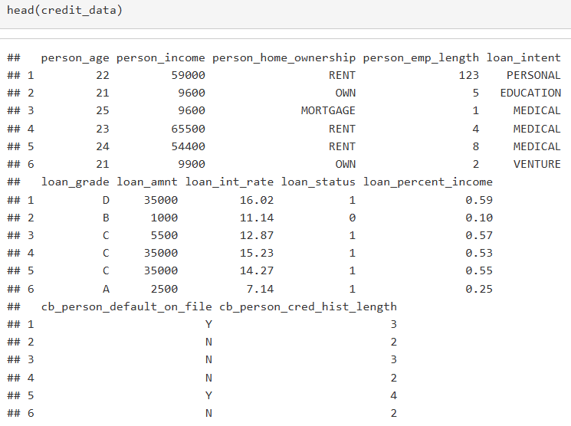
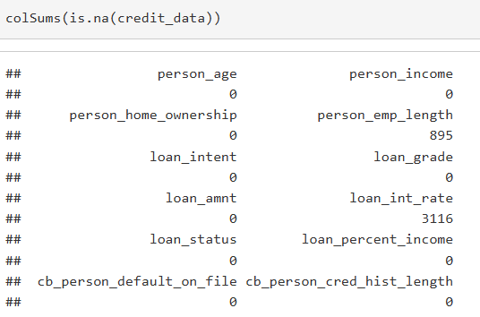
SMART QUESTION 2: CAN WE PREDICT LOAN DEFAULT?
[ R Code: str() / head() / colSums(is.na()) ]
Build a model to estimate probability of loan default using borrower demographics and financial variables.
Outcome Variable: loan_status (0 = No Default, 1 = Default)
Binary classification problem
Method: Logistic Regression
Variables: Income, Emp. Length, Home Ownership, Loan Amount, Interest Rate, Loan % Income, Age, Credit History
Split: 70% Train / 30% Test
Borrower
Logistic
Regression
Default?

Slide 20
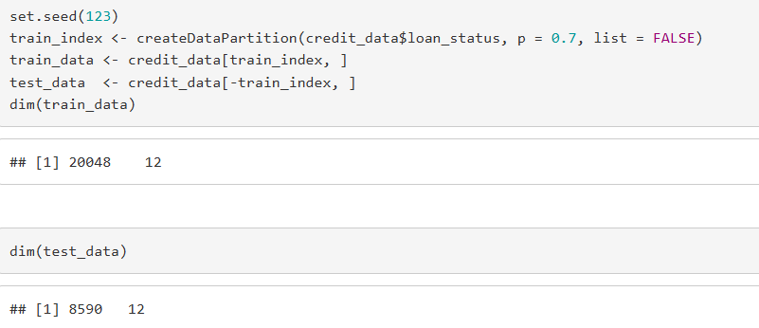
DATA PREPARATION
[ R Output: str(), head(), dim(train_data), dim(test_data) ]
Clean and structure the data before modeling.
Loaded credit_risk_dataset.csv
Checked missing values → removed with na.omit()
loan_status → factor (R needs categorical for classification)
Categorical vars → factors: home_ownership, loan_intent, loan_grade, cb_default_on_file
Train-Test Split: 70% train / 30% test | set.seed(123)

Slide 21
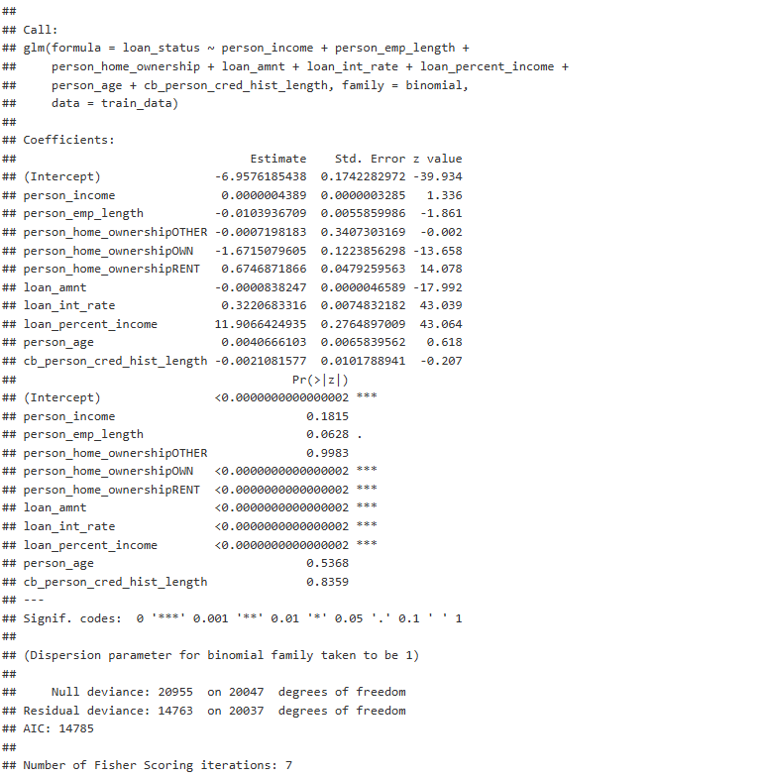
LOGISTIC REGRESSION MODEL
[ R Output: summary(model_logit) ]
glm() with family = binomial trains the model on 70% of data.
Response variable is binary → Logistic Regression
Outputs probability (0 to 1) of default for each borrower
Threshold = 0.5 → probability > 0.5 classified as Default
8 predictors: income, emp. length, home ownership, loan amt, interest rate, % income, age, credit history
summary(model_logit) shows which variables are significant

Slide 22
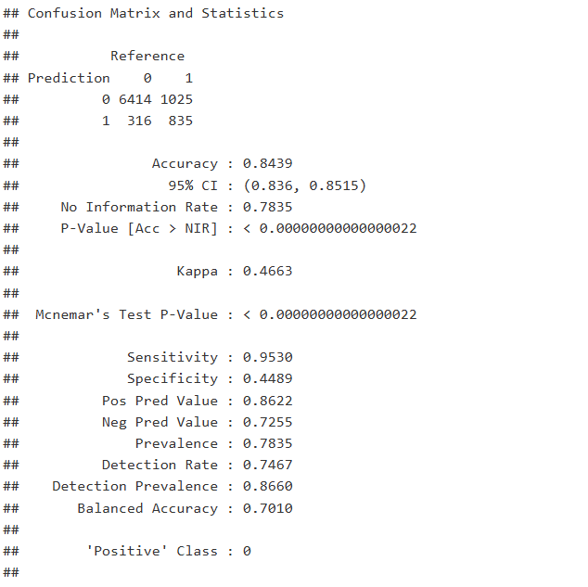
CONFUSION MATRIX
[ R Output: confusionMatrix() ]
Breaks down predictions into 4 categories to reveal what kind of mistakes the model makes.
True Negative (TN): Predicted safe → Actually safe ✓
True Positive (TP): Predicted default → Actually default ✓
False Positive (FP): Predicted default → Actually safe (False Alarm)
False Negative (FN): Predicted safe → Actually default (Missed!)
For banks — FN is the costliest mistake (missed defaults = lost money)

Slide 23
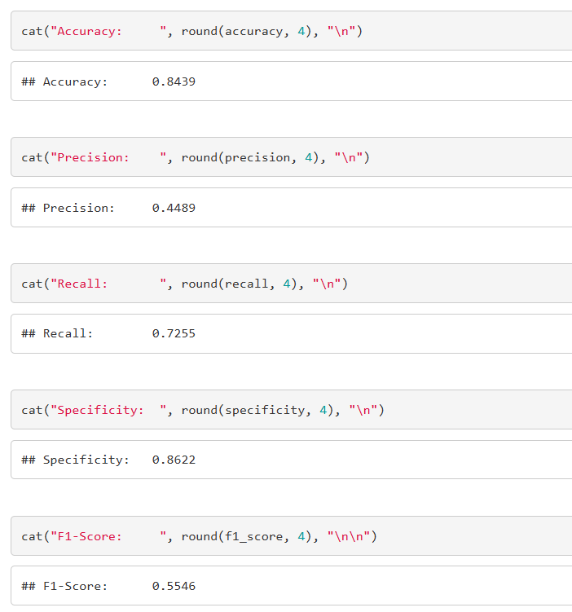
PERFORMANCE METRICS
[ R Output: Accuracy / Precision / Recall / F1-Score printout ]
Multiple metrics give a complete picture of model performance.
Accuracy 84.39%: Overall correct predictions
Precision 44.89%: When we flag a default, we're right 44.89% of the time
Recall 72.55%: We catch 72.55% of actual defaults,
miss 27.45%
F1-Score 0.5546: Balanced measure combining precision & recall
AUC 0.8478: Strong discrimination between defaulters and non-defaulters

Slide 24
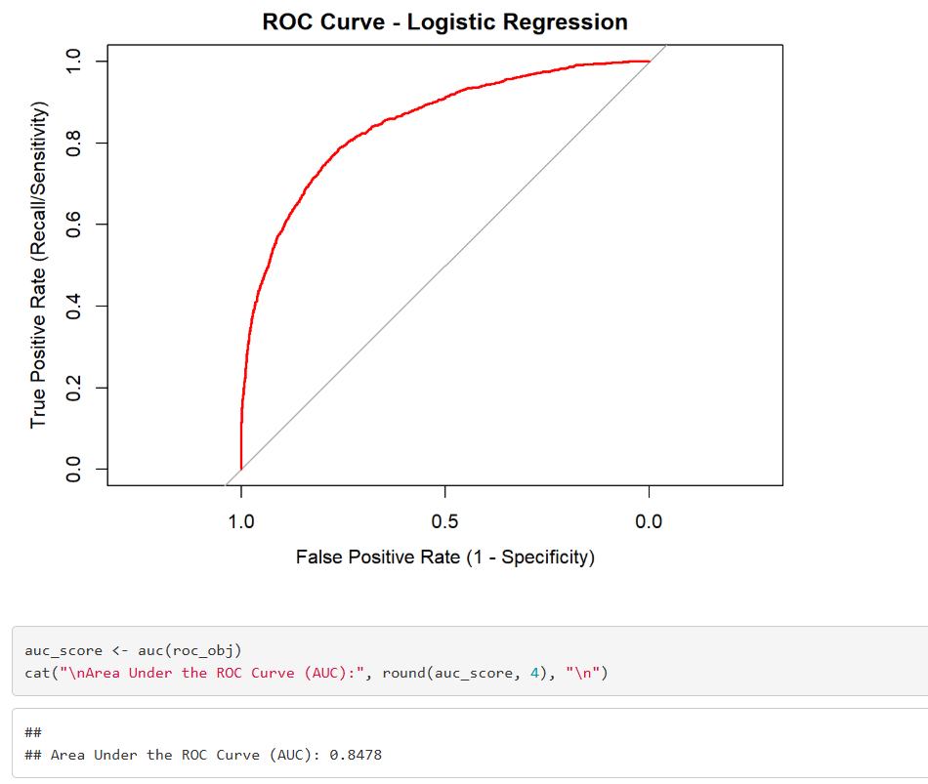
ROC CURVE & AUC
[ ROC Curve plot from R ]
The ROC curve evaluates model performance across all possible thresholds, not just 0.5.
X-axis: False Positive Rate | Y-axis: True Positive Rate
Diagonal line = random guessing (AUC = 0.5)
Our curve bends toward top-left → better than random
AUC = 0.5 → random | AUC = 1.0 → perfect
Our AUC = 0.8478 → Good model

Slide 25
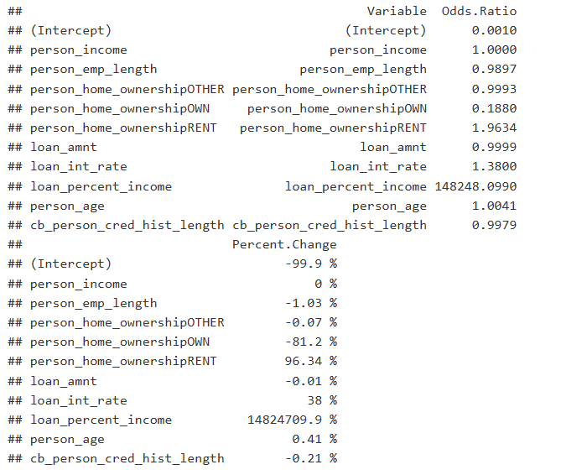
KEY RISK FACTORS – ODDS RATIOS
[ R Output: Odds Ratios table / exp(coef()) ]
Odds ratios show which variables increase or decrease default risk.
Odds Ratio > 1 → Increases Risk | Odds Ratio < 1 → Decreases Risk
↑ Interest Rate - strongest risk increaser
↑ Loan % of Income - higher burden = higher risk
↓ Home Ownership - owners are more financially stable
↓ Employment Length - longer tenure = lower risk
↓ Loan Amount - slight protective effect

Slide 26
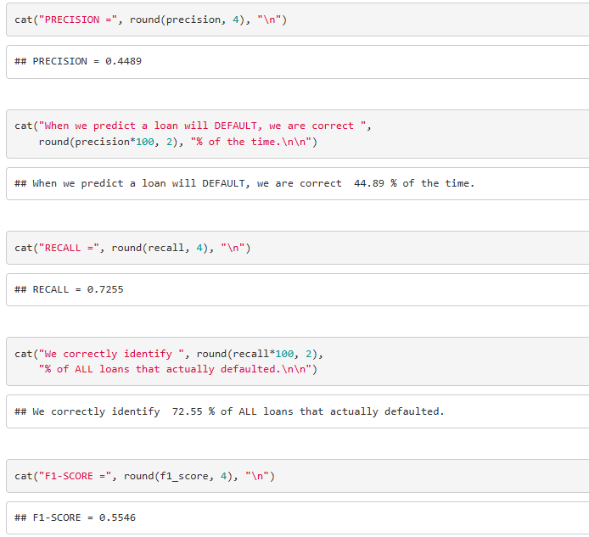
PRECISION VS. RECALL TRADE-OFF
[ R Output: Precision / Recall / F1 printout ]
For banks, missing a real default is more costly than a false alarm.
Precision 44.89% → 55.11% of flagged loans are false alarms
Recall 72.55% → we miss 27.45% of actual defaults
False Positive: bank reviews a safe loan → minor cost
False Negative: bank misses a default → loses principal
Can lower threshold (0.5 → 0.4) to improve recall, but creates more false alarms
F1-Score is the best single metric here, balances both

Slide 27
CONCLUSION
Logistic regression is an effective baseline model for loan default prediction.
84.39% accuracy and AUC 0.8478 → strong predictive performance
Interest rate and loan-to-income ratio are the strongest default risk drivers
Homeowners and longer-employed borrowers show significantly lower default risk
Recall 72.55% → model still misses 27.45% of actual defaults (main limitation)
Banks can use predicted probabilities to prescreen applicants and set interest rates
Future Work: Try Random Forest / Gradient Boosting | Optimize threshold | Cross-validation

Slide 28

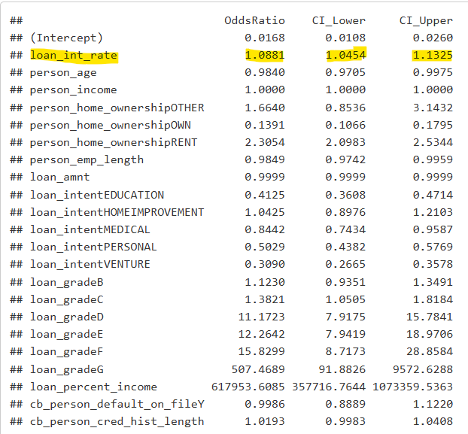
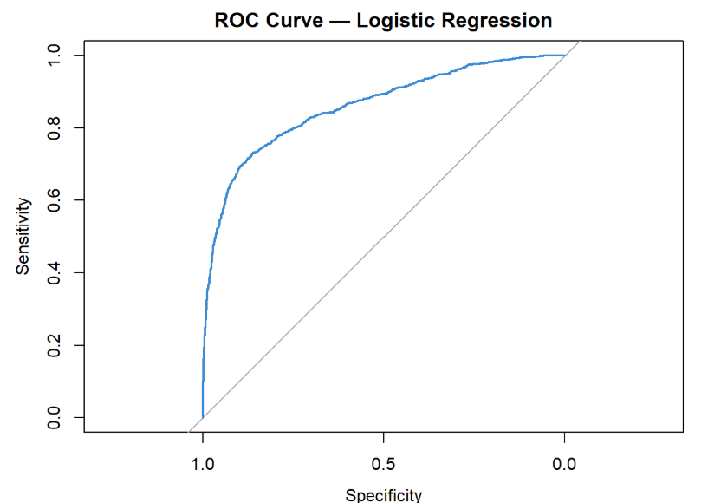


Does interest rate influence the probability of loan default, even after controlling for borrower and loan characteristics?
SMQ-3
Logistic Regression Metrics:
P-Value of Interest Rate: Below 0.05. Unlikely the observed relationship occurred by random chance in the data
Odds Ratio of Interest Rate: A one-unit increase in interest rate increases the odds of default by 1.0881, holding all else constant
McFadden R² : The R-Squared value = 0.3632. 36.32% of the model is explained by the training set
AUC = 85.93%. This is an excellent/good performance

Slide 29
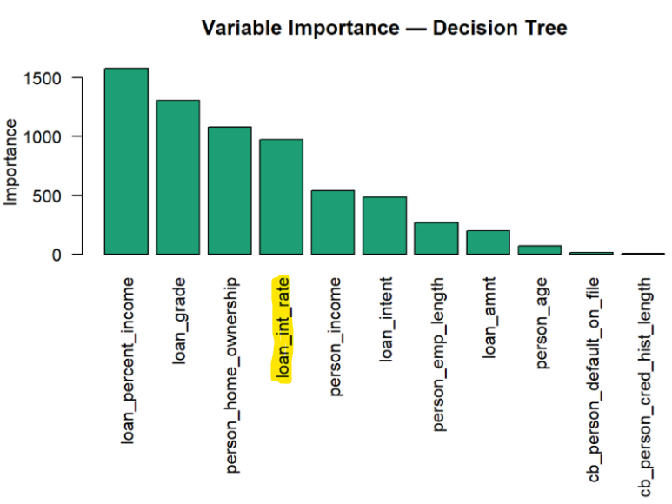
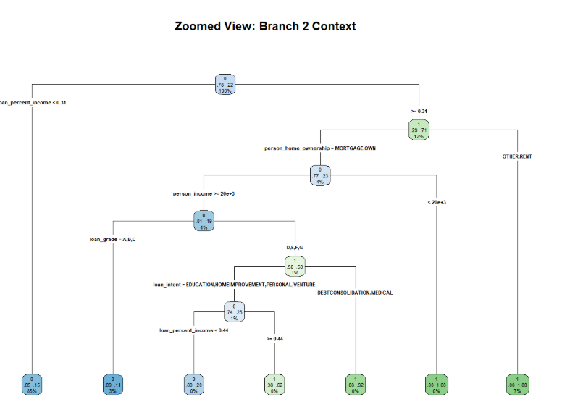
Classification Tree
SMQ-3
Decision Tree Metrics:
Variable Importance: loan_int_rate is the 4th most important
Optimal Complexity Parameter = 0.000540. The model is relatively complex
Sensitivity = 70.57%. Higher than the logistic regression model
Specificity = 99.55%. Very high, could be because it is a single decision tree
AUC = 90.32%. This is an outstanding/perfect performance

Slide 30
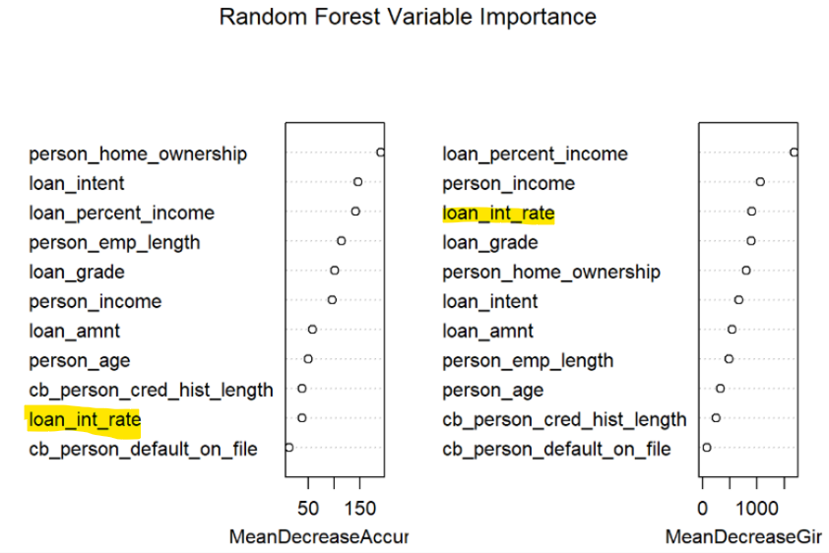
Random Forest
SMQ-3
Random Forest Metrics:
Mean Decrease Accuracy: Even though interest rate is used to make splits, the model can still predict the outcome almost as well without it
Mean Decrease Gini: Interest rate is frequently used for splits across many trees
Summary: loan_int_rate might have a relationship to other variables

Slide 31
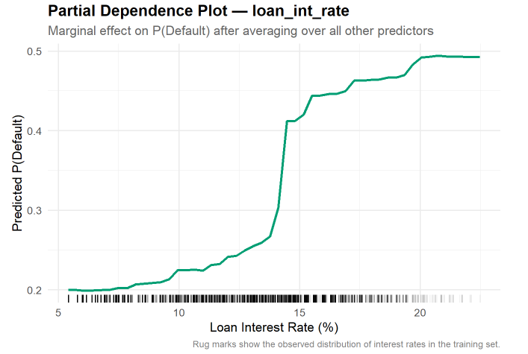
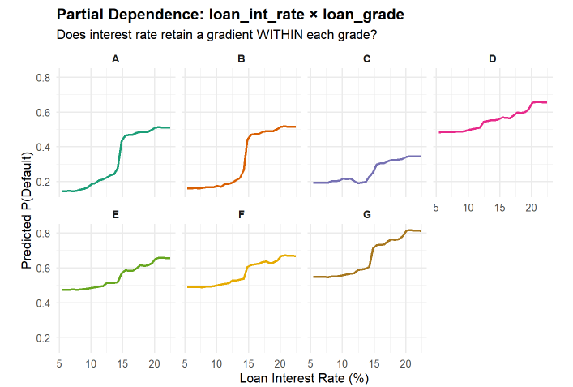
Random Forest Cont.
SMQ-3
Random Forest Metrics:
Plot 1: Interest rate has an upward slope; it has real predictive power even after controlling the other variables
Plot 2: The gradient for each loan grade gets flatter. Loan grade is absorbing interest rate’s influence on the model.

Slide 32

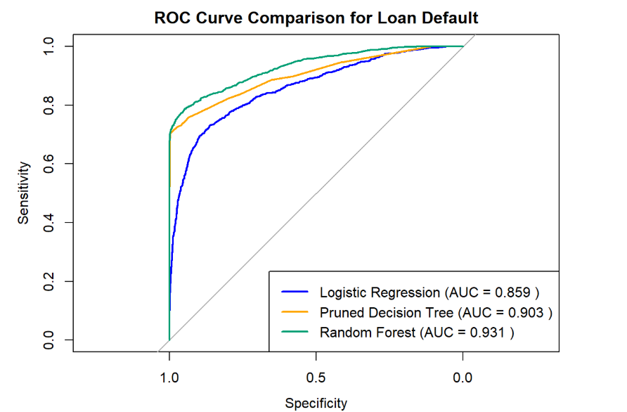
Smart Question 3 Summary
SMQ-3
Conclusion:
Yes, interest rate influences the probability of default.
Other important variables: loan_percentage_income, cb_person_default_on_file, cb_credit_hist_length, loan_grade
Model Bias: The data is imbalanced. 78% of the data are non-default borrowers.

Slide 33
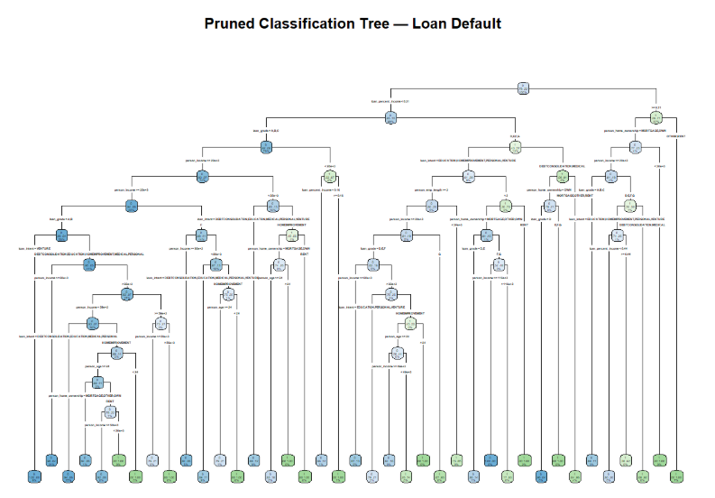
Appendix

