Slide 1



Group Presentation (Draft)
Project 2
Implementing regression-based and classification modeling techniques"
Ulugbek Islomov
Maurice Goode
Soumae Patidar

Slide 2
Introduction
This project analyzes a credit risk dataset containing more than 30,000 loan observations. The dataset includes detailed information on borrower demographics (such as age and home ownership), financial capacity (income and employment length), credit history (credit history length and prior default), and loan characteristics (loan amount, loan intent, and interest rate).Building on exploratory findings from Project 1, this project focuses on applying statistical modeling techniques to better understand and quantify the relationships between borrower characteristics and key lending outcomes.The primary objective is to apply regression-based and classification modeling approaches to address three SMART research questions that capture different dimensions of credit risk and lending behavior. These questions focus on pricing (interest rate), risk (default probability), and borrowing behavior (loan amount).The analysis integrates exploratory insights with formal statistical models to evaluate both explanatory relationships and predictive performance, while also assessing the strengths and limitations of the models used.

Slide 3
Background and summary of Project 1
In Project 1, we conducted an exploratory data analysis of the same credit risk dataset obtained from Kaggle. The goal was to identify key patterns in borrower behavior, default risk, and revenue generation.The analysis revealed that income and loan amount distributions are highly right-skewed, and that borrower characteristics such as income, employment length, loan intent, and credit history are strongly associated with both default risk and revenue outcomes. In particular, loan grade and income level were identified as major factors influencing default behavior.These findings motivate the current project, where we move from exploratory analysis to formal statistical modeling in order to quantify these relationships and assess their significance.

Slide 4
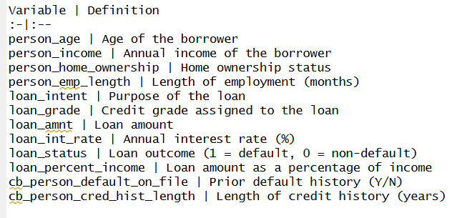
Data and variables
Dataset Overview:
Source: Kaggle
Name: credit_risk_dataset.csv
Observations: ~ 32,000
Variables: 12 borrower and loan characteristics
Target variable: loan_status (1 = default, 0 = non-default)
Nature: Consumer lending data
Variable Definitions:
Data cleaning and feature engineering:
3
1
2

Slide 5
Smart Question 1: Do Borrower Characteristics Affect Interest Rate?
Response: Interest Rate
Goal: identify key drivers of pricing
Compare:
Borrower variables only
Borrower variables + loan grade
Methods:
Linear regression
Regression tree
Introducing the question and the analytical logic.
Borrower Characteristics Used in the Model
Age
Home ownership status
Annual income
Employment length
Credit history length
Prior default history
Loan intent (purpose)
Loan amount & burden
Loan Grade
Interest Rate
Borrower

