Slide 1


Group Presentation
PROJECT 2:
IMPLEMENTING REGRESSION-BASED AND CLASSIFICATION MODELING TECHNIQUES
Ulugbek Islomov
Maurice Goode
Soumae Patidar

Slide 2
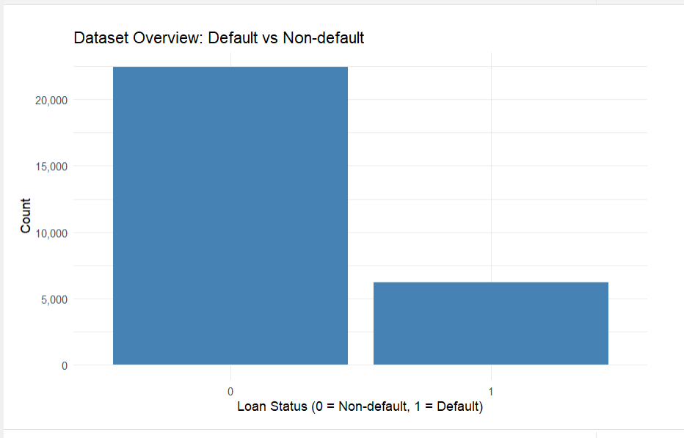

INTRO
Main Message : We combine statistical and machine learning methods to understand pricing, risk, and their relationship.
Objective
Understand pricing (interest rate)
Predict default risk
Analyze pricing–risk relationship
SMART Questions
1. What drives interest rates?
2. What predicts default probability?
3. Does interest rate affect default?
Methods
Linear regression
Logistic regression
Tree-based models
Concept diagram
Borrower Characteristics
↓
Loan Grade (Risk)
↓
Interest Rate (Pricing)
↓
Default (Outcome)

Slide 3
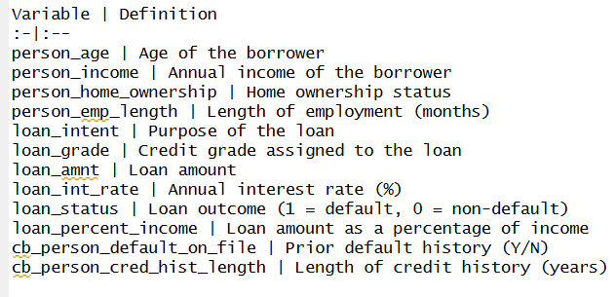
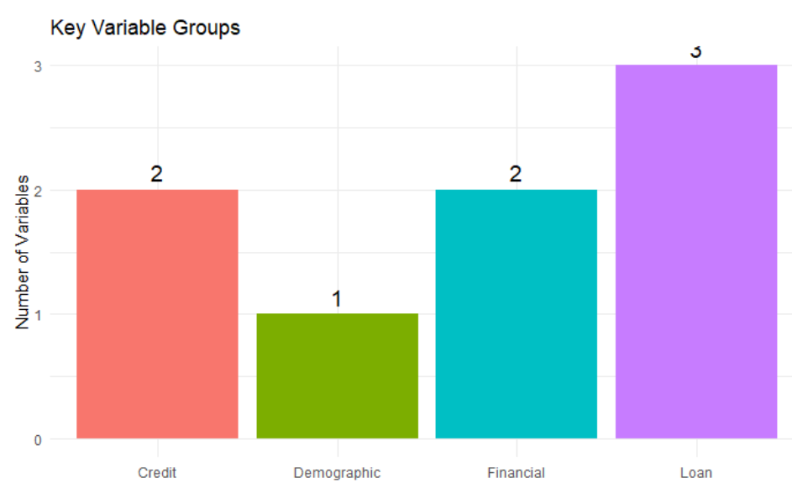
Variable Definitions:
DATA AND VARIABLES
Dataset Overview:
Source: Kaggle
Name: credit_risk_dataset.csv
Observations: ~ 32,000
Variables: 12 borrower and loan characteristics
Target variable: loan_status (1 = default, 0 = non-default)
Nature: Consumer lending data

Slide 4
SMART QUESTION 1: DO BORROWER CHARACTERISTICS AFFECT INTEREST RATE?
Main Message : Research question and conceptual relationship between borrower risk and pricing.
Borrower Characteristics Used in the Project
Age
Home ownership status
Annual income
Employment length
Credit history length
Prior default history
Loan intent (purpose)
Loan amount & burden
Outcome: Interest Rate
Pricing vs borrower profile
Role of loan grade
Regression + tree methods
Loan Grade
Interest Rate
Borrower

Slide 5
MODELING STRATEGY
Main Message : Analytical Roadmap
A METHOD FLOWCHART:
EDA
Model 1
Model 2
ANOVA
Diagnostics
Trees
Conclusion
🔍
🤖
⚙️
📊
🩺
🌲
✅
Inference problem
Model 1: borrower variables
Model 2: + loan grade
Regression trees:
with grade
without grade

Slide 6
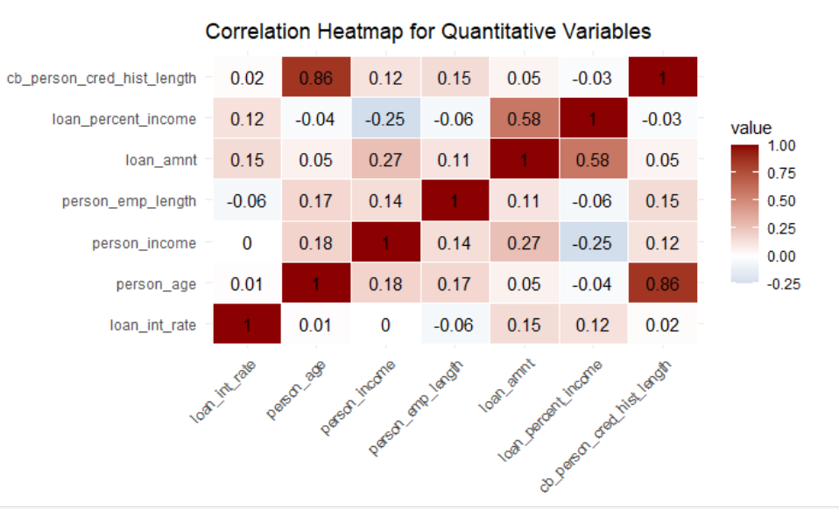
INITIAL EVIDENCE: WEAK DIRECT RELATIONSHIPS
Main Message : Borrower characteristics alone show weak direct association with interest rate.
Small correlations
Weak linear patterns
Borrower effects limited
Risk signal exists

Slide 7
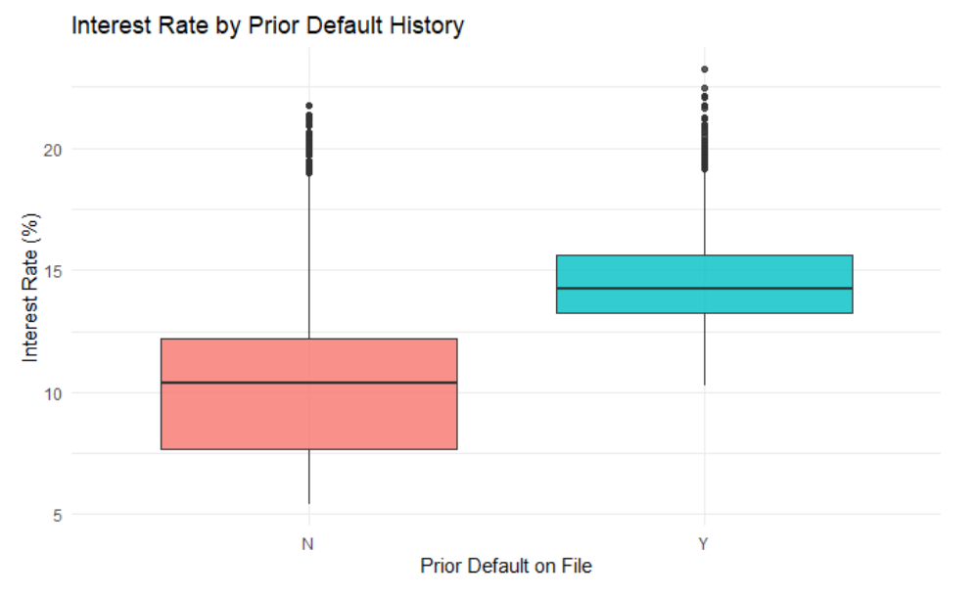
CATEGORICAL RISK SIGNAL: PRIOR DEFAULT MATTERS
Main Message : Among borrower characteristics, prior default history shows the clearest early pricing signal
Clear group difference
Default history → higher rates
Risk already priced in

Slide 8
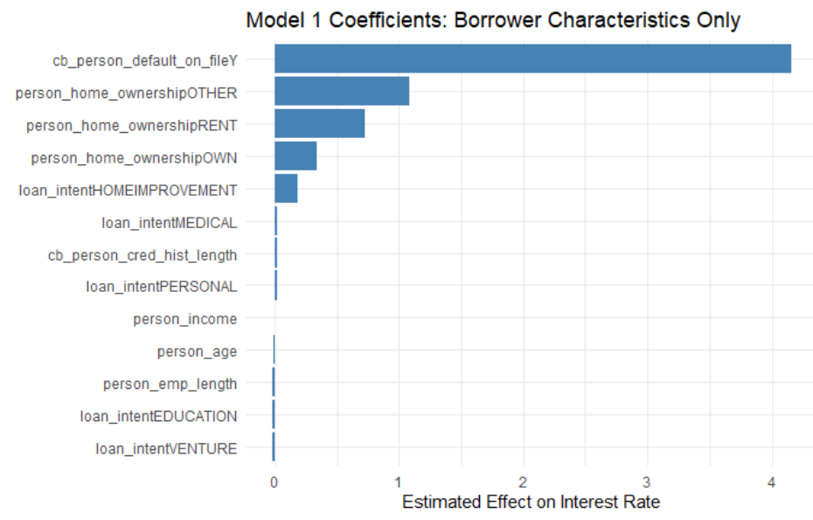
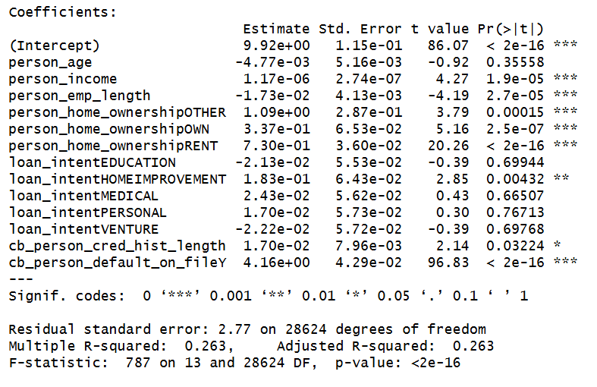
MODEL 1: BORROWER CHARACTERISTICS ONLY
Main Message : Borrower variables matter statistically, but explain only a moderate portion of pricing.
Several variables significant
Prior default strongest
R² = 26.3%
Moderate explanatory power

Slide 9
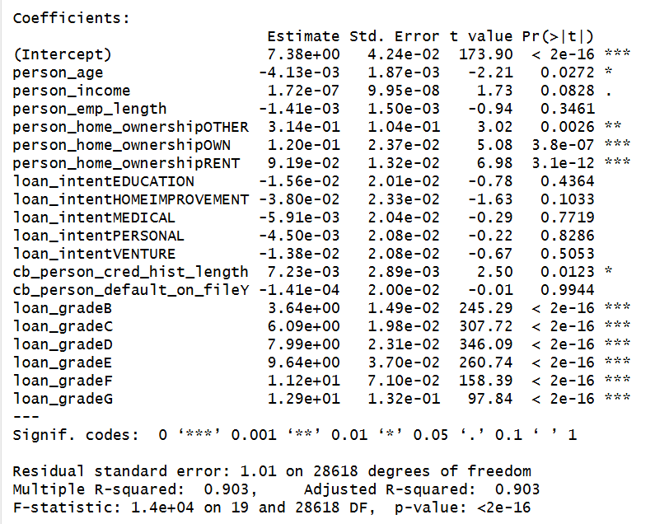
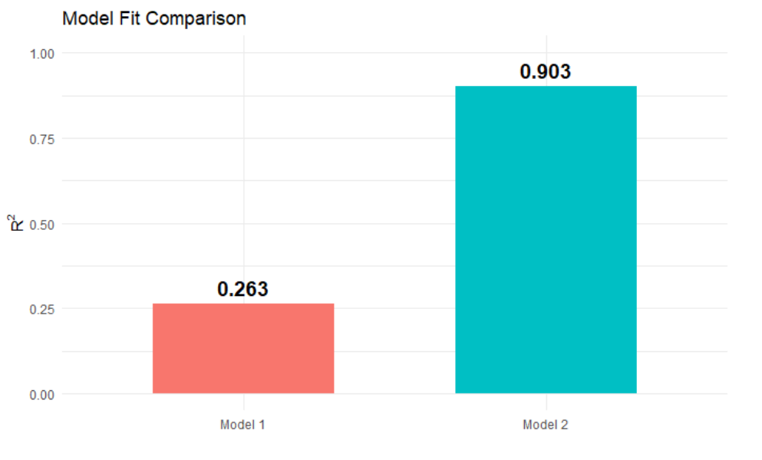
MODEL 2: LOAN GRADE CHANGES THE STORY
Main Message : Loan grade dramatically improves model fit and dominates pricing
Adding loan grade
R²: 26.3% → 90.3%
Borrower effects weaken
Grade absorbs risk information

Slide 10
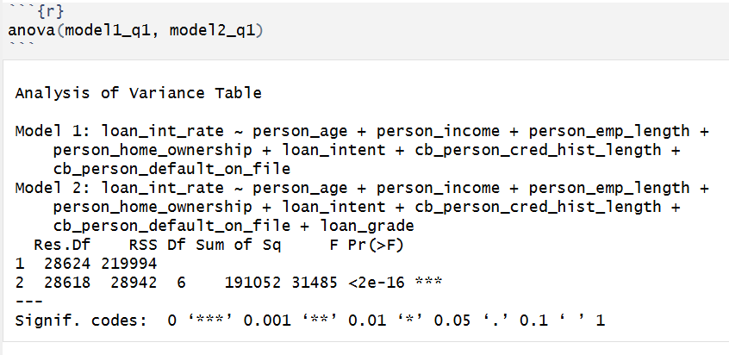
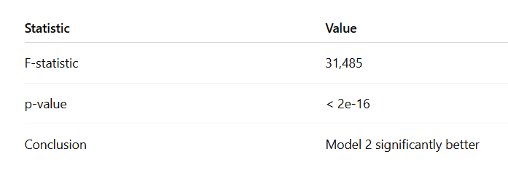
ANOVA CONFIRMS THE IMPROVEMENT
Main Message : The improvement from adding loan grade is statistically decisive.
Large RSS reduction
F = 31,485
p < 2e-16
Model 2 significantly better

Slide 11
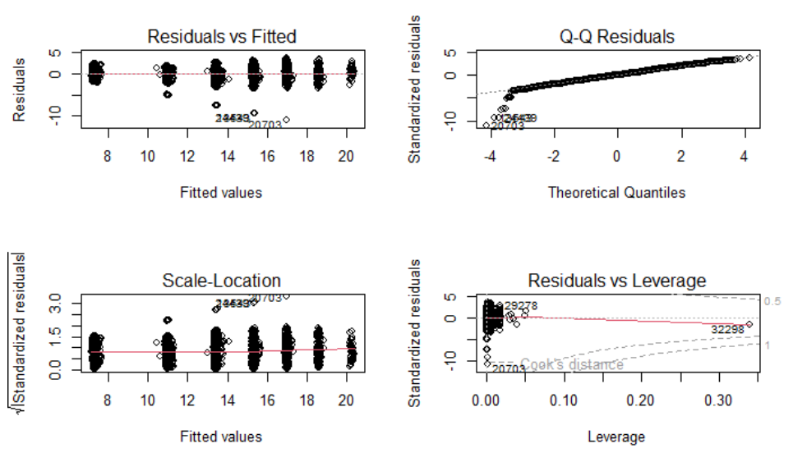
MODEL DIAGNOSTICS: THE REGRESSION IS RELIABLE
Main Message : Regression assumptions are reasonably satisfied.
No strong pattern
Variance mostly stable
No dominant outliers
Minor tail deviations only

Slide 12
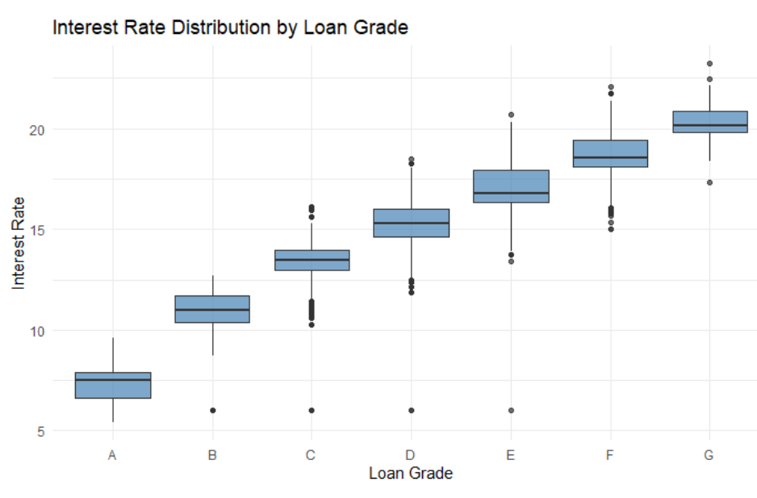
KEY VISUAL RESULT: INTEREST RATE RISES BY LOAN GRADE
Main Message : Loan grade provides the clearest visual summary of the pricing mechnism.
Clear upward trend
A → G monotonic increase
Strong evidence of
risk-based pricing

Slide 13
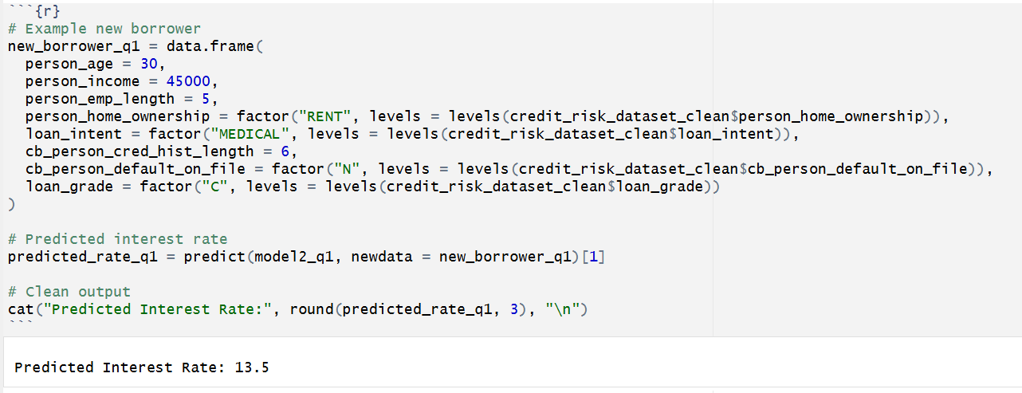
PREDICTION TOOL: ESTIMATING INTEREST RATE FOR A NEW BORROWER
Main Message : The model can be operationalized as a practical pricing tool.
Input borrower profile
Predict interest rate
Practical decision-support
Not exact institutional rule

Slide 14
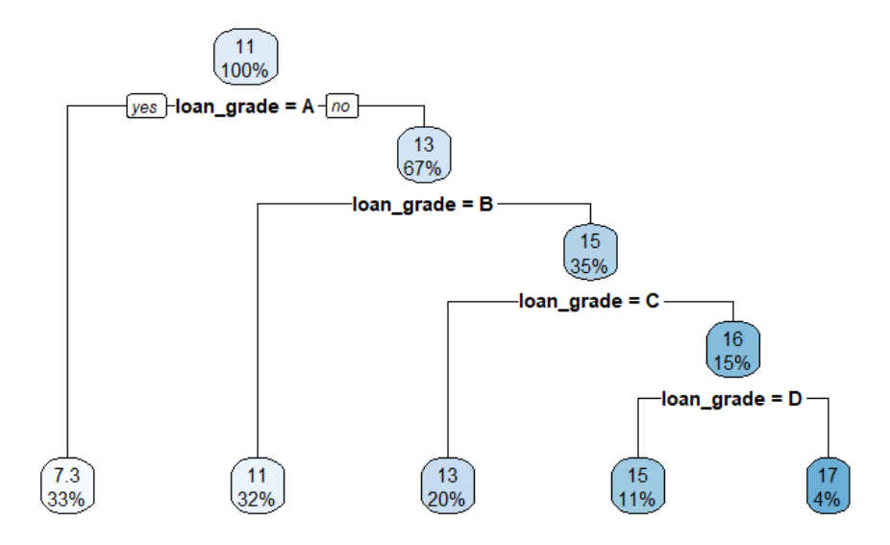
REGRESSION TREE WITH LOAN GRADE
Main Message : The tree confirms that pricing is dominated by loan grade.
First split: loan grade
Sequential risk ladder
No borrower variables used
Rule-based pricing

Slide 15
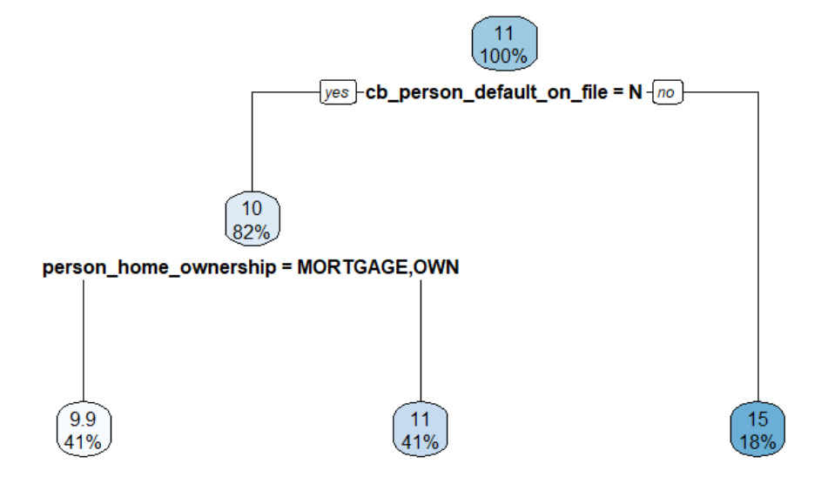
REGRESSION TREE WITHOUT LOAN GRADE
Main Message : Without loan grade, borrower-level pricing drivers become visible
Without grade:
prior default
home ownership
Grade summarizes borrower risk
May recover bank pricing rule
Market/time factors missing

Slide 16
KEY FINDINGS
🔥
Borrower characteristics alone explain surprisingly little of interest rates
Finding: While borrower attributes (income, employment, credit history) are statistically significant, they explain only about 26% of variation in interest rates.
Why this is striking: I expected borrower profile to strongly drive pricing - but it doesn’t.
🔥
Loan grade almost completely determines interest rates
Finding: Adding loan grade increases R² from 26% → over 90%.
Why this is shocking: One variable explains almost everything.
🔥
Prior default loses its effect once loan grade is included
Finding: Prior default is highly significant in Model 1, but becomes insignificant in Model 2.
Why this is revealing: A key risk factor suddenly “disappears.”
🔥
Regression tree confirms a rule-based pricing system
Finding: The regression tree (with loan grade) uses only loan grade for splitting.
Why this is unexpected: We included many variables - but the tree ignores all except one.
🔥
Without loan grade, pricing falls back to fundamental borrower risk factors
Finding: When loan grade is removed, the tree uses: prior default & home ownership
Why this is insightful: The model reveals what the bank is really using behind the scenes.

Slide 17
FINAL SUMMARY
Taken together, the regression and tree analyses imply that interest rate determination is primarily driven by structured risk classification rather than by raw borrower characteristics alone. At the same time, because loan grade is likely part of the bank’s own pricing formula, the very high explanatory power may partly reflect recovery of an internal pricing rule rather than a purely causal relationship. In addition, external market and time-related factors are not observed in the dataset
🎯

