Slide 1


2011
Modernized e-File (MeF) Application to Application (A2A) Toolkit
MeF eChannel Support:
Juanita Wueller – Senior Manager
Date: June 8th 2011
Notes:
Note : change the picture

Slide 2
Getting started
2011
You must complete an application to become an authorized eFile provider
http://www.irs.gov/taxpros/providers/article/0,,id=222533,00.html
Designate someone to become a system enroller to setup the A2A account and system details following this link http://www.irs.gov/pub/irs-utl/automated_enrollment_ae_external_user_guide.pdf
You must acquire an IRS supported x.509 certificate to use A2A strong authentication.
The Strong Authentication Users Guide is included on the CD or can be obtained by contacting the mefmailbox@irs.gov

Slide 3
MeF Design
2011
All communications with MeF are done using SOAP (Simple Object Access Protocol) – IRS defined MeF web services
MeF SOAP message are sent over the Internet using Secure Socket Layer (SSL). Security is implemented using
  x.509 Public Key Infrastructure (PKI) Certificates (Strong Authentication)
Returns (Submissions) are eXtensible Markup Language (XML) files transmitted using the web services (PDF attachments are supported)
Messages are comprised of 1 to 100 returns (submissions)

Slide 4
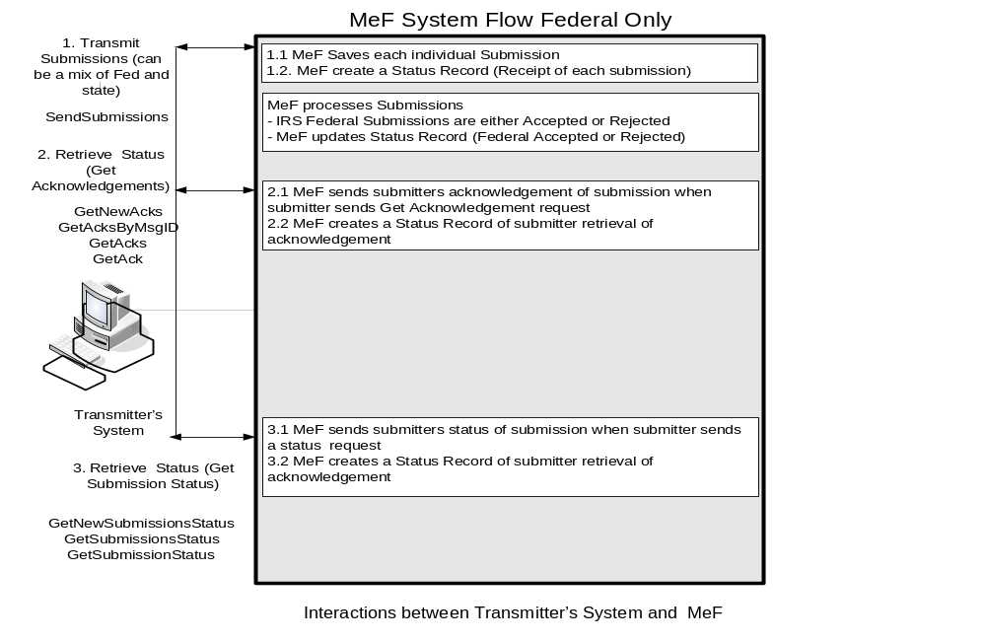
MeF System Flow Federal
2011

Slide 5
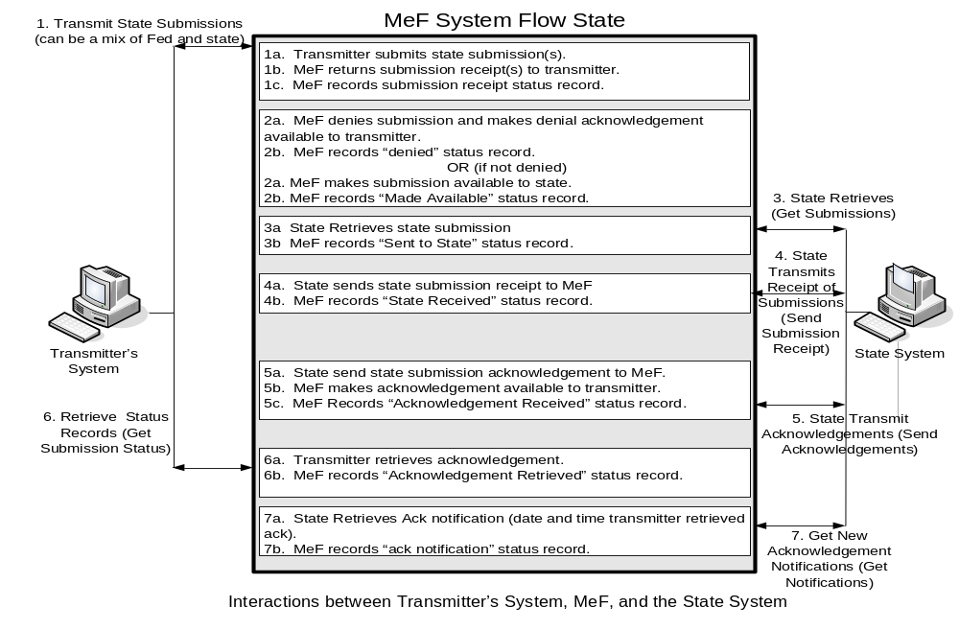
MeF System State Flow
2011

Slide 6
MeF Service Messages
2011
MeF Service Request and Response Messages for A2A
Modernized System Infrastructure (MSI) Services Messages
EtinRetrievalRequestMessage
EtinRetrievalResponseMessage
EtinStatusRequestMessage
EtinStatusResponseMessage
GetStateParticipantsListRequestMessage
GetStateParticipantsListResponseMessage
LoginRequestMessage
LoginResponseMessage
LogoutRequestMessage
LogoutResponseMessage
InitialLoginRequestMessage (For Password Clients)
InitialLoginResponseMessage (For Password Clients)
ChangePasswordRequestMessage (For Password Clients)
ChangePasswordResponseMessage (For Password Clients)
MeFFaultMessage

Slide 7
MeF Service Messages
2011
MeF Service Request and Response Messages for A2A
State Services Messages | Transmitter Services Messages
GetAckNotificationRequest | GetAckRequest
GetAckNotificationResponse | GetAckResponse
GetAckNotificationsRequest | GetAcksRequest
GetAckNotificationsResponse | GetAcksResponse
GetNewAckNotificationsRequest | GetAcksByMsgIDRequest
GetNewAckNotificationsResponse | GetAcksByMsgIDResponse
GetNewSubmissionsRequest | GetNewAcksRequest
GetNewSubmissionsResponse | GetNewAcksResponse
GetSubmissionRequest | GetNewSubmissionsStatusRequest
GetSubmissionResponse | GetNewSubmissionsStatusResponse
GetSubmissionsRequest | GetSubmissionsStatusRequest
GetSubmissionsResponse | GetSubmissionsStatusResponse
GetSubmissionsByMsgIDRequest | GetSubmissionStatusRequest
GetSubmissionsByMsgIDResponse | SendSubmissionsRequest
SendAcksRequest | SendSubmissionsResponse
SendAcksResponse | MeFException

Slide 8
MeF Service Messages
2011
MeF Service Request and Response Messages for A2A
State Services Messages | Transmitter Services Messages
SendSubmissionReceiptsRequest
SendSubmissionReceiptsResponse
GetSubmissionReconciliationListRequest
GetSubmissionReconciliationListResponse
MeFException
Implementation details for the MeF Services are in the MeF State and Trading Partners Guide http://www.irs.gov/pub/irs-utl/mef_state_and_trading_partners_icd_ref_guide_-_1-7-11.pdf

Slide 9
Why Use the Client Application and / or the A2A Toolkit?
2011
Reduce YOUR time, cost and complexity for using MeF
  Provides built-in code for web services layer
  Provides built-in logging capabilities for debugging
  Provides built-in Strong Authentication capabilities
Writing your own code to use MeF is the most time consuming, costly and complex

Slide 10
A2A Toolkit Basics
2011
The disk contains
  Transmitter Client application code with documentation
  State Client application code with documentation
  Java and .Net SDK code with documentation
  Support for Multipurpose Internet Mail Extensions (MIME) & Message Transmission Optimization Mechanism (MTOM) for Java developers and MTOM for .NET developers
  Key reference documents and links
  This presentation
To get the disk you must agree to license terms and provide required information about your business
When the WSDLs change, the Toolkit version must also be revised. Watch for information about Toolkit revisions on the MeF Status page http://www.irs.gov/efile/article/0,,id=168537,00.html

Slide 11
Your Development Steps
2011
Returns (Submissions) must be XML formatted as defined in the Submission Composition Guide http://www.irs.gov/pub/irs-utl/ad-edd_ibm_r5_mef_submission_composition_guide_v1_3.pdf
Follow the current version of IRS published Web Service Definition Language (WSDLs) for submissions
Decide on Development Options
  Use the MeF Software Development Kit (SDK) – A Java 5.0 (or .NET) application that can be integrated with your custom code
  Use the MeF Client application, state or transmitter
  Write your own code to interface with MeF

Slide 12
Important Documents
2011
Included on the CD
  MeF State and Trading Partners Guide
  MeF Submissions Guide
  A2A Strong Authentication Guide
  Automated Enrollment User Guide
  Publication 4164 Modernized e-File (MeF) Guide for Software Developers and Transmitters
  List of approved Certificates
  MeF State Gateway Application User Guide
  MeF Transmitter Application User Guide
  MeF Client SDK Installation Guide
  MeF Client SDK User Guide

Slide 13
Documents Sent by Request
2011
WSDL updates (only for developers who do not use the Client App or the SDK)
A2A Strong Authentication Users Guide
List of Certificates

Slide 14
Next Steps for You
2011
Get a copy of the CD
Register as a MeF User
Develop code to generate appropriate XML for submissions
Decide how to access MeF to send the XML
  Write your own code integrating the MeF SDK toolkit
  Use the Transmitter or State application
  Write all your own code

Slide 15
Additional Guidance
2011
  Modernized e-File (MeF) Program Information http://www.irs.gov/efile/content/0,,id=171945,00.html
  Modernized e-File (MeF) Status Page
  http://www.irs.gov/efile/article/0,,id=168537,00.html
  Modernized e-File (MeF) User Guides and Publications
  http://www.irs.gov/efile/article/0,,id=171946,00.html
  Schemas & Business Rules
  http://www.irs.gov/efile/article/0,,id=171950,00.html
Notes:
.

Slide 16
Questions ?
2011
Send your questions to our new mail box that has been established mefmailbox@irs.gov. Please note the 1040mef@irs.gov is being phased out

