Slide 1

SummaPhoto Summing up your day!
Developed by Omri Koshorek & Yonatan Wilkof
App idea by Prof. Lior Wolf
Supervision by Prof. Lior Wolf and Noga Levy

Slide 2
What is summaphoto ?
summaphoto is an online photo app that creates hot-outta-the-oven new collages consisting of your life’s most precious moments.
SummaPhoto divides your day into its primary events, and then makes a beautiful collage out of your photos! It’s like an automatic diary that you can view, share and enjoy forever.
Simply choose your preferred mode of operation, your preferred style, and you’re set!

Slide 3
Technical
Runs on Native Android OS
Min SDK: 8
Max SDK: 18 (Latest)
Tests on Nexus 1, Nexus 4
Coded in Java
Uses Geo-Tagging ability that links location to taken photos.
Bing static map services – returns a map with the location of the photos

Slide 4
Smart Mode

Slide 5
Pass photo to
activation manager
Camera Observer
Activation Manager
List of Photos to be clustered
Event Clustering
Photo Container
Dedicated Request
Clustered Events Bundle
Generator
Collage created; User notified

Slide 6
Daily Mode

Slide 7
Alarm goes off
Camera Observer
Event Clustering
Photo Container
Clustered Events Bundle
Generator
Collage created; User notified

Slide 8
Challenges
How do we define event? What are possible patterns of photo-taking? In other words – how and when should we cluster?
How to arrange the photos around the map in an aesthetic manner (minimum lines intersecting)?
Testing on data without deterministic output, dependent on multiple factores: time, location, number of photos
Android as a new platform to learn
Compatibility with older versions of Android

Slide 9
Algorithms
DBScan

Slide 10
No Intersection Line Arrangement
Bla bla

Slide 11
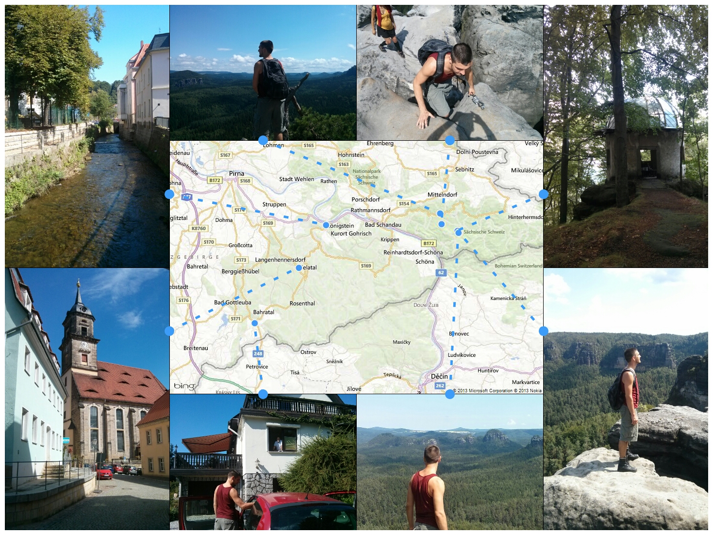
Output Examples – Map Collage

Slide 12
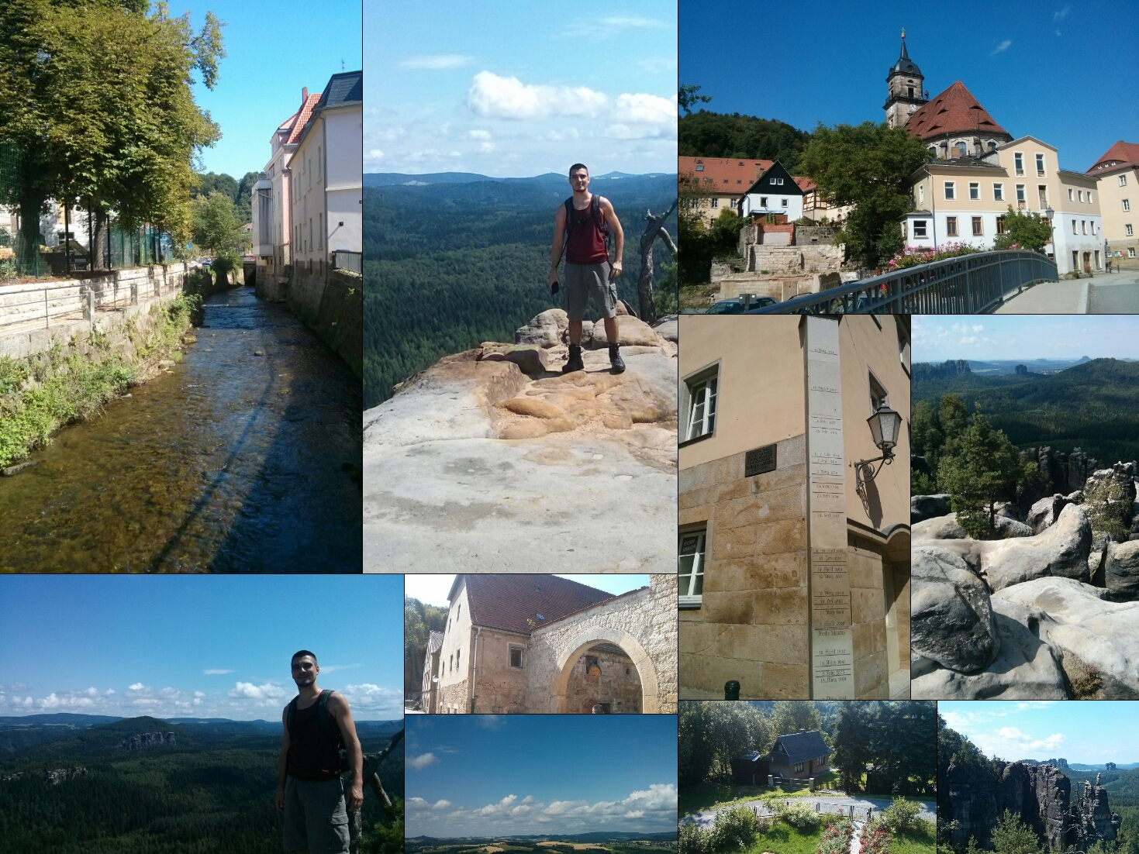
Output Examples – Block Collage

