Slide 1

SummaPhoto Summing up your day!
Developed by Omri Koshorek & Yonatan Wilkof
App idea by Prof. Lior Wolf
Supervision by Prof. Lior Wolf and Noga Levy

Slide 2
What is summaphoto ?
summaphoto is an online photo app that creates hot-outta-the-oven new collages consisting of your life’s most precious moments.
SummaPhoto divides your day into its primary events, and then makes a beautiful collage out of your photos! It’s like an automatic diary with a map that you can view, share and enjoy forever.
Simply choose your preferred mode of operation, your preferred style, and you’re set!

Slide 3
Technical
Runs on Native Android OS
Min SDK: 8
Max SDK: 18 (Latest)
Tested on Nexus 1, Nexus 4
Coded in Java 1.6
Uses Geo-Tagging ability that links location to taken photos.
Uses Bing static map services – returns a map with the location of the photos

Slide 4
Smart Mode

Slide 5
Pass photo to
activation manager
Camera Observer
Activation Manager
List of Photos to be clustered
Event Clustering
Photo Container
Dedicated Request
Clustered Events Bundle
Generator
Collage created; User notified

Slide 6
Daily Mode

Slide 7
Alarm goes off
Camera Observer
Event Clustering
Photo Container
Clustered Events Bundle
Generator
Collage created; User notified

Slide 8
Challenges
How do we define event? What are possible patterns of photo-taking? In other words – how and when should we cluster?
Testing on data without deterministic output dependent on multiple factors: time, location, number of photos and also on randomized algorithms.
Testing is depending on profiles of users.
Android as a new platform to learn & compatibility with older versions of Android

Slide 9
Algorithms
DBScan

Slide 10
No Intersection Line Arrangement
Bla bla

Slide 11
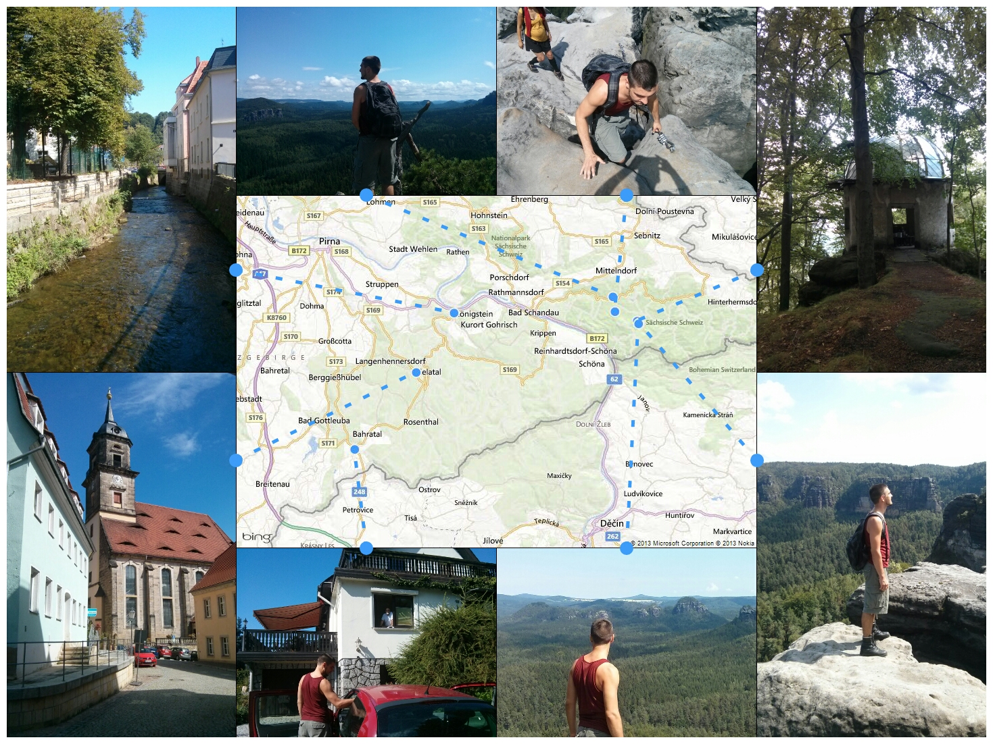
Output Examples – Map Collage

Slide 12
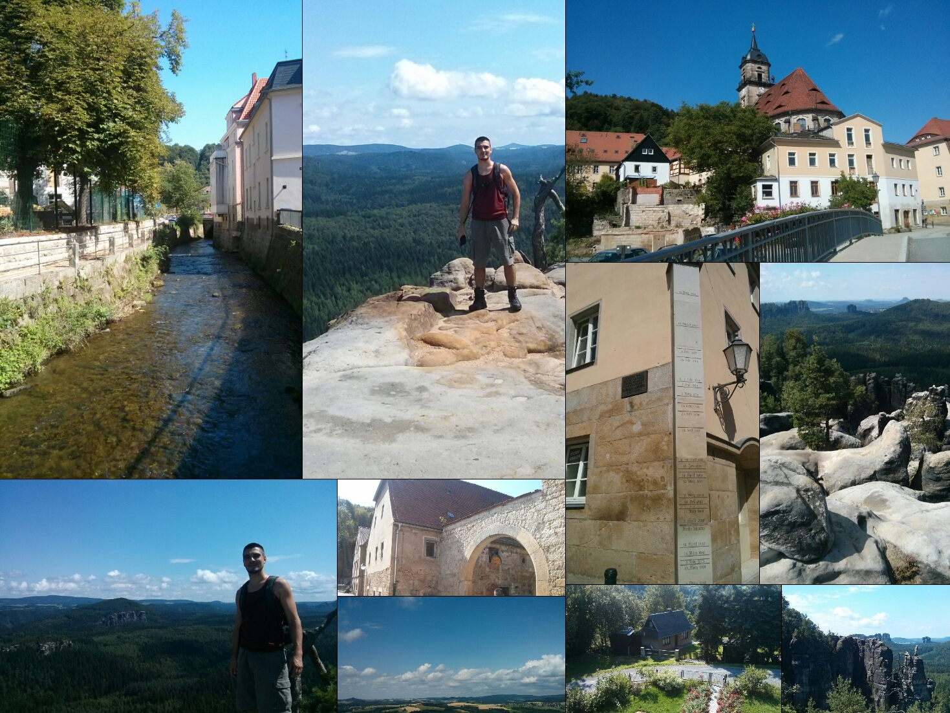
Output Examples – Block Collage

