Slide 1
MerchantMesh
Agent-to-agent local commerce,
settled on Solana
Natural-language demand → paid merchant-agent discovery → signed quotes → buyer-funded escrow → pickup release
WORKING DEVNET MVP
NEXT.JS · SOLANA · USDC
Commerce APIs
for autonomous agents
01

Slide 2
MERCHANTMESH / SOLANA DEVNET MVP
Local commerce has demand — but no shared machine layer
Today, every transaction repeats the same manual coordination loop.
Fragmented discovery
Trust before payment
AI without authority
Inventory, availability, and price live across calls, messages, and separate storefronts.
Buyers fear prepayment; merchants fear preparing an order without commitment.
A model can interpret intent, but it cannot be trusted to invent stock, price, or settlement state.
MerchantMesh turns coordination into verifiable, paid agent interactions.
02

Slide 3
MERCHANTMESH / SOLANA DEVNET MVP
One buyer agent can negotiate with an entire local market
BUYER INTENT
PERSONAL AGENT
MERCHANT AGENTS
SOLANA
Meal or shopping request
List approval
Plan + orchestration
Budget enforcement
Inventory-backed quotes
Merchant signatures
USDC escrow
Receipt + release
The LLM interprets intent. Databases, signatures, deterministic policies, and on-chain programs remain the commercial authority.
03

Slide 4
MERCHANTMESH / SOLANA DEVNET MVP
Three buyer approvals
01
Approve the basket
After the LLM conversation, confirm exactly what should be searched.
02
Choose signed offers
Compare merchant quotes and select the best allocation per product.
03
Fund all escrows
After merchants accept, sign the USDC escrow transactions in Phantom.
04
Release on pickup
As each product is received in person, release its escrowed value to the merchant.
No merchant-console navigation is required for the buyer flow.
04

Slide 5
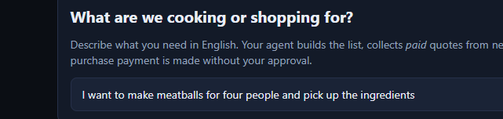
MERCHANTMESH / SOLANA DEVNET MVP
Working product: wallet-connected shopping starts from one prompt
LIVE APP SURFACE
• Solana wallet sign-in
• Natural-language shopping
• User-approved basket
• Live task timeline
• One-page funding and pickup flow
Captured from localhost:3000
05

Slide 6
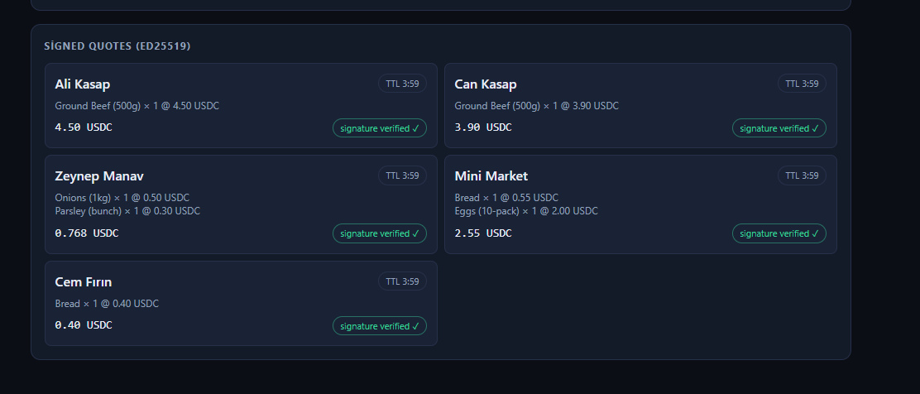
MERCHANTMESH / SOLANA DEVNET MVP
Signed merchant quotes
COMMERCIAL FACTS
Inventory and prices come from merchant data.
Each quote has a TTL, reservation state, and Ed25519 signature.
The buyer agent ranks verified offers; it never accepts an unsigned price.
LLM plans products — it does not price them.
06

Slide 7
MERCHANTMESH / SOLANA DEVNET MVP
Agent-to-agent payment makes every merchant capability callable
1
2
3
4
5
REQUEST
402 PRICE
PAY
PROVE
RESPOND
Buyer agent calls /quote with an idempotency key.
Merchant returns amount, USDC mint, payee, endpoint, and expiry.
Session wallet signs a budget-capped SPL USDC transfer.
Agent retries with the transaction proof in X-Payment.
Merchant verifies the transfer and returns a signed quote.
Micropayments use a constrained session wallet; final escrow funding always uses the buyer’s connected wallet.
07

Slide 8
MERCHANTMESH / SOLANA DEVNET MVP
Why paid agent APIs are different
Price is part of the protocol
Budgets are enforceable
Proof is portable
The service tells the calling agent exactly what the capability costs before work begins.
Per-call, per-task, daily, payment-count, and distinct-merchant limits stop runaway spend.
A Solana transaction signature can be verified independently instead of trusting an internal platform ledger.
Agents can retry safely
Humans approve value transfer
Idempotency binds payment, request payload, and response; replayed proofs are rejected.
Autonomy handles research; the user still signs the final purchase commitment.
08

Slide 9
MERCHANTMESH / SOLANA DEVNET MVP
Traditional marketplace vs. MerchantMesh
DIMENSION
TRADITIONAL
MERCHANTMESH
Discovery
Static catalog or manual search
Live requests to nearby merchant agents
Integration
Platform-specific backend workflows
Paid capability endpoints with a standard handshake
Pricing authority
Platform database or merchant UI
Inventory data + deterministic policy + signed quote
Payment
Central platform capture and ledger
SPL USDC micropayments + buyer-funded escrow
Settlement
Platform-controlled release
Program-enforced pickup, refund, and dispute states
Audit trail
Internal logs
Signed quotes, payment proofs, and on-chain receipts
09

Slide 10
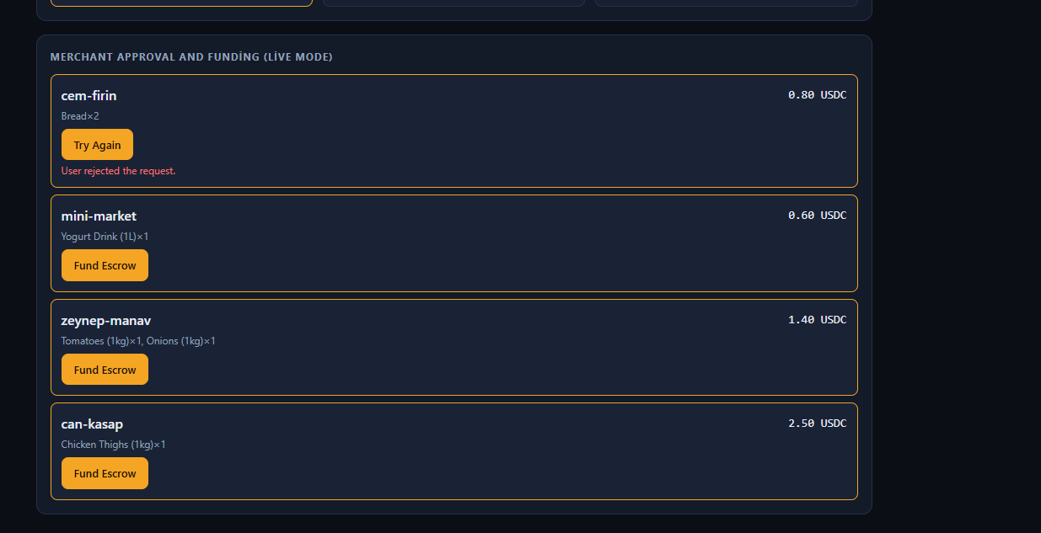
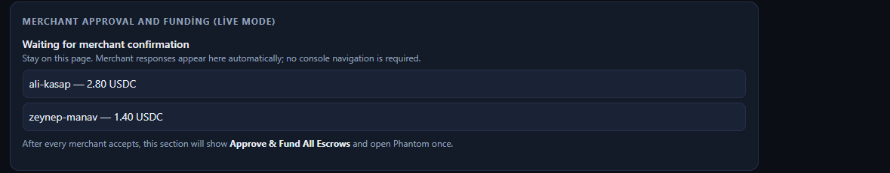
MERCHANTMESH / SOLANA DEVNET MVP
Acceptance before funding
1 · Merchant confirmation
Selected merchants explicitly accept or reject the order before escrow exists.
2 · Final payment approval
After every merchant confirms, Phantom opens for buyer-signed escrow funding.
Escrow cannot advance to pickup release unless funding succeeds on-chain.
10

Slide 11
MERCHANTMESH / SOLANA DEVNET MVP
System architecture: AI proposes, services verify, Solana settles
NEXT.JS WEB
PERSONAL AGENT
MERCHANT AGENTS
PLATFORM API
Wallet, shopping, task UI
LLM plan, orchestration, ranking
x402 gate, inventory, signed quotes
Auth, onboarding, admin
POSTGRES + REDIS
SOLANA DEVNET
Accounts, catalogs, tasks, locks
Directory, escrow, receipt
localhost:3000 :3001 :4000 :3002
11

Slide 12
MERCHANTMESH / SOLANA DEVNET MVP
A deliberate on-chain / off-chain boundary
OFF-CHAIN · MUTABLE + QUERY-HEAVY
ON-CHAIN · VALUE + PROOF
• Natural-language conversation
• Catalog, stock, price, and merchant availability
• Search, ranking, and quote collection
• Task state, SSE timeline, and reservations
• LLM discount proposal before deterministic clipping
• Merchant directory identity pointer
• Buyer-funded SPL USDC escrow
• Preparing, ready, release, refund, dispute
• Receipt and settlement evidence
• Pickup-code hash verification
Fast iteration and rich queries
Irreversible rules where trust matters
12

Slide 13
MERCHANTMESH / SOLANA DEVNET MVP
Three Anchor programs divide on-chain responsibility
merchant_directory
order_escrow
order_receipt
Lists merchant identity, active status, service URL hash, metadata hash, and authority.
Funds merchant-specific USDC escrow; enforces preparing, ready, pickup release, refund, dispute, and resolution.
Creates task-level settlement evidence and records release/refund totals for the purchase lifecycle.
Program Derived Addresses isolate merchants, orders, vault authority, and receipts without a central custody account.
13

Slide 14
MERCHANTMESH / SOLANA DEVNET MVP
Deterministic commerce guardrails
PLANNING
Zod + canonical SKUs
Unsupported products are rejected before quote collection.
MONEY
Integer micro-USDC
No floating-point arithmetic anywhere in the payment path.
PRICE + STOCK
Merchant DB + pricing policy
LLM suggestions are clipped; final numbers remain deterministic.
QUOTE
Ed25519 merchant signature
Every accepted commercial offer is verified twice.
PAYMENT
Idempotency + proof replay protection
One transfer cannot purchase two agent responses.
ORDER
Explicit state machine
Funding only follows merchant confirmation; release only follows pickup.
14

Slide 15
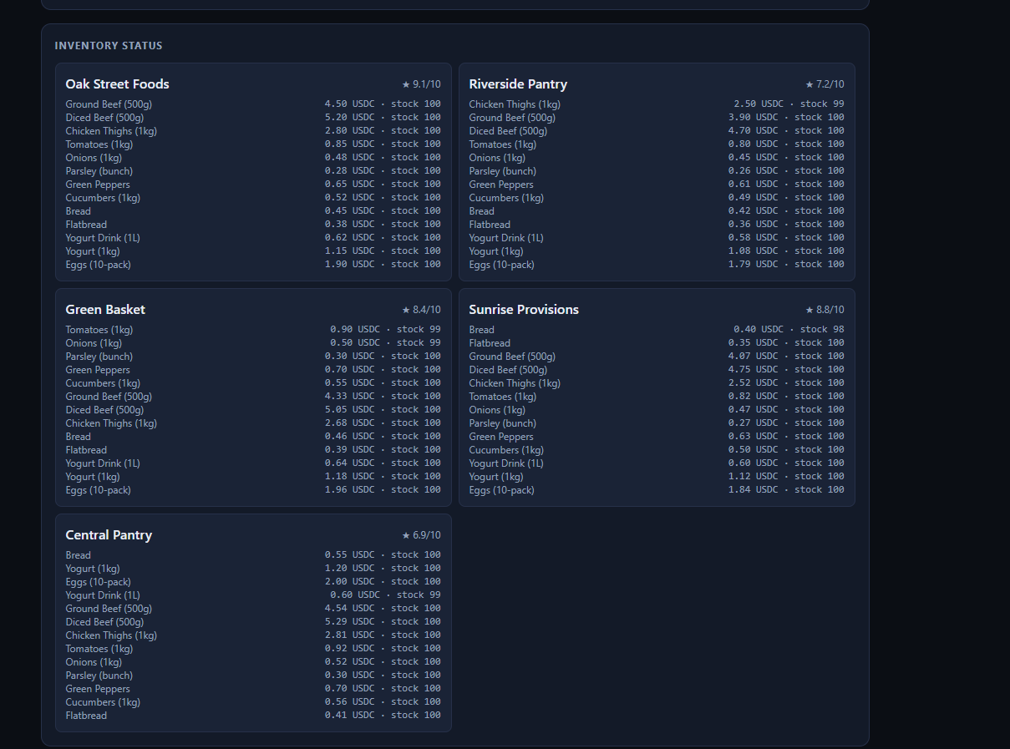
MERCHANTMESH / SOLANA DEVNET MVP
The MVP already behaves like a small merchant-agent market
CURRENT MVP
• Merchant onboarding and wallet identity
• Catalog and inventory management
• Paid quote endpoint
• Signed merchant offers
• Acceptance / rejection workflow
• Merchant dashboard and disputes
NEXT MARKET LAYER
Public catalog, manifest standard, reputation service, search/ranking API, SDK, isolation, and later stake/slashing.
15

Slide 16
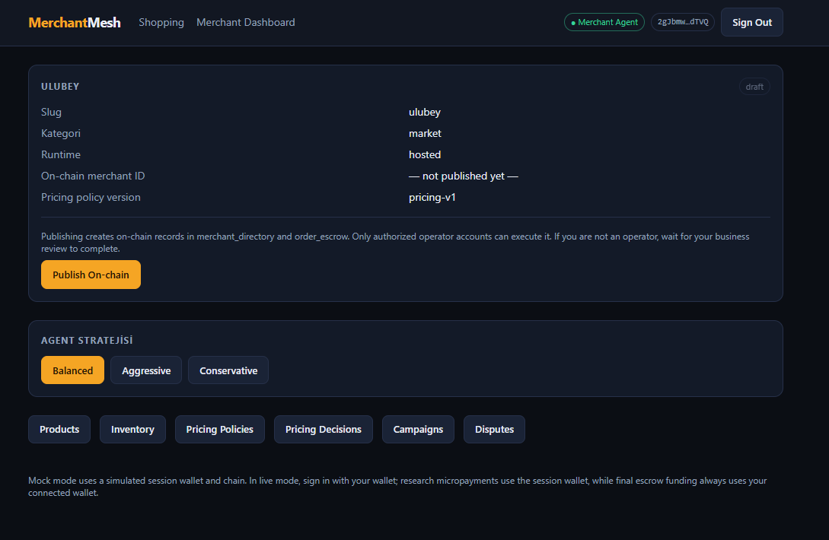
MERCHANTMESH / SOLANA DEVNET MVP
Each merchant controls an autonomous storefront
CONFIGURE THE AGENT
Choose its commercial strategy, pricing policies, campaigns, and operating limits.
OPERATE THE STOREFRONT
Add products, update inventory, review pricing decisions, and handle disputes.
PUBLISH ITS IDENTITY
After platform verification, register the merchant identity and settlement wallet on Solana.
The LLM may negotiate, but the merchant always defines its economic boundaries.
16

Slide 17
MERCHANTMESH / SOLANA DEVNET MVP
Expansion roadmap: one rail, more local markets
NOW
NEXT
LATER
LATER
LOCAL SHOPPING
COURIER MODE
TAXI MODE
LOCAL SERVICES
Product discovery, merchant quotes, escrow, pickup
Quote delivery jobs by distance, capacity, SLA, and route
Request rides, compare driver-agent offers, escrow and settle
Repair, cleaning, appointments, and task-based providers
MOBILE APP · NEXT CLIENT LAYER ACROSS EVERY MODE
Shared primitive: discover an agent → pay for a quote → accept an offer → escrow value → release on verified completion.
Courier, taxi, services, and mobile are product direction — not part of the current MVP claim.
17

Slide 18
MERCHANTMESH / SOLANA DEVNET MVP
A deliberate web-first choice, not a mobile gap
01
02
03
WHY WEB FIRST
THE PROBLEM IS MOBILE-NATIVE
WHAT PORTS DIRECTLY
Fastest path to a real, end-to-end Solana Devnet demo within the hackathon window. Wallet Adapter and browser Phantom integration are mature, and judges can review it from one URL with zero install.
Discovering nearby merchants, approving a pickup in person, and walking to the shop belong on a phone in the user’s hand — not a desktop.
The same personal-agent and merchant-agent APIs and the same Wallet Adapter pattern remain. A React Native / Expo client reuses the backend as-is: a new client, not a rewrite.
Mobile is the next client target — not part of the current MVP claim.
18

Slide 19
MERCHANTMESH / SOLANA DEVNET MVP
GitHub-ready MVP today; public pilot after deployment hardening
WORKING TODAY
TO PUBLISH AS A PUBLIC PILOT
✓ Solana wallet sign-in
✓ Merchant onboarding + inventory
✓ Agent-assisted basket planning
✓ x402-style paid quote collection
✓ Signed quote comparison
✓ Merchant acceptance
✓ Buyer-funded Devnet escrow
✓ Pickup release + refund/dispute paths
1. Deploy web + three APIs
2. Provision Postgres and Redis
3. Configure Devnet RPC, USDC mint, and secrets
4. Run external-wallet smoke tests
5. Add monitoring and rate limits
6. Record a short fallback demo
MerchantMesh turns local businesses into autonomous, payable commerce agents.
19

