Slide 1
CafeFlow
A Web-Based Cafe Management System
for Small and Medium Cafes
Amit Tharu, BIT (LC0003001642)
Supervisor: Mr. Saishab Bhattarai
Phoenix College of Management

Slide 2
Introduction
• Cafes handle many time-critical daily tasks: taking orders, tracking them, billing, and managing stock.
• Most small cafes still do this manually with notebooks, verbal orders, and spreadsheets.
◦ This is slow, error-prone, and gives no reliable view of sales or stock.
• CafeFlow: a web-based system that unifies ordering, billing, inventory, staff and reporting.

Slide 3
Problem Statement
• Manual cafe operations cause real, everyday problems:
◦ Paper orders relayed verbally lead to delays and mistakes.
◦ Bills calculated by hand are error-prone and cause disputes.
◦ Stock tracked informally runs out unexpectedly.
◦ No usable sales data, so owners lack insight into revenue and best-sellers.
◦ Commercial POS systems are costly, complex, or hardware-bound.
• Need: a simple, affordable, web-based system built for cafes.

Slide 4
Objectives
• General: a single web platform to digitise cafe ordering, billing, inventory and staff management.
• Specific objectives:
◦ Provide secure, role-based access for Admin and Staff.
◦ Manage menu, orders, billing and inventory in real time.
◦ Track orders through a pending → preparing → completed workflow.
◦ Generate accurate sales and inventory analytics.

Slide 5
Functional Requirements
• Email/password login with role-based access (Admin vs Staff).
• Menu management: create, edit, delete, toggle availability.
• Order taking with table/customer details and live status tracking.
• Itemised billing for orders, ready to print.
• Inventory tracking with automatic low-stock alerts.
• Staff management and sales reporting from real order data.

Slide 6
Non-functional Requirements
• Security: bcrypt-hashed passwords and HTTP-only session cookies.
• Usability: clean, responsive UI on desktop, tablet and mobile.
• Performance: common actions complete in a fraction of a second.
• Reliability: data persisted in SQLite, surviving restarts.
• Maintainability: clear layers — UI, API and data access.

Slide 7
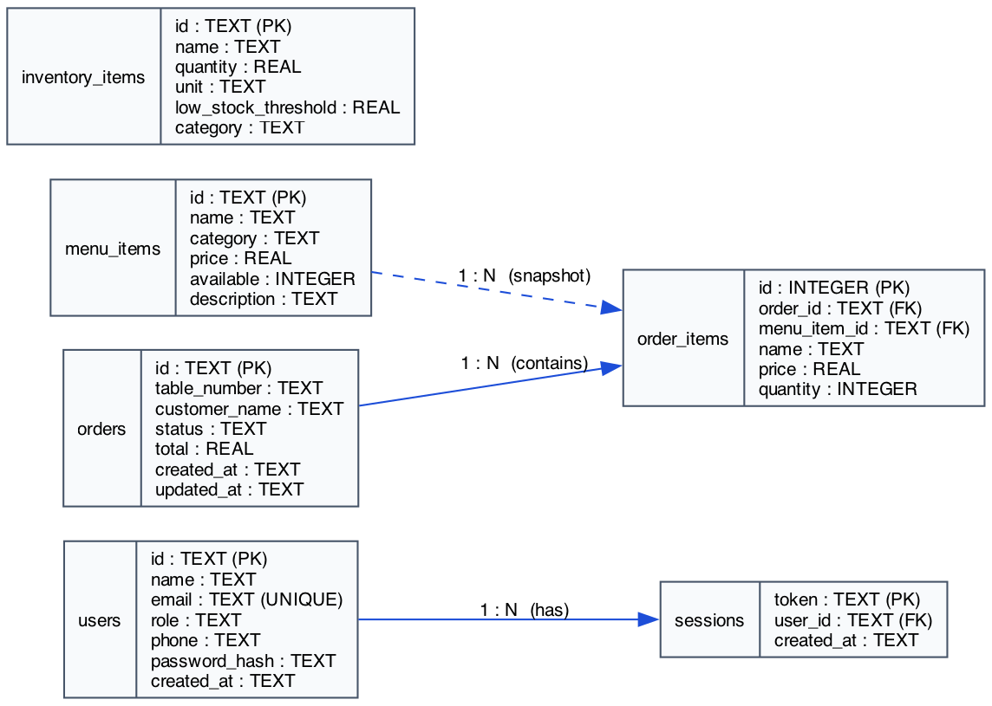
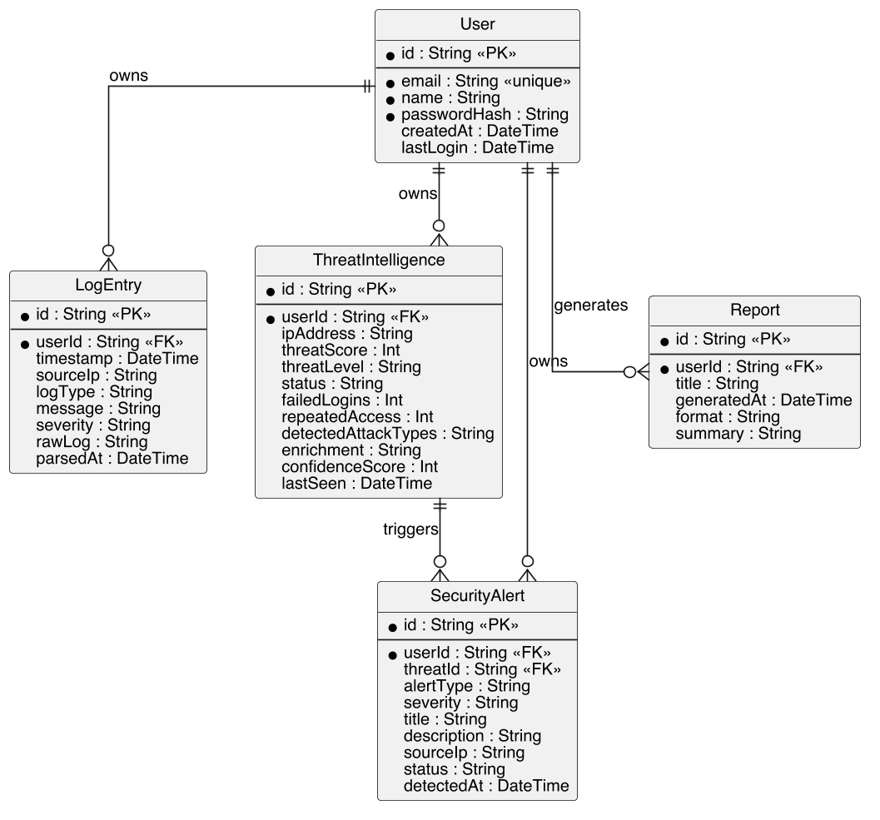
Data Modeling: ER Diagram

Slide 8
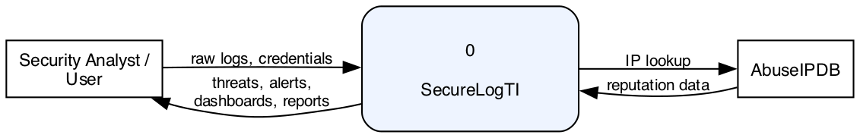
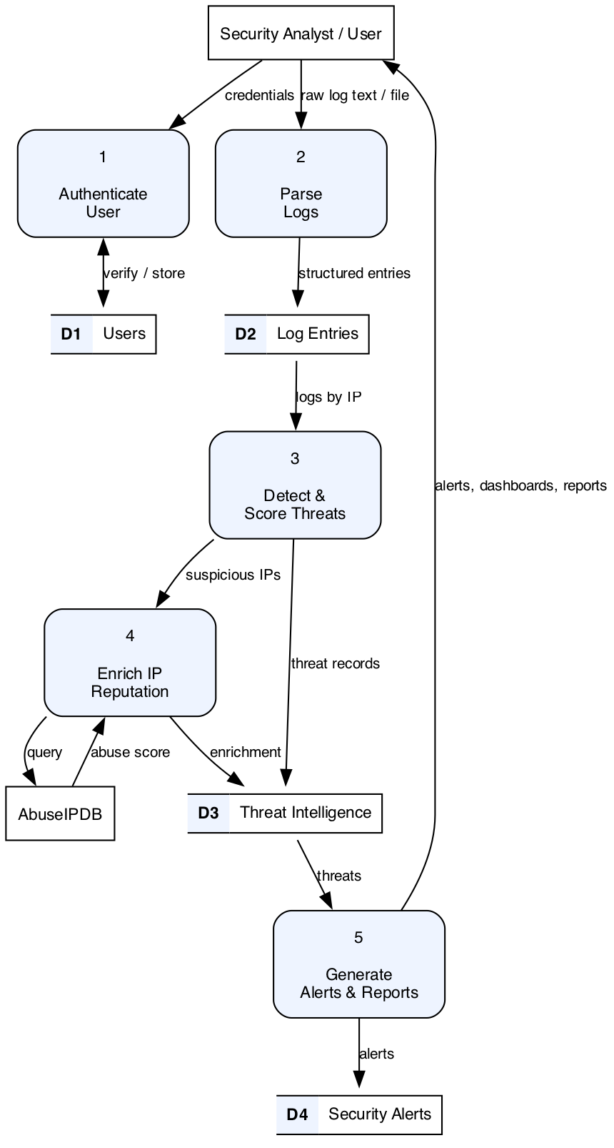
Process Modeling: Order Flow

Slide 9
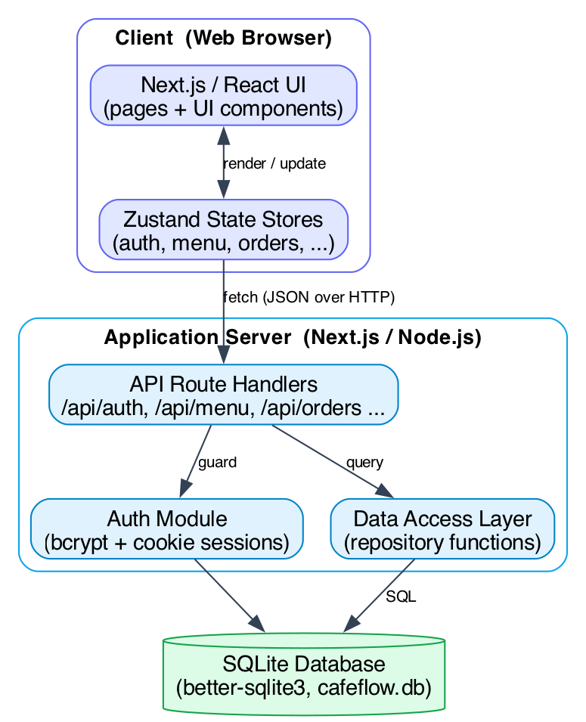
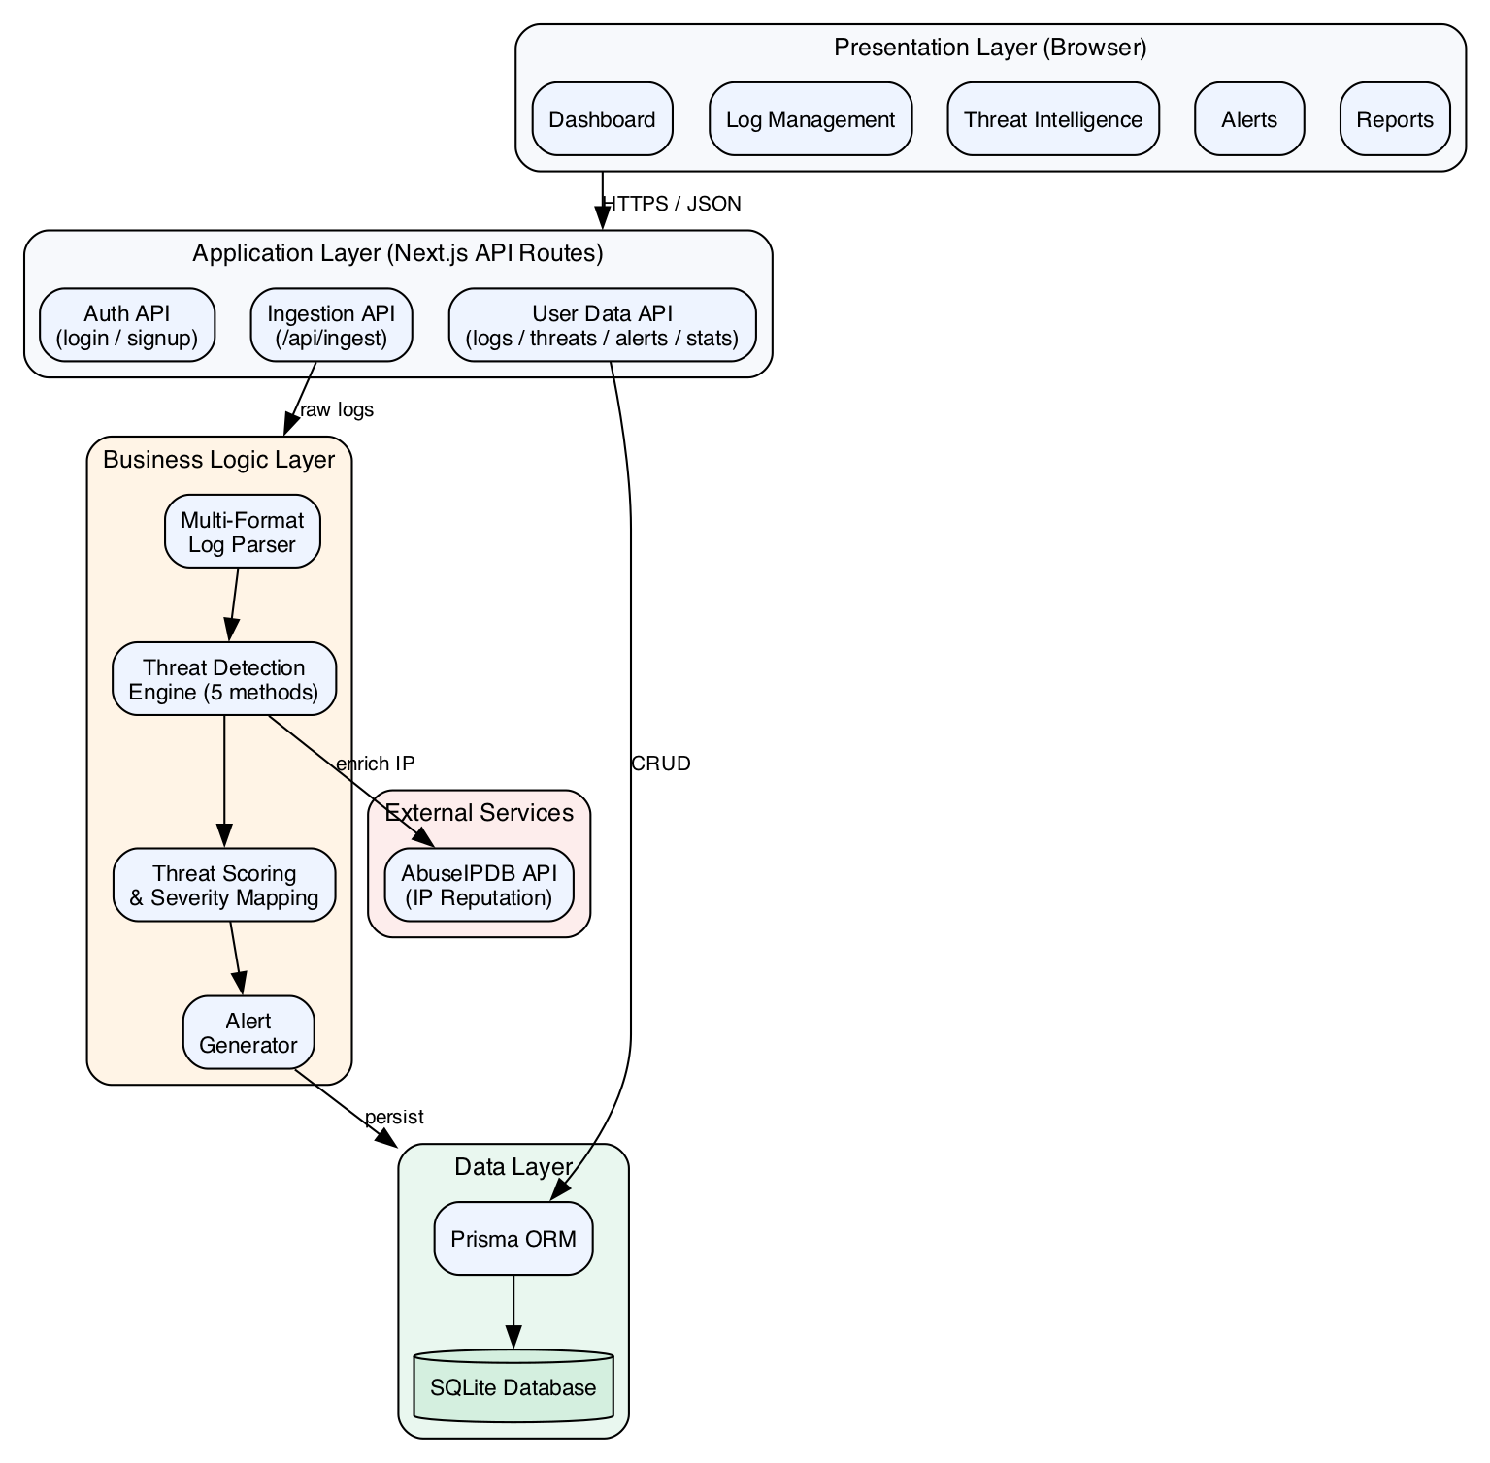
System Architecture

Slide 10
Key Logic: Orders & Reports
• Order workflow: each order moves pending → preparing → completed; each line stores a price snapshot.
• Billing: totals computed from order lines; an itemised bill is generated for printing.
• Inventory: items at or below their threshold are flagged as low stock.
• Reports: revenue, orders, top items and category split are aggregated from stored orders.
• Auth: passwords hashed with bcrypt; every API request validates the session and role.

Slide 11
Implementing Tools
• Next.js + React + TypeScript: full-stack UI and API routes.
• SQLite via better-sqlite3: embedded relational database.
• Tailwind CSS + shadcn/ui: styling and accessible components.
• Zustand: lightweight client-side state management.
• bcrypt: password hashing; Recharts: dashboard charts.
• Playwright: end-to-end testing; Git/GitHub + VS Code.

Slide 12
Implementation: Module Details
• Authentication: login, hashed passwords, sessions, role-based access.
• Menu: CRUD, availability toggle, search, filter, table/card views.
• Orders: build cart, submit, track status; price snapshot per line.
• Billing: itemised bills for completed and in-progress orders.
• Inventory: stock with units and low-stock thresholds + alerts.
• Staff & Reports: team management and analytics from real orders.

Slide 13
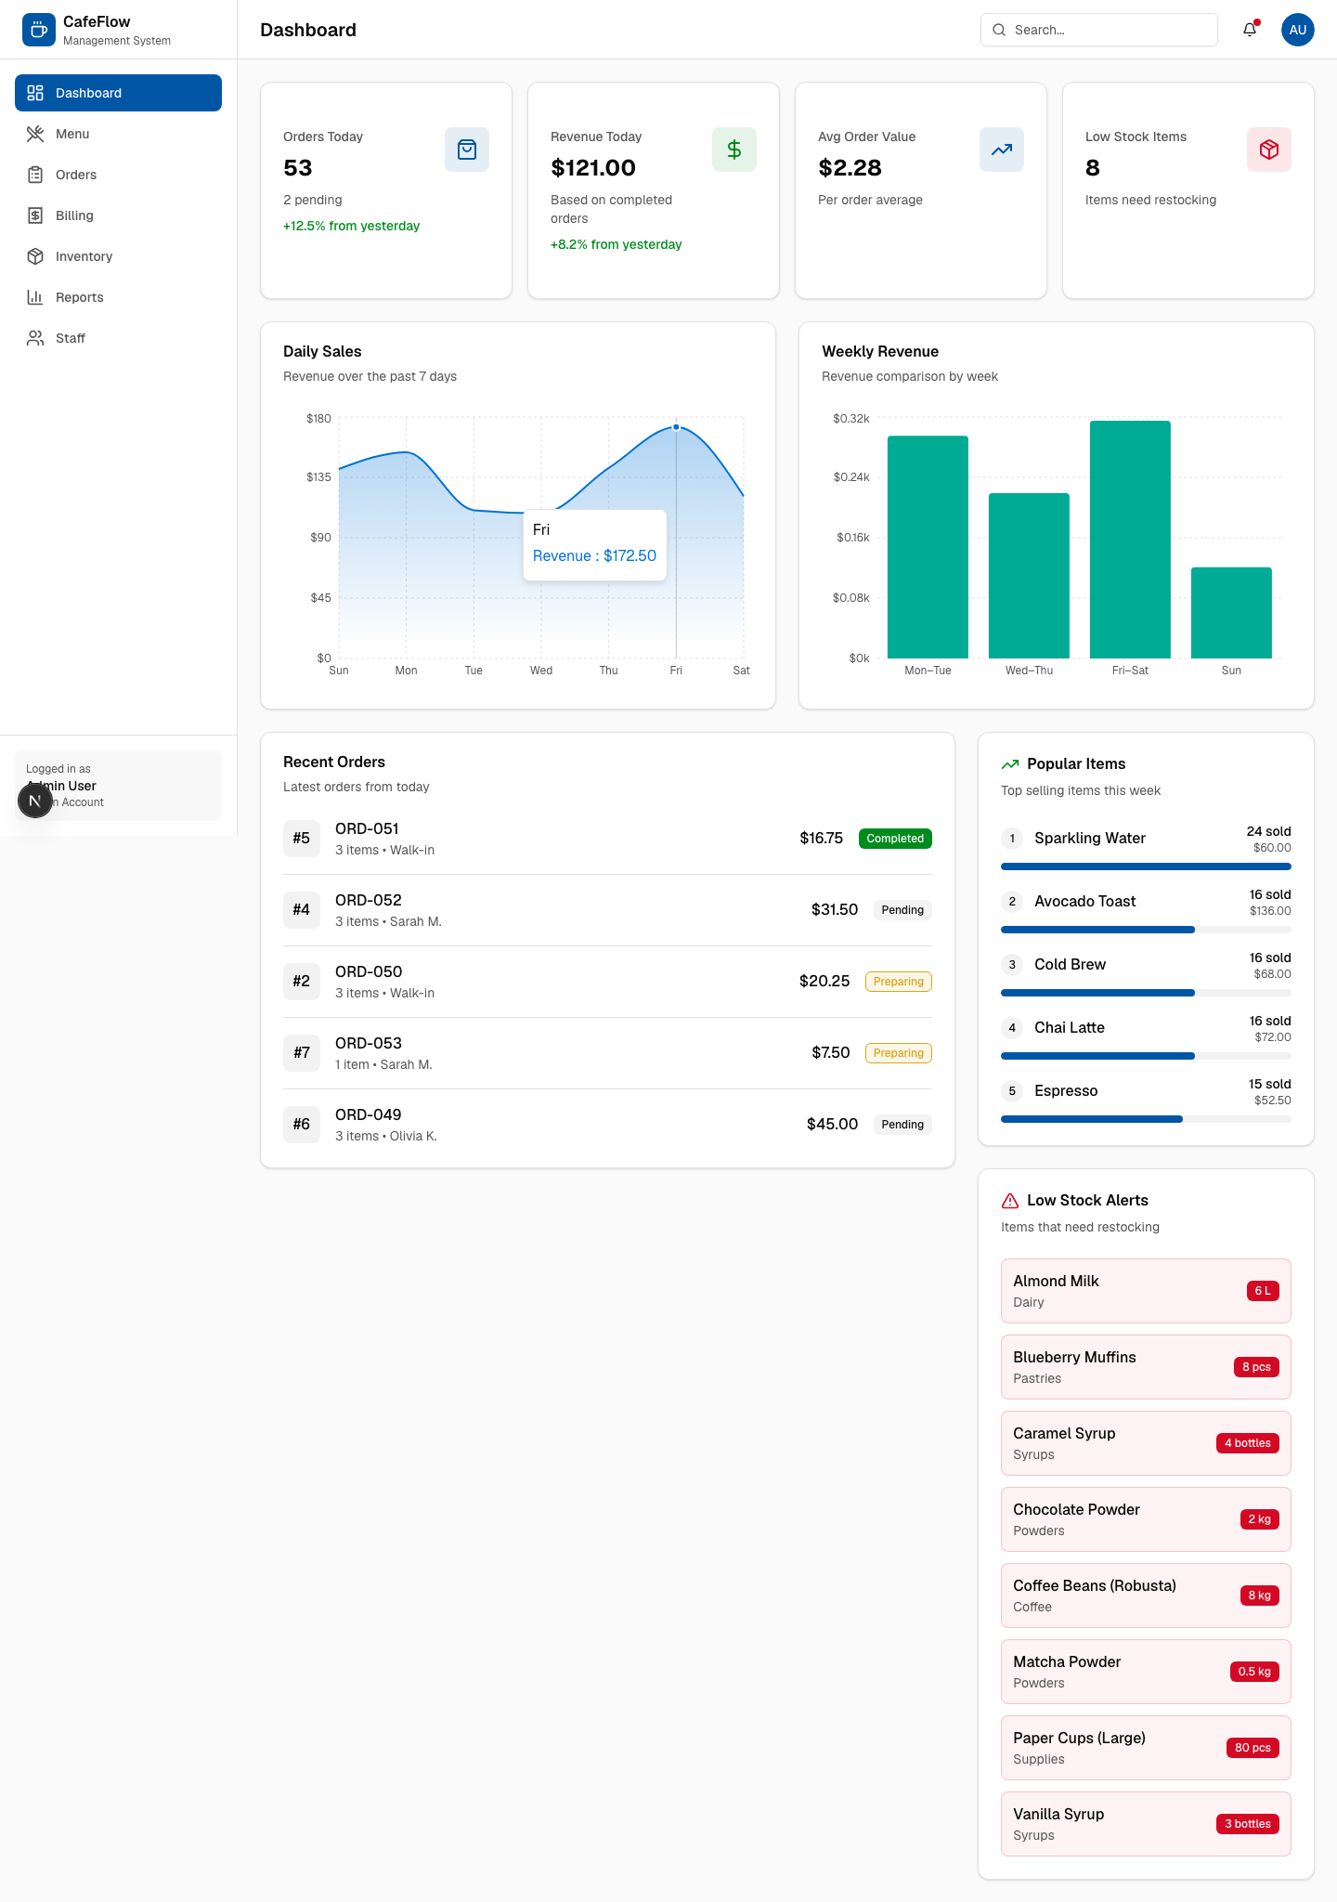
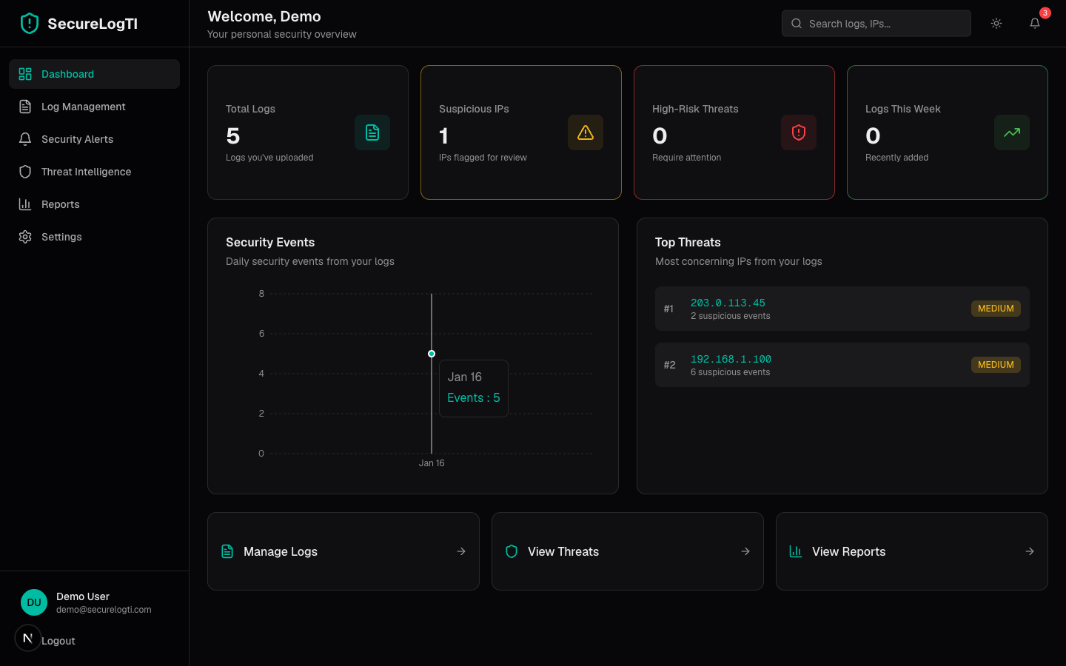
Application Demo: Dashboard

Slide 14
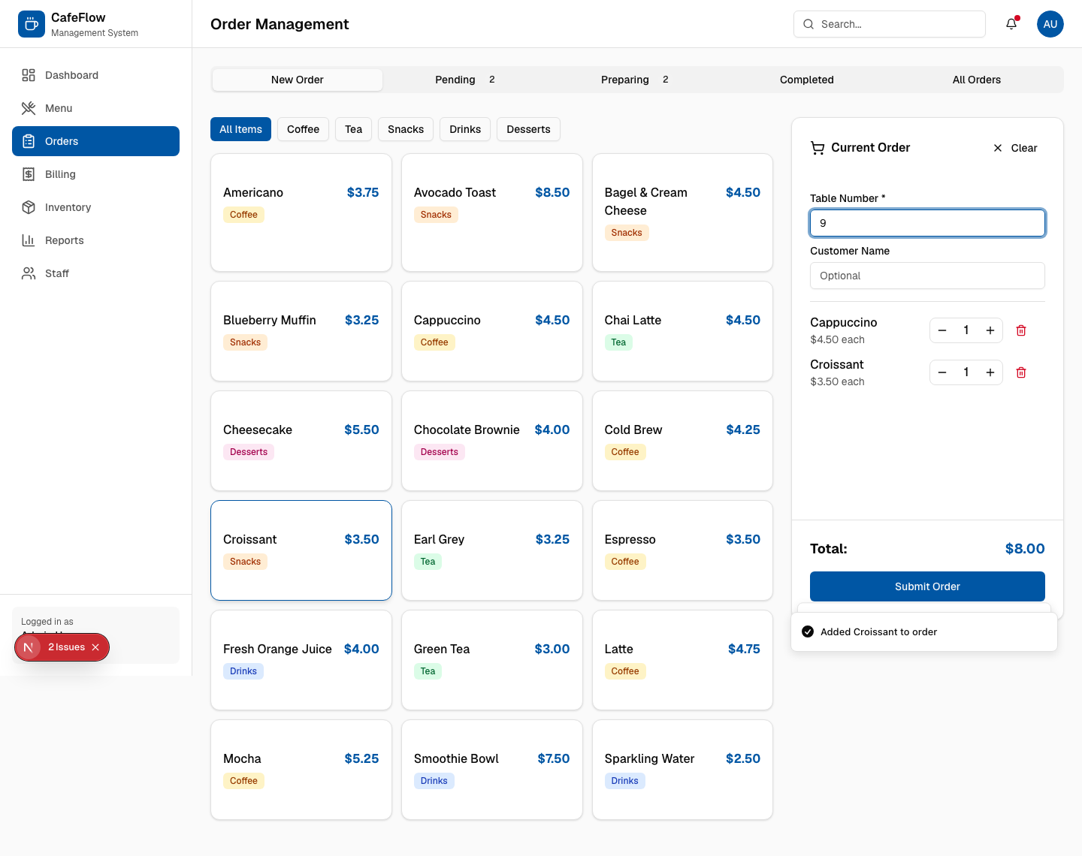
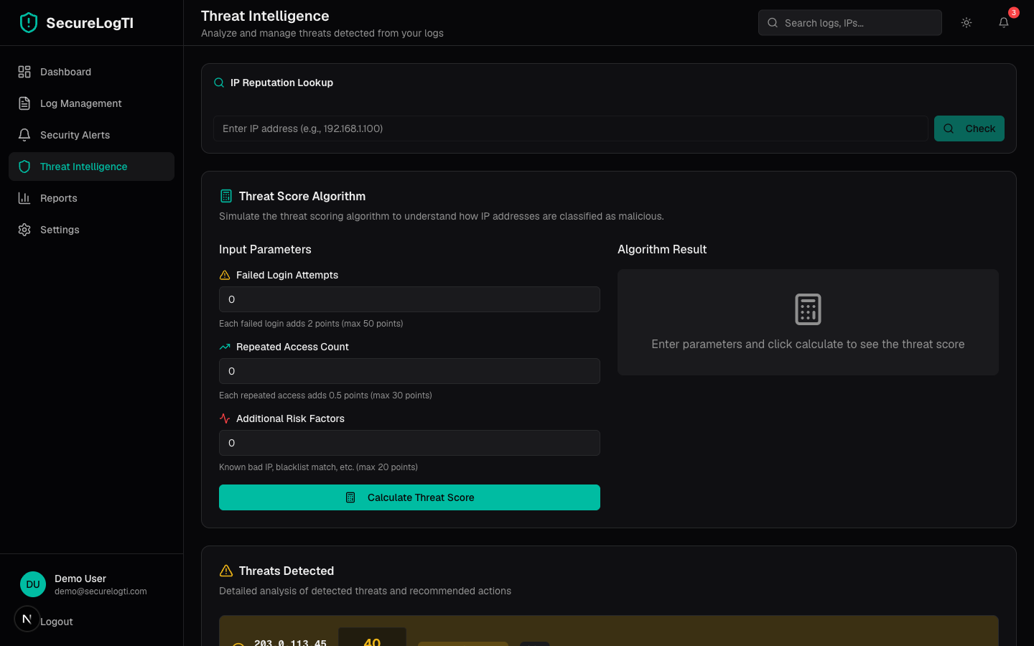
Application Demo: Orders

Slide 15
Conclusion
• CafeFlow is a complete, working cafe management system: menu, orders, billing, inventory, staff and reports.
• Replaces manual processes with a fast, consistent, role-based digital workflow.
• Secure authentication, SQLite persistence and analytics from real order data.
• Validated by 25 automated end-to-end tests, all passing.
• Future: online payments, multi-outlet, kitchen display and QR table ordering.

