Slide 1

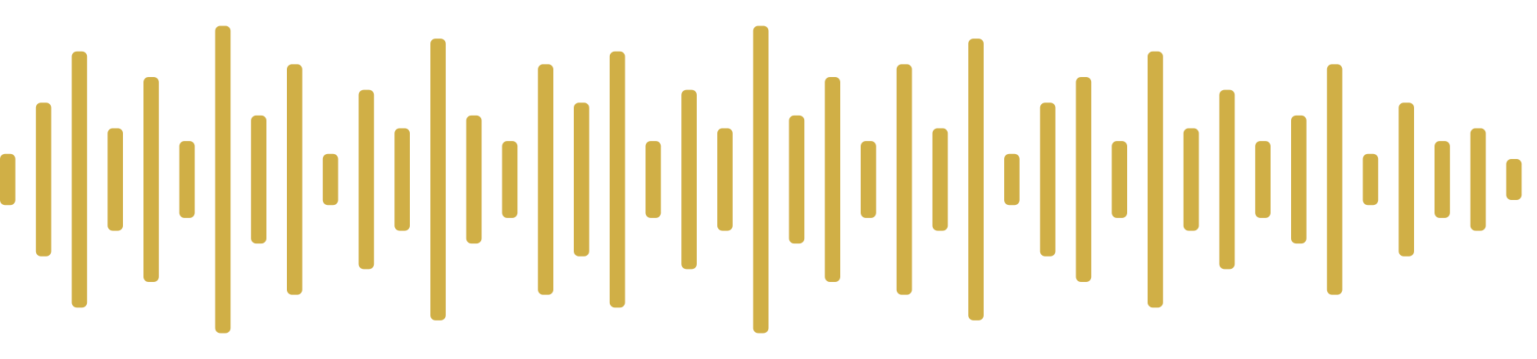
AZERBAIJAN STATE UNIVERSITY OF ECONOMICS
UNEC BUSINESS SCHOOL · MBA · ARTIFICIAL INTELLIGENCE
Master's Thesis — Defense Presentation
THESIS TOPIC
SPEECH TECHNOLOGY · NLP
Design and Development of a Rule-Based Text-to-Speech System for the Azerbaijani Language
A modular, open, documented pipeline for a low-resource Azerbaijani language — without training data.
CANDIDATE
SCIENTIFIC SUPERVISOR
Bashirov Ulvi Samir
Pashayeva Khanim Jamal
Group E27‑24 · Code 060409 · MBA
PROGRAM SUPERVISOR
PhD. Gazanfarli Mirvari Khagani
BAKU · 2026

Slide 2
01 · INTRODUCTION
Relevance of the topic
With more than 35 million speakers, Azerbaijani remains a low-resource language for speech technology.
35M+
~0
5–20 hrs
native speakers worldwide
open, documented Azerbaijani TTS systems
of speech data required by neural TTS
Azerbaijan, Iran, Turkey, Russia, Georgia
Existing solutions are proprietary or buried in multilingual models
No such open corpus exists for Azerbaijani
WHY IT MATTERS
Accessibility for visually-impaired users, e-government (ASAN services), in-car navigation, language-learning platforms and literacy tools all depend on a quality Azerbaijani TTS engine.
02 / 16

Slide 3
01 · INTRODUCTION
Problem statement
RESEARCH OBJECT
RESEARCH SUBJECT
The process of automatic text-to-speech conversion in Azerbaijani
Formalization of phonological, morphological and prosodic rules as a computational model
LIMITATIONS OF EXISTING SOLUTIONS
01
02
03
04
Closed source
Multilingual model weakness
No open corpus
No documented linguistic base
Commercial solutions (Rustamov et al.) are undocumented and inaccessible for academic research.
Multilingual models (IS2AI) fail to accurately capture Azerbaijani vowel harmony.
The 5–20 hours of speech needed for neural approaches is not openly available for Azerbaijani.
No existing system publishes a computational formalisation of Azerbaijani phonology.
03 / 16

Slide 4
01 · INTRODUCTION
Research aim and tasks
FIVE TASKS
AIM
01 Comparative review of TTS paradigms (formant, concatenative, statistical, neural).
To design, implement and evaluate an open, transparent rule-based TTS system for North Azerbaijani without requiring training data.
02 Systematize the phonological and prosodic features of Azerbaijani relevant to TTS.
03 Design a modular five-stage pipeline architecture.
04 Implement in Python and validate with a 156-case unit-test suite.
05 Evaluate against a baseline using MOS and WER.
“An interpretable baseline for low-resource languages.”
04 / 16

Slide 5
01 · INTRODUCTION
Scientific novelty and practical significance
SCIENTIFIC NOVELTY
PRACTICAL SIGNIFICANCE
The first openly published, documented rule-based TTS system for North Azerbaijani.
Accessibility
e‑Gov
Screen readers for visually-impaired users
ASAN services, voicing of government portals
The computational encoding of phonological rules is validated by a 156-case test suite covering 61 linguistic phenomena.
NAV
EDU
Navigation and automotive interfaces
Language-learning and literacy platforms
05 / 16

Slide 6
02 · THEORETICAL FOUNDATIONS
A comparison of TTS approaches
From Von Kempelen's mechanical machine to modern neural architectures.
APPROACH | EXAMPLE | DATA REQUIRED | MOS | FIT FOR AZ
Formant | DECtalk, MITalk (Mathematic way) | None | 2.0–2.5 | Mechanical quality
Concatenative | Festival (real voice cutting) | Large unit bank | 3.0–3.5 | Bank not available
Statistical (HMM) | HTS (Hidden Markov Model, still need huge data) | 5–20 hours | 3.2–3.6 | No corpus exists
Neural | Tacotron, VITS (20+ hours of clean, labelled speech) | 20+ hrs, high quality | 4.2–4.5 | Resources lacking
Rule-based | This thesis (only with rules) | NONE | 3.2 (measured) | Ideal starting point
MOS = Mean Opinion Score (1–5). Sources: published literature and the experimental results of this thesis.
06 / 16

Slide 7
02 · THEORETICAL FOUNDATIONS
Why a rule-based approach?
01
02
03
04
Zero data requirement
Transparency
Low compute footprint
Linguistic foundation
Every output is tied to a specific rule — never a black box. Errors are traceable and fixable.
No open speech corpus exists for Azerbaijani — a rule-based model bridges that gap.
No GPU required; runs in real time on standard CPUs and is suitable for mobile devices.
The rule base bootstraps future neural systems and can be used to automate corpus labelling.
For low-resource languages, rule-based TTS is not a “dead technology” — it is an interpretable baseline.
07 / 16

Slide 8
03 · LANGUAGE FEATURES
Phonetic base of Azerbaijani
32
9
23
SYLLABLE STRUCTURE
(C) V (C) (C)
Onset-maximisation: during syllable splitting, consonants attach to the following onset whenever possible.
letters
vowels
consonants
Latin-based alphabet
a, e, ə, i, ı, o, ö, u, ü
including ç, ş, ğ, x, q
GRAPHEME → PHONEME: SELECTED ALLOPHONIC RULES
/k/ /g/
/ğ/
Final obstr.
/n/ → /ŋ/
Palatalisation
Allophonic variation
Devoicing
Nasal assimilation
Softens near front vowels (e, ə, i, ö, ü): kim → [cim]
Realised as a fricative or as vowel-lengthening depending on position: dağ → [daː]
Word-finally /b/→[p], /d/→[t], /g/→[k]: kitab → [kitap]
/n/ velarises before velars: manqal → [maŋgal]
08 / 16

Slide 9
03 · LANGUAGE FEATURES
Vowel harmony — the engine of Azerbaijani
PRINCIPLE
DISTRIBUTION OF THE 9 VOWELS
The root vowel dictates whether suffix vowels are front / back and rounded / unrounded.
FRONT
BACK
e · ə · i
a · ı
UNROUNDED
ö · ü
o · u
ROUNDED
EXAMPLE — PRESENT-TENSE SUFFIX
-ır
-ir
-ur
-ür
BACK · UNROUNDED
FRONT · UNROUNDED
BACK · ROUNDED
FRONT · ROUNDED
yazır
gəlir
oxuyur
görür
root vowel: a
root vowel: ə
root vowel: u
root vowel: ö
These rules are encoded in JSON in g2p_rules.json.
09 / 16

Slide 10
03 · LANGUAGE FEATURES
Stress and intonation model
STRESS — 4-LEVEL PRIORITY HIERARCHY
INTONATION — 5 SENTENCE TYPES (ToBI)
Negation suffix (-ma / -mə)
SENTENCE TYPE | TONE | F0 CONTOUR
Declarative | H* | Final fall
Yes / No question | L* | Final rise
Wh-question | H* | High tone on the wh-word
Exclamatory | H*+L | Sharp rise–fall
Imperative | H* | Sustained high tone
Stress shifts to the syllable before negation: gə‑lir → gə‑lir‑mə‑di
Clitics and function words
The interrogative clitic ‑mı/‑mi is unstressed.
Auxiliary parts of speech
Postpositions and conjunctions carry no independent stress.
Default — final syllable
If none of the above apply, stress falls on the word-final syllable.
ToBI = Tones and Break Indices — an international prosodic annotation standard.
10 / 16

Slide 11
04 · IMPLEMENTATION
System architecture — a 5-stage pipeline
INPUT
«Bu axşam saat 19:30‑da görüşəcəyik.»
UTF‑8 text
01
02
03
04
05
Text normalization
G2P conversion
Stress assigner
Prosody engine
Synthesizer
Symbols, dates, time, numbers, abbreviations
Grapheme → phoneme with contextual rules
4-level priority hierarchy
Duration, F0 contour, pauses
Waveform generation
stress_rules.json
ToBI-based
espeak‑ng (subprocess)
8-step cascade
lookahead/lookbehind
OUTPUT
WAV / live audio stream
16 kHz · mono
DESIGN PRINCIPLES
· Each module independently testable
· Rules live in JSON configuration
· No model weights anywhere
11 / 16

Slide 12
04 · IMPLEMENTATION
Inside the modules — a worked example
The steps a sentence travels from input text to final waveform.
01
TEXT NORMALISATION
02
G2P — GRAPHEME → PHONEME
INPUT
Bu axşam saat 19:30‑da görüşəcəyik.
WORD
görüşəcəyik
OUTPUT
bu axşam saat on doqquz otuzda görüşəcəyik
IPA
[ɟœɾyʃæd͡ʒæjic]
8-step cascade: symbols → dates → time → ordinals → cardinals → Roman numerals → abbreviations → regex cleanup.
Context-sensitive: /k/ becomes [c] in the environment of front vowels (palatalisation).
03
STRESS PLACEMENT
04 + 05
PROSODY + SYNTHESIS
SYLLABLES
gö ‑ rü ‑ şə ‑ cə ‑ yik
TONE
H* · declarative contour
RULE
P4 — default → final syllable
DURATION
+25 % lengthening on the stressed syllable
P1 (negation) does not apply; P2 and P3 do not apply either — stress falls on the final syllable.
PAUSE
word-end = 80 ms · sentence-end = 350 ms
espeak‑ng ← phonetic_string + prosody_marks
12 / 16

Slide 13
04 · IMPLEMENTATION
Technical stack and rule engineering
TECHNICAL STACK
RULE BASE — 4 JSON FILES
g2p_rules.json Grapheme → phoneme maps, contextual exceptions (palatalisation, ğ allophony, devoicing).
Python 3.11
espeak‑ng
core language
waveform synthesiser
stress_rules.json The 4-level priority hierarchy: negation, clitics, auxiliaries, default final syllable.
re · json
dataclasses
rule engine
linguistic units
prosody_rules.json ToBI-based F0 contours, duration and pause parameters for the 5 sentence types.
subprocess
pytest · numpy
text_norm_rules.json Spelled-out forms for dates, time, numbers, Roman numerals and abbreviations.
talks to the synthesiser
tests and DSP (optional)
RULES LIVE OUTSIDE THE CODE →
a linguist can edit them
13 / 16

Slide 14
05 · EVALUATION
Experimental methodology
DATA
PARTICIPANTS
UNIT TESTS
BASELINE
50
5
156
espeak‑ng
(plain, no rules)
phonetically balanced sentences
native Azerbaijani listeners
automated unit tests
Age range 22–48 · higher education
Covering 61 linguistic phenomena.
The same waveform synthesiser, but without the dedicated rule base attached.
Covering all 32 letters and both stress regimes.
TWO METRICS
MOS
WER
MEAN OPINION SCORE
WORD ERROR RATE
A measure of naturalness. Listeners rate the audio on a 1–5 scale.
A measure of intelligibility. The listener transcribes what is heard; output is compared with the original text.
Each sentence is presented blind for both systems with the order randomised.
Lower is better. Substitutions, deletions and insertions are all counted.
14 / 16

Slide 15
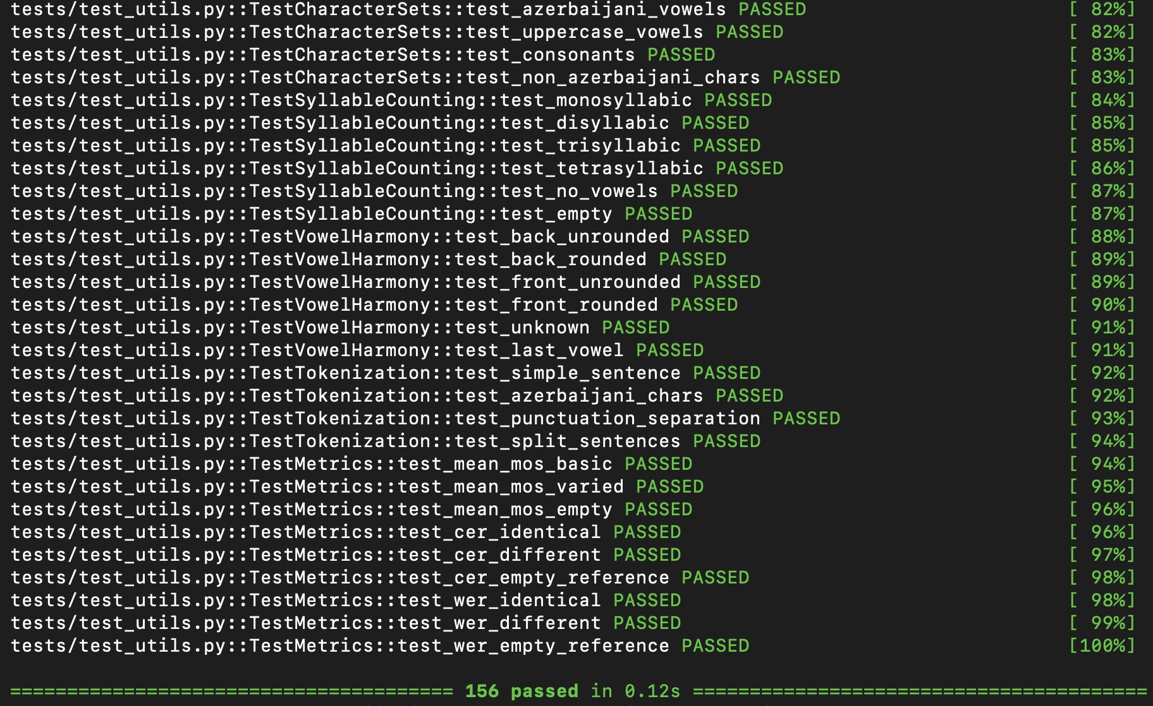
05 · EVALUATION
Experimental results
The proposed system beats the baseline on both metrics.
OTHER INDICATORS
97.2%
overall text-normalisation accuracy
100%
accuracy on date / time conversion
156/156
unit tests passing (61 phenomena)
Source: thesis, §5 — experimental report on 50 phonetically balanced sentences evaluated by 5 native speakers.
15 / 16

Slide 16
Demo with Azure
Demo with Pyhton

Slide 17
06 · CONCLUSION
Conclusion and outlook
“Rule-based TTS is a functional, transparent and extensible baseline for Azerbaijani — and a labelling tool for the neural systems that will follow.”
KEY OUTCOMES
FUTURE WORK
▸The first openly published, documented TTS system for North Azerbaijani
→ Extend loanword phonology coverage
▸MOS 3.2 vs 2.8 (+14 %), WER 12.4 % vs 18.7 % (−6.3 pp)
→ Hybrid architecture: rule-based front-end + neural vocoder
▸156-case unit-test suite covering 61 phonological phenomena
→ Create an open corpus auto-labelled by the rule base
▸A JSON-based rule base that can be edited by a linguist
→ Adapt to the South Azerbaijani dialect
▸Text normalisation reaching 97.2 % overall accuracy
→ Pilot deployments in e-government and accessibility tools
16 / 16
Thank you for your attention
Bashirov Ulvi Samir · UNEC Business School · 2026

