Slide 1
Test presentation
(dummy for converting to latex)

Slide 2
List (unnumbered) check:
Item 1;
Item 2;
Sub item 1;
Sub item 2;
Sub sub item.
Sub item 3;
Item 3;
Item 4.

Slide 3
List (numbered) check:
Item 1;
Item 2;
Sub item 1;
Sub item 2;
Sub sub item.
Sub item 3;
Item 3;
Item 4.

Slide 4
Text formatting check:
Simple text;
Cursive text;
Bold text;
Underlined text;
Crossed text;
Cursive + Bold text.

Slide 5
More text check:
Hi, you can find here some interesting (not) text. This text is about how you can occupy a lot of space for good text formatting check and this text do not contain any normal sense. This paragraph is dedicated to nothing other than taking even more space on this slide. So feel free to do with this information whatever you want.
Even this part of the text has no any sense, so, please, just move on…
P.S. Oh, you are already here. So, no mercy! Let’s leave no space for this slide!

Slide 6
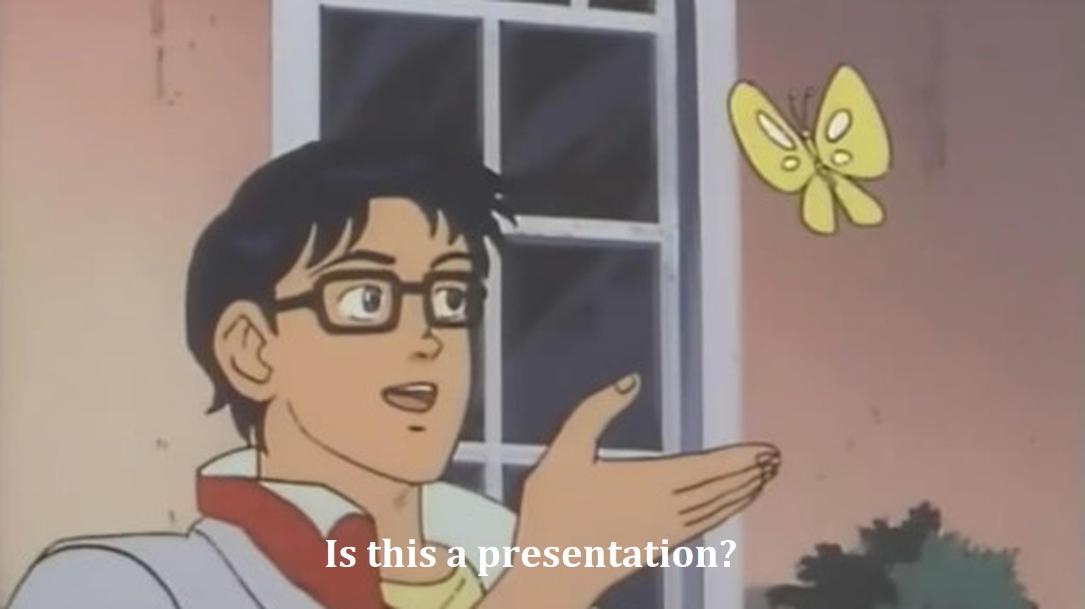
Image check:

Slide 7
Figure check:

Slide 8
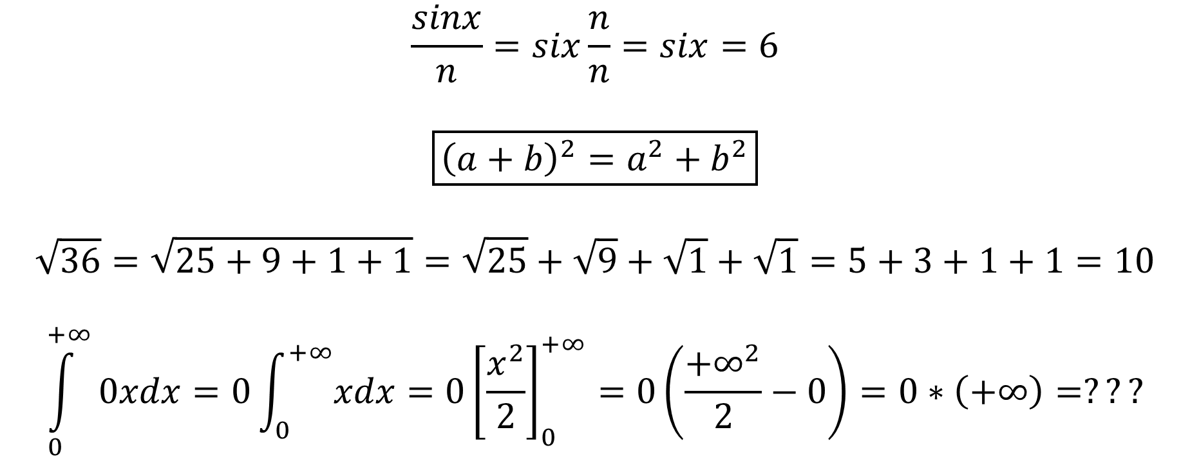
Formula check:
$$\frac{sinx}{n}=six\frac{n}{n}=six=6$$
$$\boxed{{\left(a+b\right)}^{2}=a^{2}+b^{2}}$$
$$\sqrt{36}=\sqrt{25+9+1+1}=\sqrt{25}+\sqrt{9}+\sqrt{1}+\sqrt{1}=5+3+1+1=10$$
$$\int_{0}^{+∞}{0xdx=0\int_{0}^{+∞}{xdx}=0{\left[\frac{x^{2}}{2}\right]}_{0}^{+∞}=0\left(\frac{{+∞}^{2}}{2}−0\right)}=0∗\left(+∞\right)=???$$

Slide 9
Grouped figures check:

Slide 10
Links check:
Useful links:
Google;
YouTube;
Wikipedia.

