Slide 1
Extended Finite-State Machine Induction using SAT-Solver
Vladimir Ulyantsev, Fedor Tsarev
ulyantsev@rain.ifmo.ru, tsarev@rain.ifmo.ru
St. Petersburg National Research University of IT, Mechanics and Optics
Computer Technologies Department
14th IFAC Symposium on Information Control Problems in Manufacturing
May 25, 2012

Slide 2
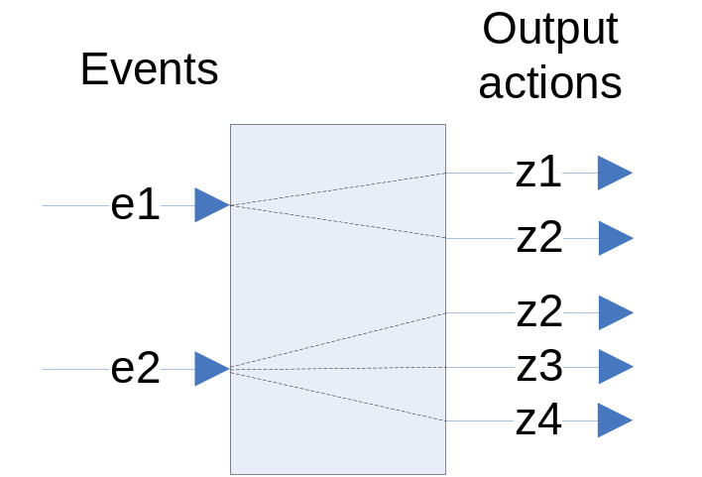
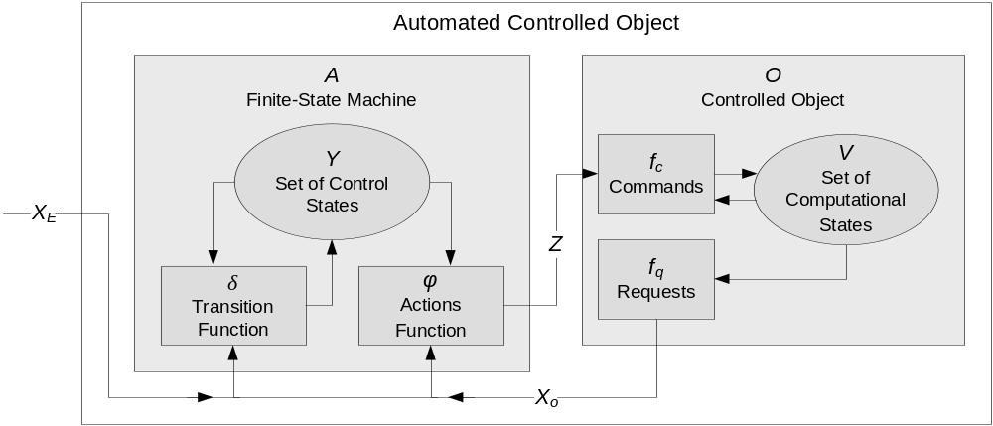
Automata-based Programming
Programs with complex behavior should be designed using automated controlled objects

Slide 3
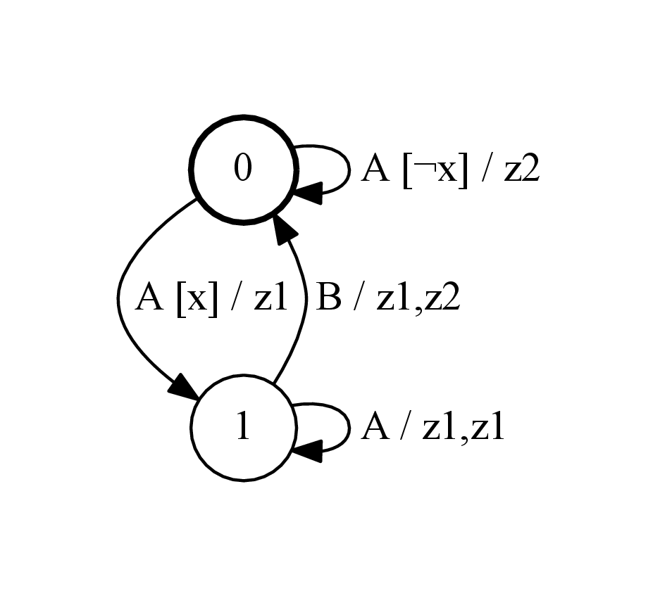
Extended Finite-State Machine and Test Scenarios
EFSM:
  input events
  input Boolean variables
  output actions
Test scenario is a sequence of triples <e, f, A>
  e – input event
  f – guard condition – Boolean formula of input variables
  A – sequence of output actions
EFSM on the picture complies with <A, ¬x, (z2)> <A, x, (z1)>
EFSM on the picture does not comply with <A, x, (z2)>

Slide 4
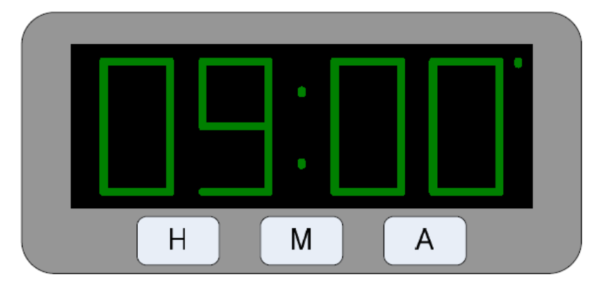
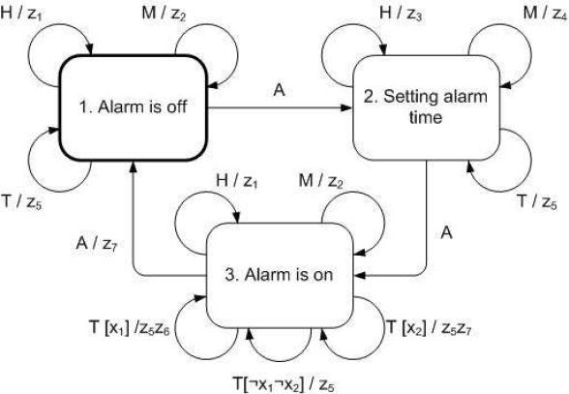
EFSM Example
Alarm clock
Four events
  H – button “H” pressed
  M – button “M” pressed
  A – button “A” pressed
  T – occurs on each time tick
Two input variables
Seven output actions

Slide 5
Goal of the Work
Focus on automata-based programs with only one automated controlled object
Given:
  Set of test scenarios (Sc)
  Number of EFSM states (C)
Need to find a EFSM with C states complying with all scenarios

Slide 6
Works of Other Authors
DFA and FST induction with genetic algorithms:
  Lucas, S., Reynolds, J. Learning DFA: Evolution versus Evidence Driven State Merging. The 2003 Congress on Evolutionary Computation (CEC '03). Vol. 1, pp. 351–358.
  Lucas, S., Reynolds, J. Learning Deterministic Finite Automata with a Smart State Labeling Algorithm. IEEE Transactions on Pattern Analysis and Machine Intelligence. Vol. 27, №7, 2005, pp. 1063–1074.
  Lucas, S. Evolving Finite-State Transducers: Some Initial Explorations. Lecture Notes in Computer Science. Springer Berlin / Heidelberg. Volume 2610/2003, pp. 241–257.
  Johnson, C. Genetic Programming with Fitness based on Model Checking. Lecture Notes in Computer Science. Springer Berlin / Heidelberg, 2007. Volume 4445/2007, pp. 114–124.
DFA induction using SAT-solvers
  Heule M., Verwer S. Exact DFA identification using sat solvers. Grammatical Inference: Theoretical Results and Applications 10th International Colloquium, ICGI 2010, ser. Lecture Notes in Computer Science, J. M. Sempere and P. Garca, Eds., vol. 6339. Springer, 2010, pp. 66–79.

Slide 7
Main Idea
Each scenario is similar to “linear” automaton
Scenarios “coloring”
  Each “state” of each scenario is to be mapped to some state of resulting EFSM
  States of resulting EFSM <-> colors

Slide 8
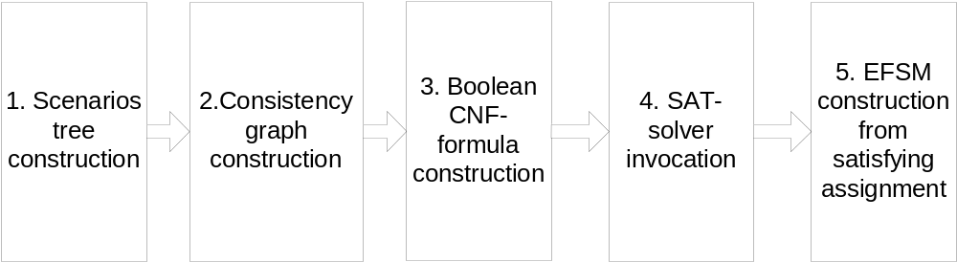
Algorithm Outline

Slide 9
Precomputations
For each pair of guard conditions from scenarios compute:
  If they are same as Boolean functions
  If they have common satisfying assignment
Time complexity:
  O(n²2^{2m}) where n is total size of scenarios, m is maximal number of input variables occurring in guard condition (in practice m is not greater than 5)

Slide 10
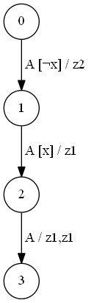
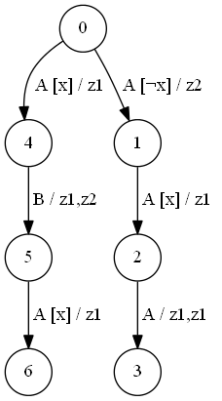
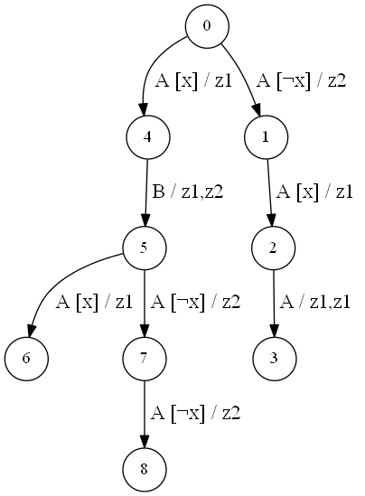
1. Scenarios Tree Construction
Similar to syntax tree construction algorithm
If contradiction is found, process is terminated

Slide 11
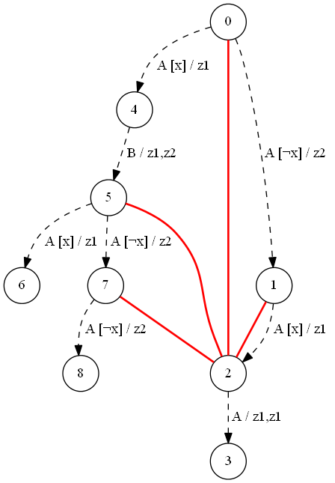
2. Consistency Graph Construction
Vertices are same as in scenarios tree
Two vertices are connected by an edge if there is a sequence telling them apart
Sets of inconsistent vertices are constructed for each tree vertex starting from leaves using dynamic programming

Slide 12
3. Boolean CNF-formula construction (1)
Variables:
  x_{v,i} – is it true that vertex v has color i
  y_{a,b,e,f} – is it true that in resulting EFSM exists a transition from state a to state b labeled with event e and formula f

Slide 13
3. Boolean CNF-formula construction (2)
Types of clauses:
  (x_{v,1} ∨ … ∨ x_{v,C}) – each vertex should be colored with some color
  (¬x_{v,i} ∨ ¬x_{v,j}) – no vertex can be colored with two colors simultaneously
  (¬x_{v,i} ∨ ¬x_{u,i}) – no pair of inconsistent vertices can be colored with same color
  (¬y_{i,j,e,f} ∨ ¬y_{i,k,e,f}) – there is no more than one transition from each state of resulting EFSM marked with same event (e) and Boolean formula (f)

Slide 14

3. Boolean CNF-formula construction (3)
Types of clauses:
  (y_{i,j,e,f} ∨ ¬x_{v,i}∨ ¬x_{u,j}) – each edge of scenarios tree must be present in resulting EFSM
  (¬y_{i,j,e,f} ∨ ¬x_{v,i} ∨ x_{u,j}) – vertex colors should not contradict with edges of scenarios tree

Slide 15
4. SAT-solver invocation
CNF-formula is represented using DIMACS CNF format
We use cryptominisat SAT-solver – winner of SAT RACE 2010

Slide 16
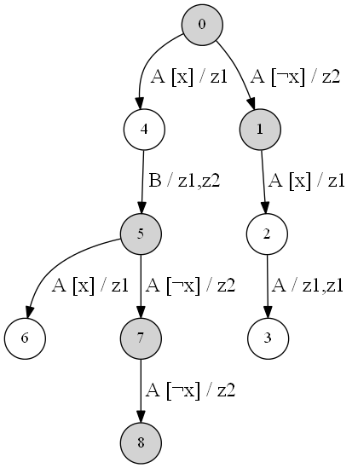
5. EFSM construction from satisfying assignment (1)
Scenarios tree coloring
Each vertex gets a color according to x_{v,i} values

Slide 17
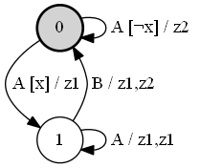
5. EFSM construction from satisfying assignment (2)
All vertices with the same color are merged

Slide 18
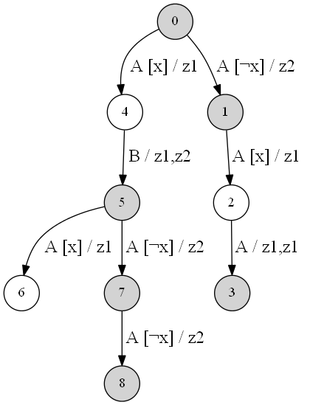
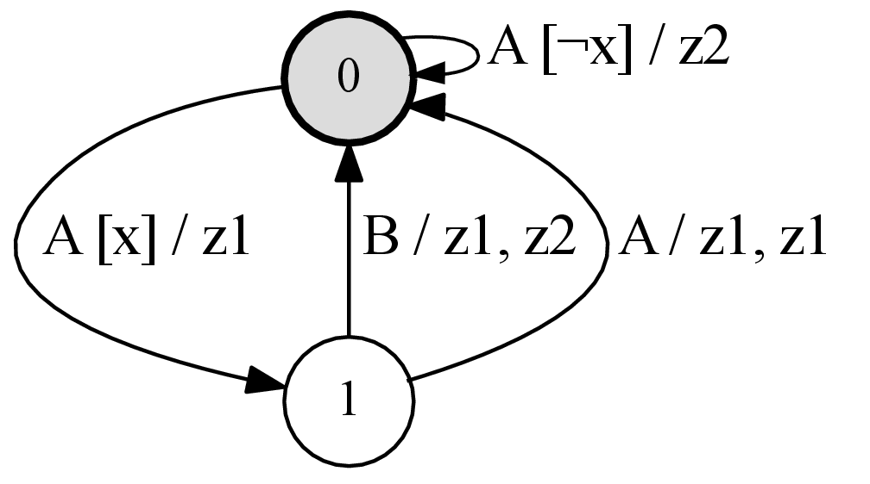
5. EFSM construction from satisfying assignment (3)
Coloring is not necessarily unique

Slide 19
Experiments
First experiment – EFSM for alarm clock:
  38 scenarios of total length 242
  Running time – 0.25 seconds
  Genetic algorithm ~ 4 minutes

Slide 20
Second experiment
Random EFSM A1 with n states generation
Test scenarios generation (random paths in A1) with total size l
EFSM A2 with n states induction
“Forward check”
  1000n random scenarios of length 4n are generated from A1
  A2 is checked against each of these scenarios
  The part of scenarios A2 complies with is recorded
1000 runs for each n and l

Slide 21
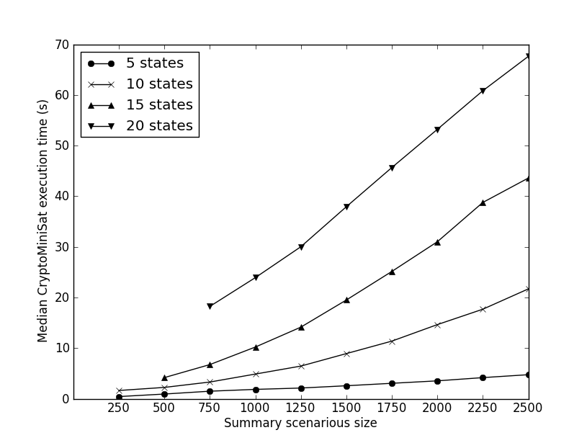
Median execution time

Slide 22
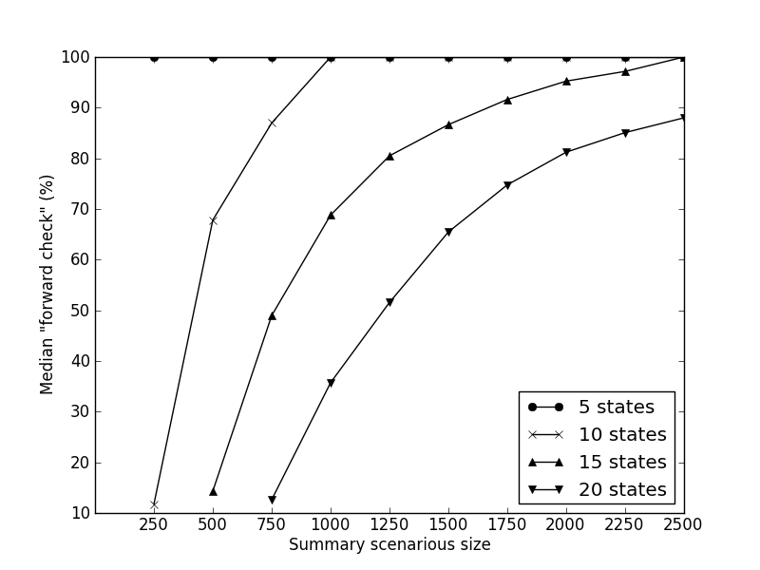
Median “forward check” percent

Slide 23
Future work
Use CSP-solver to fix errors in scenarios
Use Ant Colony Optimization Algorithms for EFSM induction (ANTS’12)
Negative scenarios
Verification

Slide 24
Results
A method for EFSM induction based on reduction to SAT problem was proposed
It was tested and proved to be much faster than genetic algorithm for the same problem

Slide 25

Thank you!
Extended Finite-State Machine Induction using SAT-Solver
Vladimir Ulyantsev

