Slide 1
CUSTOMER SEGMENTATION
Ulya Azmah Khairiah

Slide 2
Objectives
To identify the customer segmentation in aviation company, analyze characteristics of different clusters and suggest business strategy to customer categories of different values.

Slide 3
Workflow
Data Extraction
Data Understanding
Data Preparation
Modeling
Insights and Recommendation
Statistical Summary
Univariate Analysis
Multivariate Analysis
Data Cleaning
Outliers Handling
Feature Engineering
Feature Selection
Data Transformation
Data Standardization
Determine the number of clusters
K-Means Clustering for optimum k
Insights
Business Recommendation

Slide 4
Data Understanding
Code | Description
MEMBER_NO | ID Member
FFP_DATE | Frequent Flyer Program Join Date
FFP_TIER | Frequent Flyer Program Tier
LOAD_TIME | Observed time
FLIGHT_COUNT | Customer flight count
BP_SUM | Itinerary
SUM_YR_1 | Fare Revenue
SUM_YR_2 | Votes Prices
SEG_KM_SUM | Total flight kilometers in observation window
LAST_FLIGHT_DATE | Last Flight Date
LAST_TO_END | The last flight time to the end of the observation window
AVG_INTERVAL | Average flight interval
MAX_INTERVAL | Maximum flight interval
EXCHANGE_COUNT | Exchange count
avg_discount | Average discount rate
Points_Sum | The number of points earned by the customer
Point_NotFlight | Point not used by customers
This dataset has 62988 rows dan 23 columns.
Column names themselves are self explanatory, however here I provide several columns explanation related to aviation industry

Slide 5
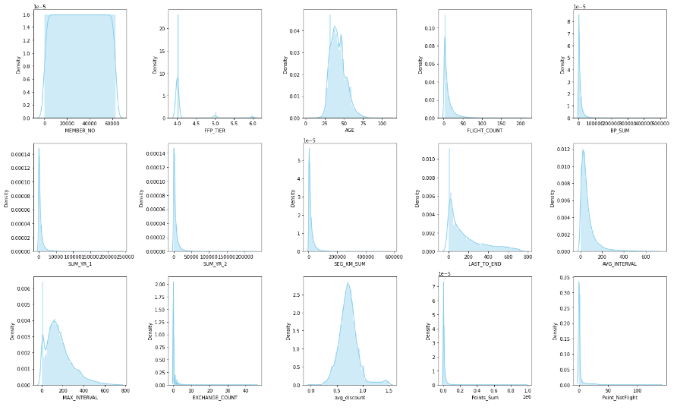
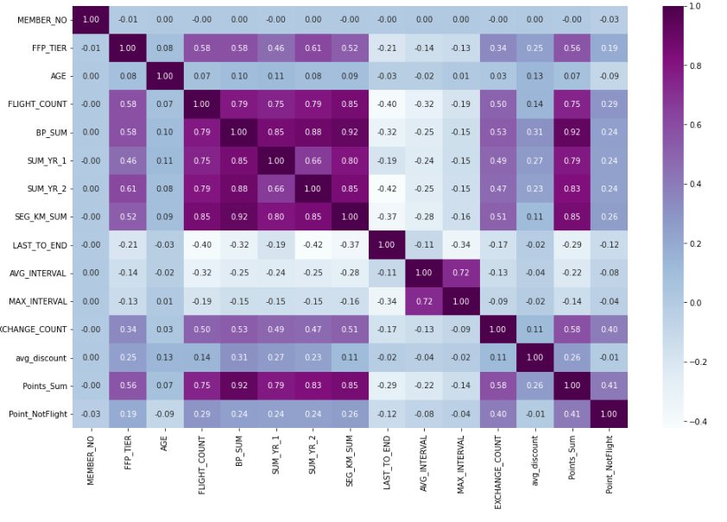
Univariate and Multivariate Analysis
FFP_TIER is actually categorical value, because it has discrete values (4, 5 or 6)
EXCHANGE_COUNT, Points_Sum and Point_NotFlight has many unique values, there is no need to handle the outliers later
MEMBER_NO has unique values so no need to check its symmetricity
Most of the features are positively skewed and have some extreme features
SEG_KM_SUM, FLIGHT_COUNT, BP_SUM, SUM_YR_1, and SUM_YR_2 are correlated to each other.
Points_Sum are correlated with FLIGHT_COUNT, SUM_YR_2, and SEG_KM_SUM.

Slide 6
Data Preparation
Data Cleansing
MEMBER_NO will be dropped since it consists of unique values
Missing values in AGE, SUM_YR_1 and SUM_YR_2 will be replaced with median
WORK_CITY, WORK_PROVINCE, and WORK_COUNTRY will also be dropped because they have many categorical values and we don't really need them.
The GENDER column will also be dropped
Feature Engineering
Change data type of FFP_DATE, FIRST_FLIGHT_DATE, LOAD_TIME, and LAST_FLIGHT_DATE to datetime
However when we try to change LAST_FLIGHT_DATE into datetime, an error occured. The error is because on a date there is a '2014/2/29' value. As we know that 2014 is not a leap year, so I changed it to '2014/2/28'

Slide 7
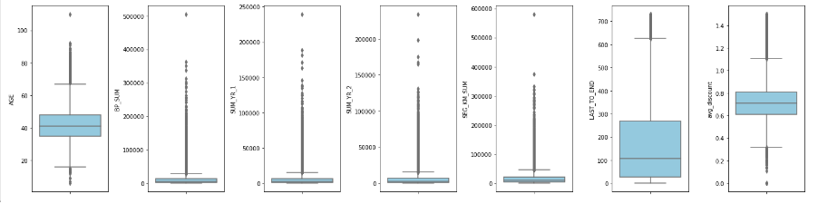
Data Preparation
Outliers Handling
Some outliers represent natural variations in the population, and they should be left as is.
I will only remove the extreme value BP_SUM, SUM_YR_1, SUM_YR_2, and SEG_KM_SUM.
From our exploration above, we understand that AGE has problematic value (age less than 17).

Slide 8
Feature Selection by using LRFMC Model
LRFMC Model for Aviation Industry:
Length: the length of days between subscriber's first register day to observation time.
Recency: the length of a passenger's last consumption to observation window.
Frequency the passenger's consumption frequency within a certain period of time.
Monetary the average amount spent over a certain period of time.
Discount Coefficient: the average space discount factor for passengers traveling within a certain period of time
The columns that are related to the parameters are as follow:
Length: LOAD_TIME - FFP_DATE
Recency: LAST_TO_END
Frequency: FLIGHT_COUNT
Monetary: SEG_KM_FM
Customer Cost: avg_discount

Slide 9
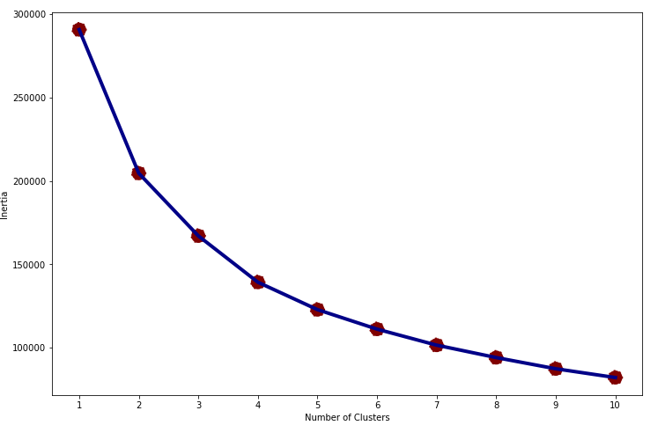
K-Means Clustering
Before we do the modeling, we have to determine the number of clusters. For determining the optimal number of clusters, I check the elbow plot of inertia.
From elbow plot, there is a possibility that the optimum clusters are 4-6.
Need to consider the business perspective in order to decide the number of clusters.

Slide 10
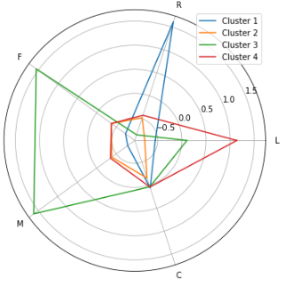
Clustering with K = 4
In this cluster division, we can't find any clusters with high value of C.
We should check if we should add the number of clusters.

Slide 11
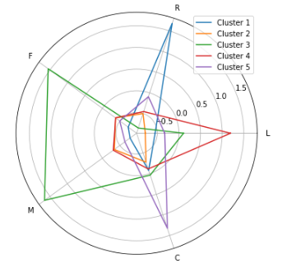
Clustering with K = 5
We finally get the cluster with high value of C.
The clusters also divided beautifully.

Slide 12
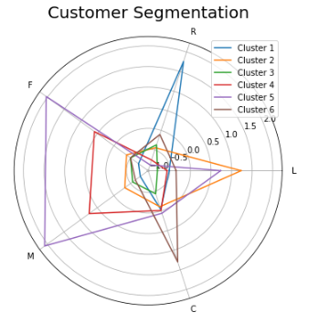
Clustering with K = 6
There is an overlapping of cluster 4 and cluster 5 (the only difference is the range, but there is no need to make them separate categories)

Slide 13
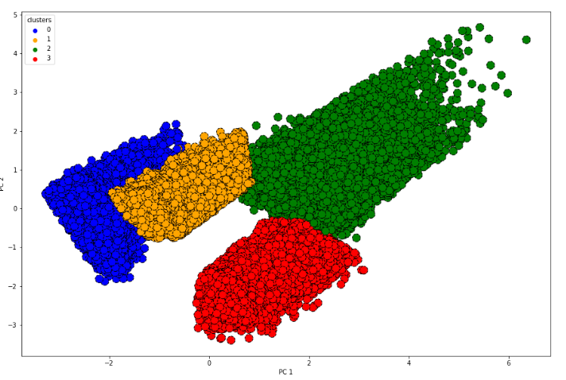
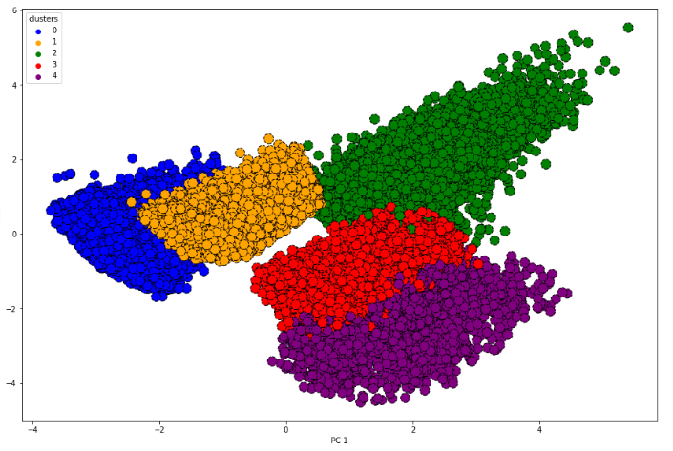
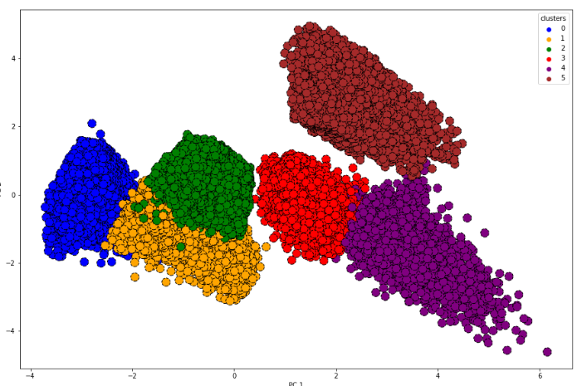
PCA Visualization in Different k
If we compare the number of customers of each cluster, it can be seen that k = 5 has a fairly even distribution.
At k=6, we can observe the mixture of green and yellow clusters so it is not good.
We decide to go with k=5.

Slide 14
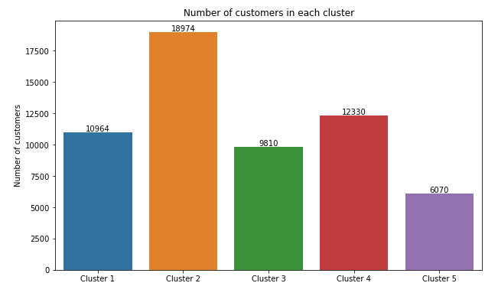
Clustering with k=5
There are 5 clusters:
Cluster 1 - The Hibernating Customers
Cluster 2 - The Promising Customers
Cluster 3 - The Loyal Customers
Cluster 4 - The Old-Seasonal Customers
Cluster 5 - The Cheap Customer

Slide 15
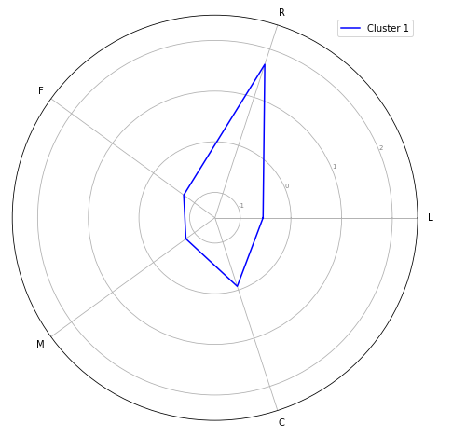
CLUSTER 1 - The Hibernating Customers
Cluster 1 has the largest recency value which means it has been a long time since they used our service (their last use is 2 years ago!)
The number of flights, total mileage and membership time are average.

Slide 16
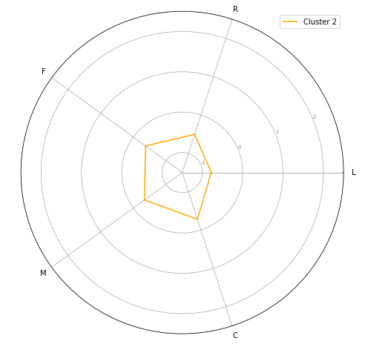
CLUSTER 2 - The Promising Customers
Cluster 2 has average scores in all aspects.
They can be considered as new customers (about 3 years) with average mileage and frequency. They also use the discount sufficiently.
However, what makes them interesting is that their frequency and total mileage is the second highest (tied with cluster 4)

Slide 17
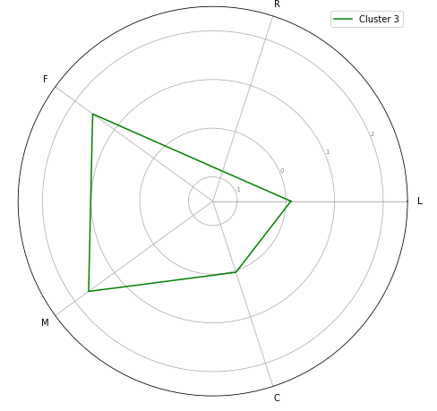
CLUSTER 3 - The Loyal Customers
Cluster 3 has an average L value which is a sign that they are not a new customer.
They have a high frequency of flights, in line with their total mileage.
They also recently used our services (recency value is the smallest).

Slide 18
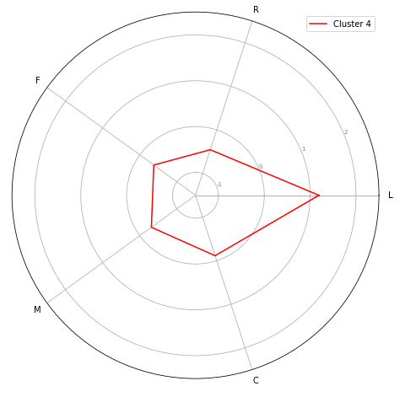
CLUSTER 4 - The Old-Seasonal Customers
Cluster 4 has the highest L value, indicating that they have been customers for a long time (they have been with us for almost 7 years)
However their frequency, total mileage and recency are average.

Slide 19
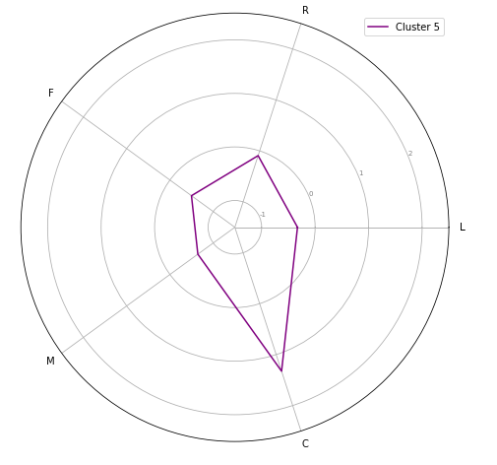
CLUSTER 5 - The Cheap Customers
Cluster 5 has the highest C value, indicating that they use discounts very often.
What makes it interesting that the number of their flights and total mileage is not so many.
This is clearly the number of customers who always take advantage of the discount! This customer is actually low value for company.

Slide 20
Recommendation (1)
1. Make Our Loyal Customers feel Loved
Cluster 3 is our loyal customer, because if we look at the customers in this cluster, they do not yet have a large average discount value. We can offer loyalty membership based on their accumulated airline miles.
2. Test Our Promising Customers with Hero Treatment a.k.a Discount Cluster 2 can be seen as prospective member because they are new customer but have a total mileage and frequency value as many as customers in cluster 4. We can try giving them a discount voucher to grab these customers and engage them to fly more and become more loyal like cluster 3.

Slide 21
Recommendation (2)
3. Offer Off-Season or Surprise Discount for Our Old Customers We know these old customers will use our service, however the frequency is average because they only fly seasonally. We should maintain these customers and make them fly more by offering them off-season discount in order to make them fly in a different time than they usually fly.
4. Give more Attention to Hibernating Customers Cluster 1 contains customers who haven't flown with us for a long time. If we don't do anything, they can be a lost customer. We can give them more attention by sending promotional emails or push notifications. The point is to show them our last-ditch big effort to reactivate.

